Slide 1
Mesleki Yabancı Dil 2

Slide 2
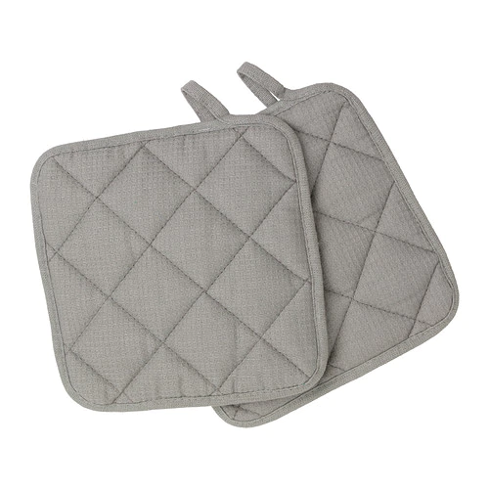
OVEN GLOVES
POT HOLDER
OVEN CLOTH

Slide 3
Piping tips

Slide 4
sugar paste modelling tools

Slide 5
Cake Comb

Slide 6
BENCH KNİFE TABLE SCRAPER used for diving dough, scraping and cleaning table

Slide 7
PARISIENNE SCOOP MELON BALLER

Slide 8
Bin

