Slide 1
Mılk hygıene and technology
Res. Assist, DVM Bahar ONARAN
Ankara University, Faculty of Veterinary Medicine
Department of Food Hygiene and Technology

Slide 2
In general, composition of cow's milk;
1- Water (87,5 %)
2- Solids (12,5 %)
A- Organic Ingredients
Carbohydrates (4,6 %)
Lipids (3,5 %)
Proteins (3,6 %)
B- Inorganic Ingredients
Minerals (0,8 %)
Vitamins
Gases

Slide 3
DRY MATTER
THE RESIDUE left when water and gases are removed is called
→the dry matter (DM) or total solids content of the milk.
DRY MATTER (DM) 12.5 %
FAT 3.5 %
NON-FAT DRY MATTER (NFDM) 9 %

Slide 4
Milk composition varies depending on the;
Species (Cow, Goat, Sheep),
Breed (Holstein, Jersey),
The Animal's Feed,
The Stage of Lactation.
Although there are MINOR variations in milk composition.

Slide 5
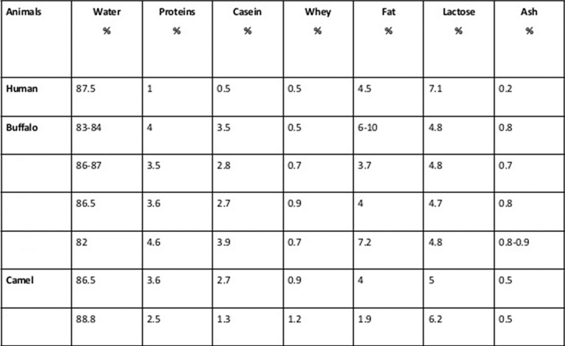
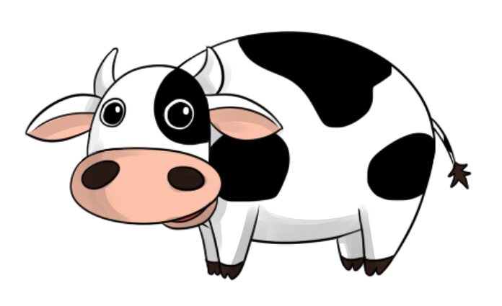
Mılk composıtıon

Slide 6
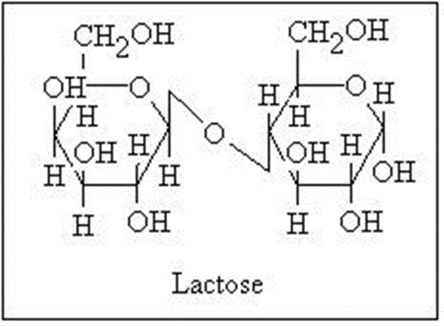
MIlk Carbohydrates
Milk contains
4.6 % of
total CH.
Milk contains 4.6 % carbohydrate
that is predominately LACTOSE
with trace amounts of monosaccharides and oligosaccharides.
Lactose is a disaccharide of glucose and galactose.
The structure of lactose is:
galactose
lactose

Slide 7
lactose
Major source for bacteria during the fermentation of milk
Help growth of lactic acid producing bacteria
→ help in absorption of Ca, P, Fe, Cu
→which prefer acidic medium for their absorption
THE BACTERIA hydrolyse the milk into glucose and galactose
→to produce lactic acid
→which inhibits the growth of most other microorganisms

Slide 8
Mılk lıpıds
Milk contains
3.5 % of
total fat.
MILK FAT has the most complex fatty acid composition of the edible fats.
OVER 400 individual fatty acids have been identified in milk fat.
However, approximately 15 to 20 fatty acids make up 90% of the milk fat.

Slide 9
Mılk lıpıds
Found in fat globules
→protected by a membrane (MFGM)
→MFGM prevents attack from lipases (lipolyses)
→and increase in the amount of diglycerides, monoglycerides and free fatty acids in milk

Slide 10
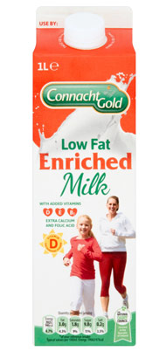
Mılk lıpıds
98 % Triglycerides
0,2-1 % Phospholipids
0,2-0,4 % Sterols
A, D, E, K Vitamins
→High Beta-carotene (Vit A),
→Low Vit D

Slide 11
myristic acid
palmitic acid
stearic acid
oleic acid
MILK contains more than 400 fatty acids…
Predominantly found fatty acids in bovine milk;
65% saturated,
30% monounsaturated,
5% polyunsaturated
fatty acids.
MILK FAT contains approximately…

Slide 12
From a nutritional perspective,
not all fatty acids are created equal.
→ FREE FATTY ACIDS
→are fairly water soluble and are situated in milk plasma and fat.
Whole milk contains
10-20 mg /100 g cholosterol
→ Located in the MFGM
→SATURATED FATTY ACIDS
→are associated with high blood CHOLESTEROL
and heart disease.

Slide 13
→Short CHAIN free fatty acıds
→(4 to 8 carbons)
→situated in milk plasma are ionized and more water soluble than
LONG CHAIN FATTY ACIDS (16 to 18 carbons)
→and are not considered to be a factor in heart disease.
HOWEVER, they conjugated with linoleic acid (is a trans fatty acid in milk fat)
→ that is beneficial to humans in many way.

Slide 14
Mılk Proteıns…
Milk contains
3.6 %
total protein.
contain all ESSENTIAL amino acids required by humans.
are less in human than in cow’s milk.
All milk proteins synthesized in mammary gland.
Temperature
Ionic strenght
pH
effect the protein confirmation

Slide 15
Mılk proteıns
high protein digestibility (85-95%)
high biological value →consists all essential aminoacids
→easily digested
→esily absorbed
→easily metabolized
there are 2 major categories of milk protein that are broadly defined by their chemical composition and physical properties.

Slide 16
Types of proteıns
Caseın (83 %)
contains phosphorus and will coagulate or precipitate at ph 4.6.
Alpha-casein, Beta-casein, Kappa-Casein, Gamma-Casein
SERUM (WHEY) PROTEINS
do not contain phosphorus, and these proteins remain in solution in milk at pH 4.6.
Lactalbumin, Lactoglobulin, Immunglobulins, Proteose-peptones
Mılk enzymes

Slide 17
caseın
is the main and
most dominant
milk protein
It’s a compound protein→ phospho-protein
High phosphate content of casein
→allows it to associate with CALCIUM
→and form Calcium Phosphate Salts

Slide 18
caseın
At normal pH of fresh milk (6.6) casein present as insoluble
CA. CASEINATE-PHOSPHATE COMPLEX
Very heat stable (till 140 °C)
Hydrophobicity
→High Phosphate Content
→Low Sulphur Content

Slide 19
maın types of caseın
Alpha-casein 48%
Beta-casein 36% → Most Hydrophobic
Kappa-casein 13% → Unlike other caseins, ıt’s not sensitive to calcium and surrounds the miselles, keeping them intact
Gamma-casein

Slide 20
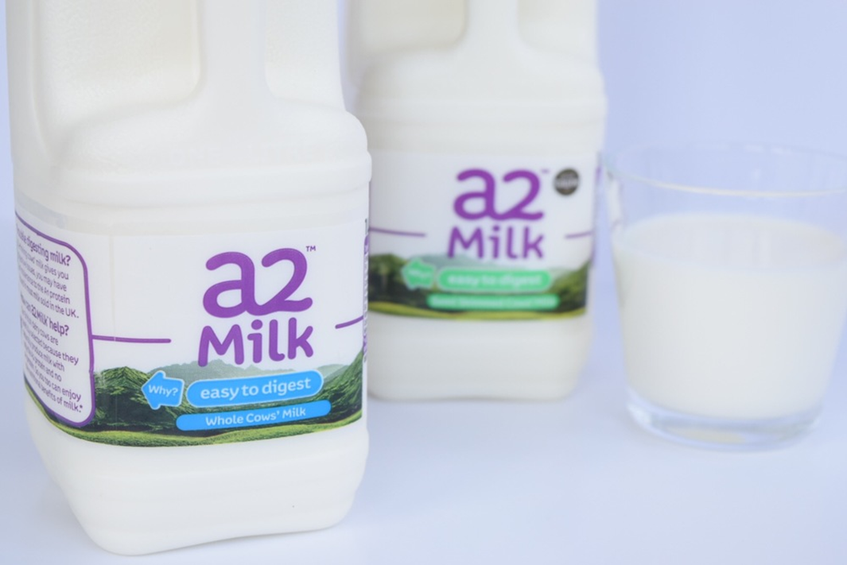
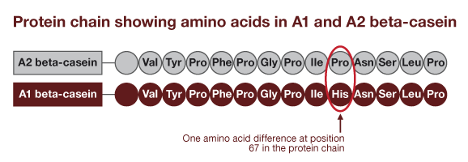
A2 milk
is cow's milk that mostly lacks a form of β-casein proteins called A1 and instead has mostly the A2 form.

Slide 21
Caseın mıselles
THE CASEINS in milk form complexes called micelles
→that are dispersed in the water phase of milk.
THE CASEIN MICELLES consist of subunits of the different caseins (α, ß, γ, κ) held together by CALCIUM PHOSPHATE BRIDGES on the inside, surrounded by a layer of κ -casein which helps to stabilize the micelle in solution.

Slide 22
Whey proteıns
Contain disulphide linkages
Poor heat stability (denaturate 75 °C)
αlpha-lactalbumin (20%)
beta-lactoglobulin (40%)
proteose peptons,
immunglobulins,
serum albümin
other whey proteins

Slide 23
BETA-LACTOGLOBULIN
Better heat stability than αlpha-lactalbumin due to the free sulphydryl unit.
It’s assosiation depends on temperature, pH, protein concentration and ionic conditions
It binds to several hydrophobic molecules including fatty acids.

Slide 24
Mılk enzymes
Enzymes are proteins that have biological functions.
EACH ENZYME has a specific site of action on;
its target molecule,
and optimal conditions
(pH and temperature).

Slide 25
Milk enzymes come from several sources:
The native milk,
Airborne bacterial contamination,
Bacteria that are added intentionally for fermentation,
In somatic cells present in milk.

Slide 26
Lipases
are enzymes that degrade fats.
THE MAJOR lipase in milk is lipoprotein lipase.
It is associated with the casein micelle.
Shaking during processing may bring the lipase into contact with the milk fat resulting in fat degradation and off-flavors.
PASTEURIZATION will inactivate the lipase in milk and increase shelf life.

Slide 27
Alkaline phosphatase
is a heat sensitive enzyme in milk that is used as INDICATOR of pasteurization.
If milk is properly pasteurized, alkaline phosphatase is INACTIVATED.

Slide 28
Proteases
are enzymes that degrade proteins.
the MAJOR protease in milk is plasmin.
protein degradation can be undesirable and result in bitter off-flavors, or it may provide a desirable texture to cheese during ripening.
proteases are important in cheese manufacture, and a considerable amount of information is available in the cheese literature.

Slide 29
Lactoperoxidase
is one of the most heat-stable enzymes found in milk.
the presence of lactoperoxidase in raw milk inhibits the disease causing microorganisms (pathogens) present in milk.
lactoperoxidase, when combined with hydrogen peroxide and thiocyanate, has antibacterial properties.
HOWEVER, there is no hydrogen peroxide or thiocyanate present in fresh milk, these compounds would have to be added to milk in order to achieve the antibacterial benefits.

Slide 30
Lactoperoxidase
LPO
(hydrogen peroxide)
BACTERISID EFFECT
SCN⁻
(thiocyanate)
OSCN⁻
(hypothiocyanite)

Slide 31
Other enzymes found in milk are;
Lysozyme,
Catalase,
Xanthine Oxidase,
Lipase,
Amylase,
Lactase…

Slide 32
mınerals
copper and iron
Minerals associated with the FAT GLOBULE MEMBRANE are
Other minarals in milk
Cobalt, Calcium, Sodium,
Potassium, Zinc,
Magnesium, Manganese, Molybdenium…

Slide 33
vıtamıns
Fat soluble
(A, d, e, k Vitamins)
→High Beta-carotene
(Vit a)
→Low Vit d
WATER SOLUBLE
Vit C,
Vit B
Thiamine (B1),
riboflavin (B2), niacin (B3), pyridoxine (B6), folate (B9), cobalamin (B12)

Slide 34
Mılk gases
Oxygen means quality of milk.
Oxygen has the negative effect on vitamin activity.
OxIdatIve rancIdIty
AerobIc mIcroorganIsms
After the milking (fresh milk)
Milk contains;
5-10 % CO2
2-3 % N
0.5-1 % 02

Slide 35
TIME TO DO MILK FIGHT !!!

