Slide 1
QUANTITATIVE ANALYTICAL CHEMISTRY PRACTICES
Quantitative analytical chemistry is related with the quantitative determinations of the substances. Today, many methods for quantification exist. In practice, some factors such as the structural properties of a material, sensitivity, accuracy, reliability, ease of implementation and cost-effectiveness of methods are considered for selecting a proper method. In our lab, volumetric and instrumental analysis will be used for quantitative analysis.
Qualitative Analysis | Quantitative Analysis
Analysis for identification of species in a sample | Analysis for determination of the quantities of species in a sample.

Slide 2
Analytical Methods
Classical Methods | Instrumental Methods
If the analysis is carried out solely using solutions of chemical substances, this is called as classical analysis. - Gravimetric analysis - Volumetric analysis | If the analysis is performed using a device, then it is called instrumental analysis. - Spectroscopic analysis - Electrochemical analysis - Chromatographic analysis
Some basic terms:
Sample: A representative part taken to be analyzed from a material (sample).
Analyte: the component to be analyzed in a sample.
Molarity: number of moles per liter
Normality: the number of equivalents in liter
Ppm: solids content in grams per 1 kg solvent (parts per million)
Density: mass of matter per unit volume

Slide 3
Volumetric analysis
Volumetric analysis is a quantitative analysis based on the measurement of the volume of a solutions that gives reaction. Here, the concentration of analyte can be found by reacting it with a standard solution with a known concentration.
The volumetric analysis is based on the stoichiometry between reactive species. for example;
A + B → AB
according to the above reaction, the stoichiometric ratio between A and B is 1:1. It means 1 mole of A reacts with 1 mole of B to give 1 mole of AB.
C + 2D → CD₂
On the other hand, for the above reaction, the stoichiometry between C and D is 1:2. It means 1 mole of C reacts with 2 mole of D to give 1 mole of CD₂.

Slide 4
Calculations in volumetric analysis
A + B → AB
The concentration of a sample A can be found by reaction with a substance B with exactly known concentration (standard solution). Since they reacted 1:1 ratio, their moles will be equal at the end of reaction (equivalence point):
$n_{A}$ =${ n}_{B}$
$M_{A}$ x${ V}_{A}$ = $M_{B}$ x${ V}_{B}$
Here, V_{A} and V_{B} are the volumes of A and B, and M_{B} is the molarity of B. By using this equiation, the molarity of A ($M_{A}$) can be calculated.
For calcaulation of concentration in g/L, molarity of A can be multiplied with molecular weight of A:
C (g/L) = $M_{A}$ x ${M.A.}_{A}$

Slide 5
Standard solutions
Standard solutions are solutions that have exactly known concentration and react with analytes.
For example, if concentration of a base solution is to be determined, an acid solution with known concentration can be used as standard solution.
The standard solution can be prepared by precisely weighing the required amount of reagent. Then, the precise concentration of the standard solution can be found by the reaction with special substances called primary standards.

Slide 6
Dilution Factor
Samples are (not neccesarily but generally) diluted before analysis. The reason for dilution might be the reduction of reagent use in the analysis or increase of the volume of the sample so that analysis can be repeated when needed. Dilution must be accounted in calculations:
Dilution ratio = amount before dilution / amount after dilution
Dilution factor (DF) = amount after dilution / amount before dilution
For example, if 90 mL of distilled water is added onto 10 mL sample, the total volume after dilution will be 100 mL. It means that the sample is diluted 10/100 ratio (or 1/10 ratio). The dilution factor in this case:
DF = 100/10 = 10
After the titration, the concentration of the diluted sample can be calculated using titration results. Then the concentration of the real sample can be calculated by multiplying the concentration of diluted sample with DF.

Slide 7
EXAMPLE
A concentrated sample of 20 mL HCl is diluted to 100 mL with distilled water. Then 25 mL of the diluted sample is titrated with 0.1 M 12.5 mL NaOH. Calculate the molarity of the sample?
HCl + NaOH → NaCl + H₂O
(mole ratio 1:1)
$n_{HCl}$ =${ n}_{NaOH}$
$M_{HCl}$ x${ V}_{HCl}$ = $M_{NaOH}$ x${ V}_{NaOH}$
$M_{HCl}$ x 25 = 0.1 x 12.5
$M_{HCl}$ = 0.05 M (concentration of diluted sample)
Dilution factor= 100 / 20 = 5
M_{sample} = $M_{HCl}$ x DF
M_{sample} = $0.05$ x 5
M_{sample} = $0.25 M$
Question: How much NaOH will be used in the titration, if the sample is not diluted?

Slide 8
Primary standard
A primary standard is a highly pure compound that serves as a reference material in volumetric and mass titrimetric methods. The accuracy of a method is critically dependent on the properties of this compound. Important requirements for a primary standard are the following:
1. Highly pure or exact purity must be known
2. Atmospheric stability.
3. Absence of hydrate water so that the composition of the solid does not change with variations in humidity.
4. Modest cost.
5. Reasonable solubility in the titration medium.
6. Reasonably large molar mass so that the relative error associated with weighing the standard is minimized.

Slide 9
CHARACTERISTICS OF QUANTITATIVE REACTION
1) Reaction must be specific and unique
2) Reaction must be in one direction
3) The reaction must be fast
4) The end of the reaction can be detected easily
5) The reaction must be repeatable yielding same results every time.

Slide 10
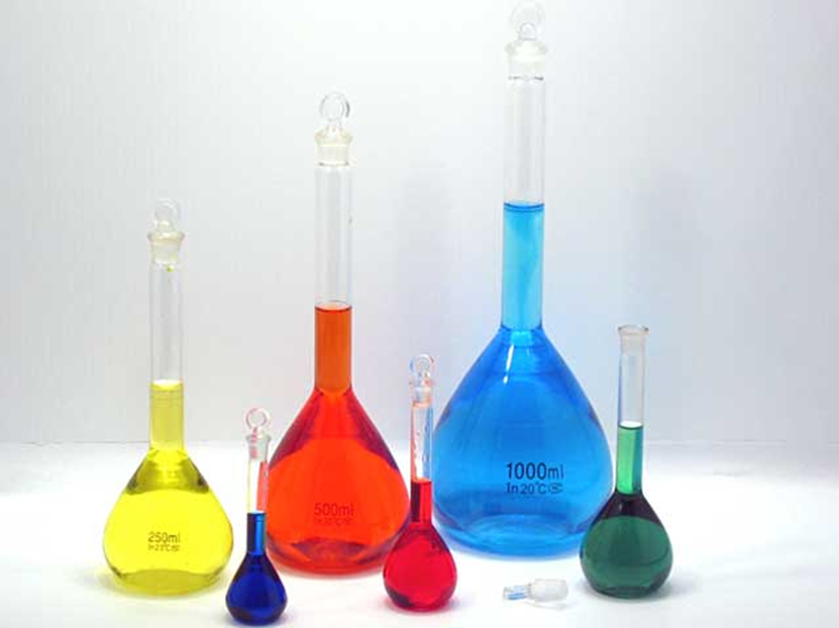
GLASSWARES USED IN QUANTITATIVE ANALYTICAL CHEMISTRY PRACTICES
VOLUMETRIC FLASK: glass measuring vessel used to prepare a certain volume of solution. There is a marking line on the neck that indicates the volume.

Slide 11
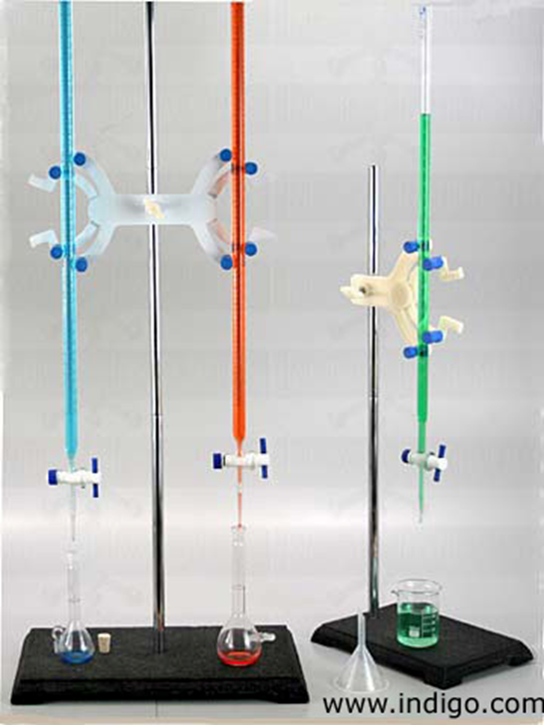
GLASSWARES USED IN QUANTITATIVE ANALYTICAL CHEMISTRY PRACTICES
BURETTE: is a gauge glass container with a graduated pipe shape used to measure the volume of the liquid. The burette is used for transferring and measurement of a liquid in a controlled way . There is a tap at the bottom end to discharge the liquid inside. In the market there are burettes with volume between 10 - 100 mL.

Slide 12
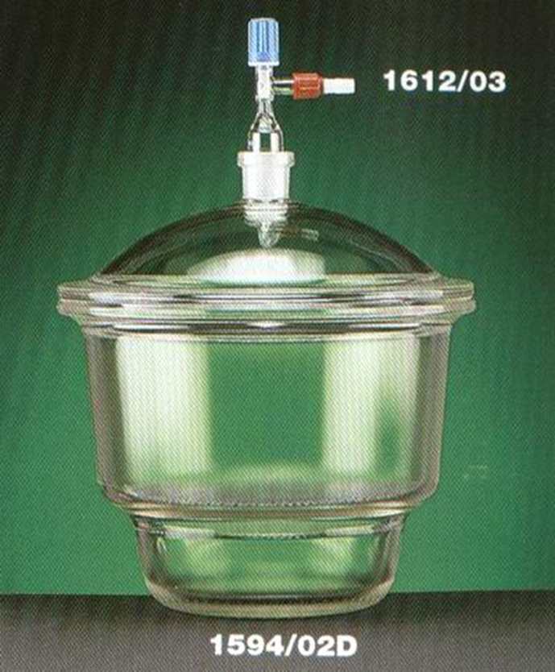
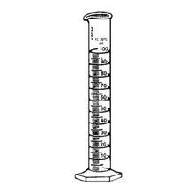
GLASSWARES USED IN QUANTITATIVE ANALYTICAL CHEMISTRY PRACTICES
DESICATOR: they are used to keep materials away from humidity
GRADUATED CYLINDER: graduated glass containers used for liquid transfer.

Slide 13
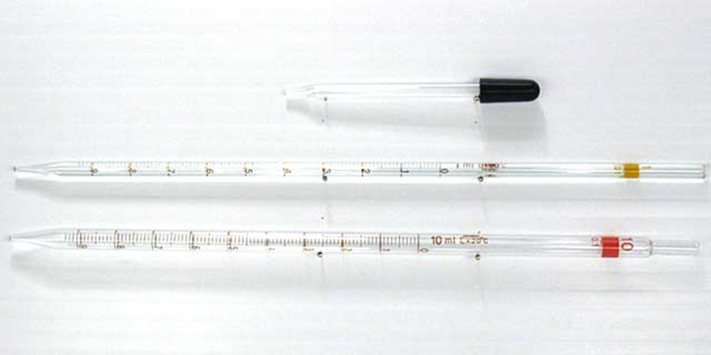
PIPET: is a tube used to transfer liquid in a known volume. There are two types of pipettes. Single-marked pipettes and graduated pipettes.
Single-mark pipettes (transfer pipette, volumetric pipette), single marking on the volume
They are used to transfer a constant volume of liquid. They allow fluid to be delivered in the correct volume relative to the graduated pipettes. Burettess should be preferred when transferring liquids over 25 mL.
Graduated pipettes allow for transfer of the desired volume of liquid to the maximum rated capacity since they are graded.
They are called glass jugs, burette and pipettes measuring glass vessels whose volumes are precisely adjusted.

Slide 14
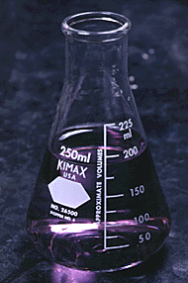
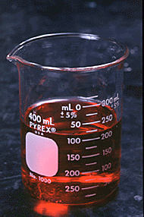
Erlenmeyer flask is a conical flask used for swirling liquids.
Beaker is cylindirical dlask used for swirling, mixing and heating liquids.
They are roughly graduated,so please do not use them for measuring certain amount of liquid.
Erlen Beher

Slide 15
Preparation of 1L 0.1M HCl solution
From HCl stock solution, 37% purity, d= 1.19 g/cm³
M=d xV
The weight of concentrated HCl of 1000 mL is
M= 1.19 x1000= 1190 gr.
In 100 g 37 g HCl is pure
In 1190 g x x= 440.3 g pure HCl
1 M 1L HCl 36.5 g HCl required
0.1 M 1L 3.65 g HCl requires.
1000 mL 440.3 g pure HCl
x 3.65 g HCl x=8.3 mL
Therefore if you take 8.3 mL acid and dilute it to 1000 mL it will be 1 L, 0.1 M HCl. Do not forget, never add acid to water, put some water to volumetrik flask first, then add 8.3 mL of HCl. And mix it well, finally complete it to 1000 mL till the line.

Slide 16
Preparation of 2.5 L 0.1M NaOH solution
1 L 1M NaOH solution 40 g NaOH required
2.5 L 0.1 M 10 g NaOH requires.
10 g of NaOH is weighed in watch glasses. Then it is transferred to a beaker and dissolved in nearly 400 mL of water. Transfer it to the volumetric flask, complete it until 1L. Then transfer it to 2.5 L of bottle. Add more 1.5 L water to this bottle and mix well. Do not forget labeling.

