Slide 1
SUTURE MATERIALS
Assoc Prof. Dr. Murat ÇALIŞKAN

Slide 2
The ideal suture
should maintain its tensile strength for as long as possible;
be easy to handle;
knot securely;
be biocompatible,
non- toxic, non-carcinogenic and non allergenic;
have low capillarity;
create minimal friction;
cause the least inflammatory reaction possible;
and have a low cost.

Slide 3
The term “suture” refers to any thread made of material used to ligate blood vessels or approximate tissues
The word suture is generally associated with the needle and thread used to approximate tissues, while a needle-free suture used to close a tube is known as a ligation.
Suture materials are classified as absorbable or nonabsorbable, natural or synthetic, and monofilament or multifilament, based on composition and structure.

Slide 4
Natural materials are absorbed through enzymatic degradation by macrophages.
Synthetic materials are absorbed through nonenzymatic hydrolysis of ester bonds, with final by products being carbon dioxide and water.
Materials that lose tensile strength within 60 days of implantation are classified as absorbable; whereas most suture materials will eventually be absorbed.
The truly nonabsorbable sutures are polypropylene and stainless steel.
Depending on their number of strands, sutures are classified as monofilament or multifilament

Slide 5
Monofilament sutures
are made of a single strand.
They pass through the tissue with less resistance and cause less tissue dam- age.
They have no capillarity, and so they do not retain bacteria on their surface.
However, they are more susceptible to breakage and more difficult to handle, and require more knots to stabilise knotting.
Extreme care must be taken when handling and knotting monofilament sutures. If they are compressed or tightened, a notch or weak spot may be formed and cause the suture to break.

Slide 6
Multifilament sutures
are made of several strands plaited together.
This gives them greater tensile strength and flexibility and makes them easier to handle.
However, they have a greater coefficient of tissue friction and capillarity.
Bacteria can settle on the surface of multifilament thread. Consequently, such thread cannot be used on infected wounds or when contamination is suspected.

Slide 7
General advantages and disadvantages of types of thread

Slide 8
ABSORBABLE SUTURE MATERIALS

Slide 9
Surgical gut (catgut)
is a natural multifilament suture made from either intestinal submucosa (ovine) or serosa (bovine). It consists of 90% collagen.
When cured with chromic salts, surgical gut has increased strength, less inflammatory reaction, and slower absorption.
Surgical gut is absorbed by enzymatic digestion and phagocytosis by macrophages.
Inflammation, infection, and catabolic states increase the rate of absorption.
Chromic gut is difficult to handle, has poor knot security when wet, and has become less popular due to wide availability of greater quality synthetic absorbable sutures.

Slide 10
Polyglactin 910
is a braided multifilament synthetic suture material made of 90% glycolide and 10% L-lactide.
has greater initial strength than surgical gut and polyglycolic acid.
elicits minimal inflammatory reaction and is absorbed by hydrolysis.
is best used in tis- sues that heal with a rapid increase in ten- sile strength, such as the urinary bladder and the gastrointestinal tract.
A rapidly absorbed type of polyglactin 910 (Vicryl-Rapide, Ethicon, Inc.) was developed for situations where the surgeon desires to minimize the time tissues are exposed to suture material.
Vicryl- Rapide is polyglactin 910 that is irradiated to increase absorption rate.
Vicryl-Rapide is re- ported by the manufacturer to be the fastest- absorbing synthetic suture, losing 50% of its ten- sile strength at 5 days and 100% at 10–14 days.

Slide 11
Polyglycolic acid
is a multifilament braided synthetic suture material with greater initial strength than surgical gut.
is absorbed by hydrolysis and has a pattern of loss of strength similar to polyglactin 910.
It has good handling characteristics, but tissue drag and relatively low knot security are drawbacks.
Polygly colic acid may be less desirable for use in the oral cavity and in infected urinary bladder due to the alkaline pH, which increases its absorption rate.
Polyglycolic acid can be used in intestinal anastomosis and in circumstances where long-term tensile strength is not a requirement.

Slide 12
Poliglecaprone 25
is a monofilament synthetic suture material made from copolymers of glycolide and epsilon caprolactone.
Ihas greater initial tensile strength than chromic gut and is designed to lose most of its tensile strength over 14 days.
is used in tissues that gain tensile strength rapidly, such as urinary bladder and subcutaneous tissue.
has excellent handling char- acteristics and knot security.
has caused less tissue reaction than polyglactin 910 and polydioxanone.

Slide 13
Polydioxanone
is a monofilament synthetic suture made from a polymer of paradioxanone.
has greater tensile strength compared to surgical gut and lower tissue drag compared to braided absorbable sutures.
has notable memory, which decreases its handling quality, and has the lowest knot security of the synthetic absorbable sutures.
oses approximately 20% of its tensile strength in two weeks and is used in tissues where long-term strength is needed, such as the linea alba .
may cause more skin reaction than poliglecaprone 25 and glycomer 631, but tissue reactions can be expected to be minimal with all three of these suture materials

Slide 14
Polyglyconate
is a monofilament synthetic s ture material with properties similar to poly dioxanone.
It maintains approximately 75% of its tensile strength in 14 days.
has less memory and suture kinking and better knot security than polydioxanone.
Like polydioxanone, polyglyconate incites minimal tissue reaction.

Slide 15
Antimicrobial sutures
Antimicrobial sutures have been promoted to decrease the chance of surgical wound infection.
Polyglactin 910 (Coated Vicryl PLUS, Ethicon, Inc., poligle- caprone 25 (Monocryl PLUS, Ethicon, Inc.), and polydioxanone (PDS II PLUS, Ethicon, Inc.) are currently available with the impregnated antibacterial triclosan.

Slide 16
Glycomer 631
is a synthetic monofilament suture made of a combination of glycolide, diox- anone, and trimethylene carbonate.
displays very little tissue drag.
loses 25% of its tensile strength in 2 weeks.
Effective wound support is maintained for 3 weeks and absorption is complete in 3–6 months.

Slide 17
Glycolide/lactide copolymer
is a braided synthetic suture covered with a copolymer of capro-lactone, glycolide, and calcium stearoyl lactylate.
effective wound support is maintained for three weeks and absorption is complete in 56–70 days.

Slide 18
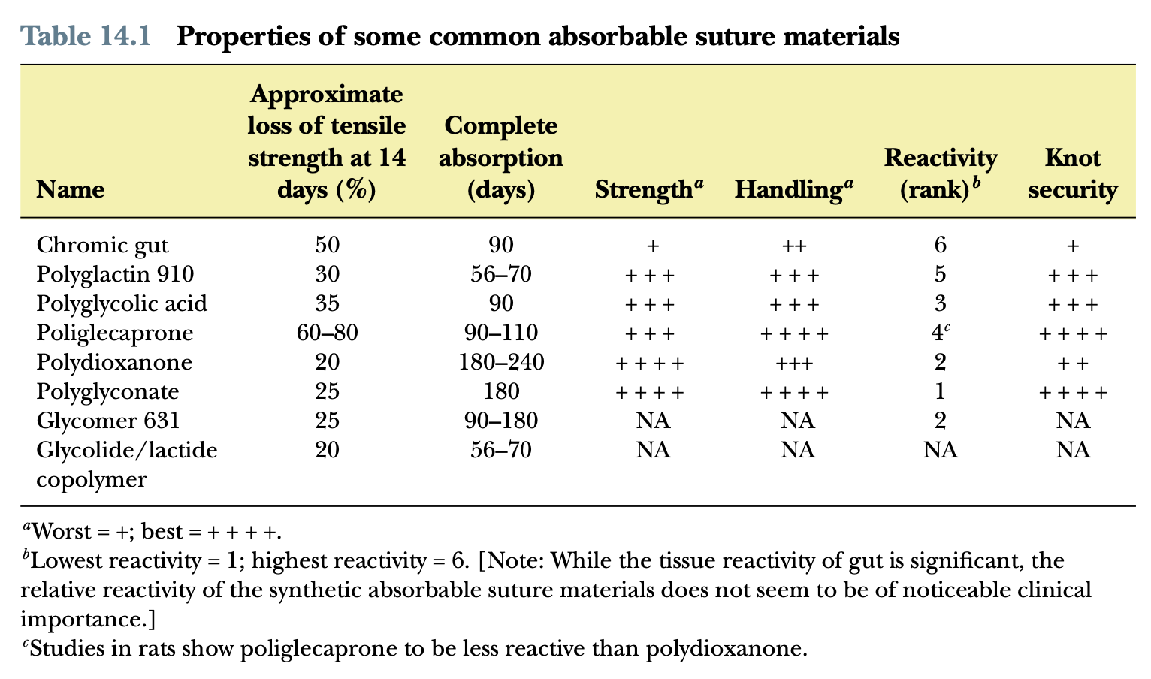

Slide 19
NONABSORBABLE SUTURE MATERIALS

Slide 20
Silk
is the only natural nonabsorbable suture material in common use today.
is a braided multifilament suture made from the cocoon of the silk worm.
elicits intense inflammatory reaction and has marked capillarity.
It is inexpensive, has excellent handling characteristics, and has excellent knot security.
must not be applied in infected tissues since it will decrease the number of bacteria necessary to cause a wound infection.
can cause granulomas when used in hollow viscera.
loses most of its tensile strength in 6 months.
Today, silk is still commonly used in vascular surgery (not as vascular grafts) and as inexpensive and dependable ligature material.

Slide 21
Polyester
is a nonabsorbable multifilament material made from polyethylene terephthalate.
is stronger than surgical gut and silk and does not lose significant strength over time.
incites a severe inflammatory reaction and has marked tissue drag.
Coating with polybutilate decreases tissue drag and in-creases handling characteristics at the expense of knot security.
Polyester must not be used in infected wounds.

Slide 22
Polybutester
is formed from a monofilament copolymer of polybutyline and polytetramethylene.
It elicits minimal tissue reactivity and displays good handling characteristics and knot security.
has high elasticity (up to 30%) without losing tensile strength and can be used in tissues where prolonged wound healing is expected to occur, such as linea alba and tendons.
In addition, because the suture allows significant compliance, polybutester has been used in venous and arterial anastomosis and skin

Slide 23
Nylon
is a polyamide nonabsorbable suture material derived from hexamethylenediamine and adipic acid.
available as monofilament and multifilament, but monofilament is more widely used.
has good handling characteristics and knot security, although memory and stiffness are negative factors.
Nylon is commonly used as a skin suture due to its elastic capabilities, which are important since post surgical inflammation and edema are common, and nonelastic suture will cut the swelling tissue.
Nylon is metabolized over 2–3 years by hydrolysis. In this process, adipic acid is released, which has antibacterial effects.
Most suture companies distribute nylon suture. One company distributes a fluorescent monofilament nylon suture (Fluorescent Supramid ) that makes the suture easy to find at the time of removal.

Slide 24
Polymerized caprolactam
is another polyamide suture.
It is a twisted multifilament suture that is coated with a polyethylene sheath to minimize capillarity.
Polymerized caprolactam has superior tensile strength compared to nylon, catgut, and silk, and incites less tissue reaction when compared to catgut and silk.
Excessive swelling with the possibility of sinus formation has been reported; therefore, polymerized caprolactam should be reserved for skin suturing only.

Slide 25
Polypropylene
is a nonabsorbable synthetic suture material that displays minimal tissue drag and moderate strength and knot security.
It tends to be stiff and have significant memory, which decreases its handling characteristics.
Polypropylene is the one of the least thrombogenic sutures available and is commonly used in vascular surgery.
Most suture companies distribute polypropylene suture. One company distributes a fluorescent monofilament polypropylene suture (Fluorofil, Intervet) that makes the suture easy to find at the time of removal.

Slide 26
Stainless steel
is biologically inert and the strongest of the suture materials.
is commonly used in orthopedics in the form of stainless steel implants, but is uncommonly used as a suture material.
Stainless steel suture has a tendency to cut through tissue and has poor handling characteristics.
Although stainless steel sutures are not routinely used for closure of soft tissues, stainless steel skin staples are becoming increasingly popular due to easy application and improved speed in closure, compared to conventional suturing.

Slide 27
Advantages and disadvantages of different suture types

Slide 28
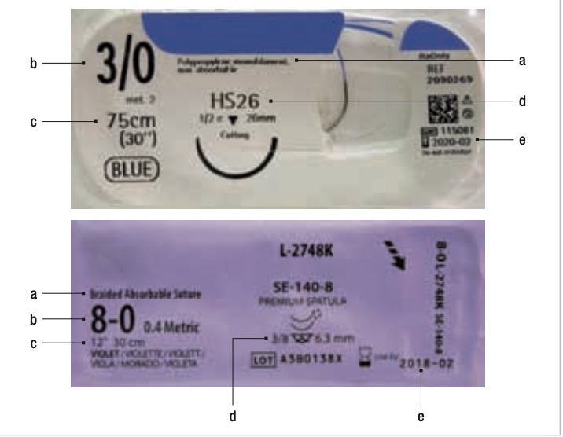
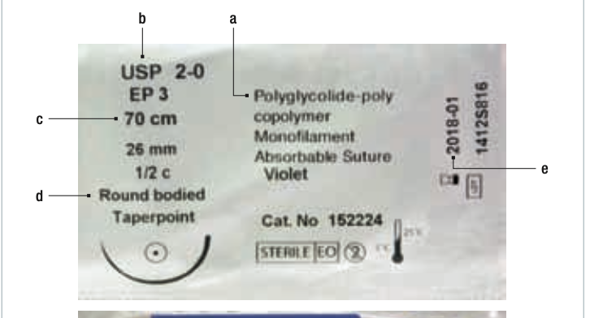
Suture package information
a) Composition and characteristics of the suture thread.
(b) Calibre of the thread in the USP and metric systems. (
c) Length of the thread.
(d) Type of needle. Length, curvature, actual size and profile of the needle and profile of the tip (cylindrical, reverse cutting, spatulated, etc.).
(e) Expiry date.

Slide 29
Needles
The suture needle is as important as the suture thread.
Most surgical needles are made of stainless steel. The needle must allow the suture thread to pass through it, make as small a hole as possible and damage no more tissue than necessary.
A surgical needle can be divided into three main parts:
the point,
the body
the swage

Slide 30
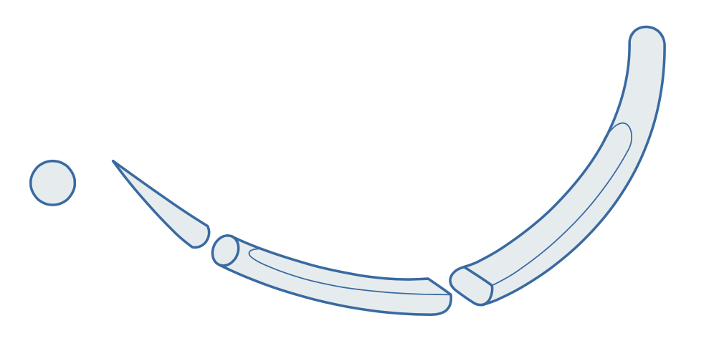
The needle point determines its sharpness, and the choice of needle will depend on the tissue to be sutured
Cylindrical or round-point needles:
are designed to pass through the fibres that comprise the tissue without cutting it.
The body of the needle is flattened to prevent the needle holder from rotating when it is immobilised.
These needles are used on low-resistance tissues such as the intestines, fat, muscle and urogenital tract.

Slide 31
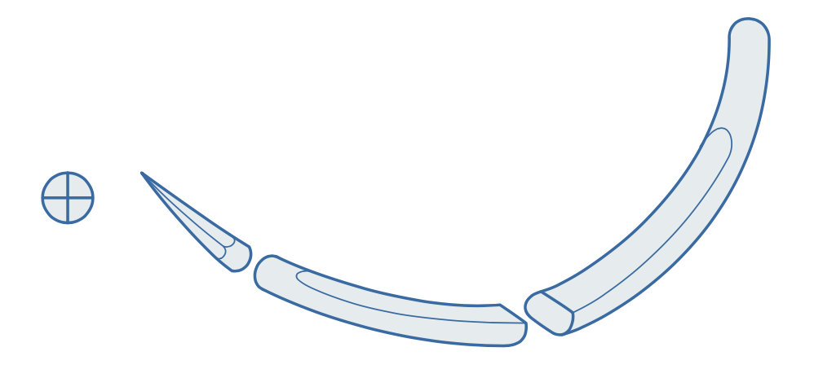
Blunt-point needles
are used on friable tissue such as the liver and spleen.
Their point dissects the tissue as it passes through it without damaging blood vessels or bile ducts.
Trocar-point needles
have a point with four cutting edges that gradually turn into a cylindrical body.
With this design, the needle easily penetrates the tissue without cutting it.
is used to suture tendons and in cardiovascular surgery.

Slide 32
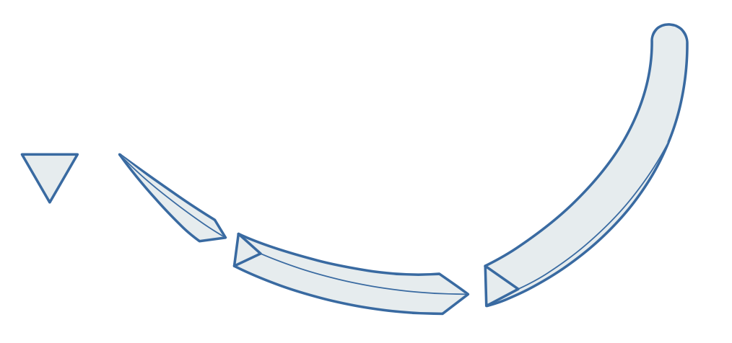
Cutting-point needles
are those with several cutting edges.
Their sharp edges pass through tough tissue such as skin and fasciae.
They should be avoided on soft tissue, as they increase tissue damage and the risk of bleeding and infection.
The most commonly used needle is the reverse cutting needle

Slide 33
The swage is the end of the needle in which the thread is secured:
It may have an eye or hole through which to thread the suture. These are known as traumatic needles .These needles cause more trauma in the tissue because the suture protrudes from both sides of the eye of the needle when it is threaded through it.
Traumatic needles can accidentally become unthreaded, require resterilisation, form notches due to repeated use in needle holders and become blunt with use.
The thread may be fitted to or joined in the hollow end of the needle to achieve a smooth transition between the nee- dle and the thread. These needles are known as atraumatic needles.

Slide 34
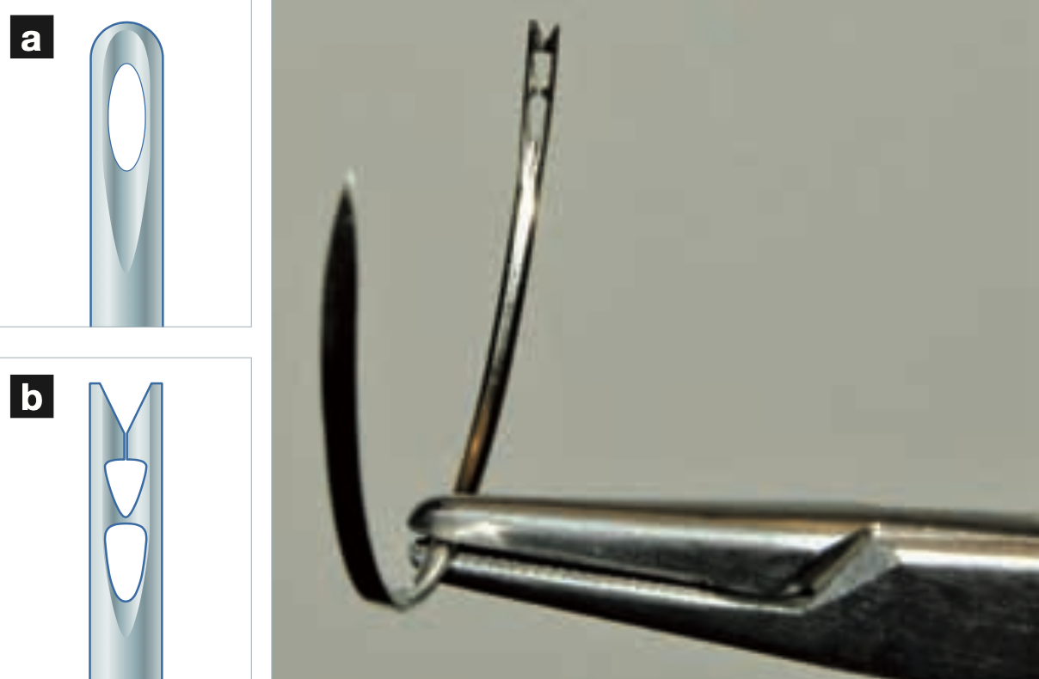
Threadable needles allow rolls of sutures to be used.
These are less expensive, although the thread may be damaged when it passes through the eye of the needle and is more difficult to handle as it is not firmly secured to the needle.
They may be (a) closed eye needles or (b) French eye needles, which are easier to thread, although the thread is more easily damaged.

Slide 35
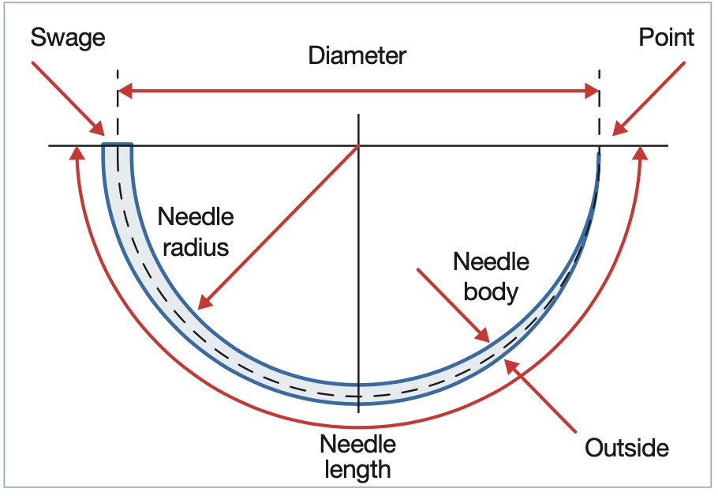
Several factors must be taken into account to identify a needle. The most important ones are:
Needle length, which is the distance in millimetres from the point to the swage
Radius or angle of curvature, which is the distance from the centre of the cord to the body of the needle. This characteristic determines the turning radius of the needle when it is handled with the needle holder. The most commonly used ones are 1⁄2 circle, 3⁄8 circle and straight.
Characteristics that identify the needle. The radius or angle of curvature determines the choice of needle based on the surgical field.
More curved needles are indicated in deep surgical fields, while straight needles are used in superficial fields.

Slide 36
Types of suture and needle by tissue. Basic concepts
Sutures inside the body should be absorbable so that they do not become foreign bodies.
A multifilament thread is chosen when greater resistance to ten- sion is required, as in closure of a laparotomy.
If tissue is suspected to be contaminated, multifilament sutures should be avoided, as bacteria can get trapped between the strands.
A monofilament thread should be used to suture a skin wound to prevent bacteria from passing from the patient’s skin into the patient’s body

Slide 37
Hollow organs should be sutured with monofilament absorbable material to prevent the capillary effect of multifilament thread.
Non-absorbable material is used when the suture must not dis- appear over time, as in hernia repair and ligation of patent ductus arteriosus.
The size of the needle to be selected depends on the thickness of the tissue to be sutured. The curvature depends on the depth of the structure in question; preferably, the deeper the structure, the greater the curvature.
Skin and superficial structures are easier to suture using 3⁄8 or straight needles with triangular points.

Slide 38
Internal organs should be sutured using an atraumatic needle with a cylindrical point and a 1⁄2 curvature.
Poorly vascularised structures such as tendons should be sutured with non-absorbable material.
Parenchymatous organs such as the spleen, liver and kidneys are sutured with monofilament absorbable material and blunt-point needles. A thick calibre should be used to keep from cutting the tissue when tightening the knot.

Slide 39
Catheters and drains
Dr. Murat ÇALIŞKAN

Slide 40
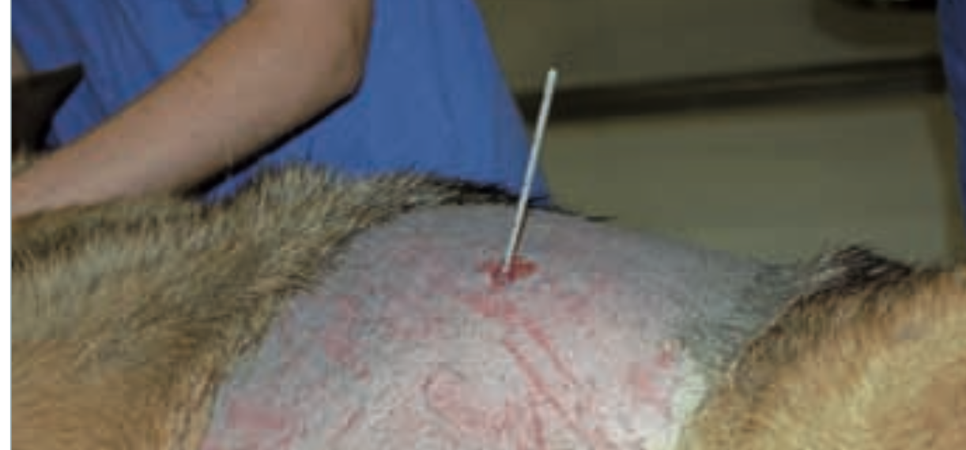
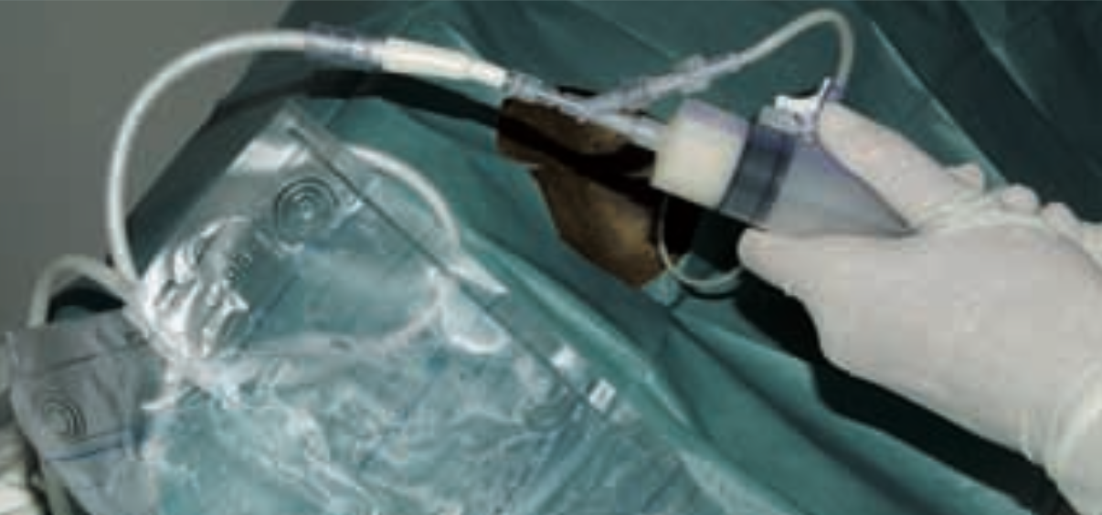
A drainage tube has been inserted into the stomach of this patient to remove gas trapped inside due to gastric dilatation-volvulus. In these patients, the stomach is punctured on the left side, as the spleen has been displaced towards the right hemiabdomen.
Tubes and drains are placed in the patient in order to remove fluids and air that have accumulated in parts of the body in which they should not be, or in order to access the inside of a patient’s body to administer food, medication or oxygen.
This patient had dyspnoea, tachypnoea and coughing as a result of a pleural effusion. A drain has been placed in the thorax to remove and analyse the fluid. This was a case of chylothorax.

Slide 41
A drain connects the inside of the body to the outside. It is placed when there is a need to perform regular lavage or aspiration of fluids or air from a certain location.
Drains help to reduce the risk of infection, prevent possible delays in healing and even maintain organ function (as in a chest drain for a pleural effusion), provided that they are properly placed and maintained.
Drains can be passive (gravity or capillary) or active (fitted to a suction system).

Slide 42
Passive drain
Penrose drain
Peritoneal drain
Percutaneous urinary drainage

Slide 43
Penrose drain
This is the most commonly used passive drain.
It consists of a soft latex tube, which is inserted into a wound.
Next, each end is drawn out through different incisions and one of these is always left in the most ventral area possible so that gravity promotes the drainage of accumulated fluid.
Both ends can be secured to the skin, or better still, joined together with a stitch, knot or staple to facilitate the move- ment of the tube and the drainage of fluid.
The Penrose drain is mainly indicated in infected wounds and abscesses
During removal, the part of the drain that has been outside the body should never enter the wound.

Slide 44
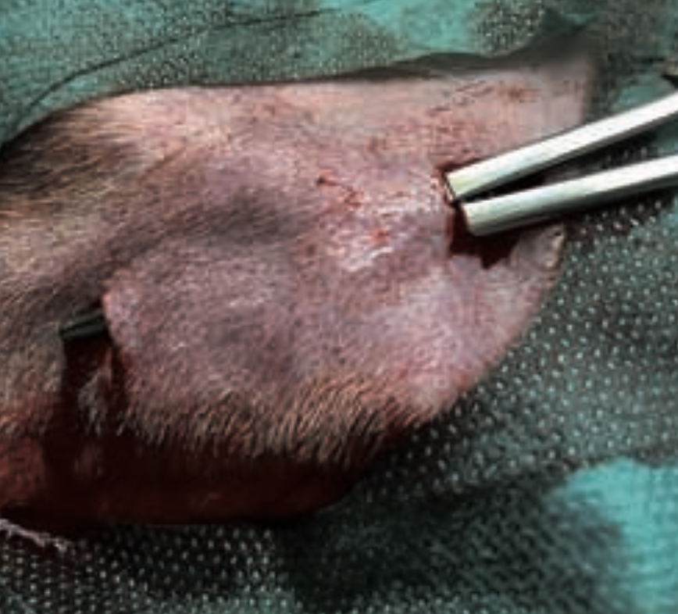
Two sterile incisions measuring approximately 1 cm are made in the skin.
It is ensured that one of them is in the lowest part of the body to facilitate the drainage of secretions.
Once the contents has been removed, forceps are inserted into the cavity to break up any trabeculae that may be there, and they are drawn out through the other incision to insert the drain.

Slide 45
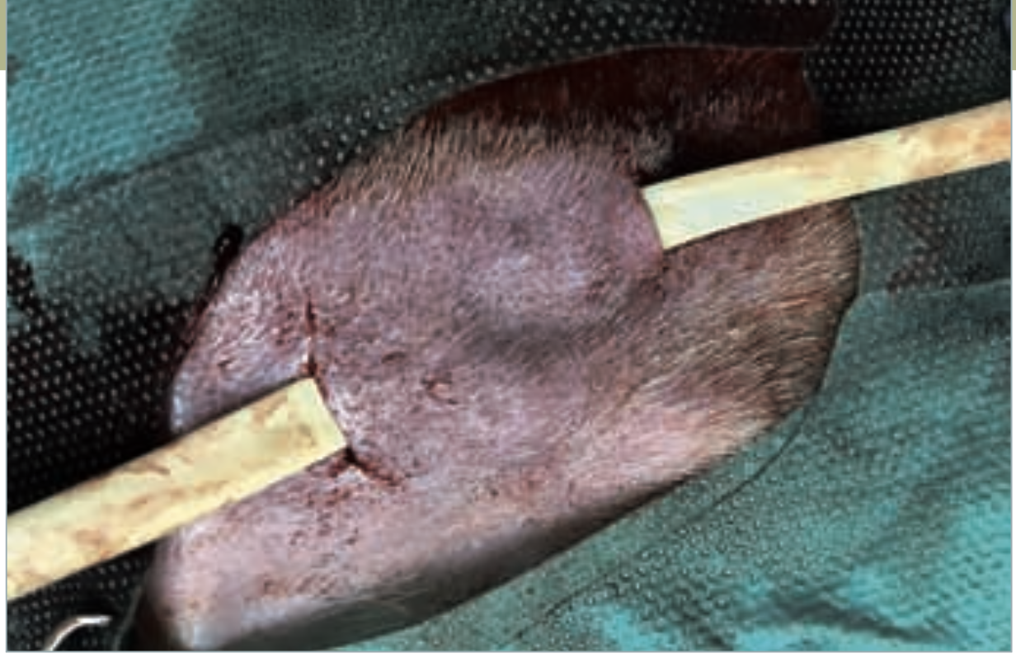
Secure the end of the drain with the tips of forceps and draw it out through the other incision

Slide 46
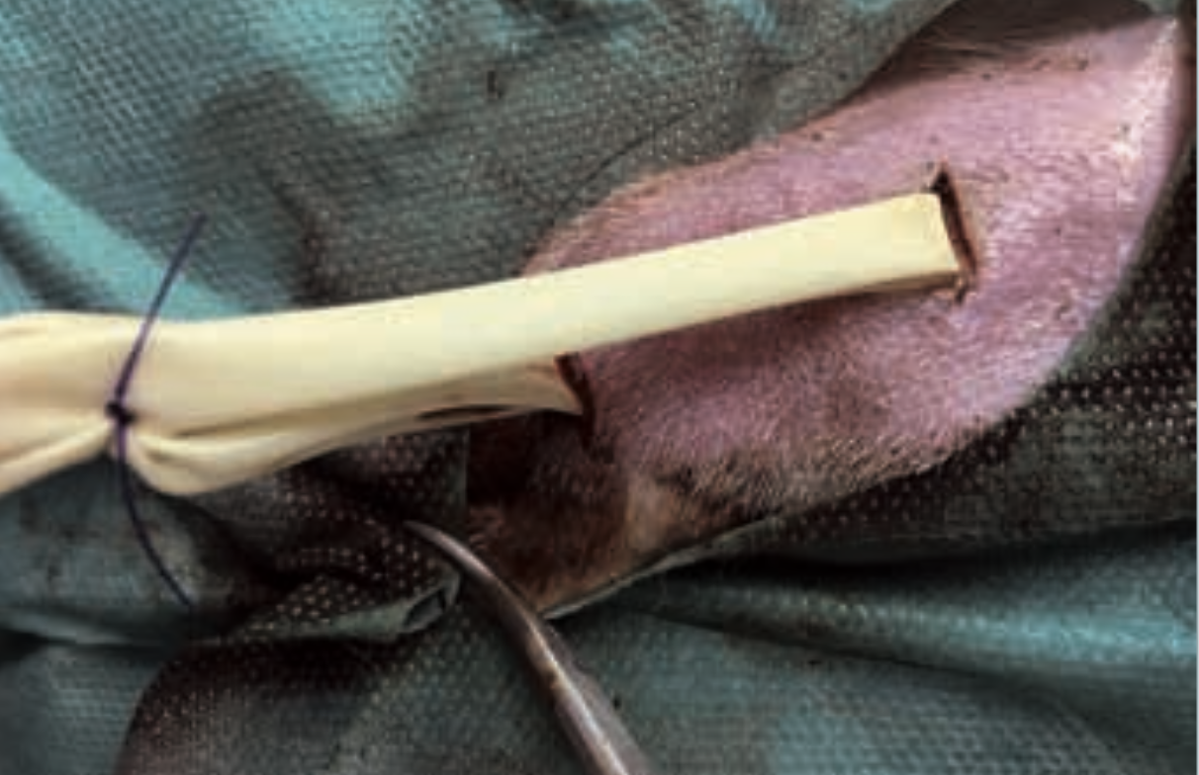
Example in which the two ends of the drain have been secured to each other with a simple stitch.
It should be covered with a dressing that is changed regularly to avoid excessive moisture in the wound and accumulation of fluids that increase the risk of infection.

Slide 47
Peritoneal drain
This can be used in peritoneal effusions and peritonitis, and in pa- tients with renal failure requiring peritoneal dialysis.
It consists of a flexible tube with rigid walls and multiple perforations on the sides to prevent possible obstructions.
It is inserted with a trocar that is used to perforate the abdominal wall.
The drainage tube is connected to a closed collection system to prevent ascending abdominal contamination.
It is important to cover the drain system with a bandage and place an Elizabethan collar on the patient to prevent it from biting the tube, with consequent risks of infection and/or loss of part of the tube in the abdominal cavity

Slide 49
Percutaneous urinary drainage
Placing a catheter inside the bladder through the abdominal wall is indicated in patients with urethral obstruction or injury (calculi, rupure, neoplasms, etc.).
After securing the urinary catheter to the abdominal wall with a “Chinese finger trap” stitch, connect it to a closed urine collection system to prevent ascending contamination and backflow of urine.

Slide 51
Active drain
Closed suction drain with bulb
Chest drain

Slide 52
Closed suction drain with bulb
This is also known as a Jackson-Pratt (JP) drain.
It consists of a multiperforated silicone tube that is placed and then connected to a low-pressure vacuum system with a bulb or bellows
As an alternative to a low-pressure vacuum system, a syringe can be used and its plunger can be blocked after aspiration has been performed using a hypodermic needle

Slide 53
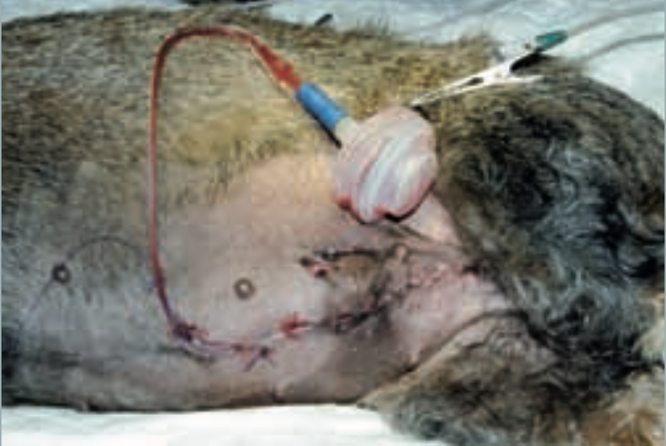
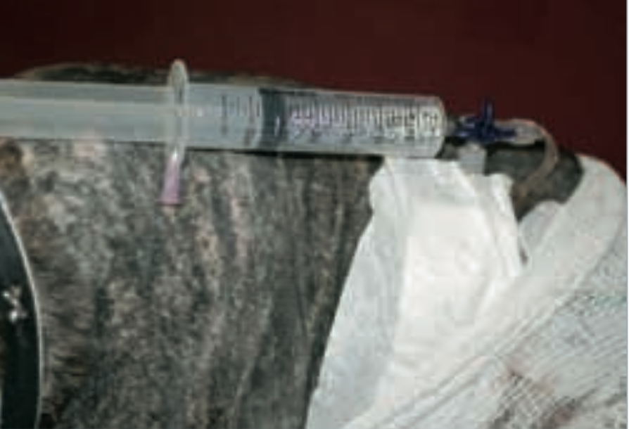
Active low-pressure drainage can also be performed with a syringe that, after being fitted to the drain, maintains the vacuum through a hypodermic needle that passes through the plunger.
The drain is secured to the skin and connected to the continuous low- pressure aspiration system

Slide 54
Chest drain
A chest drain is placed by tunnelling 2-3 cm (two intercostal spaces) from the outlet of the tube to the outside and inserting a tube (with rigid walls) into the pleural space between the ribs.
It can be used to remove air from the pleural space after a thoracotomy, or fluids and blood in pleural effusions (haemothorax, pyothorax, chylothorax).
It may also be an emergency procedure in cases of severe pleural effusions and pneumothorax that prevent the animal from expanding the lungs normally and cause serious dyspnoea.

Slide 55
Its placement requires general anaesthesia, shaving of the hemithorax where the drain is to be placed, subcutaneous infiltration with local anaesthetic between the sixth and 10th intercostal spaces, and the usual asepsis associated with any sterile surgical procedure.
Position the animal in lateral decubitus, and make a 0.5-1 cm vertical incision in the skin over the 10th or 11th rib. Proceed to cranial tunnelling of approximately two intercostal spaces until reaching the 7th or 8th intercostal space.
Skin tunnelling prevents the point of entry into the thorax and the skin opening to the outside from overlapping. This reduces the risk of pneumothorax and loss of negative pressure in the pleural cavity.

Slide 56
Puncture the 7th or 8th intercostal space over the cranial edge of the rib to avoid the intercostal vessels running along the caudal edge. Avoid driving the trocar in too far and damaging the lungs (Fig. 9).
Next, remove the stylet, insert the drain in the desired location, secure it to the chest wall and connect it to the vacuum system to remove the fluid or air in the thorax
The chest wall must be passed through as close to the cranial side of the rib as possible to avoid the vascular bundle on the caudal side and thus prevent accidental bleeding.

