Slide 1
Lecture 5: What CDC Is Doing These Days?

Slide 3
Malaria
Malaria is a mosquito-borne disease caused by a parasite.
People with malaria often experience fever, chills, and flu-like illness.
Left untreated, they may develop severe complications and die.
In 2016 an estimated 216 million cases of malaria occurred worldwide and 445,000 people died, mostly children in the African Region.
About 1,700 cases of malaria are diagnosed in the United States each year.
The vast majority of cases in the United States are in travelers and immigrants returning from countries where malaria transmission occurs, many from sub-Saharan Africa and South Asia.

Slide 4
Other mosquito-borne diseases?
Dengue
Zika
Chikungunya
West nile fever

Slide 5
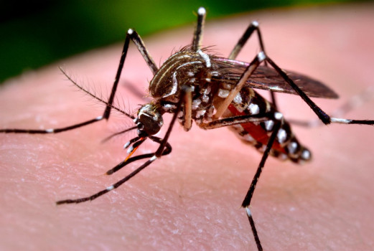
Dengue
What is dengue?
Dengue is a disease caused by any one of four closely related dengue viruses (DENV 1, DENV 2, DENV 3, or DENV 4).
The viruses are transmitted to humans by the bite of an infected mosquito.
In the Western Hemisphere, the Aedes aegypti mosquito is the most important transmitter or vector of dengue viruses, although a 2001 outbreak in Hawaii was transmitted by Aedes albopictus.
It is estimated that there are over 100 million cases of dengue worldwide each year.

Slide 6
What is dengue hemorrhagic fever (DHF)?
DHF is a more severe form of dengue infection. It can be fatal if unrecognized and not properly treated in a timely manner. DHF is caused by infection with the same viruses that cause dengue fever. With good medical management, mortality due to DHF can be less than 1%.

Slide 7
How are dengue spread?
Dengue is transmitted to people by the bite of an Aedes mosquito that is infected with a dengue virus.
The mosquito becomes infected with dengue virus when it bites a person who has dengue virus in their blood.
The person can either have symptoms of dengue fever or DHF, or they may have no symptoms.
After about one week, the mosquito can then transmit the virus while biting a healthy person.
Dengue cannot be spread directly from person to person.

Slide 8
What are the symptoms of the disease?
The principal symptoms of dengue fever are high fever, severe headache, severe pain behind the eyes, joint pain, muscle and bone pain, rash, and mild bleeding (e.g., nose or gums bleed, easy bruising). Generally, younger children and those with their first dengue infection have a milder illness than older children and adults.
Dengue hemorrhagic fever is characterized by a fever that lasts from 2 to 7 days, with general signs and symptoms consistent with dengue fever.
When the fever declines, symptoms including persistent vomiting, severe abdominal pain, and difficulty breathing, may develop.
This marks the beginning of a 24- to 48-hour period when the smallest blood vessels (capillaries) become excessively permeable, allowing the fluid component to escape from the blood vessels into the peritoneum (causing ascites) and pleural cavity (leading to pleural effusions).
This may lead to failure of the circulatory system and shock, followed by death, if circulatory failure is not corrected.

Slide 9
Where can outbreaks of dengue occur?
Outbreaks of dengue occur primarily in areas where Ae. aegypti (sometimes also Ae. albopictus) mosquitoes live.
This includes most tropical urban areas of the world.
Dengue viruses may be introduced into areas by travelers who become infected while visiting other areas of the tropics where dengue commonly exists.

Slide 10
How can we prevent epidemics of dengue hemorrhagic fever (DHF)?
The emphasis for dengue prevention is on sustainable, community-based, integrated mosquito control, with limited reliance on insecticides (chemical larvicides, and adulticides).
Preventing epidemic disease requires a coordinated community effort to increase awareness about dengue fever/DHF, how to recognize it, and how to control the mosquito that transmits it.
Residents are responsible for keeping their yards and patios free of standing water where mosquitoes can be produced.

Slide 11
Zika
Zika is spread mostly by the bite of an infected Aedes species mosquito (Ae. aegypti and Ae. albopictus).
Zika can be passed from a pregnant woman to her fetus.
Infection during pregnancy can cause certain birth defects.
There is no vaccine or medicine for Zika.

Slide 12
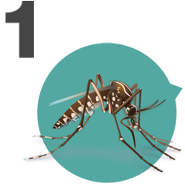
Zika primarily spreads through infected mosquitoes. You can also get Zika through sex.
Many areas in the United States have the type of mosquitoes that can spread Zika virus.
These mosquitoes bite during the day and night.
Zika can also be passed through sex from a person who has Zika to his or her sex partners, even if the person doesn’t have symptoms.

Slide 13
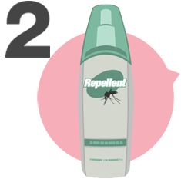
The best way to prevent Zika is to prevent mosquito bites.
Use EPA-registered insect repellent. It works!
Wear long-sleeved shirts and long pants.
Stay in places with air conditioning or window and door screens.
Remove standing water around your home.

Slide 14
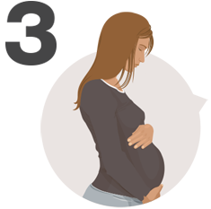
Zika is linked to birth defects.
Zika infection during pregnancy can cause a serious birth defect called microcephaly that is a sign of incomplete brain development.
Doctors have also found other problems in pregnancies and among fetuses and infants infected with Zika virus before birth.

Slide 15
Pregnant women should not travel to areas with risk of Zika.
If you must travel to one of these areas, talk to your healthcare provider first and strictly follow steps to prevent mosquito bites and sexual transmission during your trip. See CDC’s guidance for the US for information on travel within the continental US and Hawaii.

Slide 16
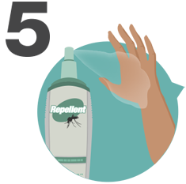
Returning travelers infected with Zika can spread the virus through mosquito bites and sex.
Even if they do not feel sick, travelers returning from an area with risk of Zika should take steps to prevent mosquito bites for 3 weeks so they do not spread Zika to uninfected mosquitoes. If a mosquito bites a person while he or she has Zika virus in his or her blood, the mosquito can become infected and then infect other people.
Couples with a partner who lives in or has traveled to an area with risk of Zika, especially those who are pregnant or planning to become pregnant, should take steps to protect during sex. Zika can stay in semen for months after infection (even without symptoms), and can be spread to partners during that time.

Slide 17
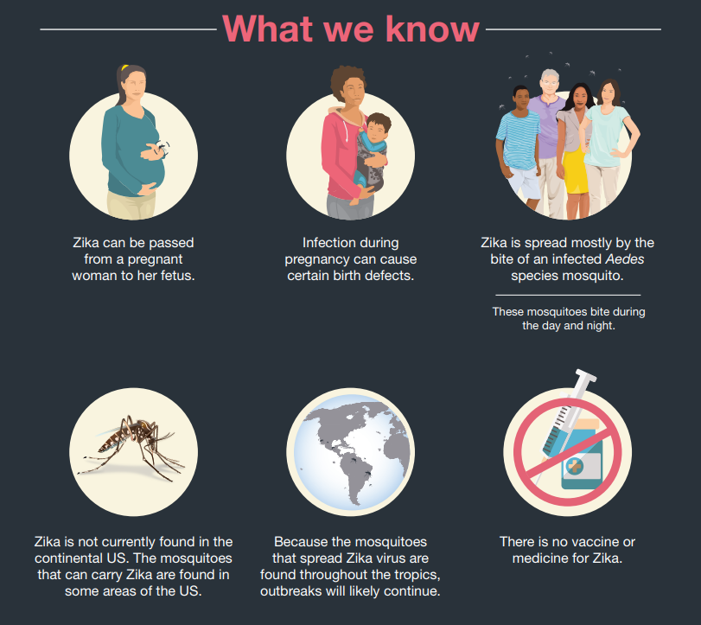
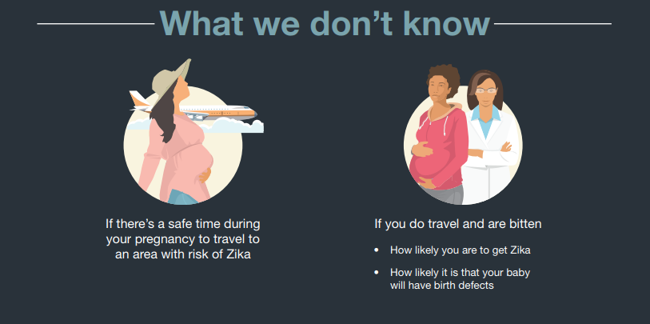
https://www.cdc.gov/zika/pdfs/zika-what-we-know-infographic.pdf

Slide 18
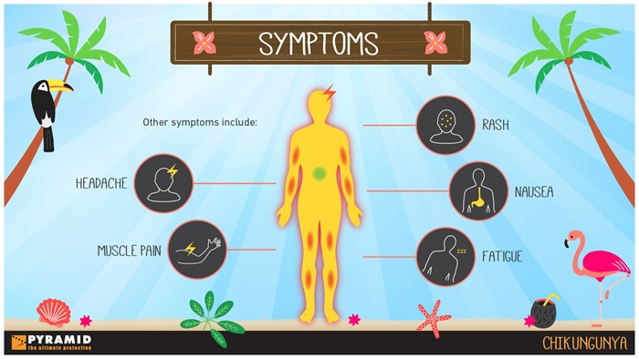
Chikungunya
Chikungunya virus (CHIKV) is transmitted to people by mosquitoes.
The most common symptoms of chikungunya virus infection are fever and joint pain.
Outbreaks have occurred in countries in Africa, Asia, Europe, and the Indian and Pacific Oceans.

Slide 19
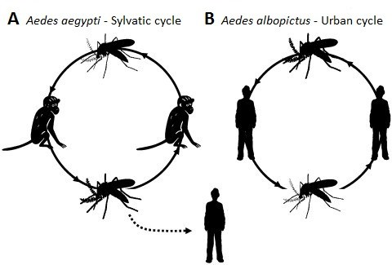
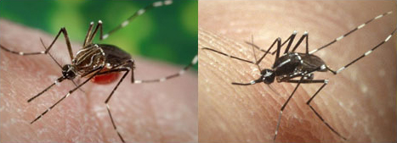
Transmission
1. Through mosquito bites
Mosquitoes become infected when they feed on a person already infected with the virus.
Infected mosquitoes can then spread the virus to other people through bites.
Chikungunya virus is most often spread to people by Aedes aegypti and Aedes albopictus mosquitoes.
These are the same mosquitoes that transmit dengue virus. They bite during the day and at night.
Aedes mosquitoes transmit chikungunya virus to people.
These types of mosquitoes are found throughout much of the world.

Slide 20
Transmission
2. Rarely, from mother to child
Chikungunya virus is transmitted rarely from mother to newborn around the time of birth.
To date, no infants have been found to be infected with chikungunya virus through breastfeeding. Because of the benefits of breastfeeding, mothers are encouraged to breastfeed even in areas where chikungunya virus is circulating.
3. Rarely, through infected blood
In theory, the virus could be spread through a blood transfusion. To date, there are no known reports of this happening.

Slide 21
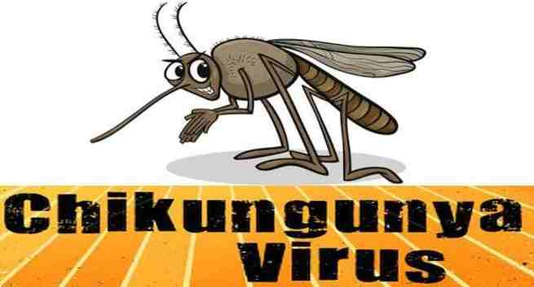
Where Has Chikungunya Virus Been Found?
Prior to 2013, chikungunya virus cases and outbreaks had been identified in countries in Africa, Asia, Europe, and the Indian and Pacific Oceans.
In late 2013, the first local transmission of chikungunya virus in the Americas was identified in Caribbean countries and territories.
Local transmission means that mosquitoes in the area have been infected with the virus and are spreading it to people.
The virus then spread throughout most of the Americas.
2015 Florida
2018 Sudan

Slide 22
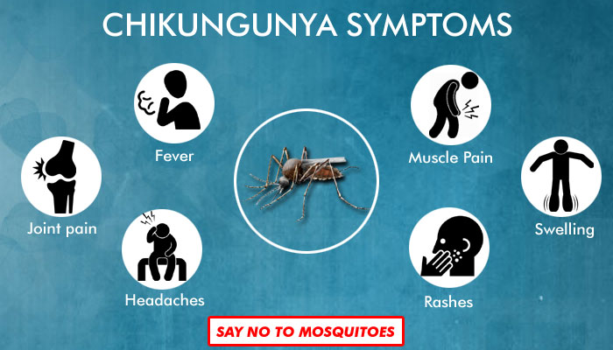
Symptoms
Symptoms usually begin 3–7 days after being bitten by an infected mosquito.
Chikungunya disease does not often result in death, but the symptoms can be severe and disabling.
Most patients feel better within a week. In some people, the joint pain may persist for months.
People at risk for more severe disease include newborns infected around the time of birth, older adults (≥65 years), and people with medical conditions such as high blood pressure, diabetes, or heart disease.
Once a person has been infected, he or she is likely to be protected from future infections.

Slide 25
West Nile Fever

Slide 26
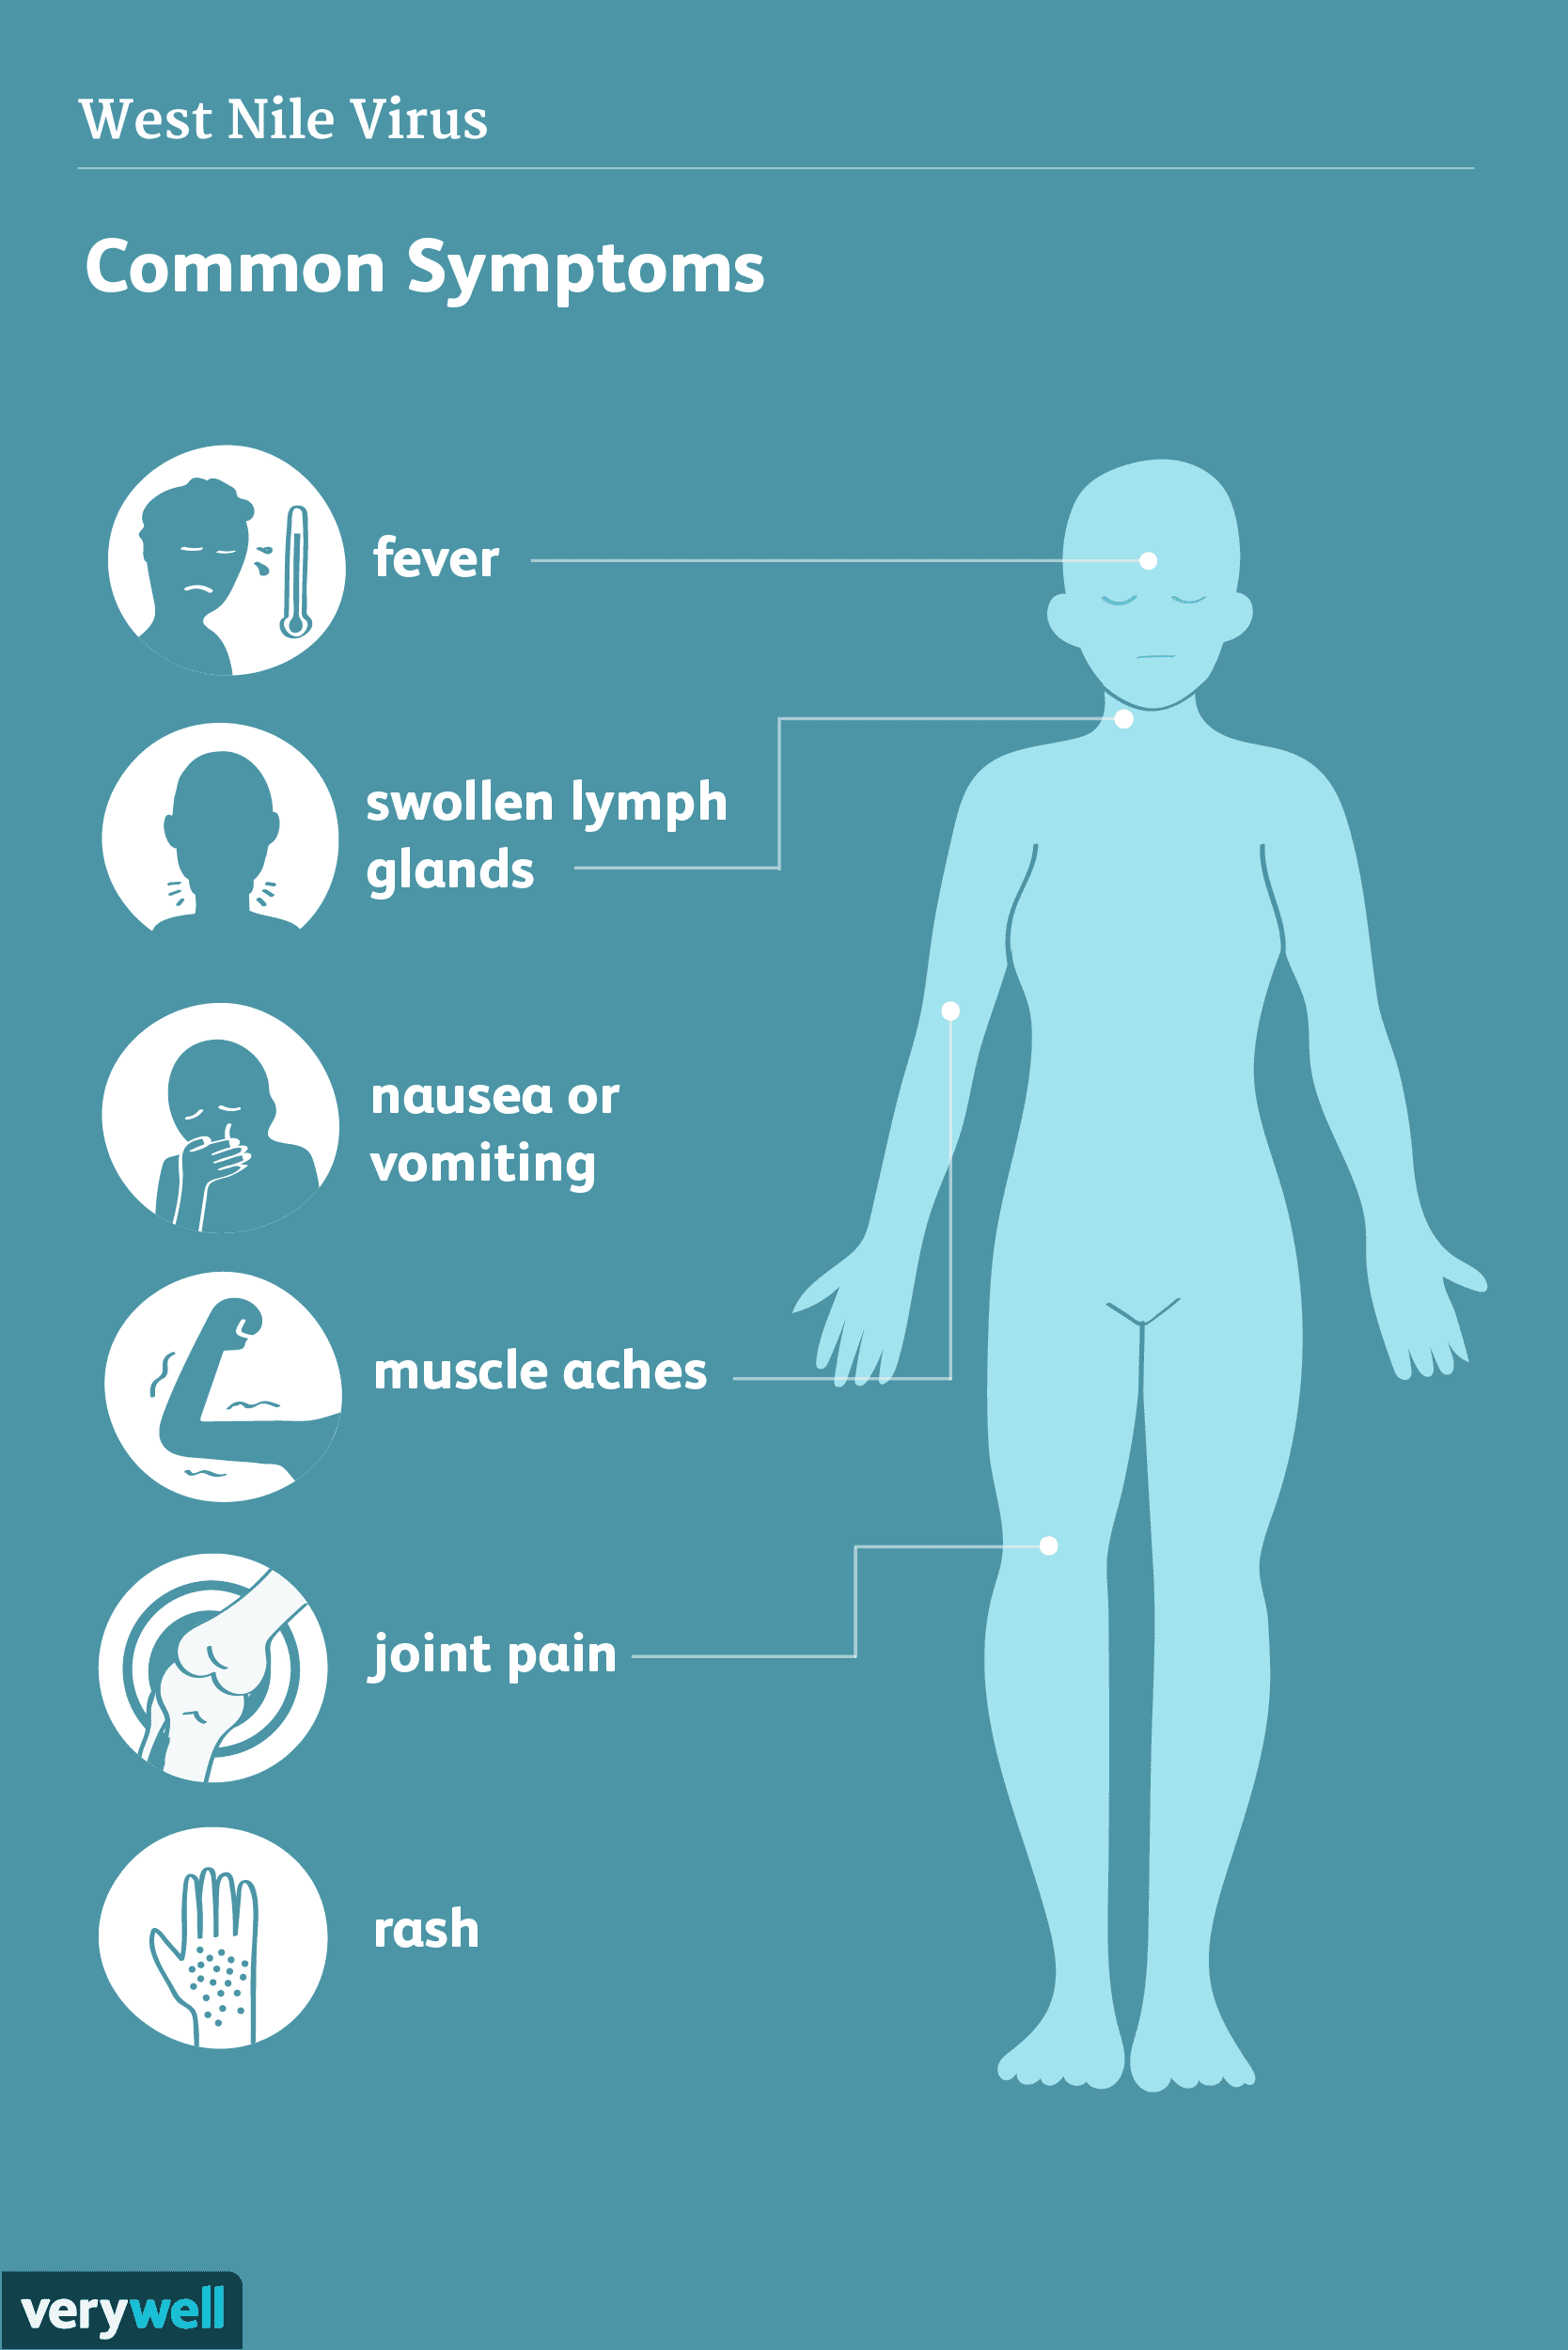
Symptoms
No symptoms in most people.
Most people (8 out of 10) infected with West Nile virus do not develop any symptoms.
Febrile illness (fever) in some people.
About 1 in 5 people who are infected develop a fever with other symptoms such as headache, body aches, joint pains, vomiting, diarrhea, or rash.
Most people with this type of West Nile virus disease recover completely, but fatigue and weakness can last for weeks or months.

Slide 27
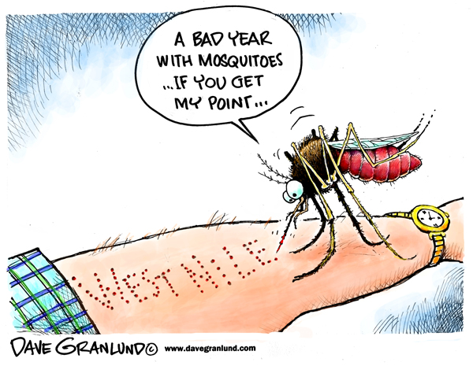
Serious symptoms in a few people.
About 1 in 150 people who are infected develop a severe illness affecting the central nervous system such as encephalitis or meningitis.
Symptoms of severe illness include high fever, headache, neck stiffness, stupor, disorientation, coma, tremors, convulsions, muscle weakness, vision loss, numbness and paralysis.
About 1 out of 10 people who develop severe illness affecting the central nervous system die.

Slide 29
West Nile Virus & Dead Birds
West Nile virus has been detected in variety of bird species.
Some infected birds, especially crows and jays, are known to get sick and die from the infection.
Reporting and testing of dead birds is one way to check for the presence of West Nile virus in the environment.
Some surveillance programs rely on citizens to report dead bird sightings to local authorities.

Slide 30
How do birds get infected with West Nile virus?
West Nile virus is transmitted to birds through the bite of infected mosquitoes.
Mosquitoes become infected by biting infected birds.
Some birds that are predators (such as hawks and owls) or scavengers (such as crows) may become infected after eating sick or dead birds that were already infected with West Nile virus.

