Slide 1
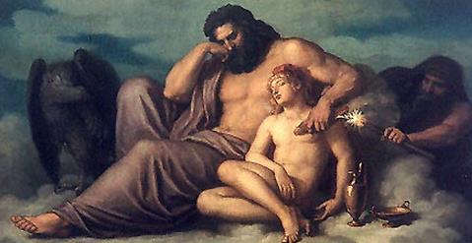
CREATION OF MAN
From the website Ancient Origins
Dr. Funda HAY Kılıç
fhay@ankara.edu.tr
Ankara University

Slide 2
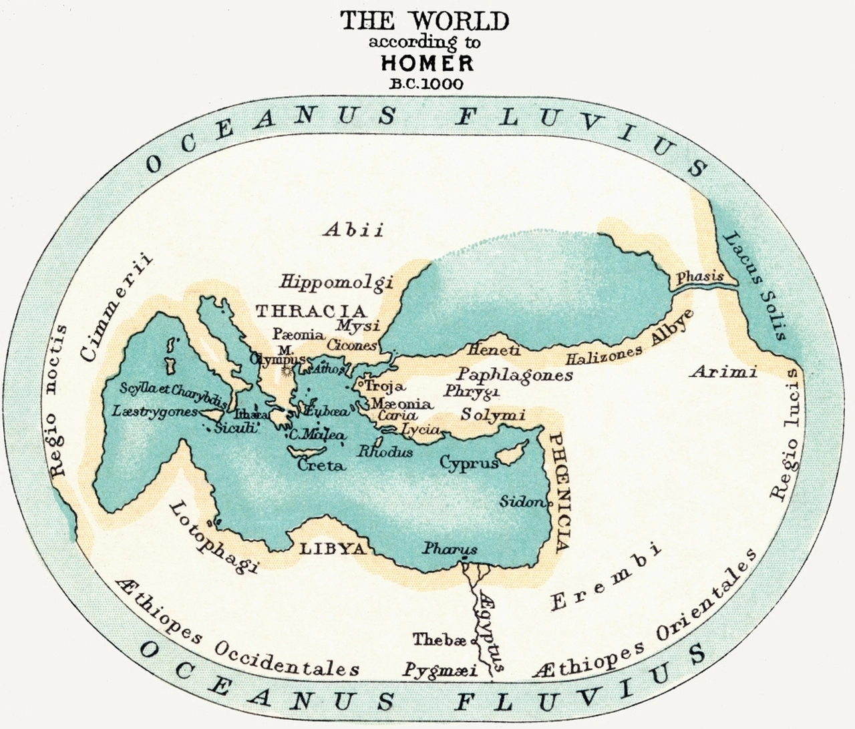
From the website Posterazzi
Notes:
The earth was believed to be a round disk, divided into two equal parts by the Sea, as the Greeks called it, —which we know as the Mediterranean,— and by what we call the Black Sea. Around the earth flowed the great river, Ocean, never troubled by wind or storm. On the farther bank of Ocean were mysterious people, it was a land cloud-wrapped and misty land where endless night was spread over its melancholy people.

Slide 3
Ovid tells about the birth of man, depicting the superiority and lofty ambition of this highest creature in the order of things (Metamorphoses 1.76-88):
Until now there was no animal more godlike than these and more capable of high intelligence and able to dominate all the rest. Then man was born; either the creator of the universe, originator of a better world, fashioned him from divine seed or earth, recently formed and separated from the lofty aether, retained seeds from its kindred sky and was mixed with rain water by Prometheus, the son of Iapetus, and fashioned by him into the likeness of the gods who control all.

Slide 4
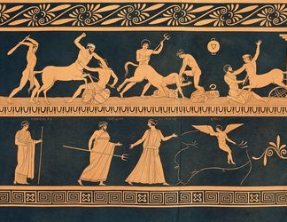
Ovid goes on to describe the four ages of man:
Gold,
Silver
Bronze,
Iron
Hesiod adds a fifth race, «heroes»
From the website ThoughtCo

Slide 5
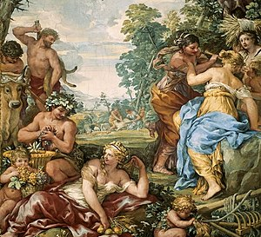
THE FIVE RACES OF MAN:
Golden Race
From the website Wikipedia

Slide 6
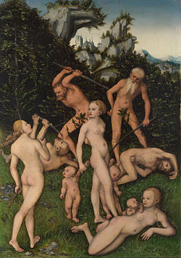
2) Silver Race
From the website Wikipedia

Slide 7
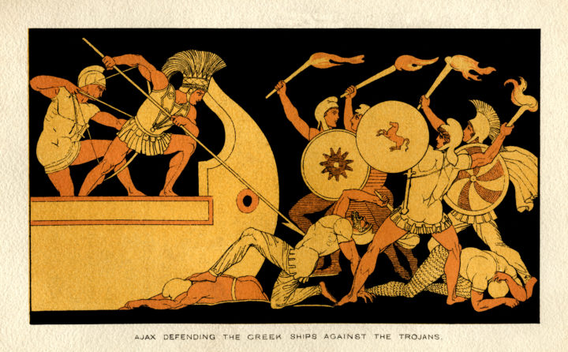
From the website Greek Boston
3) the Race of Bronze: «Father Zeus made another race of mortal men, the third, of bronze and not at all like the one of silver; terrible and mighty because of their spears of ash, they pursued the painful and violent deeds of Ares. They did not eat bread at all but were terrifying and had dauntless hearts of adamant.» (Hesiod, Works and Days).

Slide 8
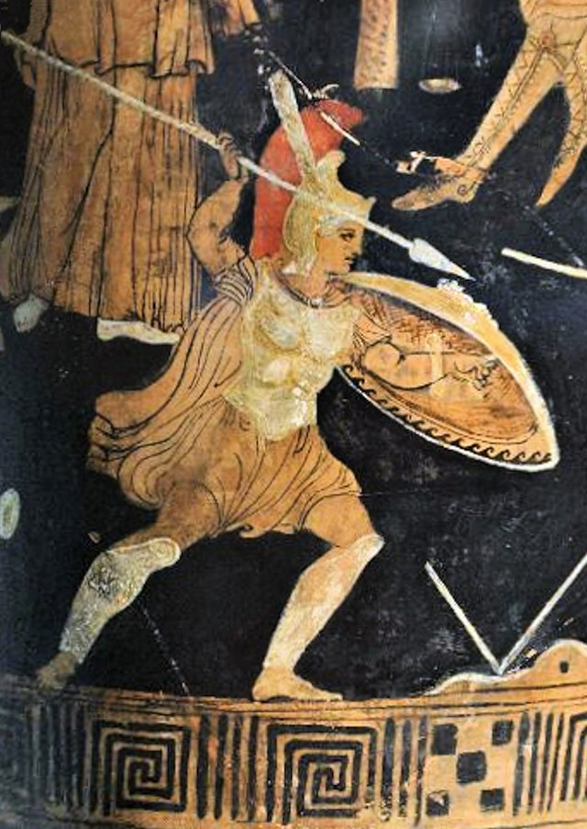
4) the Race of Heroes: “Zeus the son of Cronus made still another, the fourth on the nourishing earth, valiant in war and more just, a godlike race of heroic men, who are called demigods, and who preceded our own race on the vast earth… these happy heroes inhabit the Islands of the Blessed with carefree hearts by the deep swirling stream of Ocean.” (Hesiod, Works and Days).
From the website Wikipedia

Slide 9
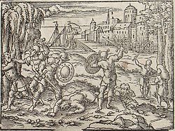
5) the Race of Iron: “Far-seeing Zeus again made still another race of men who live on the nourishing earth… And men never rest from toil and misery by day, nor from perishing by night; and the gods lay harsh trouble upon them” (Hesiod, Works and Days).
From the website Wikipedia

Slide 10
THE CREATOR OF MAN: PROMETHEUS
From the website Wikimedia Commons

Slide 11
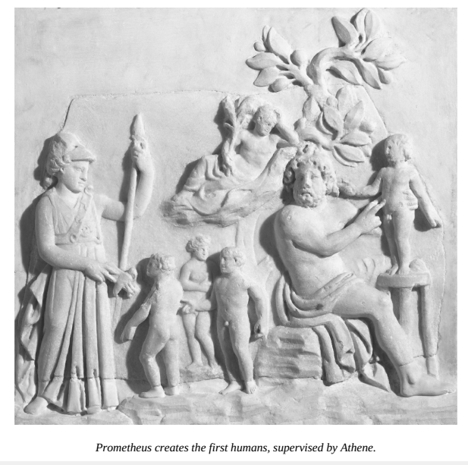
From the book The Penguin Books of Classical Myths

Slide 12
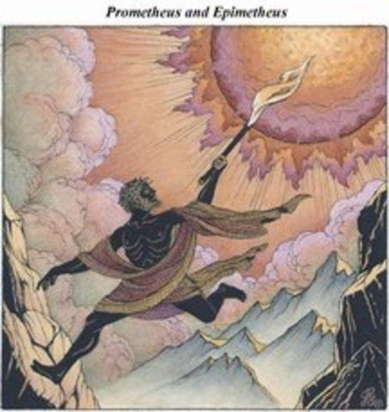
From the website Pinterest

Slide 13
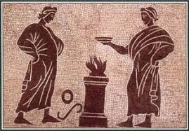
PROMETHEUS AND PANDORA
From the website Myths Encyclopedia

Slide 14
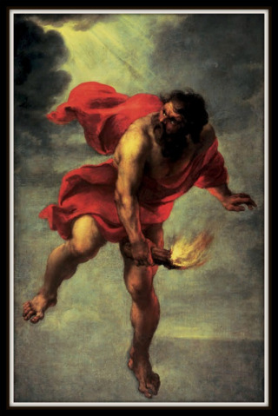
From the website Pinterest

Slide 15
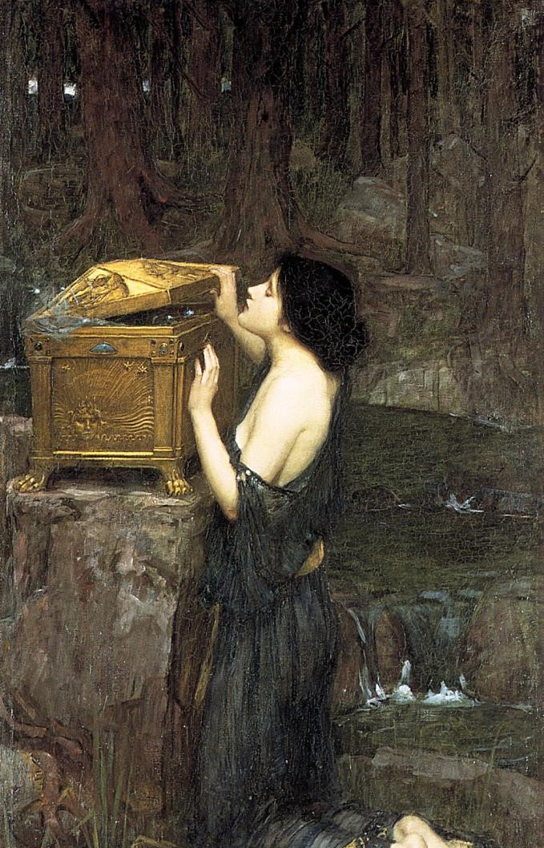
PANDORA
Hesiod says, “Don’t be deceived by a wheedling, sweet-talking woman, flaunting her body, she’s only after your barn. Anyone who trusts a woman is trusting a cheat.” (Works and Days)
From the website wikipedia

Slide 16
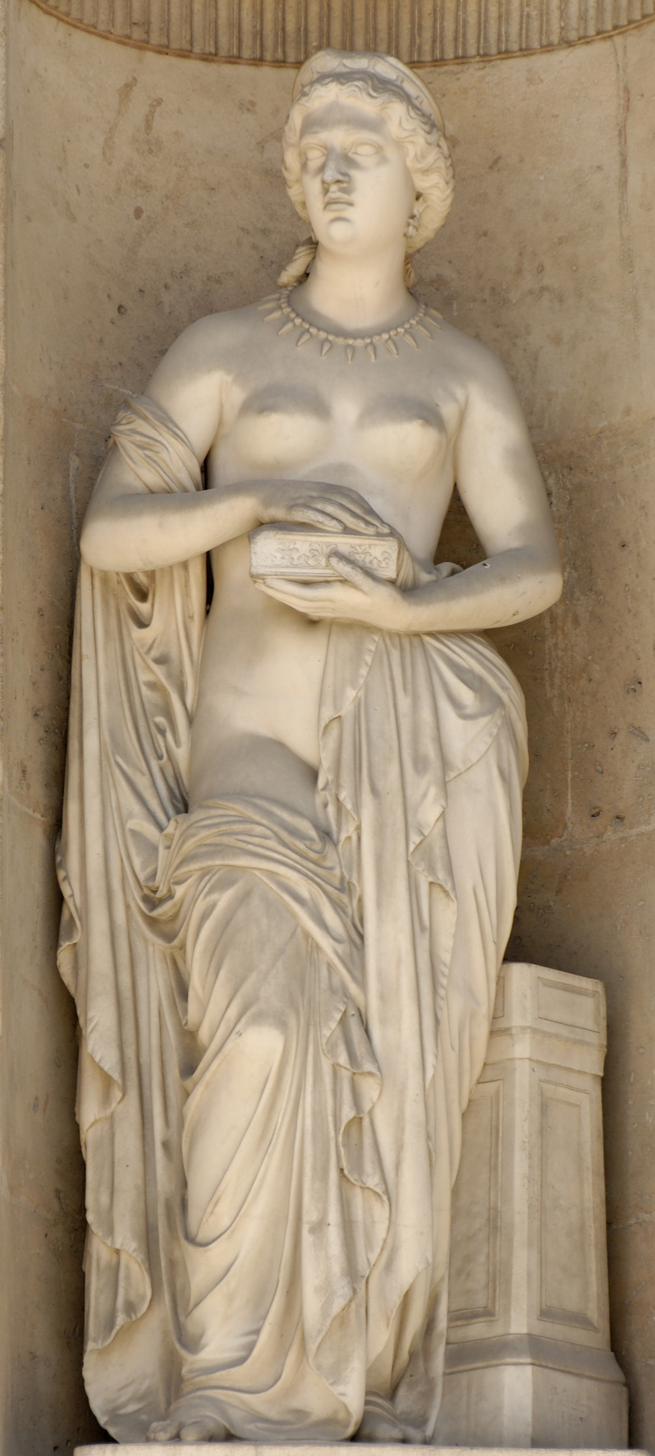
This first woman’s name was Pandora (‘Allgifts’)
From the website Simple Wikipedia

Slide 17
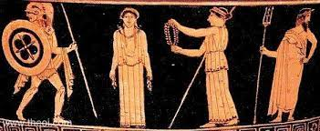
From the website Theoi Greek Mythology

Slide 18
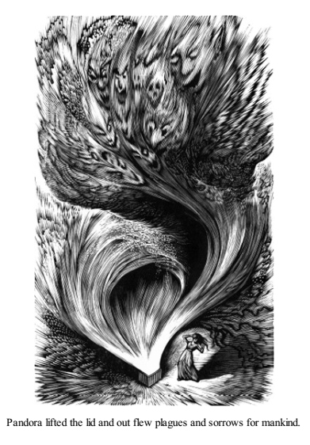
From the book Edith Hamilton's Mythology

Slide 19
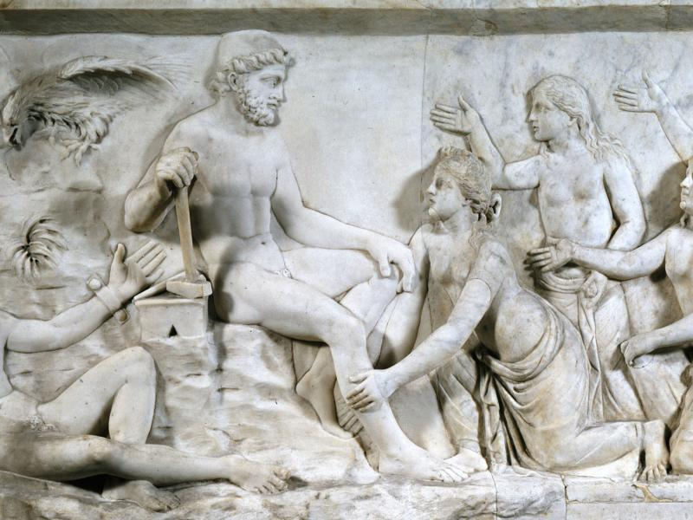
From the website National Museums Liverpool

Slide 20
From the website Ancient History Encyclopedia

Slide 21
In Aeschylus’ tragedy Prometheus Bound, he regrets none of his deeds:
‘Let the twisted fork of lightning fire be flung
against me: let the high air be stirred
with thunderclaps and the convulsive fury
of the winds: let earth to the roots of her foundations
shake before the blasting storm: let it confound
the waves of the sea and the paths of the heavenly stars
in a wild turmoil, and let him raise
my body high and dash it whirling down
to murky Tartaros. He cannot make me die.’

Slide 22
Bibliography:
Hamilton, Edith. Mythology: Timeless Tales of Gods and Heroes. Little, Brown and Co., 1942.
Hansen, William. Handbook of Classical Mythology. ABC-CLIO, 2004.
March, Jenny. The Penguin Books of Classical Myths. Penguin Books, 2009.
Morford, Mark, P. O. and Robert J. Lenardon. Classical Mythology. Longman, 1985.

