Slide 1
55490005
Chapter 3: Transport Layer
(PART 2)

Slide 2
Outline
Connection-oriented Transport: TCP
Principles of Congestion Control
TCP Congestion Control

Slide 3
Connection-oriented Transport: TCP
TCP: Overview
Point-to-point
Reliable in order byte stream
Pipelined
Full duplex data
Connection-oriented
Flow-controlled

Slide 4
Connection-oriented Transport: TCP
TCP round trip time, timeout
How to set TCP timeout value?
Longer than RTT
Too short: Premature timeout, unnecessary retransmissions
Too long: Slow reaction to segment loss

Slide 5
Connection-oriented Transport: TCP
TCP creates reliable data transfer service on top of IP’s unreliable service
Pipelined segments
Cumulative ACKs
Single retransmission timer
Retransmission triggered by:
Timeout events
Duplicate ACKs

Slide 6
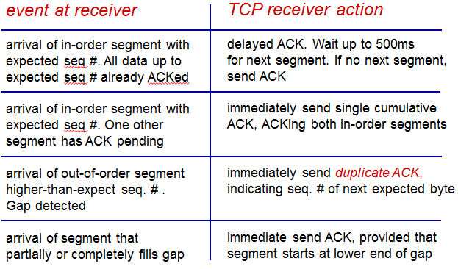
Connection-oriented Transport: TCP

Slide 7
Connection-oriented Transport: TCP
TCP fast retransmit
Time-out period often relatively long
Detect lost segments via duplicate ACKs
Sender often sends many segments back to back
If segment is lost, there will be many duplicate ACKs
If sender receives 3 ACKs for same data, resend unacked segment with smallest sequence number

Slide 8
Connection-oriented Transport: TCP
TCP flow control
Receiver controls sender so sender will not overflow receiver’s buffer
Receiver advertises free buffer space in TCP header of receiver to sender segments
Sender limits amount of unacked data to receiver’ free buffer space value
Guarantees receive buffer will not overflow

Slide 9
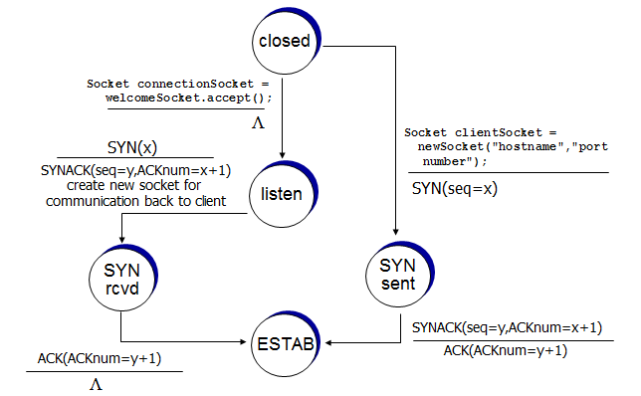
Connection-oriented Transport: TCP
TCP 3-way handshake: FSM

Slide 10
Principles of Congestion Control
Congestion:
If too many sources sends too much data too fast for network to handle
Different from flow control
Lost packets
Long delays
Costs of congestion
More work retrans) for given goodput
Unneeded retransmissions

Slide 11
Principles of Congestion Control
Approaches towards congestion control
End to end congestion control
No feedback from network
Congestion inferred from loss, delay
TCP uses this approach
Network assisted congestion control
Routers provide feedback to end systems

Slide 12
TCP Congestion Control
TCP congestion control: additive increase, multiplicative decrease
Sender increases transmission rate until loss occurs
Additive increase: Increase TCP sender congestion window size by 1 MSS every RTT until loss detected
Multiplicative decrease: Cut TCP sender congestion window size in half after loss

Slide 13
TCP Congestion Control
TCP Slow Start
When connection begins, rate is increased exponentially until first loss event
Initial rate is slow but ramps up exponentially fast

Slide 14
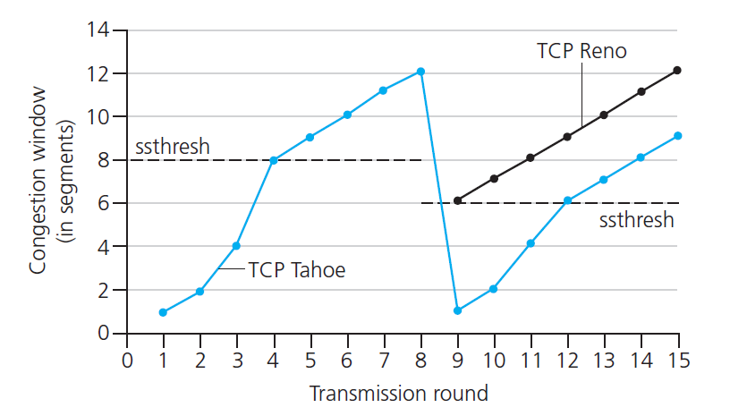
TCP Congestion Control
TCP: switching from slow start to CA
When should the exponential increase switch to linear?
When TCP sender congestion window size gets to ½ of its value before timeout.

Slide 15
TCP Congestion Control
TCP fairness
If K TCP sessions share same bottleneck link of bandwidth R, each should have rate of R/K
Fairness, parallel TCP connections
Applicaiton can open multiple parallel connections between two hosts

Slide 16
TCP Congestion Control
Fairness and UDP
Multimedia applicaitons often do not use TCP
Do not want rate throttled by congestion control
Instead use UDP
Send audio/video at constant rate, tolerate packet loss

