Slide 1
Imperfections in Solids
Types of imperfections
point defects,
line defects (or dislocations),
surface defects.

Slide 2
Significance of Dislocations
Plastic deformation is defined as a irreversible deformation or change in shape that occurs when the force or stress is removed.
Permanent deformation which is caused by dislocation motion.
Elastic deformation is a deformation that is fully recovered when the stress is removed.
Temporary change in the shape
No dislocation motion
Dislocation density is defined as the ratio of the total length of dislocation line and volume of the material.

Slide 3
Significance of Dislocations
Slip in Metals
Plastic deformation in metals: Slip plane is defined as sliding of blocks of the crystal over one another along the definite crystallographic plane.
Slip plane is the plane with the greatest atomic density
Slip direction is the closest-packed direction within the slip plane
Slip = Specific direction + Certain planes
Slip system = Slip plane + Slip direction
Limited slip system causes low ductility in the material
Higher stresses are required to cause slip
Slip occurs by dislocation motion in the crystals

Slide 4


Significance of Dislocations
Slip in Single Crystals; Extent of slip depends on:
Geometry of crystal structure
Magnitude of shear stress
Orientation of slip plane
Schimid’s Law
$$σ=\frac{F}{A_{o}}$$
Normal stress
$$φ$$
$$λ$$
$$F_{r}=Fcosλ$$
Normal to
Slip plane
Slip direction
$$τ_{r}=\frac{F_{r}}{A}$$
A
Resolved shear stress
A_{o}
$$τ_{r}=σcosφcosλ$$

Slide 5
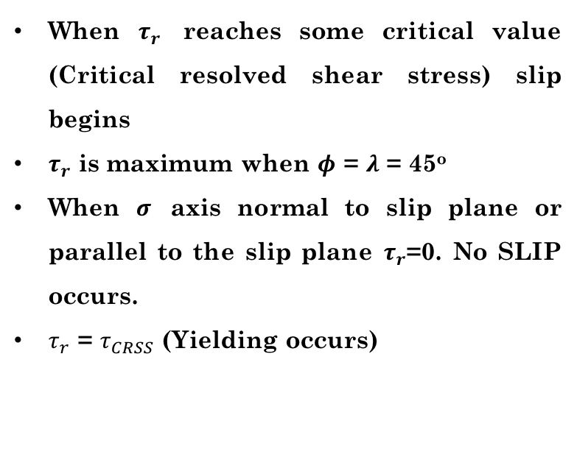
Significance of Dislocations
$$σ=\frac{F}{A_{o}}$$
Normal stress
When $τ_{r}$ reaches some critical value (Critical resolved shear stress) slip begins
$τ_{r}$ is maximum when $φ$ = $λ$ = 45º
When $σ$ axis normal to slip plane or parallel to the slip plane $τ_{r}$=0. No SLIP occurs.
$τ_{r}$ = $τ_{CRSS}$ (Yielding occurs)
$$φ$$
$$λ$$
$$F_{r}=Fcosλ$$
Normal to
Slip plane
Slip direction
$$τ_{r}=\frac{F_{r}}{A}$$
A
Resolved shear stress
A_{o}

Slide 6
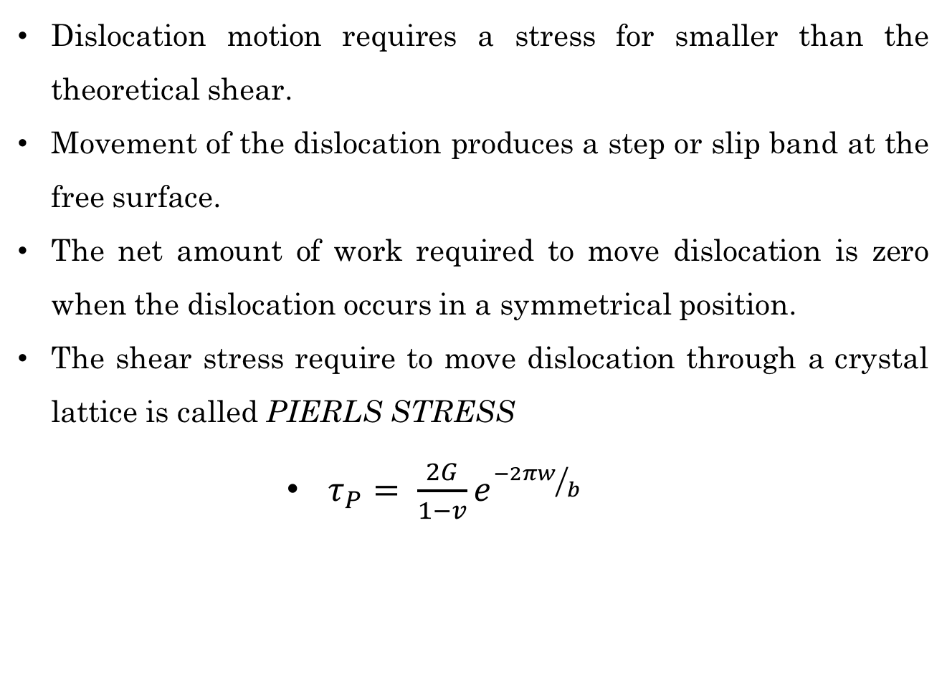
Slip by Dislocation Motion
Dislocation motion requires a stress for smaller than the theoretical shear.
Movement of the dislocation produces a step or slip band at the free surface.
The net amount of work required to move dislocation is zero when the dislocation occurs in a symmetrical position.
The shear stress require to move dislocation through a crystal lattice is called PIERLS STRESS
$τ_{P}= \frac{2G}{1−v}e^{{−2πw}/b}$
a (distance between slip planes)
w

Slide 7
Slip by Dislocation Motion
A screw dislocation may move by slip or glide any direction perpendicular to itself, but edge dislocation can only glide in its slip plane.
Climb of edge dislocation involve motion in a direction perpendicular to slip plane.
Edge Dislocation
Screw Dislocation
b
b

Slide 8
Surface Defects
Boundaries or planes separate a material into regions
Same crystal structure with different orientation
MATERIAL SURFACES
disruption in atomic stacking
minimization of surface areas decreases the surface energy of the system
GRAIN BOUNDARIES
A grain boundary is a highly defective, relatively open region where impurities prone to segregate.

Slide 9
Importance of Defects
Defects have a importance in affecting the materials properties (mechanical, electrical, optical and magnetic).
Effect on Mechanical Properties by Controlling the Slip Process
Strain Hardening
Annealing
Solid-Solution Strengthening
Introducing substitutional or interstitial atoms
Grain-Size Strengthening
Second phase strengthening
Precipitation strengthening

Slide 10
References
Donald R. Askeland, Pradeep P. Fulay, Wendelin J. Wright, The Science and Engineering of Materials, Sixth Edition
William D. Callister, David G. Rethwisch, Materials Science and Engineering, Eighth Edition, Wiley, 2011.

