Slide 1
Periodic Table II

Slide 2
Quantum Numbers
All atoms can be described by four numbers, called quantum numbers.
Quantum numbers are set by mathematical study of wave characters of electrons.
There are four quantum numbers (n, l, m, m_{s}) that describe an orbital are integers.

Slide 3
Quantum numbers
Principal quantum number (n)
Orbital quantum number (l)
Magnetic quantum number(m_{l})
Spin quantum number (m_{s} )

Slide 4
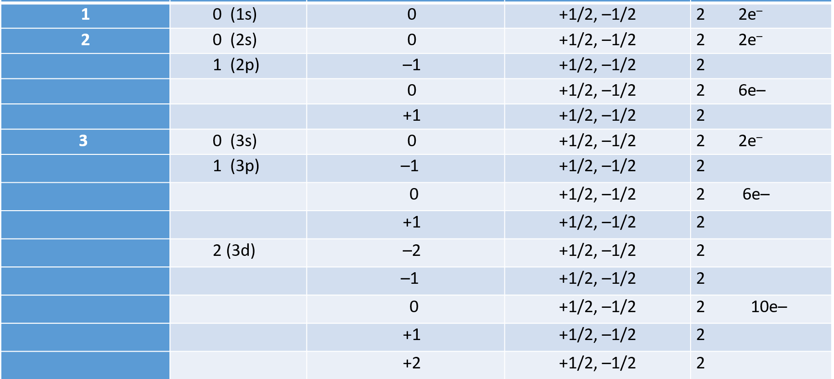
n | l | m l | m s | Electron number

Slide 5
[₁H] = 1s¹
[₂He] = 1s²
[₃Li] = 1s² 2s¹
[₅B] = 1s² 2s² 2p¹
[₆C] = 1s² 2s² 2p²
[₉F] = 1s² 2s² 2p⁵
[₁₀Ne] = 1s² 2s² 2p⁶
[₁₁Na] = [Ne] 3s¹
[₁₂Mg] = [Ne] 3s²
[₁₃Al] = [Ne] 3s² 3p¹
[₁₄Si] = [Ne] 3s² 3p²
[₁₈Ar] = [Ne] 3s² 3p⁶
[₁₉K] = [Ar] 4s¹
[₂₀Ca] = [Ar] 4s²

Slide 6
[₂₁Sc] = [Ar] 4s² 3d¹
[₂₃V] = [Ar] 4s² 3d³
[₂₄Cr] = [Ar] 4s¹ 3d⁵
[₂₅Mn] = [Ar] 4s² 3d⁵
[₂₆ Fe] = [Ar] 4s² 3d⁶
[₂₈ Ni] = [Ar] 4s² 3d⁸
[₃₁Ga] = [Ar] 4s² 3d¹⁰ 4p¹
[₃₂Ge] = [Ar] 4s² 3d¹⁰ 4p²
[₃₆Kr] = [Ar] 4s² 3d¹⁰ 4p⁶
[₃₇Rb] = [Kr] 5s¹
[₃₈Sr] = [Kr] 5s²

Slide 7
Actinids
[₉₀Th] = [Rn] 6d² 7s²
[₉₁Pa] = [Rn] 5f² 6d¹ 7s²
[₉₂U] = [Rn] 5f³ 6d¹ 7s²
[₉₄Pu] = [Rn] 5f⁶ 7s²
[₉₅Am] = [Rn] 5f⁷ 7s²
[₉₆Cm] = [Rn] 5f⁷ 6d¹ 7s²
[₉₇Bk] = [Rn] 5f⁹ 7s²
[₉₈Cf] = [Rn] 5f¹⁰ 7s²
[₁₀₂No] = [Rn] 5f¹⁴ 7s²
[₁₀₃Lr] = [Rn] 5f¹⁴ 6d¹ 7s²
[₁₀₄Rf] = [Rn] 5f¹⁴ 6d² 7s²

Slide 8
Noble gases
[₂He] = 1s²
[₁₀Ne] = [He] 2s² 2p⁶
[₁₈Ar] = [Ne] 3s² 3p⁶
[₃₆Kr] = [Ar] 3d¹⁰ 4s² 4p⁶
[₅₄Xe] = [Kr] 4d¹⁰ 5s² 5p⁶
[₈₆Rn] = [Xe] 4f¹⁴ 5d¹⁰ 6s² 6p⁶

