Slide 1
What’s mastitis ?
Inflammation of one or more quarters of the udder
Normal
Inflamed
Mammae = breast
-itis = Latin suffix for
inflammation
Swelling
pain
warm
redness

Slide 2
What’s the significance of bovine mastitis ?
Causes significant economic losses to the dairy industry
The most costly disease affecting dairy dairy cattle throughout the world

Slide 3
What are the health concerns of mastitis ?
Animal health
Loss of functional quarter
Lowered milk production
Death of cow
Human health
Poor quality milk
antibiotic residues in milk

Slide 4
How severe can mastitis be ?
Subclinical Mastitis
~ 90 -95% of all mastitis cases
Udder appears normal
Milk appears normal
Elevated SCC (score 3-5)
Lowered milk output (~ 10%)
Longer duration
Clinical Mastitis
~ 5 - 10% of all mastitis cases
Inflamed udder
Clumps and clots in milk
Acute type
major type of clinical mastitis
bad milk
loss of appetite
depression
prompt attention needed
Chronic type
bad milk
cow appears healthy

Slide 5
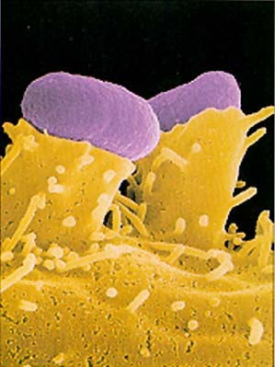
What causes mastitis ?
Bacteria ( ~ 70%)
Yeasts and molds ( ~ 2%)
Unknown ( ~ 28%)
physical
trauma
weather extremes

Slide 6
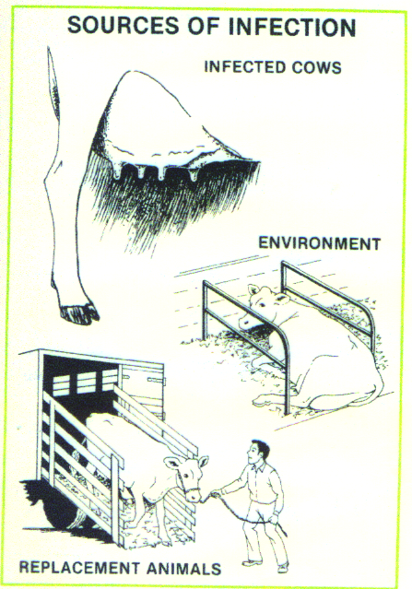
Where do these organisms come from ?
Infected udder
Environment
bedding
soil
water
manure
Replacement animals

Slide 7
BACTERIA Streptococci
Field
language
Environmental
S. uberis
S. dysgalactiae
S. equinus
More subclinical mastitis
Environment
Predominant early and late lactation
Contagious
S. agalactiae
Clinical mastitis
Cannot live outside the udder
Treated easily with penicillin
“Streps”
“Environmentals”
“Environmental
Strep”

Slide 8
BACTERIA Staphylococci
Staph. aureus
Summer mastitis
Spread by milking equipment and milker’s hands
Persistent, difficult to eliminate
If unattended leads to chronic mastitis
Other Staph
Found normally on skin
Lowers milk yield
Elevated SCC
Easily responds to antibiotics
Relapse frequently seen
Field
language
“Staph”
“Staph.
Mastitis”

Slide 9
BACTERIA Coliforms
Groups of organisms
E. coli, Klebsiella, Enterobacter
Environmental source (manure, bedding, barns, floors and cows)
Coliforms cause acute clinical mastitis
high temp, and inflamed quarter
watery milk with clots and pus
toxemia
J-5 vaccine

Slide 10
Other organisms
Pseudomonas aeruginosa
outbreaks of clinical mastitis
Serratia
outbreaks of clinical mastitis
Corynebacterium pyogenes
Fungi
Candida
Mycoplasma bovis

Slide 11
How does mastitis develop ?
Cow
Predisposing conditions
Existing trauma (milking machine, heat or cold, injury)
Teat end injury
Lowered immunity (following calving, surgery)
Nutrition
Organisms
Environment
Organism
Cow
Environment

Slide 12
Process of infection
Organisms invade the udder through
teat canal
Migrate up the teat canal and colonize the
secretory cells
Colonized organisms produce toxic substances
harmful to the milk producing cells

Slide 13
The cow’s immune system send white blood cells (Somatic cells) to fight the organisms
recovery
clinical
subclinical

Slide 14
How is mastitis diagnosed ?
Physical examination
Signs of inflammation
Empty udder
Differences in firmness
Unbalanced quarters
Cowside tests
California Mastitis test

Slide 15
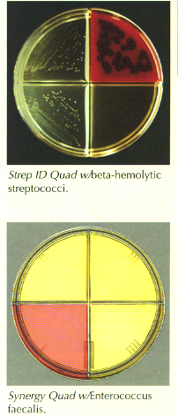
How is mastitis diagnosed ?
Culture analysis
The most reliable and accurate method
costly ($ 5- 12)

Slide 16
How do you treat mastitis ?
Clinical mastitis
Strip quarter every 2 hours
Oxytocin valuable
high temp, give aspirin
Seek veterinary assistance
Treatment with penicillins
Subclinical mastitis
Questionable
Attitude adjustment !!!!!!
Don’t expect SCC to go down ASAP (4-5 weeks !)
Discard milk from treated cows (double jeopardy !)

Slide 17
THE 10 STEPS TO MASTITIS CONTROL
ONE: Prepare cows properly for milking
Udder preparation is pre-dipping with a dip labeled for pre-dipping.Pre-dips lower the risk of new infections by 70% !!!!!!!!!!!!!!!!
Pre-dips
Iodophors 0.0 -1.0 %
Chlorhexidine 0.2%
Quats 0.5%
LDBSA 0.2%
Hypochlorous acid
Bleach ?
Use single service paper towels, dry teats before machine-application.

Slide 18
TWO: Have a good milking system
Milking equipment should be adequate in size, functioning properly, and regularly cleaned and maintained
Correctly use proper functioning milking machines and properly prepare udders
Attach teat cups after thorough cleaning and drying of teats
Provide stable vacuum
Check for slipping of teat cup liners
Shut of vacuum before removing teat cups.

Slide 19
THREE: Apply and remove machine carefully
Properly adjust to prevent liner slippage.
Remove machine when cow is milked out, shut off vacuum at claw before removal.
FOUR: Dip each teat after each milking using a germicidal teat dip.
Post-dips seal the teat ends temporarily for 6 to 8 hours
A must for long term mastitis control program
FIVE: Monitor your mastitis score (DHI-SCC, WMT) regularly. Take action when significant increases occur.

Slide 20
SIX: Treat clinical cows, follow label recommendations, treat aseptically. Withhold treated cows' milk from milk supply.
SEVEN: Segregate chronic mastitis cows, milk them last, cull when necessary.
cows with chronic mastitis serve as reservoirs of organisms and could infect susceptible cows
EIGHT: Dry treat each quarter using partial insertion techniques with an approved dry cow treatment at drying off.
Cure rate is twice high as that during lactation
Lowers the risk of clinical and subclinical mastitis during subsequent lactation

Slide 21
NINE: Keep cows clean, udders free from soil and manure.
Fence off wet, swampy areas.
Keep free stalls and stanchions bedded properly.
Keep calving areas clean, properly bedded (straw preferred).
TEN: Properly feed and care for cows.

Slide 22
Summary
Mastitis is primarily a management problem
Mastitis can be controlled
Prevention programs work best when correctly followed

Slide 23
Milking Procedures for Quality Milk

Slide 24
Milking Procedures for Quality Milk
PREREQUISITES
Maintain clean, well ventilated bedded areas for cows
Segregate known infected cows. Milk them last or with designated equipment
CMT all fresh cows by the 6th milking
Milk all treated cows last
Change rubber inflations every 60 days or 1000 cow milkings whichever comes first

Slide 25
PREREQUISITES
Check the milking systems or units periodically for function and reliability
Clip or singe the udder hair
Examine periodically teats and teat ends
Mastitis treatments should be done by one or two persons and should be done after milking
Cloth towels should be washed after every use

Slide 26
Simple Steps “Two trips to each cow will provide a routine to Maxmize Milk Quality and Parlor Performance”…. Dr. Andy Johnson Step One………Strip and Predip Step Two………Dry and Apply

Slide 27
Standardized Milking Procedures
Stanchion / Tiestall
Wear Gloves
Wipe off excess dry manure, straw and bedding
Strip each teat into a stripcup
Dip teats with an approved pre-dip
Allow the pre-dip to react for at least 30 sec.
Parlor
Wear Gloves
Wipe off excess dry manure, straw and bedding
Strip each teat into a stripcup
Dip teats with an approved pre-dip
Dip 3-4 cows
Allow the pre-dip to react for at least 30 sec.

Slide 28
Stanchion/ Tiestall
Clean teat and teat ends using single paper towel or individual towel cloth
The teats must be dried for at least 15 sec
Attach milking machines immediately after teats are dried
Dip teats with post-dip immediately after milking
Parlor
Return to the first cow and clean teat and teat ends using a single paper towel or individual towel cloth
The teats must be dried for at least 15 sec
Attach milking machines immediately after teats are dried
Dip teats with post-dip immediately after milking
EACH STEP IS A CRITICAL POINT !!!!!!!

Slide 29
HACCP-based concepts for implementing proper milking procedures in Pennsylvania

Slide 30
Steps involved in employing HACCP-based concepts for establishing proper milking procedures
STEP ONE
Educate owners and milkers about implementing a standardized milking procedure (Benefits !!!!!!)
IF a dairy farm initiates and shows sustained interest
Establish ground rules
They will have to be proactive and adopt changes
TEAM EFFORT !!!

Slide 31
STEP TWO
Establish a team ( owner, milkers, veterinarian, facilitator)
Mission statement
Goals and timeline
Written Procedures
Protocols
Critical Limits ( SCC > 250,000)
Recording Keeping
Milking time/milking
Bulk Tank Temp; end of 1 hr of milking
Sanitation
Schedule team meetings to review the process

Slide 32
STEP THREE
Train milkers and owners in implementing the standardized milking procedure
STEP FOUR
Monitor the application of the standardized milking procedure
Floor tests (each step is a critical point !)
Laboratory tests (SPC or BTSCC)
Monitor records
STEP FIVE
Establish corrective actions to be implemented if milk quality critical limits have exceeded.

