Slide 1
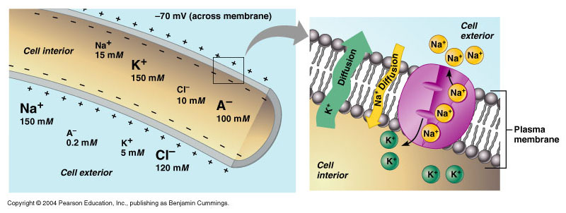
ACTION POTENTIALS WEEK 5
Dr. Etkin ŞAFAK

Slide 2
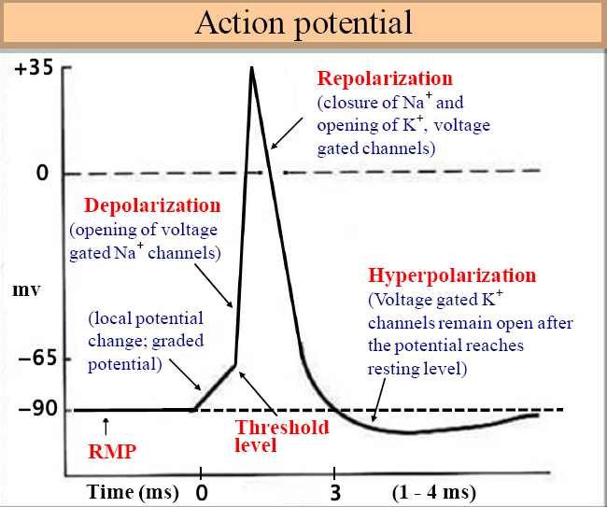
Threshold Potential
Action potentials occur only when the net movement of positive charge through ion channels is inward.
The membrane potential at which this occurs is called the threshold potential,
Stimuli that are just strong enough to depolarize the membrane to this level are threshold stimuli
The threshold of most excitable membranes is about 15 mV less negative than the resting membrane potential.
Thus, if the resting potential of a neuron is 70 mV, the threshold potential may be 55 mV.

Slide 3
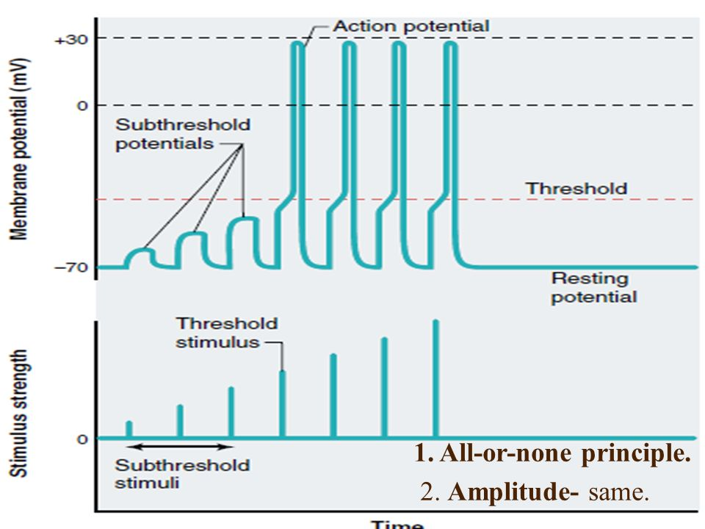
Threshold Potential
At depolarizations less than threshold, outward potassium movement still exceeds sodium entry, and the positive-feedback cycle cannot get started despite the increase in sodium entry.
In such cases, the membrane will return to its resting level as soon as the stimulus is removed, and no action potential is generated.
These weak depolarizations are subthreshold potentials, and the stimuli that cause them are subthreshold stimuli.

Slide 4
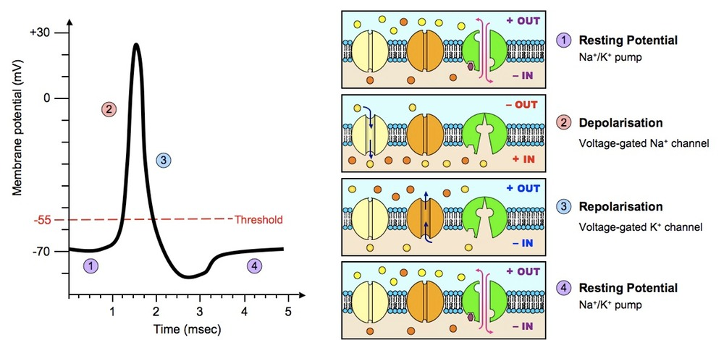
All–or-none
Stimuli of more than threshold magnitude also elicit action potentials,
The action potentials resulting from such stimuli have exactly the same amplitude as those caused by threshold stimuli.
This is because once threshold is reached, membrane events are no longer dependent upon stimulus strength.
Rather, the depolarization generates an action potential because the positive-feedback cycle is operating.
Action potentials either occur maximally or they do not occur at all.
Another way of saying this is that action potentials are all-or-none.

Slide 5
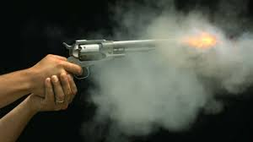
All - or-none
The firing of a gun is a mechanical analogy that shows the principle of all-or-none behavior.
The magnitude of the explosion and the velocity at which the bullet leaves the gun do not depend on how hard the trigger is squeezed.
Either the trigger is pulled hard enough to fire the gun, or it is not; the gun cannot be fired halfway

Slide 6
All –or-none
How does one distinguish between a loud noise and a whisper, a light touch and a pinch?
This information depends upon the number and pattern of action potentials transmitted per unit of time and not upon their magnitude.

Slide 7
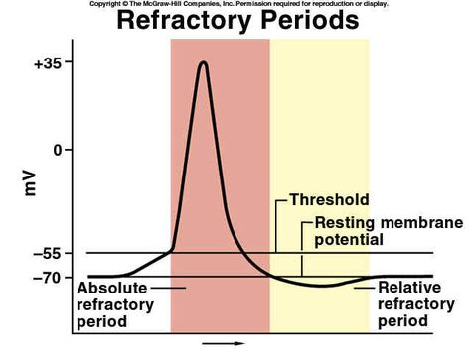
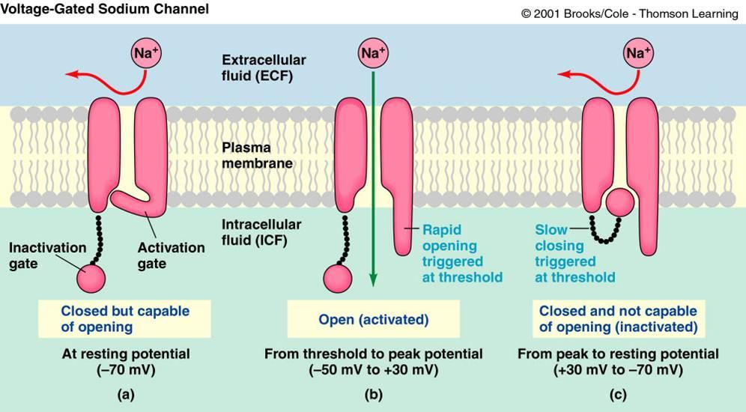
ABSOLUTE Refractory Period
During the action potential, the membrane is said to be in its absolute refractory period.
A second stimulus, no matter how strong, will not produce a second action potential
This occurs because the voltage-gated sodium channels enter a closed, inactive state at the peak of the action potential.
The membrane must repolarize before the sodium channel proteins return to the state in which they can be opened again by depolarization.

Slide 8
RELATIVE Refractory Period
Following the absolute refractory period, there is an interval during which a second action potential can be produced, but only if the stimulus strength is considerably greater than usual.
This is the relative refractory period, which can last 10 to 15 ms or longer in neurons
It coincides roughly with the period of after hyperpolarization.
During the relative refractory period, there is lingering inactivation of the voltage-gated sodium channels, and an increased number of potassium channels are open.
If a depolarization exceeds the increased threshold or outlasts the relative refractory period, additional action potentials will be fired.

Slide 9
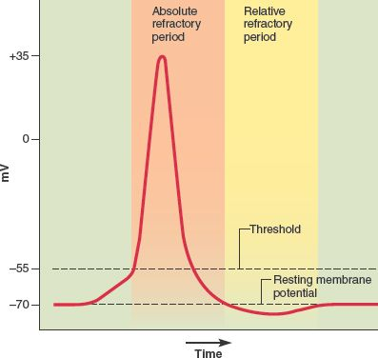
Functions of Refractory period
The refractory periods limit the number of action potentials that can be produced by an excitable membrane in a given period of time.
They also increase the reliability of neural signaling because they help limit extra impulses.
The refractory periods are key in determining the direction of action potential propagation.

Slide 10
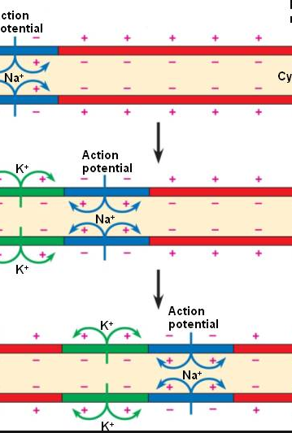
Action-Potential Propagation
There is a sequential opening and closing of sodium and potassium channels along the membrane.
The action potential doesn’t move but “sets off” a new action potential in the region of the axon just ahead of it.
Because the membrane areas that have just undergone an action potential are refractory and cannot immediately undergo another, the only direction of action potential propagation is away from a region of membrane that has recently been active

Slide 11
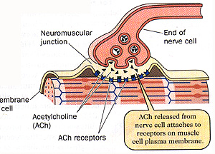
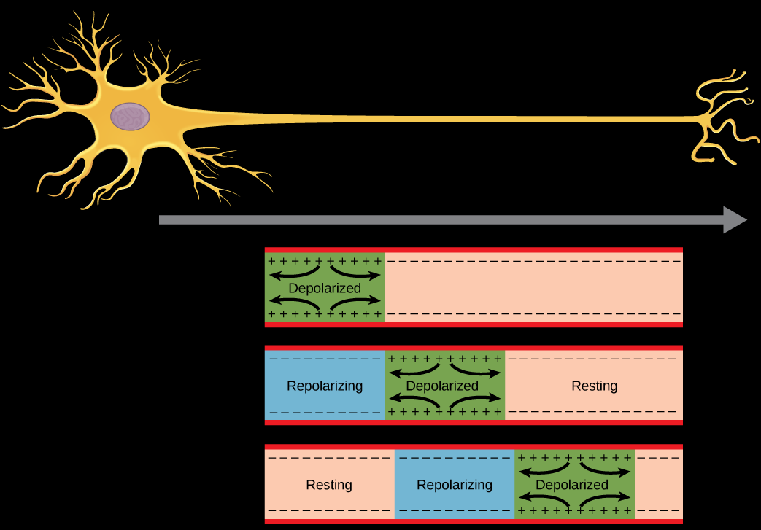
Action-Potential Propagation
The direction of propagation being determined by the stimulus location.
For example, the action potentials in skeletal-muscle cells are initiated near the middle of these cylindrical cells and propagate toward the two ends.
In most nerve cells, however, action potentials are initiated physiologically at one end of the cell (for reasons to be described in the next section) and propagate toward the other end

Slide 12
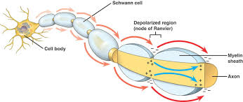
Action-Potential Propagation
The velocity with which an action potential propagates along a membrane depends upon fiber diameter and whether or not the fiber is myelinated.
The larger the fiber diameter, the faster the action potential propagates.
WHY?
A large fiber offers less resistance to local current; more ions will flow in a given time, bringing adjacent regions of the membrane to threshold faster.

Slide 13
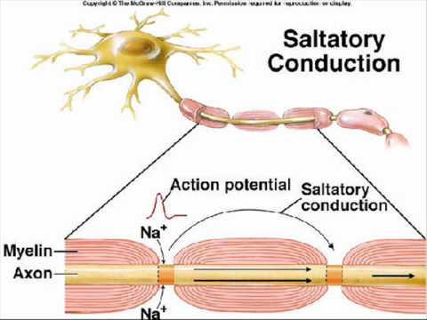
Action-Potential Propagation
Myelin is an insulator that makes it more difficult for charge to flow between intracellular and extracellular fluid compartments.
There is less “leakage” of charge across the myelin
The concentration of voltage-gated sodium channels in the myelinated region of axons is low
Therefore, action potentials occur only at the nodes of Ranvier where the myelin coating is interrupted and the concentration of voltage-gated sodium channels is high.
Action potentials literally jump from one node to the next as they propagate along a myelinated fiber, and for this reason such propagation is called saltatory conduction

Slide 14
Any questions?

