Slide 1
Yapay Zeka 802600715151
Doç. Dr. Mehmet Serdar GÜZEL
Slides are mainly adapted from the following course page:
at http://ai.berkeley.edu created by Dan Klein and Pieter Abbeel for CS188

Slide 2
Lecturer
Instructor: Assoc. Prof Dr. Mehmet S Güzel
Office hours: Tuesday, 1:30-2:30pm
Open door policy – don’t hesitate to stop by!
Watch the course website
Assignments, lab tutorials, lecture notes

Slide 3
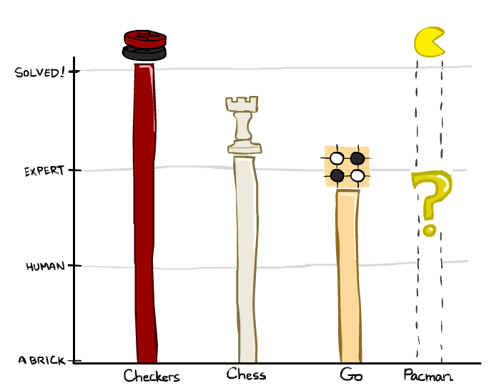
Game Playing State-of-the-Art
Checkers: 1950: First computer player. 1994: First computer champion: Chinook ended 40-year-reign of human champion Marion Tinsley using complete 8-piece endgame. 2007: Checkers solved!
Chess: 1997: Deep Blue defeats human champion Gary Kasparov in a six-game match. Deep Blue examined 200M positions per second, used very sophisticated evaluation and undisclosed methods for extending some lines of search up to 40 ply. Current programs are even better, if less historic.
Go: Human champions are now starting to be challenged by machines, though the best humans still beat the best machines. In go, b > 300! Classic programs use pattern knowledge bases, but big recent advances use Monte Carlo (randomized) expansion methods.
Pacman

Slide 4
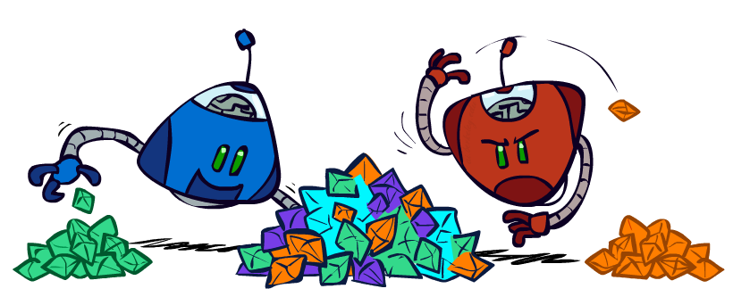
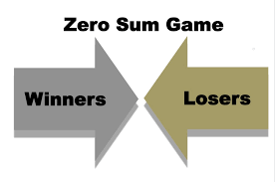
Zero-Sum Games
Zero-Sum Games
Agents have opposite utilities (values on outcomes)
Lets us think of a single value that one maximizes and the other minimizes
Adversarial, pure competition
General Games
Agents have independent utilities (values on outcomes)
Cooperation, indifference, competition, and more are all possible
More later on non-zero-sum games

Slide 5
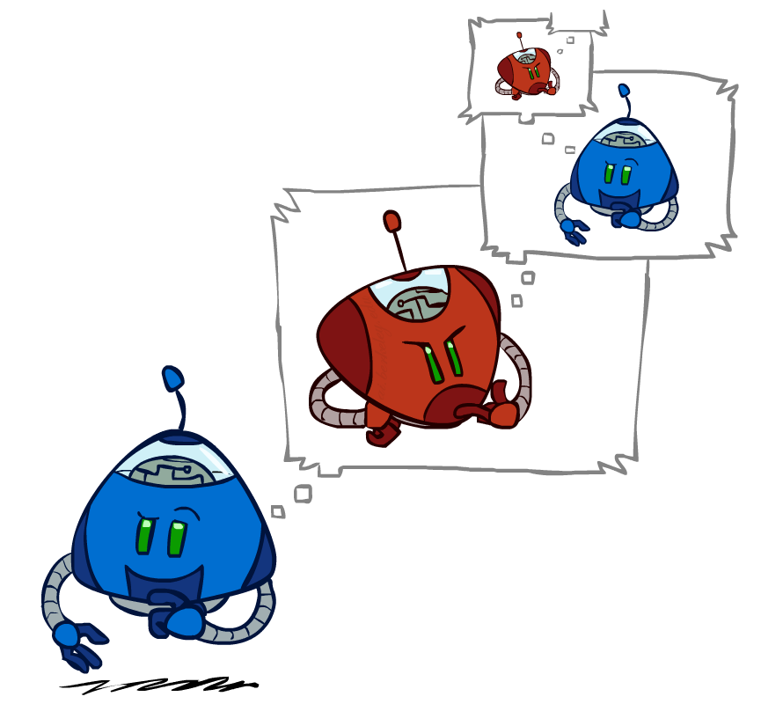
Adversarial Search

Slide 6
Single-Agent Trees
8
2
0
…
2
6
…
4
6

Slide 7
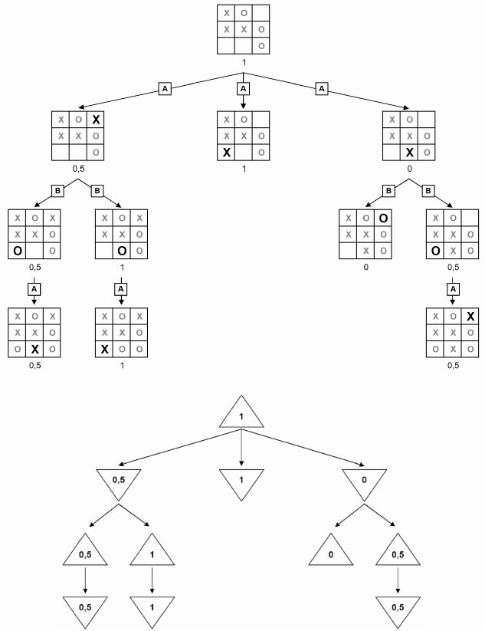
Tic-Tac-Toe Game Tree

Slide 8
Adversarial Search (Minimax)
Deterministic, zero-sum games:
Tic-tac-toe, chess, checkers
One player maximizes result
The other minimizes result
Minimax search:
A state-space search tree
Players alternate turns
Compute each node’s minimax value: the best achievable utility against a rational (optimal) adversary
Minimax values: computed recursively
5
max
2
5
min
8
2
5
6
Terminal values: part of the game

Slide 9
Minimax Implementation
def max-value(state):
initialize v = -∞
for each successor of state:
v = max(v, min-value(successor))
return v
def min-value(state):
initialize v = +∞
for each successor of state:
v = min(v, max-value(successor))
return v

Slide 10
Minimax Implementation (Dispatch)
def value(state):
if the state is a terminal state: return the state’s utility
if the next agent is MAX: return max-value(state)
if the next agent is MIN: return min-value(state)
def max-value(state):
initialize v = -∞
for each successor of state:
v = max(v, value(successor))
return v
def min-value(state):
initialize v = +∞
for each successor of state:
v = min(v, value(successor))
return v
Notes:
Pick an order for two reasons: sequential processor and pruning

Slide 11
Minimax Example
30
120
80
20
40
60
140
50
20

Slide 12
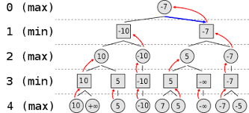
Minimax Efficiency
How efficient is minimax?
Time: O(b^{n})
Space: O(bn)
Example: For chess, b ≈ 35, m ≈ 100
Exact solution is completely inefficient
But, do we need to explore the complete tree?

