Slide 1
Crime and Social Policy
Dr. Boran A. Mercan

Slide 2
Policing, Prison and Imprisonment
what it is that the police do?
the issues of policing
Ensuring social order and the role of police
Governmentality

Slide 3
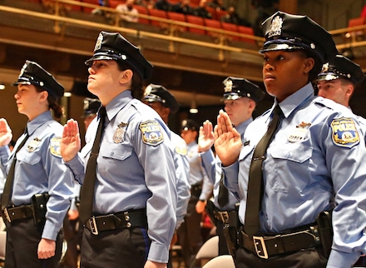
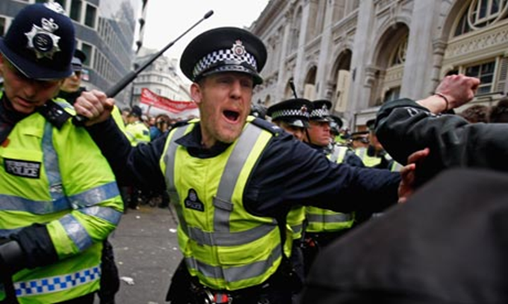
Is the police only revealing crime and detecting criminals?

Slide 4
Police officers, according to the mainstream approach, keeping the ‘peace officer’,
This means the police is not directly to do with keeping the ‘law’, so empirically spending less time enforcing the law than otherwise might be.
The functional definitions of police work come on the agenda of criminology.
The maintenance of order is an actual concern.

Slide 5
What do the Police do?
The security of person and property, the preservation of the public tranquillity, and all other objects of a police establishment will thus be better effected than by the detection and punishment of the offender after he has succeeded in committing the crime. This should be constantly kept in mind by every member of the police force, as the guide for his own conduct. Officers and police constables should endeavour to distinguish themselves by such vigilance and activity as may render it impossible for any one to commit a crime within that portion of the town under their charge (The Metropolitan Police’s first instruction book)

Slide 6
We need to return back to Michel Foucault…
Security, Territory and Population, Lectures at the Collège de France between 1977 and 1978

Slide 7
Police is the apparatus (technological assemblage) that makes reason of state function – “the set of means by which the state’s forces can be increased while preserving the state in good order.”
(Foucault, Security, Territory, Population)

Slide 8
Police is the “laws and regulations that concern the interior of a state and which endeavour to strengthen and increase the power of this state and make good use of its forces.”
(J.H.G. von Justi, Éléments généraux de police)

Slide 9
Population size (relative to territory, resource, economy)
Provision of the necessities of life (food, clothing, shelter, etc.)
Provision of health (epidemics and everyday health)
Regulation of activity (prevention of idleness, regulation of professions, etc.)
Circulation of things and people

Slide 10
Fabrication of Order
Born of security apparatuses
Right-hand of the state
Governmentality and policing

Slide 11
Neocleus (2000):
Police Begets Good Order’
Mastering the masterless; imposing order
Mastering the market, imposing work and policing the poor
The means of regulation and surveillance of the working-class
Social police

Slide 12
Neocleus (2000)
Ordering Insecurity:
The fabrication of wage labour
Social classes, criminals and relief recipients
19th Poor Law
Medical police
Towards the legal reconstruction of policing practices

Slide 13
Modern policing: How modern? And What is modern?
Plural policing (Loader, 2000)
Not the matter of the state, but the democratic regulation of social control
an attempt to critique policing by searching a democratic ‘public good’ in and through governance,
We’re in the age of neo-liberal order and security

Slide 15
Segregation and unification techniques at work
New categories of risk and dangerous population
Hyper-ghettos containing massive African-American most precarious section of the working-class; Black-belt
Even in Europe, the zero-tolerance policy being transferred from the US
France Red-belt
Deproleterianisation, workfare, prisonfare, spatial relegation, the deterioration and demarcation of symbolic collective hope to survive....
L.J. Wacquant: Urban Outcasts (2008) and Punishing the Poor (2009)

Slide 16
Discipline and Punish: Prison

Slide 17
The emergence of the prison as the modern system of punishment
Discipline and Punish: The Birth of the Prison(Foucault, 1977)
The idea of Panopticon
Regulation of bodies and internalisation of surveillance

Slide 18
D&P focuses on the language through which we know and make sense of the world (archaeology) and reveals the role of power that changes it (genealogy).
D&P presents a history of the present (Nietzsche)
The aim of such a history is to understand and evaluate present rules, practices and institutions like prison.
Foucault helps us dislocate the notion of historical progress and civilisation – the transition from vengeance to rehabilitation or more medical forms

Slide 19
A historical transformation from torture to detention
Torture was the main form of punishment
Painful the interrogation and public torture (Robert Damiens in D&P)
Principles of Utility (Bentham)
Three elements appear in the logic of torture:
the infliction of a measured amount of pain;
the regulation of that pain;
and the ritualistic character of the application of techniques producing pain
What is the rationale of this punishment?:
- the king, as the sovereign body,
- He uses sovereignty

Slide 20
the18th century humanism:
a group of reformers sought to change the form and content of punishment
Penalties to be regulated, proportioned and even abolished wherever they go against humanity
New logic of punishment emerged.
Punishment should regain the offender back in society and be corrective to pain inflicted on individuals or society
So punishment must be efficient, effective and humane

Slide 21
“Discipline is basically the mechanism of power through which we come to control the social body in its finest elements, through which we arrive at the very atoms of society, which is to say individuals […] How to oversee someone, how to control their conduct, their behaviour, their aptitudes, how to intensify their performance, multiply their capacities, how to put them in the place where they will be most useful: this is what discipline is, in my sense”
(M. Foucault, ‘The Meshes of Power’, p. 159)

Slide 22
The birth of the prison was the emergence of detention as a preventive form
The prison was the main form of punishment
The punishment in the form of prison both incorporates and contradicts the ideas and aims of humanist reformers
Public torture is no longer important because the aim is to modify behaviour.
A single defined punishment for all crimes instead of arbitrarily matching punishment to crime.

Slide 23
the birth of prison is merely the birth of a disciplinary society
Some dimension of discipline can be identified:
hierarchical observation,
normalising judgment,
Examination
Panopticon by Bentham (1791)
The birth of prison complex with all “carceral agents and institutions: social workers, psychologists, psychiatrists, judges, family doctors, personal counsellors, the legal system, and so forth

Slide 24
how prison policy has changed in recent decades in the West?
- The Anglo-American case
who is incarcerated in prison?
The intersection of social and criminal justice
Assistantial-carceral net (Wacquant, 2009)
Swollen population of inmates
New roles and functions of the prison

Slide 25
Prison functions as a satellite of hyperghettos
Containment of massive wage-labour population
Ethno-racial and socio-economic, multidimensional means of control
Huge numbers of inmate population in the US
Neo-liberal governmental technology to keep deproleterianised population within workfare
The emergence of prisonfare
Social & criminal justice (worfare + prisonfare)

