Slide 1
INDUSTRIAL FIXATION
Catalyst used to combine nitrogen and hydrogen forming ammonia.
High pressure and temperature (600 deg. C).
Ammonia formed is used as a fertilizer.

Slide 2
BIOLOGICAL FIXATION
Atmospheric nitrogen reduced to ammonia in presence of nitrogenase.
Nitrogenase - Biological catalyst found naturally only in certain micro-organisms.
Examples - Symbiotic Rhizobium and Frankia, or the free living Azospirillium and Azotobacter.

Slide 3
TYPES OF ‘NITROGEN FIXATION’
BACTERIA
FREE LIVING BACTERIA
(30%)
SYMBIOTIC RELATIONSHIP BACTERIA
(70%)

Slide 4
FREE LVING BACTERIA
SYMBIOTIC RELATIONSHIP BACTERIA
Present in roots of legume family plants.
Provide ammonia in exchange of carbon.
Present in soil.
Highly specialized in combining atmospheric nitrogen and hydrogen.

Slide 5
FACTORS INHIBITING NITROGEN FIXATION
Edaphic factors
Biotic factors
Climatic factors

Slide 6
EDAPHIC FACTORS
Excessive moisture
Phosphorous deficiency
Soil acidity
Mineral N

Slide 7
Climatic factors
Extreme temperature
Availability of light

Slide 8
Biotic factors
Absence of required Rhizobia species.
Crop competition.
Insects and nematodes.
Excessive defoliation of host plant.

Slide 9
FACTORS ENHANCING NITROGEN FIXATION
Inoculations with proven strains.
Screening for improved microbial and host plant materials.
Introduction of improved cultural practices.

Slide 10
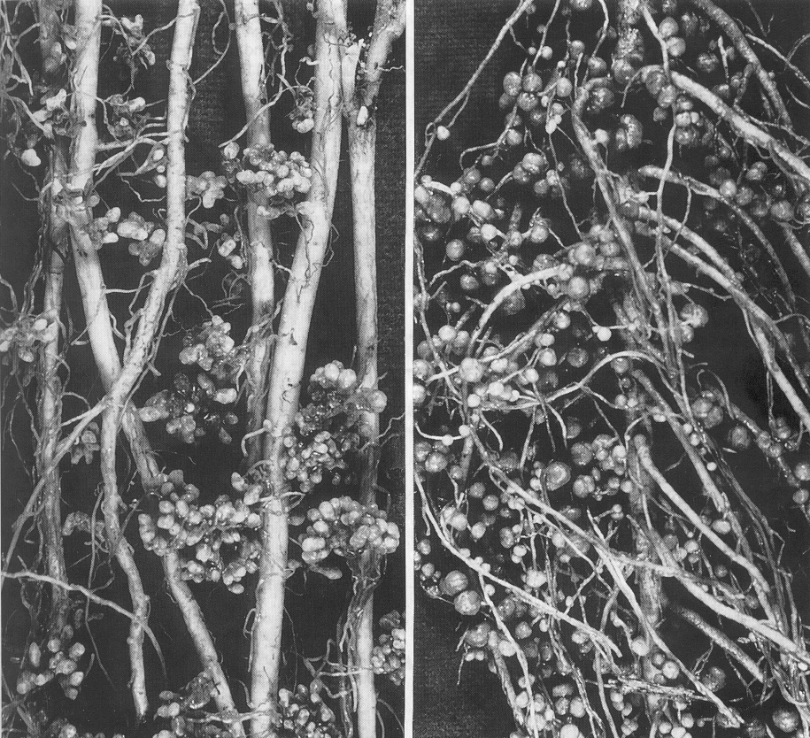
Obvious signs of nodulation by common rhizobial species
MEDICAGO
(alfalfa)
LOTUS
(birdsfoot trefoil)

Slide 11
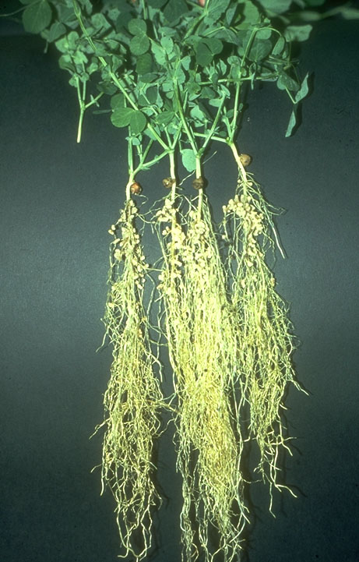
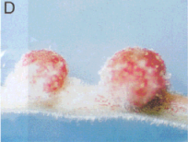
Pea Plant
R. leguminosarum
nodules
Pink color is leghaemoglobin a protein that carries oxygen to the bacteroids

Slide 12
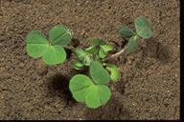
Very early events in the Rhizobium-legume symbiosis
Flavonoids
nod-gene
inducers
rhizosphere
Nod-factor

Slide 13
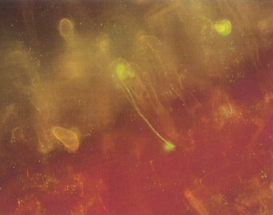
Rhizobium encoding GFP from jellyfish as a marker
Infection thread
(From Quaedvlieg et al. Plant Mol. Biol. 37: 715-727, 1998)

Slide 14
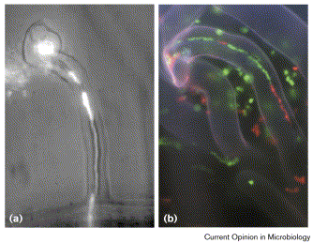
Bacteria divide as they traverse infection thread

Slide 15
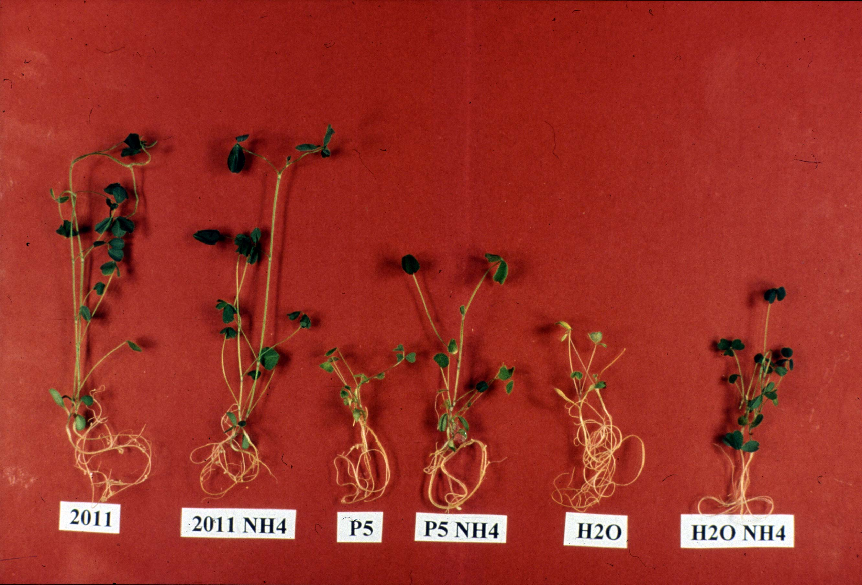
Inoculation of a mutated Sinorhizobium strain does not transfer fixed N to the plant
wild-type
mutant
Genes & Development 11:1194, 1997

Slide 16
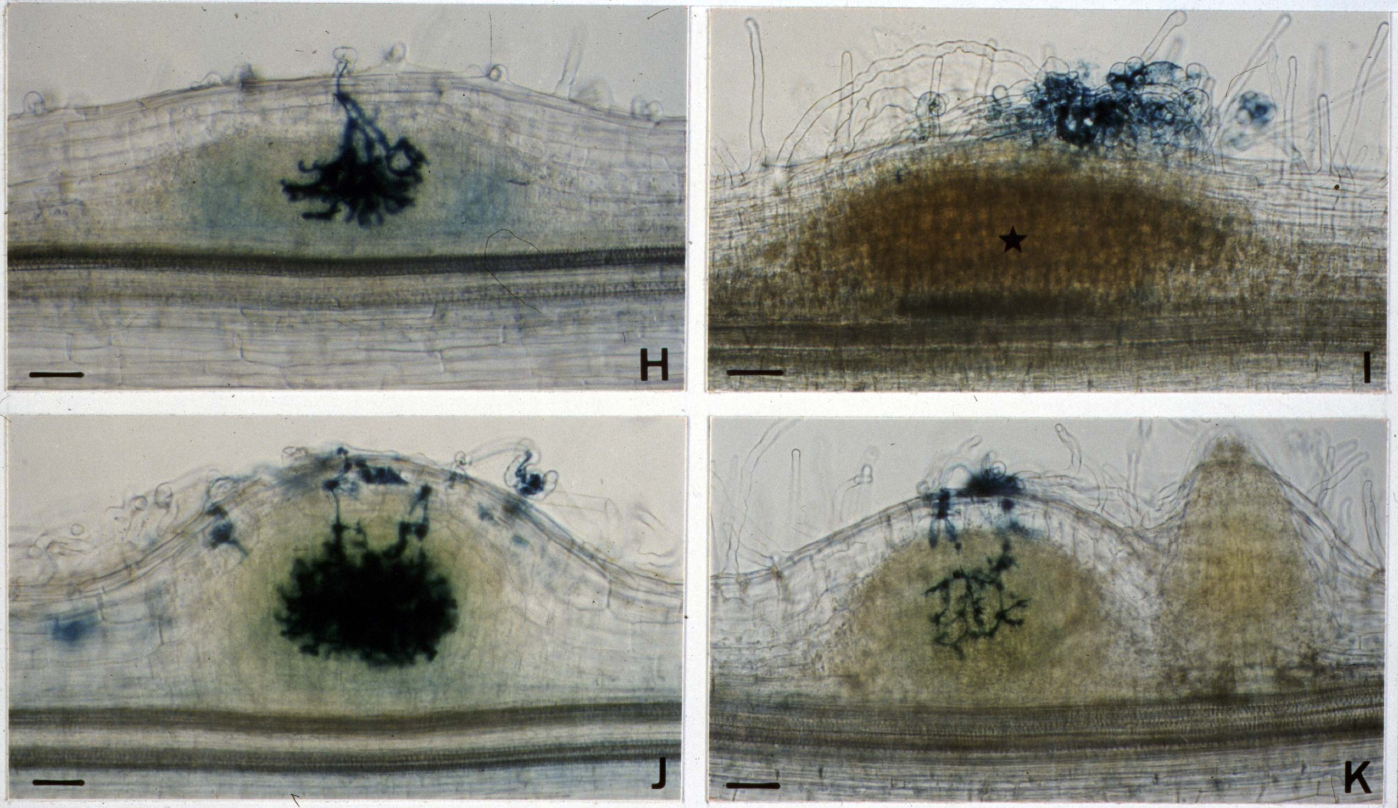
wt
glnBΔ10
6 days
7 days
wt
glnBP5
Genes & Development 11:1194, 1997

Slide 17
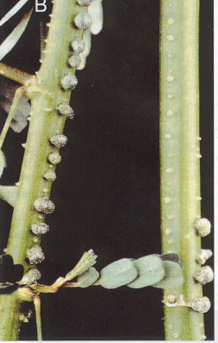
Azorhizobium caulinodans
on
Sesbania

Slide 18
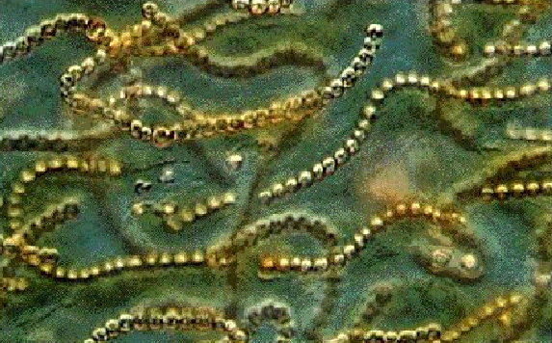
Non-symbiotic nitrogen fixation
Aquatic:
Cyanobacteria
Anabaena
Nostoc
Terrestrial and rhizosphere-associated:
Azospirillum
Azotobacter
Acetobacter
Klebsiella
Clostridium

Slide 19
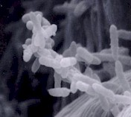
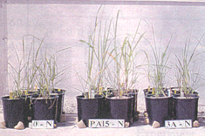
Plant-associated nitrogen fixation: the endophytes and epiphytes
Acetobacter diazotropicus
Lives as an endophyte of sugarcane and various other monocots and some dicots
On sugarcane

Slide 20
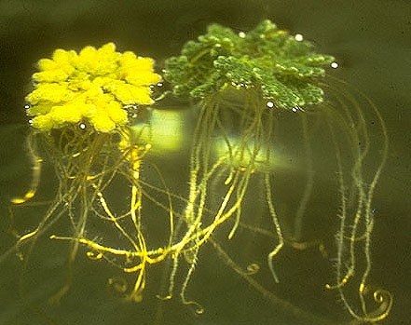
A nitrogen-fixing fern
-Co
+Co
The aquatic fern Azolla is the only fern that can fix nitrogen. It does so by virtue of a symbiotic association with a cyanobacterium (Anabaena azollae).

Slide 21
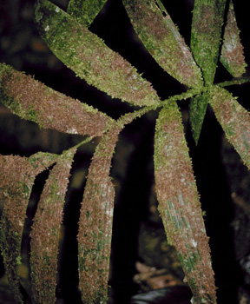
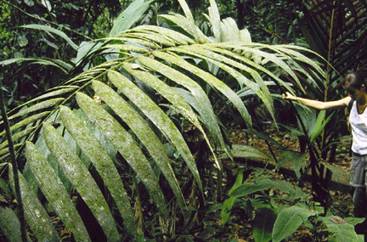
Another cyanobacterium on the palm Welfia regia in an epiphyllic relationship
It is believed that these bacteria transfer some % of fixed N to the plants through the leaf surfaces

Slide 22
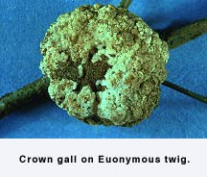
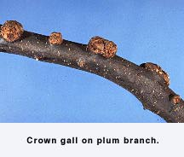
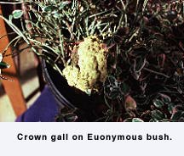
Symptoms of crown gall
http://ohioline.osu.edu/hyg-fact/3000/3054.html

Slide 23
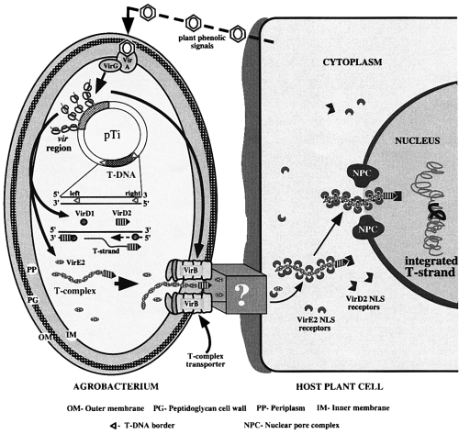
Agrobacterium tumefaciens “transforms” plant cells
Transgenes produce OPINES, unique amino acid-like molecules,
as well as plant hormones

Slide 24
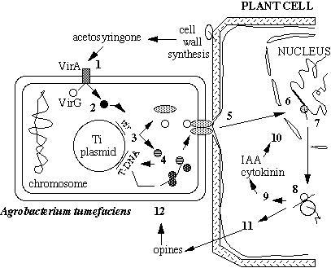
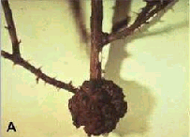
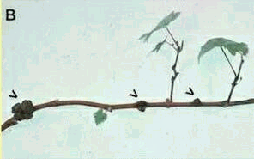
Rhizobium’s bad brother: Agrobacterium tumefaciens
Crown gall on rose
and on grapevine
Opines are an Agrobacterium-specific C- source to feed future generations

