Slide 2
Common Types of Plant Cells - are specialized of cells in structure and function.

Slide 3
Sclerenchyma Cells

Slide 5
Sugar-Conducting Cells of the Phloem

Slide 6
Concept 35.2: Meristems generate cells for new organs

Slide 9
Primary Growth - Lengthens Roots and Shoots

Slide 11
Primary Growth of Shoots - Apical Meristems

Slide 13
Tissue Organization of Leaves

Slide 15
The Vascular Cambium and Secondary Vascular Tissue

Slide 17
The Cork Cambium and the Production of Periderm

Slide 18
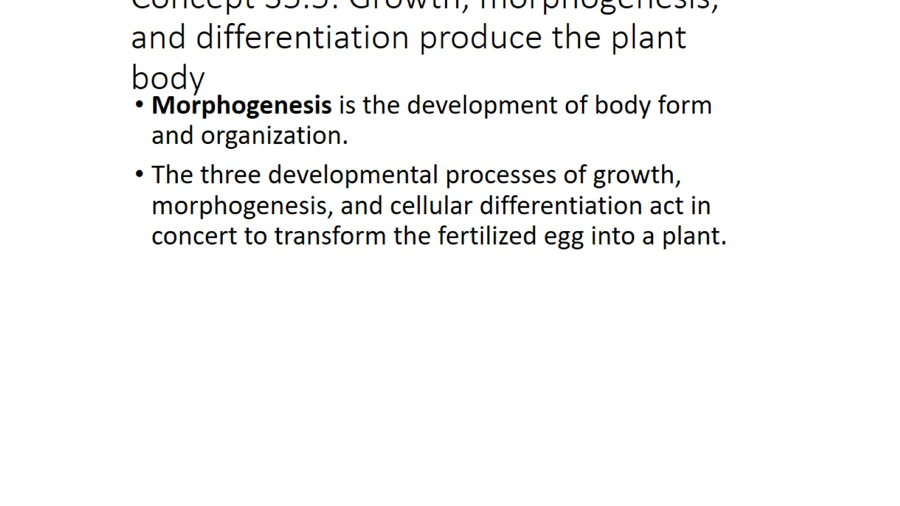
Concept 35.5: Growth, morphogenesis, and differentiation produce the plant body

Slide 19
Growth: Cell Division and Cell Expansion

Slide 20
Orientation of Cell Expansion

Slide 21
Morphogenesis and Pattern Formation

Slide 22
Gene Expression and Control of Cellular Differentiation

Slide 23
Location and a Cell’s Developmental Fate

Slide 24
Genetic Control of Flowering

