Slide 1
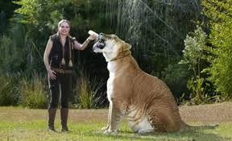
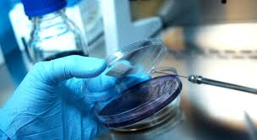
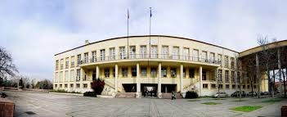
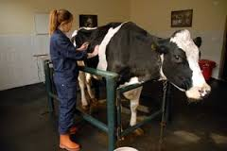
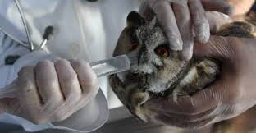
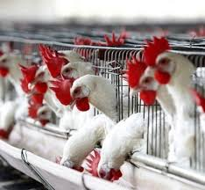
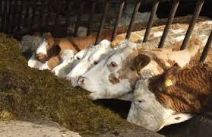
Feed Additives Dr. Özge SIZMAZ University of Ankara Faculty of Veterinary Medicine Department of Animal Nutrition and Nutritional Diseases, Ankara, Turkey

Slide 2
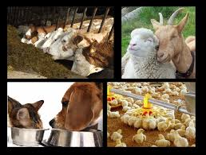
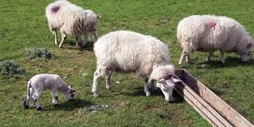
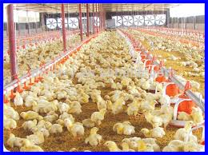
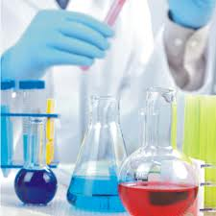
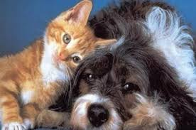
Phytobiotics
Essential oils
They are compounds which are derived from the leaves, flowers, seeds and roots of plants and which are usually in liquid form and have the odor and flavor of their own plants.

Slide 3
Phytobiotics
they have 2 basic structure:
Terpens
Phenylpropen = Phenols

Slide 4
Phytobiotics
they are obtained by:
Distillation
Extraction
Ether extraction
Consumption
Mechanic

Slide 5
Phytobiotics
Essential oils show their effect with the active compounds in their composition.
In Thyme = thymol
In clove = eugenol
In olive leaves = oleuropein
In black seed = thymoquinone
In mint = menthol

Slide 6
Phytobiotics
Antioxidant effects
It can disrupt the initial reactions that create reactive oxygen species (ROS), which is destructive.
They may clear the free oxygen molecules necessary for the initiation of ROS production, which limits adverse cell reactions.
Elements that accelerate oxidative processes such as iron can form chelates by removing the cofactors required for ROS production.

Slide 7
Phytobiotics
Antimicrobial effects
This effect is coming from phenols. Phenols denaturate the proteins of cell wall and increase the permeability of cell wall. When the permeability detoriated, intercellular liquid go out, so the bacteria die.
Antibiotics denaturated the cromosal structure of bacteria.

Slide 8
Phytobiotics
In ruminants;
The main affect mechanism of EO is inhibition of the production of ammonia. Because EO effect on bacteria that produce high level of ammonia.

Slide 9
Phytobiotics
Immunmodulator effects
In some research EO increased the anticor against infections in poultry. However, that studies are in normal conditions. It is warranted that it must be studied with infections.

