Slide 1
Food spoilage and preservation methods
FDE 101-Basic Concepts in Food Engineering

Slide 2
Food spoilage
All food products are composed of biological materials.
Biological products inherently spoil and deteriorate by microorganisms over time.
This spoilage and deterioration can not be completely stopped; however, it is slowed down as much as possible by using preservation methods through formulation, processing, packaging, storage and handling.

Slide 3
Types of food spoilage
The three main categories of food spoilage are
Physical spoilage
Chemical spoilage
Microbial spoilage, or in other words, microbial biodeterioration

Slide 4
Consequences of food spoilage
Physical, chemical, and microbiological food spoilage cause the occurrence of some detrimental effects given below:
Loss in nutritional value
Undesirable changes in appearance, color, and texture
Off-flavor and rancid (in other words bitter) taste formation
Decrease in shelf life
Unacceptable and unsafe foods

Slide 5
Factors that affect food spoilage
The main factors which influence the most types of food spoilage are listed as follow
Temperature
pH value
Water activity
Exposure to oxygen
Exposure to light
The composition of the food

Slide 6
PHYSICAL SPOILAGE

Slide 7
Physical spoilage
Different types of physical food spoilage, which affect appearance, texture and taste of food, are listed below
Physical damage
Water loss or water gain
Chilling injury
Freeze burn
Crystallization of sugar and/or fat
Emulsion breakdown

Slide 8
CHEMICAL SPOILAGE

Slide 9
Chemical spoilage
Chemical spoilage occurs in food products due to the reaction or breakdown of chemical components of food such as proteins, lipids, corbohdyrates etc…
Water activity, temperature, pH value, and exposure to oxygen or light are the factors determining the rate of chemical spoilage

Slide 10
Chemical spoilage
Chemical spoilage affect the color, flavor, aroma, and/or texture of food
Different types of chemical spoilage are given below
Enzymatic reactions
Protein degredation
Chemical spoilage of carbohydrates
Lipolysis
Oxidation in proteins, lipids, and color pigments

Slide 11
MICROBIAL SPOILAGE

Slide 12
Microbial spoilage
Microbial spoilage, or in other words microbial biodeterioration, is defined as the breakdown of food by microorganisms
These microorganisms are naturally present in the food and they are contaminated to the food from the enviroment
Potential food spoilage microoganisms are bacteria, fungi (mold and yeast), viruses and parasites.

Slide 13
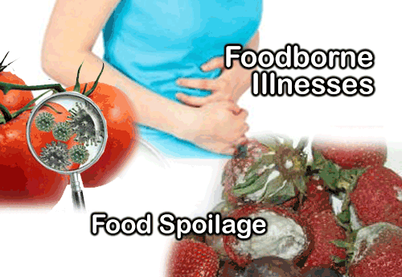
Food spoilage or foodborne illness?
Some microorganisms simply cause spoilage of foods, while others can cause illness or even death if consumed

Slide 14
Preservation methods
Thermal processes such as pasteurization and sterilization are used to kill microorganisms
Irradiation, a non-thermal process, is also used to kill microorganisms in spices
Drying, refrigeration and freezing are common unit operations in order to slow or prevent the growth of microorganisms
Curing, pickling, fermentation and smoking are traditional methods, which is used to slow or prevent microbial growth

Slide 15
References
Singh, R.P. and Anderson, B.A. (2004) The major types of food spoilage: an overview (chapter 1) in a book titled «Understanding and Measuring the Shelf-life of Food» Ed. by Steele, R. Woodhead Publishing Limited and CRC Press LLC. Pages 3-17.
Tucker, G.S. (2003). Food biodeterioration and methods of preservation (chapter 2) in a book titled «Food Packaging Technology» Ed. by Coles, R., McDowell, D. and Kirwan M.J. CRC Press Blackwell Publishing, Florida, USA. Pages 32-63.
Tucker, G.S. (2016). Control of biodeterioration in food (chapter 1) in a book titled «Food Preservation and Biodeterioration». John Wiley & Sons Ltd., UK. Pages 1-35.

