Slide 1
Panel: Bone Marrow Failure
Clinician: Meltem Kurt YÜKSEL MD
Pathologist: Işınsu KUZU MD
AUMF 2021-2022

Slide 2
49 y Male , Symptoms of the patient

Slide 3
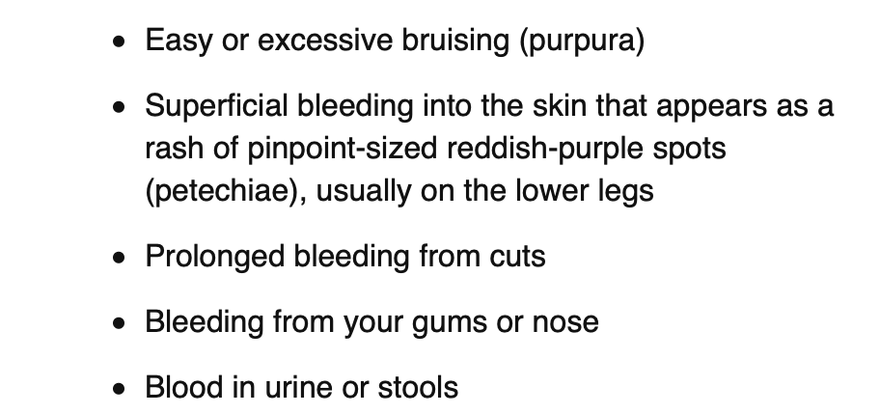

Slide 4
Many of his friends died in short time after expriencing these kinds of symptoms

Slide 5
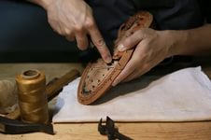
What is your job?

Slide 6
Worker
Hand made shoes
Glue

Slide 7
GLUE contains Benzene

Slide 8
Benzene derivatives

Slide 9
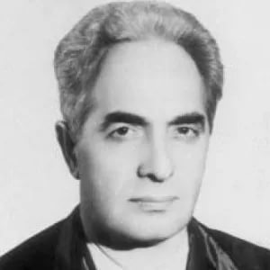
Admitted to hospital: Dr Muzaffer Aksoy
Medical History is important
His mentor Bernardino Ramazzani told him………

Slide 10
In 1974, Professor Muzaffer Aksoy established a link to leukemia in humans as a result of occupational exposure to benzene. The aim of this study is to evaluate his epidemiological approach for his investigation on the effects of benzene and to bring attention to the benzene problem in Turkey. Dr. Aksoy observed that a large group of leukemic patients were shoemakers, or they worked in leather manufacturing. In the 1960s, benzene was a popular solvent in the leather industry. Dr. Aksoy conducted a field investigation in Gedikpasa- Istanbul, where the shoemakers worked so that he could draw his key observations from actual environmental conditions. With a gas detector, he found the concentration of benzene in these work places to be 150-210 ppm and up to 650 ppm on rare occasions. He performed an epidemiological study and health education among 28,500 shoe, slipper and handbag workers during the period from 1967 to 1974. He published these data, establishing an association between benzene and leukemia. The incidence of leukemia among the shoe workers was decreased by screening, health education, and legislative actions in Turkey, but it began to increase again because of lack of an occupational health policy and underestimation of the problem. These results suggest the importance of primary prevention of occupational cancers. Dr. Aksoy's epidemiologic approach may highlight the necessity for detailed investigations of the occupational status of patients who need medical aid in order to diagnose the real underlying factor.

Slide 12
What is the diagnosis?
Physical examination:
Pale and no organomegaly
Blood Tests:…

Slide 13
Complete Blood Count (CBC) Result

Slide 14
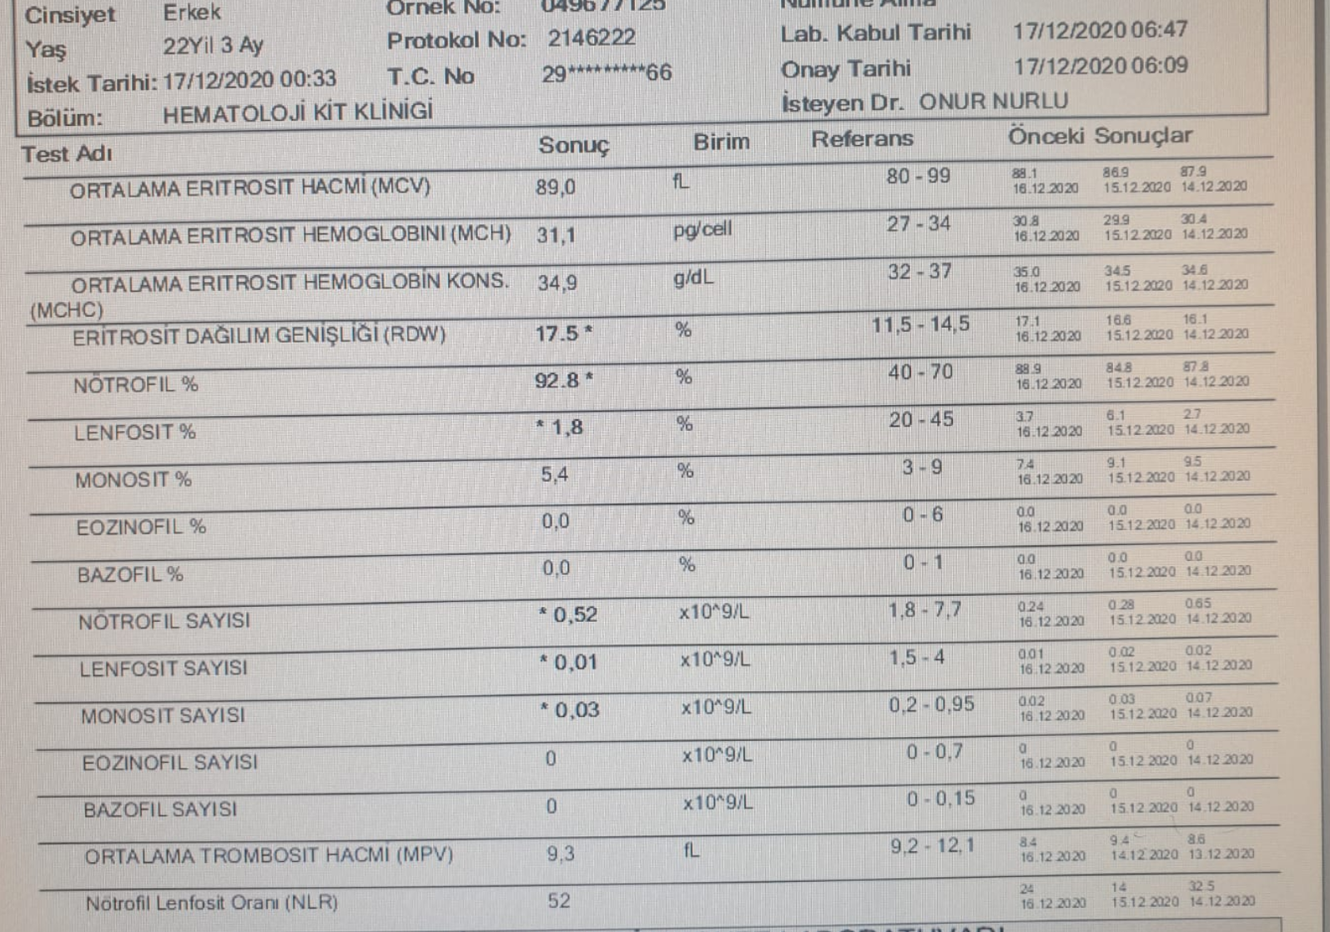

Slide 15
49 years old man
Worker, hand made shoes
Symptom: Fatigue
Physical examination:
Pale and no organomegaly
Blood Tests: Pancytopenia

Slide 16
PANCYTOPENIA

Slide 17
The symptoms
Anemia
Fatigue, shortness of breath
Leukopenia
Recurrent infections
Thrombocytopenia
Mucosal bleeding, bruising
Risk factors
Hepatic Diseases cirrhosis

Slide 18
The history
The history provides several critical pieces of information
How severe is the pancytopenia?
How long has it been present?
Is it getting better or worse?
What was going on when it began?
Was there an infection at onset or has the pateint haf any new medications or occupational exposures?

Slide 19
The physical exam
Should be comprehensive with a particular focus on organomegaly and adenopathy

Slide 20
The lab Degree of severity of Acquired Aplastic Anemia

Slide 21
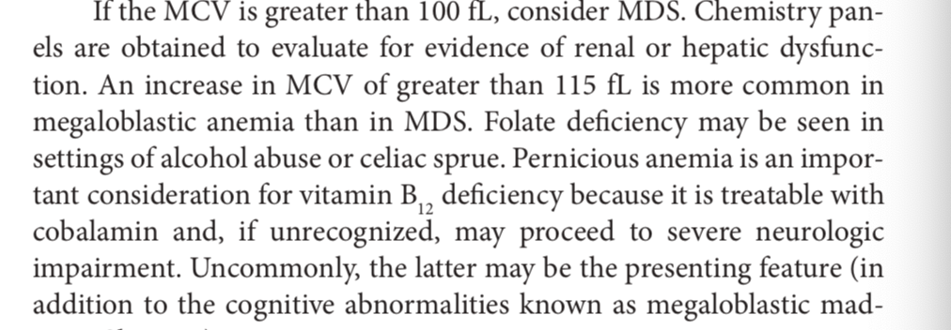
The interpretation of the lab results
CBC!

Slide 22
Hints for diagnosis Reticulocyte and Blood smear
William’s 9th ed Chapter 4

Slide 23
The presentation of a patient with new- onsetpancytopenia requires immediate medical attention
In formulating an approach to a patient who presents with a combination of anemia, thrombocytopenia and leukopenia it is useful to think the pathophysiology in mechanistic terms

Slide 24
Pancytopenia
Congenital
Wiskott Aldrich Syndrome
Fanconi Anemia
Dyskeratoisis congenite/telomere biology disorders
Acquired
Bone Marrow Infiltration and Replacement
Bone Marrow Failure
Destruction/sequestration/redistribution
Scwachman-Diamond syndrome
GATA-2 Deficiency
Hemophagocytic lymhohistiocytosis(HLH)

Slide 25
Acquired Pancytopenia Bone Marrow infiltration /replacement
Malignant
Acute leukemia
Myelodysplastic Syndromes
Non-Malignant
Myelofibrosis
Infectious (fungal, tuberculosis)
Chronic leukemia(Myeloprolifetive Neoplasms (mpn)
Multipl Myeloma
Metastatic Cancer
Storage diseases

Slide 26
Acquired Pancytopenia Bone Marrow Failure
Immun destruction/suppression
Aplastic anemia/Proxymal nocturnal hemoglobinuria
Nutritional
Megaloblastic (B12,Folate
Medications (Cytotoxic Drugs ,Idiosencratic Reactions to medications
Large Granular Lymhphocytic Leukemia
Autoimmune Disordes(SLE,RA)
Hemophagocytic lymphohitiyocytosis
Excessive alcohol
Other (Copper deficiency,Zinc deficinecy
Malnutrition/anorexia nervosa
Marrow Supression
Ineffective hematopoesi. MDS
Viral infection HIV,EBV Hepatitis

Slide 27
Acquired Pancytopenia Destruction/Sequestration/Redistribution
Consumption
Disseminated intravascular coagulation(Associated with sepsis or malignancies)
Splenomegaly
Portal hypertension/cirrhosis
Infections (eg EBV)
Autoimmune Disordes (SLE,RA,Felty Syndrome)
Malignancies (eg Lymphomas,MPN)
Myelofibrosis with myeloid metaplasiz
Storage Diseases (eg Gauchae(

Slide 28
Differential Diagnosis of Pancytopenia

Slide 29
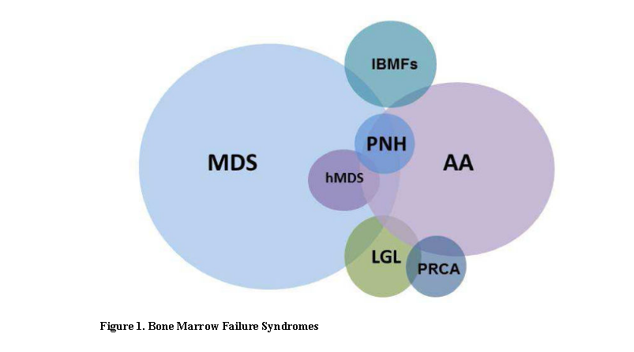
Pancytopenia differential diagnosis→Bone marrow failure syndromes

Slide 30
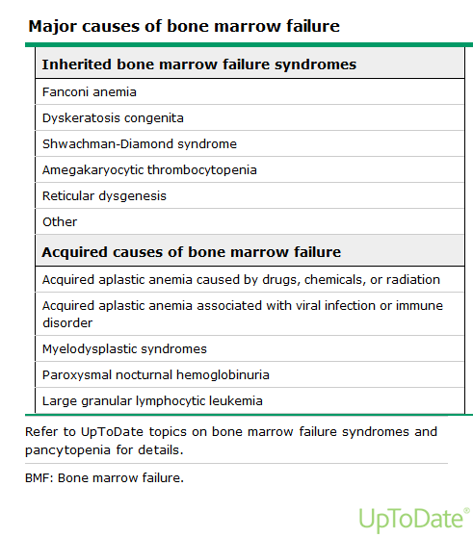
Inherited or Acquired

Slide 31
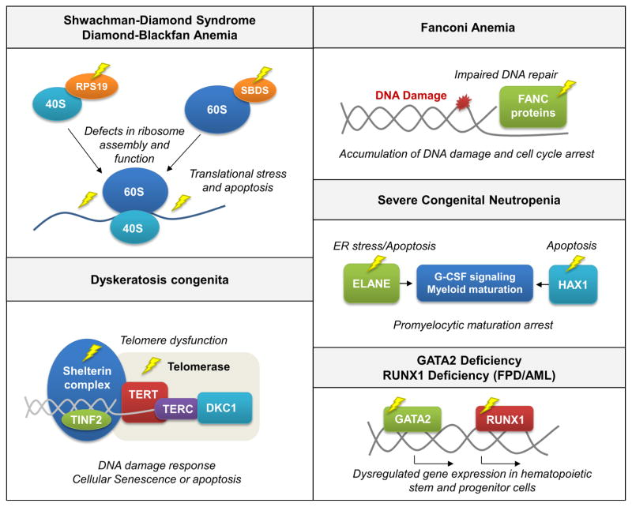
Inherited

Slide 32
ACQUIRED

Slide 33
Common Procedures: History, family history and physical examination

Slide 34
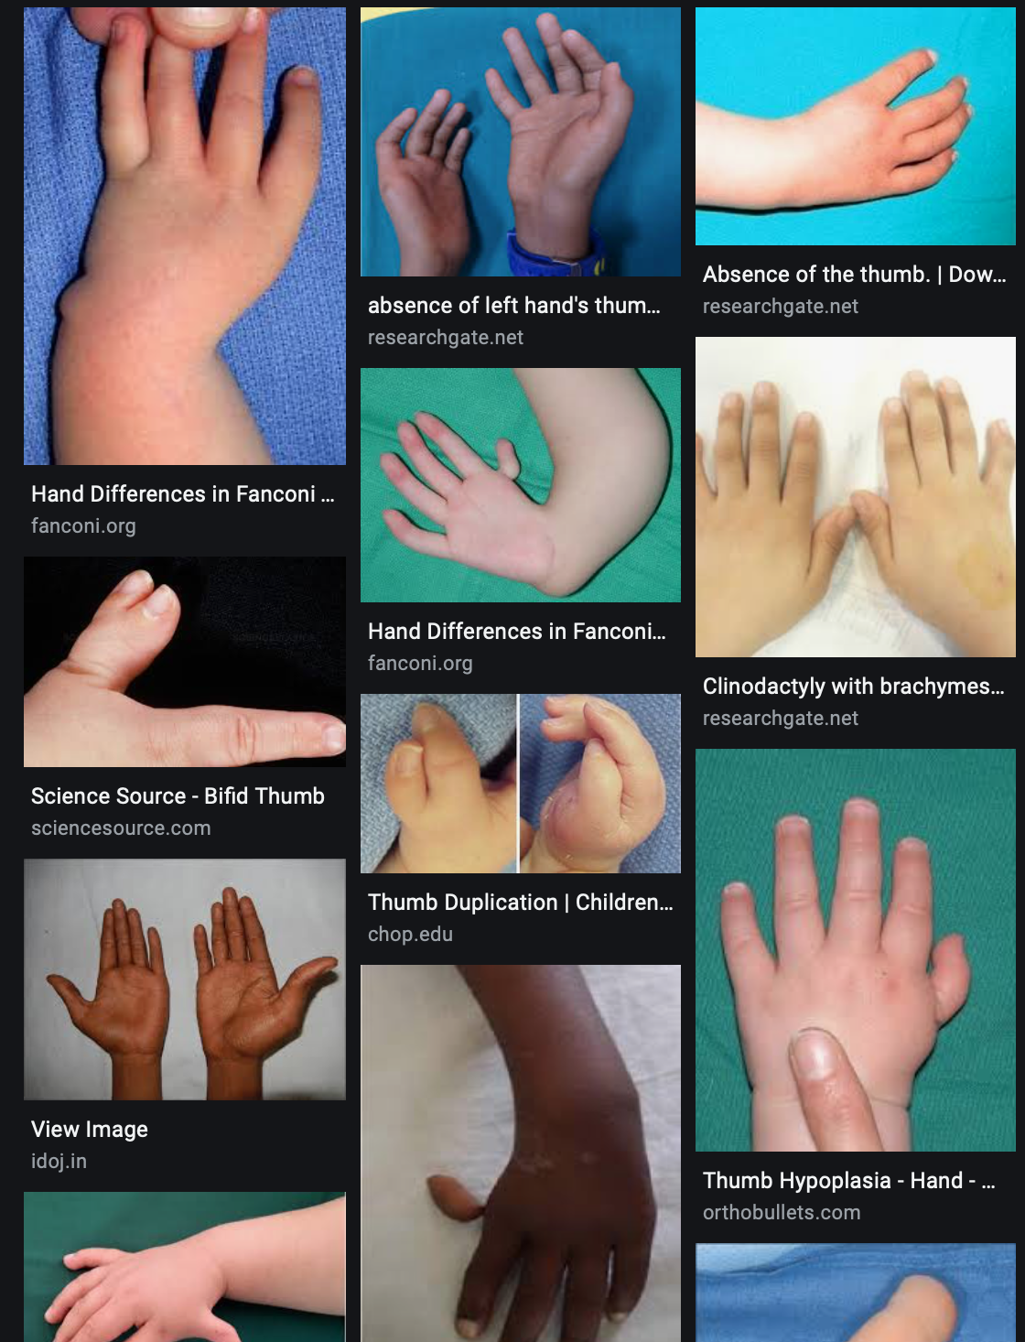
Fanconi AA

Slide 35
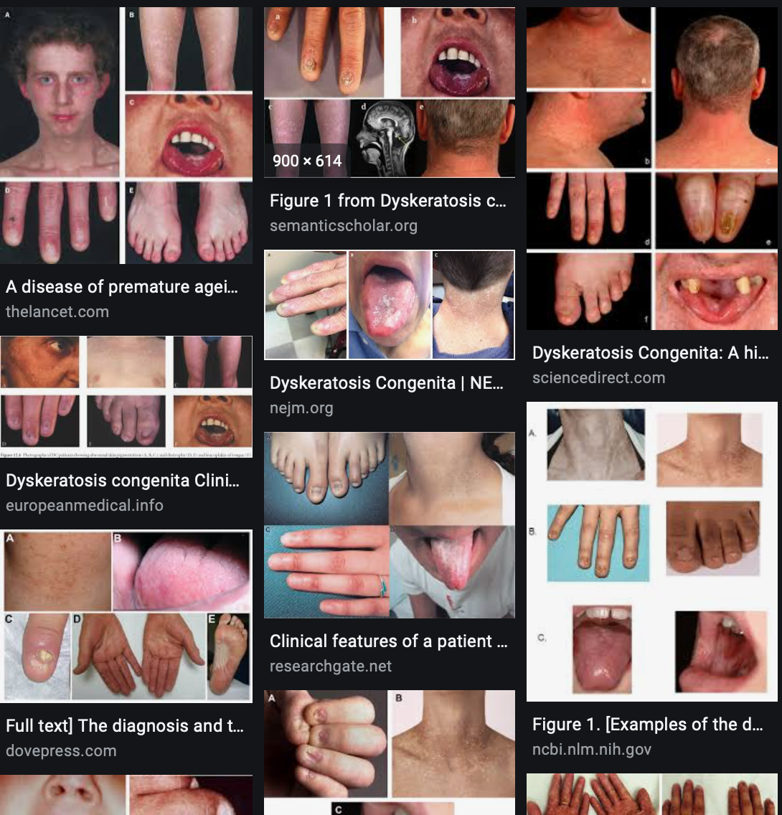
Diskeratosis Konjenita

Slide 36
To make a diagnose

Slide 37
Bone Marrow Biopsy

Slide 38
Thank you very much….
Any questions?

