Slide 1
REPRODUCTIVE HERD HEALTH
Prof.Dr. Şükrü Küplülü

Slide 2
Prepartum and Postpartum Follow-up
General health parameters
Energy and mineral status
Urine pH
Metabolites of defense mechanisms
Routine breast control
Milk yield
Stool monitoring
Colostrum review
Water and KM consumption rates
(cockroft, 2015 ;Anonim, 2017)

Slide 3
Prepartum and Postpartum Follow-up
To determine energy status during the transition period
Parameter monitoring in urine, milk and blood
NEFA
BHBA
Ketone
Ca
Glucose
BUN
> 0.3 mmol/L ve pospartum 0.6 mmol/L
> 1.2 mmol/L
> 10mg/dl
P.P Disorders
< 8 mg/dl
< 50 mg/dl
> 20 (5-19.5) mg/dl
(Duffield, 2011; Esposito ve ark, 2014)

Slide 4
Prepartum and Postpartum Follow-up
PREPARTUM NEFA
POSTPARTUM BHBA
Plesantal R. :1,8
Abomasal D. :4 – 8
P.P. culling: 2
Culling from herd during lactation : 1,5
Duration and severity of production diseases
Conception rate
(Leblanc, 2006; Esposito ve ark, 2014)

Slide 5
Prepartum and Postpartum Follow-up
Ca status
(Martinez ve ark., 2012)

Slide 6
Prepartum and Postpartum Follow-up
Urine pH
Asidik
Alkalin
Evaluation of anionic feeding
Post partum disease prediction
Prepartum ideal pH:
5,5 – 6,5
Ration DCAD | Pre-fresh cow Urine pH | Pre-fresh cow Acid-base status | Fresh cow Ca status
Pozitif (>0 mEq/100g) | 7 – 8 | Alkalosis | Low blood Ca concentration
(<0 mEq/100g) | 5,5 – 6,5 | Moderate metabolic acidosis | Normal blood Ca con.
 | < 5,5 | Kidney problems, crisis
(Heinrichs ve ark., 1996; Seifi ve ark., 2004; Sweenwy ve ark., 2015)

Slide 7
Prepartum and Postpartum Follow-up
Milk Production Curve
Metabolic monitoring of milk production
estimated 98% of diseases
(Peter ve ark., 2017)

Slide 8
Prepartum and Postpartum Follow-up
Consumption of Water and Dry Matter
Fluctuations in water and KM consumption metabolic or infectious problems
1 kg dry matter digestion: 4kg water
10 Lt drop in water T.: P.p disease probability
KMT decline per unit:
Probability of P.p disease
Hierarchy and distance
(Leblanc, 2010, Anonim 2017)

Slide 9
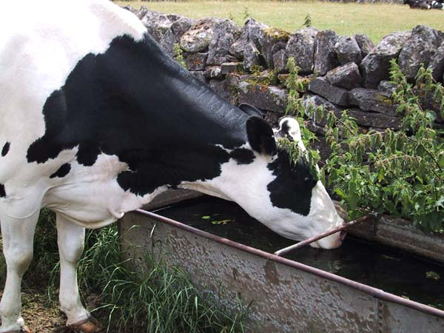
Consumption of Water and Dry Matter
(Anonim 2017)

