Slide 1
Drug Interactions Citalopram - Buspirone
Oktay GÖRÜCÜ - 16030155

Slide 2
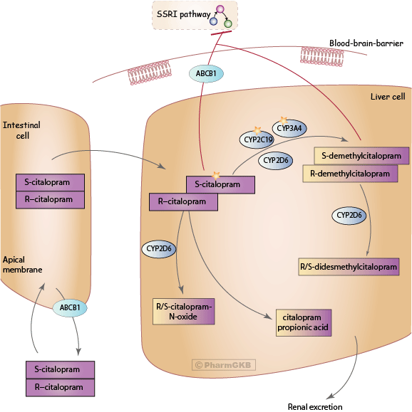
Mechanism of Citalopram
Citalopram hydrobromide acts as an antidepressant by potentiating serotonergic activity in the central nervous system. Multiple studies confirmed that citalopram hydrobromide is a selective serotonin reuptake inhibitor and that it has minimal effects on norepinephrine and dopamine neuronal reuptake.

Slide 3
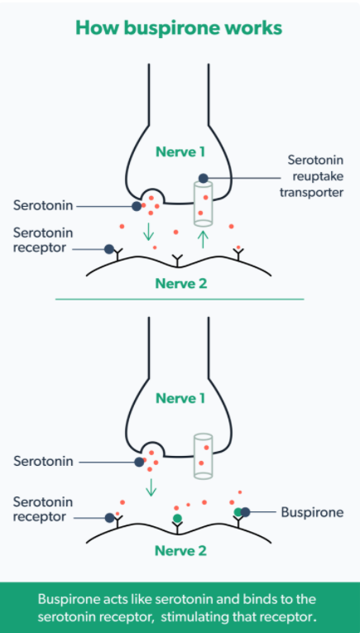
Mechanism of Buspirone
Buspirone is classified as azapirones. It has a strong affinity for serotonin 5HT1a receptors, where it acts as a partial agonist, which some researchers believe produces the preponderance of clinical effects. It also has a weak affinity for serotonin 5HT2 receptors and acts as a weak antagonist on dopamine D2 autoreceptors.
The underlying mechanism behind how the partial 5HT1a agonism translates into clinical results remains largely unknown.

Slide 4
Buspirone – Citalopram Interaction
Buspirone was found to be a weak 5-HT2C receptor antagonist, with a low affinity for 5-HT2A and 5-HT2C receptors. Repeated buspirone-citalopram combination treatment markedly decreased [3H]ketanserin and [125I]DOI binding to 5-HT2A receptors. Repeated administration of buspirone and buspirone-citalopram combination increased the affinity of [3H]mesulergine toward 5-HT2C receptors, and buspirone-citalopram combination also decreased [125I]DOI binding to 5-HT2C receptors.
Downregulation of brain 5-HT2A receptors and possibly of 5-HT2C receptor agonist sites is involved in the beneficial clinical effects of buspirone-SSRI augmentation treatment. Furthermore, a conversion of brain 5-HT2C receptors from high- to low-affinity state may provide an additional mechanism for the anti-anxiety effects of buspirone.

Slide 5
References
https://www.ncbi.nlm.nih.gov/books/NBK482222/
https://www.ncbi.nlm.nih.gov/books/NBK531477/
https://www.drugs.com/drug-interactions/buspirone-with-citalopram-441-0-679-0.html
https://pubmed.ncbi.nlm.nih.gov/16453246/
https://ro.co/health-guide/buspirone-uses/
https://www.pharmgkb.org/pathway/PA164713429

