Slide 1
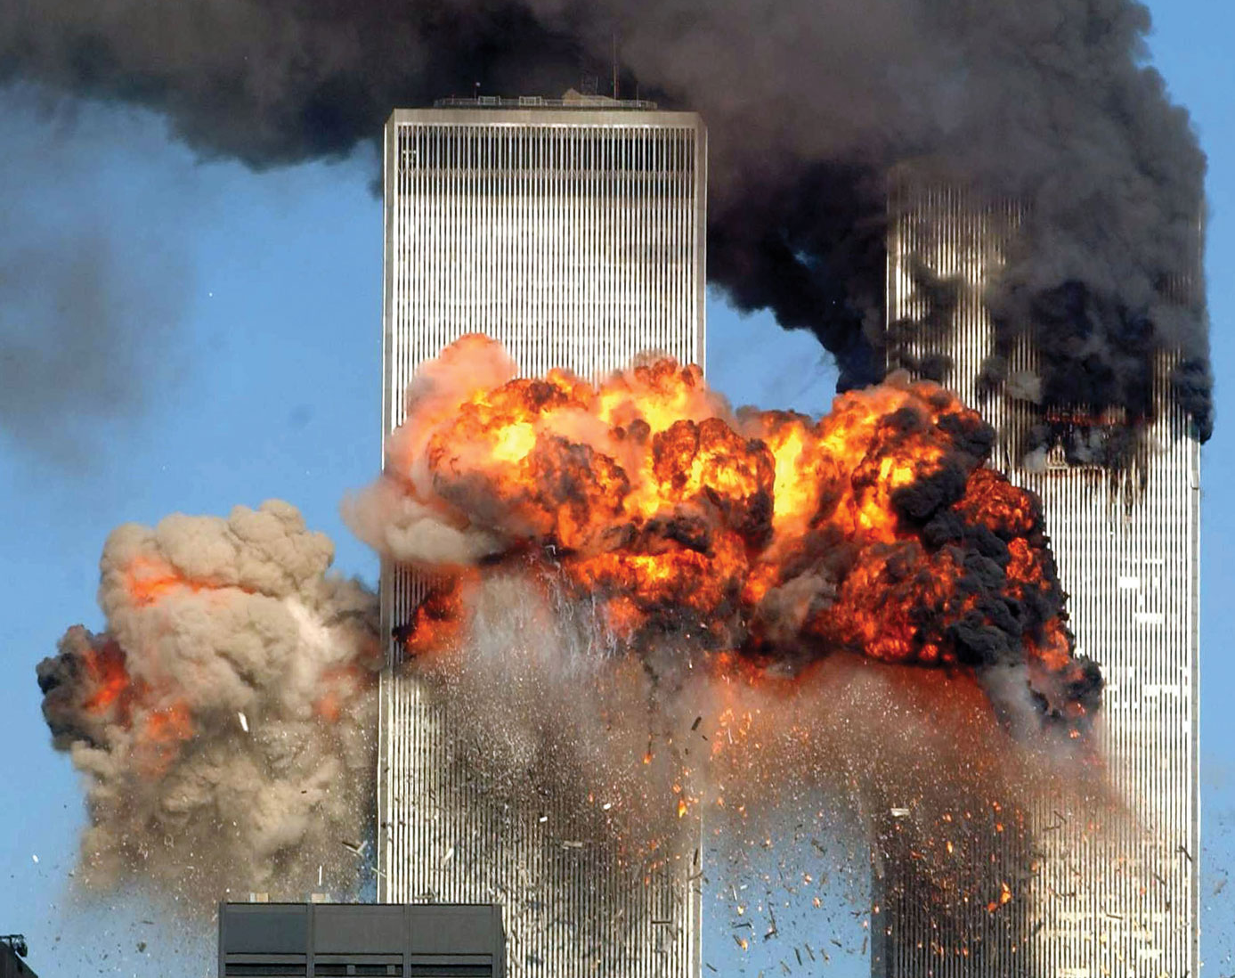
9/11 Attacks
AKE 118
Dr. Gamze Kati Gumus

Slide 2
9/11
On September 11, 2001, 19 militants associated with the Islamic extremist group al Qaeda hijacked four airplanes and carried out suicide attacks against targets in the United States.
Notes:
https://www.history.com/topics/21st-century/9-11-attacks

Slide 3
9/11
Two of the planes were flown into the twin towers of the World Trade Center in New York City
a third plane hit the Pentagon just outside Washington, D.C.
and the fourth plane crashed in a field in Shanksville, Pennsylvania.

Slide 4
9/11
Almost 3,000 people were killed during the 9/11 terrorist attacks, which triggered major U.S. initiatives to combat terrorism and defined the presidency of George W. Bush.

Slide 5
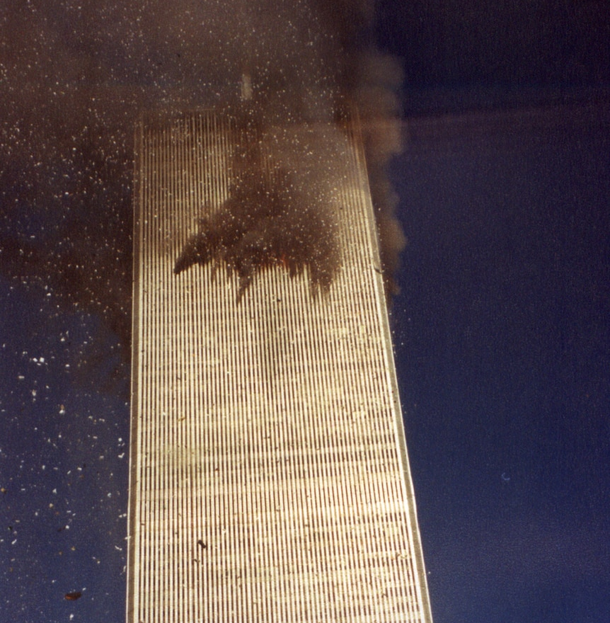
World Trade Center/North Tower
On September 11, 2001, at 8:45 a.m. on a Tuesday morning, an American Airlines Boeing 767 loaded with 20,000 gallons of jet fuel crashed into the north tower of the World Trade Center in New York City.
The impact left a gaping, burning hole near the 80th floor of the 110-story skyscraper, instantly killing hundreds of people and trapping hundreds more in higher floors.

Slide 6
World Trade Center/South Tower
As the evacuation of the tower and its twin got underway, television cameras broadcasted live images of what initially appeared to be a freak accident.
18 minutes after the first plane hit, a second Boeing 767—United Airlines Flight 175—appeared out of the sky, turned sharply toward the World Trade Center and sliced into the south tower near the 60th floor.
The collision caused a massive explosion that showered burning debris over surrounding buildings and onto the streets below.
It immediately became clear that America was under attack.

Slide 7
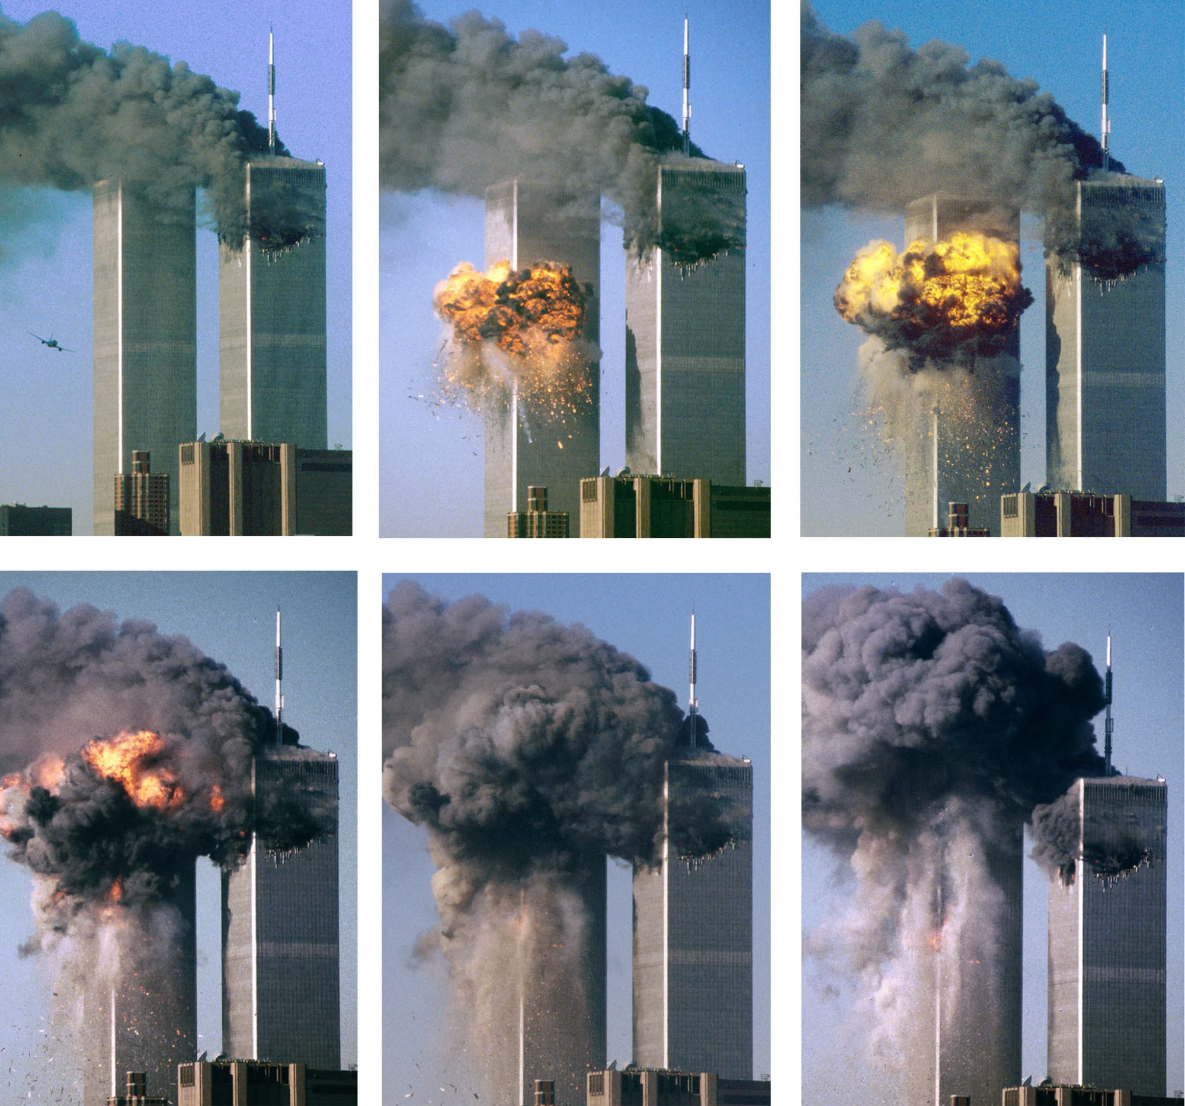

Slide 8
Notes:
Photos from https://www.reuters.com/news/picture/defining-images-from-the-9-11-attacks-idUSRTS2Q0UX

Slide 9
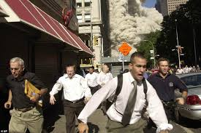

Slide 10
President George W. Bush listens as White House Chief of Staff Andrew Card informs him of a second plane hitting the World Trade Center while Bush was conducting a reading seminar at the Emma E. Booker Elementary School in Sarasota, Florida, September 11, 2001

Slide 11
People look out of the burning North Tower of the World Trade Center, September 11, 2001.

Slide 12
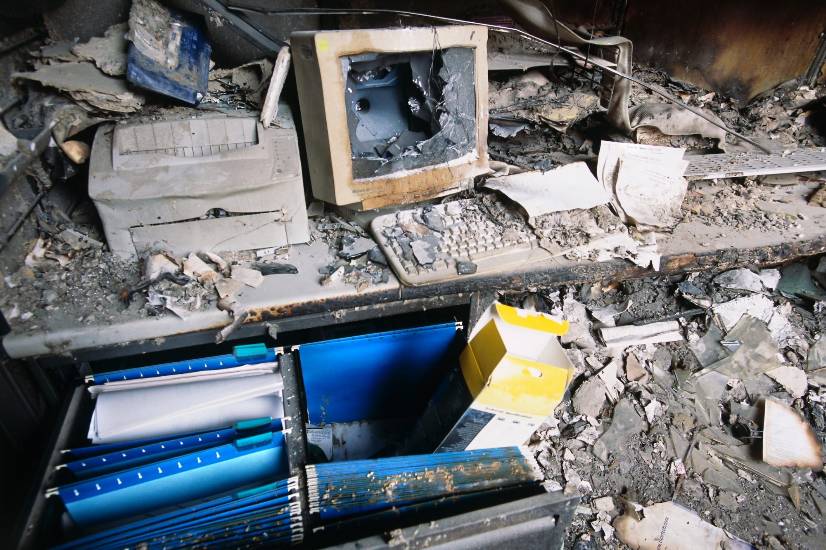

Slide 14
The South Tower Collapses

Slide 15
The remaining tower of World Trade Center, Tower 2 (North), dissolves in a cloud of dust and debris about a half hour after the first twin tower (South) collapsed, September 11, 2001

Slide 16
Rescue workers carry mortally injured New York City Fire Department chaplain, the Rev. Mychal Judge, from the wreckage of the World Trade Center, September 11, 2001. The chaplain was crushed to death by falling debris while giving a man last rites in the trade center.

Slide 17
Cars smolder in the street as the destroyed World Trade Center burns in New York, September 11, 2001.

Slide 18
A firefighter walks amid rubble near the base of the destroyed World Trade Center in New York, September 11, 2001

Slide 19
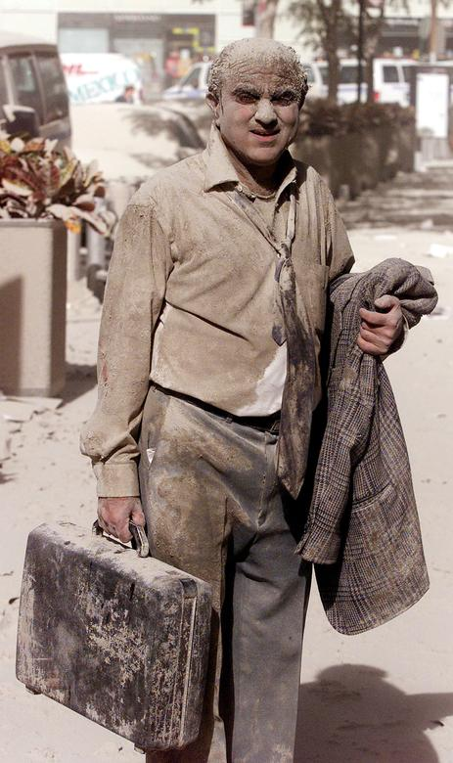
A man walks in the street near the World Trade Center towers in New York City, September 11, 2001.

Slide 20
The wreck of the World Trade Center smolders in the background as a man passes a subway stop near the World Trade Center towers, September 11, 2001

Slide 22
1993 WTC Bombing
On February 26, 1993, a bomb exploded in a parking garage of the World Trade Center (WTC) in New York City.
Although the terrorist bomb failed to critically damage the main structure of the skyscrapers, six people were killed and more than 1,000 were injured.
Notes:
https://www.state.gov/1993-world-trade-center-bombing/
https://www.history.com/this-day-in-history/world-trade-center-bombed

Slide 23
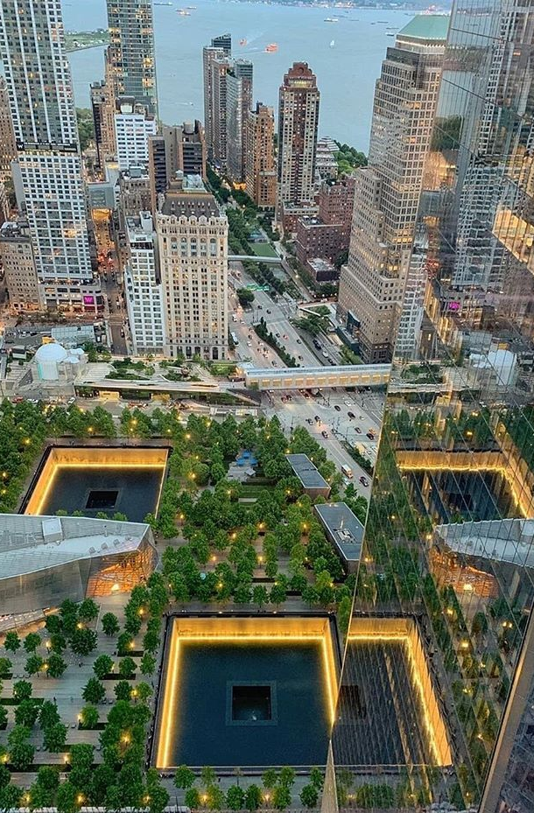
9/11 Memorial
In January 2004, the design submitted by architect Michael Arad and landscape architect Peter Walker, Reflecting Absence, was chosen as the winning entry.
Their design features twin waterfall pools surrounded by bronze parapets that list the names of the victims of the 9/11 attacks and the 1993 World Trade Center bombing.
Notes:
https://www.911memorial.org/visit/memorial/about-memorial

Slide 24
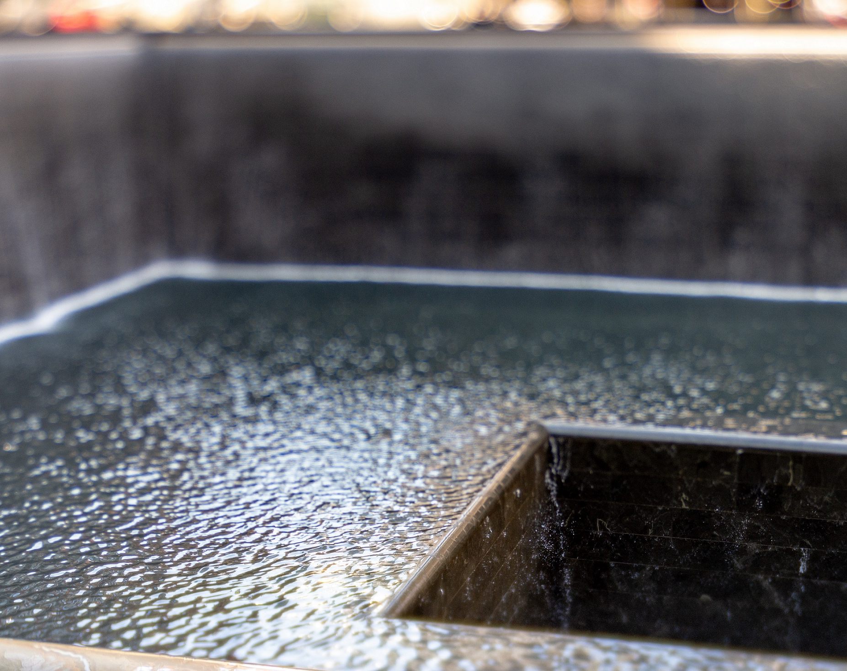
9/11 Memorial
According to the architect, Michael Arad, the pools represent “absence made visible.” Although water flows into the voids, they can never be filled.
Notes:
https://www.911memorial.org/visit/memorial/about-memorial

Slide 29
Who?
The hijackers were Islamic terrorists from Saudi Arabia and several other Arab nations.
They were reportedly financed by the al Qaeda terrorist organization of Saudi fugitive Osama bin Laden

Slide 30
Why?
The hijackers were allegedly acting in retaliation for
America’s support of Israel
its involvement in the Persian Gulf War
its continued military presence in the Middle East

Slide 31
How?
The terrorists boarded four early-morning flights bound for California, chosen because the planes were loaded with fuel for the long transcontinental journey.
Soon after takeoff, the terrorists commandeered the four planes and took the controls, transforming ordinary passenger jets into guided missiles.

Slide 32
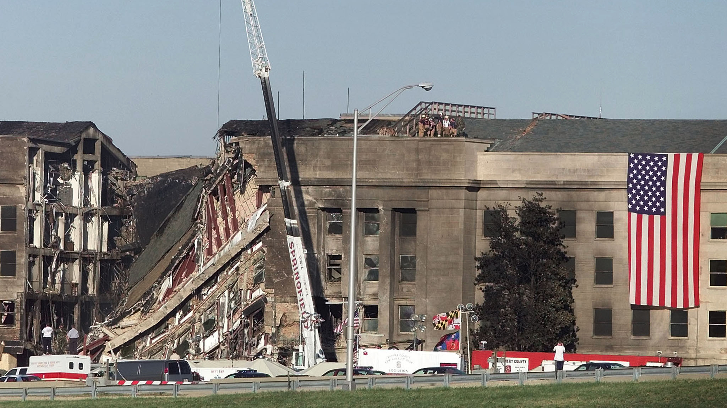
Pentagon Attack
American Airlines Flight 77 crashed into the west side of the Pentagon military headquarters at 9:45 a.m.
Jet fuel from the Boeing 757 caused a devastating inferno that led to the structural collapse of a portion of the giant concrete building, which is the headquarters of the U.S. Department of Defense.
125 military personnel and civilians were killed in the Pentagon, along with all 64 people aboard the airliner.

Slide 33
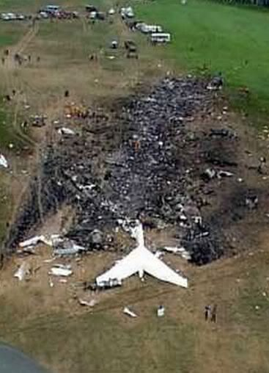
Flight 93
Meanwhile, a fourth California-bound plane—United Flight 93—was hijacked about 40 minutes after leaving Newark Liberty International Airport in New Jersey.
Because the plane had been delayed in taking off, passengers on board learned of events in New York and Washington via cell phone and Airfone calls to the ground.
Knowing that the aircraft was not returning to an airport as the hijackers claimed, a group of passengers and flight attendants planned an insurrection.
Notes:
https://www.history.com/topics/21st-century/9-11-attacks

Slide 34
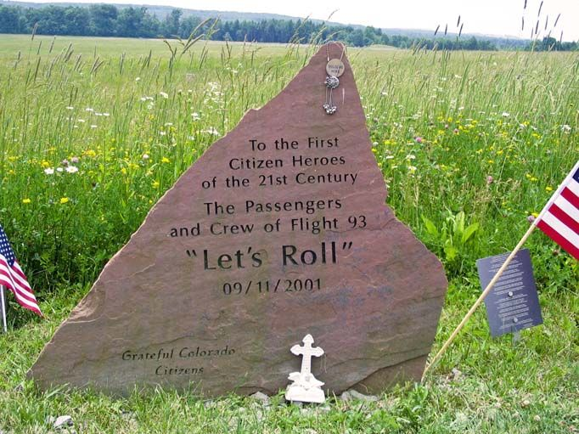
Flight 93
One of the passengers, Thomas Burnett, Jr., told his wife over the phone that “I know we’re all going to die. There’s three of us who are going to do something about it. I love you, honey.” Another passenger—Todd Beamer—was heard saying “Are you guys ready? Let’s roll” over an open line.
Sandy Bradshaw, a flight attendant, called her husband and explained that she had slipped into a galley and was filling pitchers with boiling water. Her last words to him were “Everyone’s running to first class. I’ve got to go. Bye.”

Slide 35
Flight 93
The passengers fought the four hijackers and are suspected to have attacked the cockpit with a fire extinguisher.
The plane then flipped over and sped toward the ground at upwards of 500 miles per hour, crashing in a rural field near Shanksville in western Pennsylvania at 10:10 a.m.
All 44 people aboard were killed.
Its intended target is not known, but theories include the White House, the U.S. Capitol, the Camp David presidential retreat in Maryland or one of several nuclear power plants along the eastern seaboard.

Slide 36
How many People died in 9/11 Attacks?
A total of 2,996 people were killed in the 9/11 attacks, including the 19 terrorist hijackers aboard the four airplanes.
Citizens of 78 countries died in New York, Washington, D.C., and Pennsylvania.

Slide 37
How many People died in 9/11 Attacks?
At the World Trade Center, 2,763 died after the two planes slammed into the twin towers.
That figure includes 343 firefighters and paramedics, 23 New York City police officers and 37 Port Authority police officers who were struggling to complete an evacuation of the buildings and save the office workers trapped on higher floors.

Slide 38
How many People died in 9/11 Attacks?
At the Pentagon, 189 people were killed, including 64 on American Airlines Flight 77, the airliner that struck the building.
On Flight 93, 44 people died when the plane crash-landed in Pennsylvania.

Slide 39
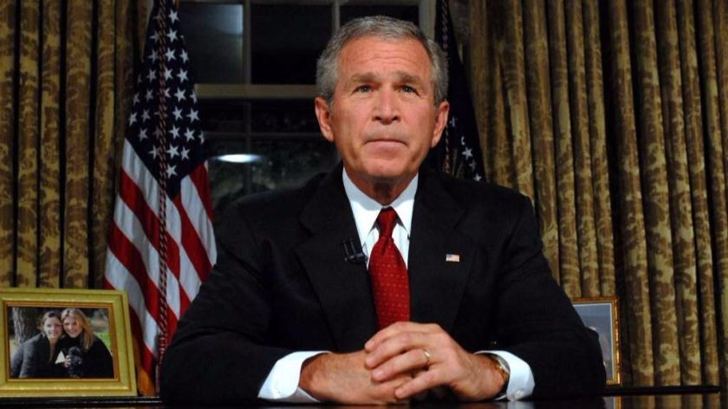
American Response to 9/11

Slide 40
American Response to 9/11
7:00 PM
At 7 p.m., President George W. Bush, who was in Florida at the time of the attacks and had spent the day being shuttled around the country because of security concerns, returned to the White House.
9:00 PM
At 9 p.m., he delivered a televised address from the Oval Office.

Slide 41
Operation Enduring Freedom
Operation Enduring Freedom, the American-led international effort to oust the Taliban regime in Afghanistan and destroy Osama bin Laden’s terrorist network based there, began on October 7.
Within two months, U.S. forces had effectively removed the Taliban from operational power, but the war continued.

Slide 42
American Response to 9/11
2 May 2011
Osama bin Laden, the mastermind behind the September 11th attacks, remained at large until May 2, 2011, when he was finally tracked down and killed by U.S. forces at a hideout in Abbottabad, Pakistan.
June 2011
In June 2011, then-President Barack Obama announced the beginning of large-scale troop withdrawals from Afghanistan.

Slide 43
American Response to 9/11
9 Nov.
In the wake of security fears raised by 9/11 and the mailing of letters containing anthrax that killed two and infected 17, The Homeland Security Act of 2002 created the Department of Homeland Security.
25 Nov. 2002
It was signed into law by President George W. Bush on November 25, 2002.
Today
the Department of Homeland Security is a cabinet responsible for preventing terror attacks, border security, immigrations and customs and disaster relief and prevention.

Slide 44
Economic Impact of 9/11
Many Wall Street institutions, including the New York Stock Exchange, were evacuated during the attacks.
On the first day of trading after the attacks, the market fell 7.1 percent, or 684 points.
New York City’s economy alone lost 143,000 jobs a month and $2.8 billion wages in the first three months.
The heaviest losses were in finance and air transportation, which accounted for 60 percent of lost jobs.

Slide 45
Economic Impact of 9/11
The estimated cost of the World Trade Center damage is $60 billion.
The cost to clean the debris at Ground Zero was $750 million.

Slide 46
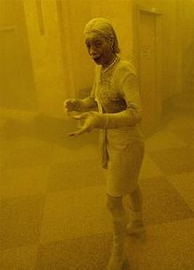
9/11 Victim Compensation Fund
Thousands of first responders and people working and living in lower Manhattan near Ground Zero were exposed to toxic fumes and particles emanating from the towers as they burned and fell.
By 2018, 10,000 people were diagnosed with 9/11-related cancer, such as Marcy Borders pictured here, who died of stomach-cancer.
From 2001 to 2004, over $7 billion dollars in compensation was given to families of the 9/11 victims and the 2,680 people injured in the attacks.

Slide 48
"What So Proudly We Hailed," 2001, Carter Goodrich, Courtesy of The New Yorker (Cover/Nov. 5, 2001)

