Slide 1
ANKARA UNIVERSITY DEPARTMENT OF ENERGY ENGINEERING NUMERICAL METHODS
INSTRUCTOR
DR. ÖZGÜR SELİMOĞLU

Slide 2
CONTENTS
Interpolations and Cubic Spline
a) Neville Method
b) Interpolations with Cubic Spline

Slide 3
Neville’s Method
Newton’s method of interpolation involved two steps: computation of the coefficients, followed by evaluation of the polynomial. It works well if the interpolation is carried out repeatedly at different values of x using the same polynomial. If only one point is to be interpolated, a method that calculates the interpolant in a single step like Neville's algorithm is a more appropriate choice.
P _{k} [x _{i} , x _{i+1}, . . . , x _{i+k} ] denote the polynomial of degree k that passes through the k +1 data points
(x _{i} , y _{i} ), (x _{i+1}, y _{i+1}), . . . , (x _{i+k} , y _{i+k} ). For a single data point, we have
The interpolant based on two data points is
It is easily verified that P₁[x_{i} , x_{i+1}] passes through the two data points; that is, P₁[x_{i} , x_{i+1}] = y_{i} when x = x_{i}, and
P₁[x_{i} , x_{i+1}] = y_{i+1} when x = x_{i+1}.
The three-point interpolant is

Slide 4
To show that this interpolant does intersect the data points, we first substitute x= x_{i} , obtaining
Similarly, x = x_{i+2} yields
so that
Having established the pattern, we can now deduce the general recursive formula:
Given the value of x, the computations can be carried out in the following tabular format (shown for four data points):

Slide 5
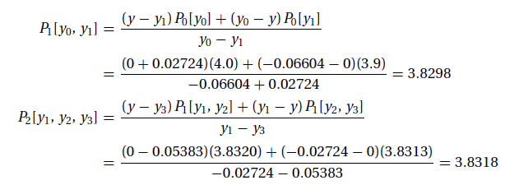
Example 1 : Given the data points
determine the root of y(x) = 0 by Neville’s method.
Solution: This is an example of inverse interpolation, in which the roles of x and y are interchanged. Instead of computing y at a given x, we
are finding x that corresponds to a given y (in this case, y = 0). Employing the format of Neville’s Table (with x and y interchanged, of
course), we obtain
The following are sample computations used in the table:
All the P’s in the table are estimates of the root resulting from different orders of interpolation involving different data points. For example,
P1[y0, y1] is the root obtained from linear interpolation based on the first two points, and P2[y1, y2, y3] is the result from quadratic
interpolation using the last three points. The root obtained from cubic interpolation over all four data points is x = P3[y0, y1, y2, y3] = 3.8317.

Slide 6
Example 2: Table lists the values of f (x) = ln x accurate to the places given. Use Neville’s method and four-digit rounding arithmetic to approximate f (2.1) = ln 2.1 by completing the Neville table.
Solution: Table to be used
Because x − x₀ =2.1 - 2= 0.1, x − x₁ =2.1 - 2.2= −0.1, x − x₂ =2.1-2.3= −0.2
and we are given ln2= Q_{0,0} = 0.6931, ln2.2= Q_{1,0} = 0.7885, and ln2.3=Q _{2,0} = 0.8329, we have

Slide 7
The final approximation we can obtain from this data is
Make the data into a similar table.

Slide 8
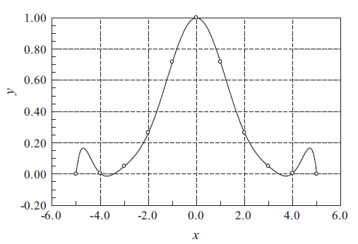
Limitations of Polynomial Interpolation
Polynomial interpolation should be carried out with the fewest feasible number of data points. Linear interpolation, using the nearest two points, is often sufficient if the data points are closely spaced. Three to six nearest-neighbor points good results in most cases. An interpolant intersecting more than six points may be mistake.
Figure 1:Polynomial interpolant displaying oscillations.
The danger of using too many points is illustrated in Figure 1 . The 11 equally spaced data points are represented by the circles. The solid line is the interpolant, a polynomial of degree 10, that intersects all the points. As seen in the figure, a polynomial of such a high degree has a tendency to oscillate excessively between the data points. A much smoother result would be obtained by using a cubic interpolant spanning four nearest-neighbor points.
The fifth-degree interpolating polynomial is represented by the solid line. The interpolant looks fine within the range of data points, but drastically departs from the obvious trend when x > 12. Extrapolating y at x = 14, for example, would be meaningless in this case.
If extrapolation cannot be avoided, the following measures can be useful:
• Plot the data and visually verify that the extrapolated value makes sense.
• Use a low-order polynomial based on nearest-neighbor data points. A linear or quadratic interpolant, for example, would yield a reasonable estimate of y(14) for the data in Figure 1.

Slide 9
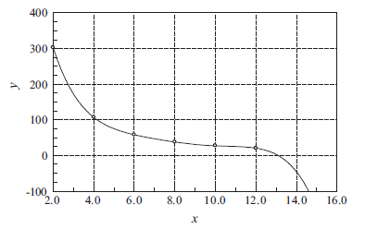
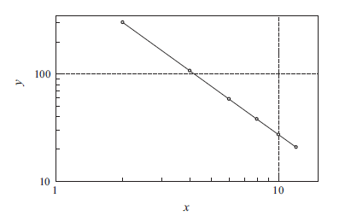
Figure 2: Extra polation may not follow the trend of data.
Work with a plot of log x vs. log y, which is usually much smoother than the x-y curve and thus safer to extrapolate. Frequently this plot is almost a straight line. This is illustrated in Figure 3, which represents the logarithmic plot of the data in Figure 2.
Figure 3 : Logarithmic plot of the data in Figure 2.

Slide 10
Rational Function Interpolation
Some data are better interpolated by rational functions rather than polynomials. A rational function R(x) is the quotient of two polynomials:
Because R(x) is a ratio, it can be scaled so that one of the coefficients (usually b_{n+1}) is unity. That leaves (m + n + 1) undetermined coefficients that must be computed by forcing R(x) through (m+n +1) data points. A popular version of R(x) is the so-called diagonal rational function, where the degree of the numerator is equal to that of the denominator (m = n) if (m+n) is even, or less by one (m = n − 1) if (m+n) is odd. The recursive formula that is the basis of the algorithm is due
Where
R[x_{i} , x_{i+1}, . . . , x_{i+k} ] denotes the diagonal rational function that passes through the data points (x_{i} , y_{i} ), (x_{i+1}, y_{i+1}), . . , (x_{i+k} , y_{i+k} ). It is also understood that R[x_{i} , x_{i+1}, . . . , x_{i−1}] = 0 (corresponding to the case k = −1) and R[x_{i} ] = y_{i} (the case k = 0).
The computations can be carried out in a tableau, similar to Table used for Neville’s method. We start by filling the column
k = −1 with zeros and entering the values of y_{i} in the column k = 0.

Slide 11
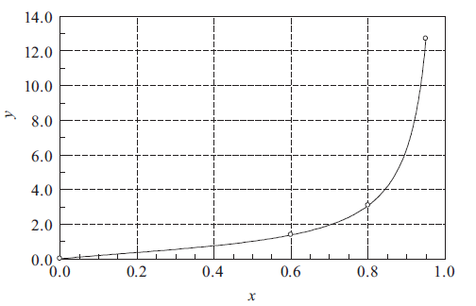
Example:Given the data
determine y(0.5) by the diagonal rational function interpolation.
Solution:The plot of the data points indicates that y may have a pole at around x = 1. Such a function is a very poor candidate for polynomial interpolation, but can be readily represented by a rational function.
We set up our work in the format of Table. After completing the computations, the table looks like this:
Notes:
Python’da Çözemedim.

Slide 12
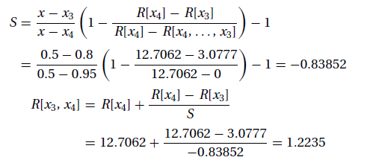
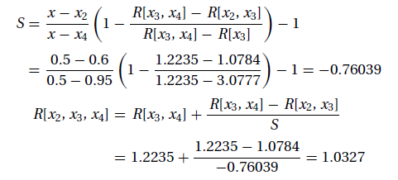
Let us now look at a few sample computations. We obtain, for example, R[x₃, x₄] by substituting i = 3, k = 1 into Eqs.
The entry R[x₂, x₃, x₄] is obtained with i = 2, k = 2. The result is
The interpolant at x = 0.5 based on all four data points is R[x₁, x₂, x₃, x₄] = 1.0131.

Slide 13
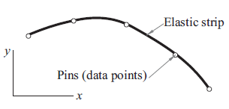
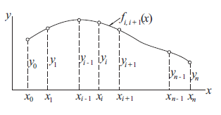
Interpolation with Cubic Spline
If there are more than a few data points, a cubic spline is hard to beat as a global interpolant. It is considerably “stiffer” than a polynomial in the sense that it has less tendency to oscillate between data points.
Figure 1: Mechanical model of a natural cubic spline.
The mechanical model of a cubic spline is as in Figure 1. The pins (i.e., the data points) are called the knots of the spline. At the pins, the slope and bending moment (and hence the second derivative) are continuous. There is no bending moment at the two end pins; consequently, the second derivative of the spline is zero at the end points. Because these end conditions occur naturally in the beam model, the resulting curve is known as the natural cubic spline.
Figure 2: A cubic spline.

Slide 14
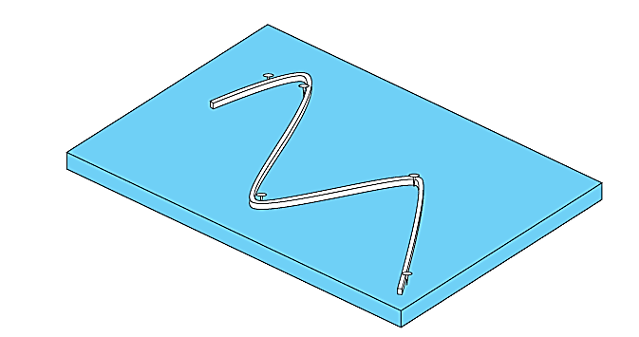
The objective in cubic splines is to derive a third-order polynomial for each interval between knots, as in
Thus, for n + 1 data points ( i = 0, 1, 2, . . . , n), there are n intervals and, consequently, 4n unknown constants to evaluate. Just as for quadratic splines, 4n conditions are required to evaluate the unknowns. These are:
1. The function values must be equal at the interior knots (2n − 2 conditions).
2. The first and last functions must pass through the end points (2 conditions).
3. The first derivatives at the interior knots must be equal (n − 1 conditions).
4. The second derivatives at the interior knots must be equal (n − 1 conditions).
5. The second derivatives at the end knots are zero (2 conditions).
The visual interpretation of condition 5 is that the function becomes a straight line at the end knots. Specification of such an end condition leads to what is termed a “natural” spline. It is given this name because the drafting spline naturally behaves in this fashion (Fig.). If the value of the second derivative at the end knots is nonzero (that is, there is some curvature), this information can be used alternatively to supply the two final conditions. The above five types of conditions provide the total of 4n equations required to solve for the 4n coefficients. Whereas it is certainly possible to develop cubic splines in this fashion, we will present an alternative technique that requires the solution of only n − 1 equations.

Slide 15
Figure 2 shows a cubic spline that spans n + 1 knots. We use the notation f_{i,i+1}(x) for the cubic polynomial that spans the segment between knots i and i + 1. Note that the spline is a piecewise cubic curve, put together from the n cubics f_{0,1}(x), f_{1,2}(x), . . . , f_{n−1},n(x), all of which have different coefficients.
Denoting the second derivative of the spline at knot i by k_{i} , continuity of second derivatives requires that
(1)
At this stage, each k is unknown, except for
The starting point for computing the coefficients of f_{i,i+1}(x) is the expression for f _{i,i+1}(x), which we know to be linear. Using Lagrange’s two point interpolation, we can write
Where
Therefore,
(2)

Slide 16
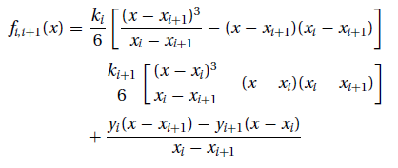
Integrating twice with respect to x, we obtain
(3)
where A and B are constants of integration. The terms arising from the integration would usually be written as C_{x} + D. By letting C = A − B and D = −A_{xi+1} + B _{xi}, we end up with the last two terms of Eq. (3), which are more convenient to use in the computations that follow.
Imposing the condition f _{i,i+1}(x_{i} ) = y_{i}, we get from Eq. (3)
(4)
Therefore,
(5)
Similarly, f _{i,i+1}( x_{i+1}) = y_{i+1} yields
(6)
Substituting Eqs. (5) and (6) into Eq. (3) results in
(6.a)

Slide 17
The second derivatives k_{i} of the spline at the interior knots are obtained from the slope continuity conditions
f _{i−1,i} (x_{i} ) = _{f i,i+1}(x_{i} ), where i = 1, 2, . . . , n − 1. After a little algebra, this results in the simultaneous equations
(7)
If the data points are evenly spaced at intervals h, then x_{i−1} − x_{i} = x_{i} − x_{i+1} = −h, and the Eqs. (7) simplify to
(8)

Slide 18
Example 3: Use a natural cubic spline to determine y at x = 1.5. The data points are
Solution: The five knots are equally spaced at h = 1. Recalling that the second derivative of a natural spline is zero at the first and last knot, we have k₀ = k₄ = 0. The second derivatives at the other knots are obtained from Eq. (8).Using i = 1, 2, 3 results in the simultaneous equations
The solution is k₁ = k₃ = −30/7, k2 = 36/7.
The point x = 1.5 lies in the segment between knots 0 and 1. The corresponding interpolant is obtained from Eq. (6.a) by setting i = 0. With x_{i} − x_{i+1} = −h= −1, we obtain from Eq. (6.a)

Slide 19
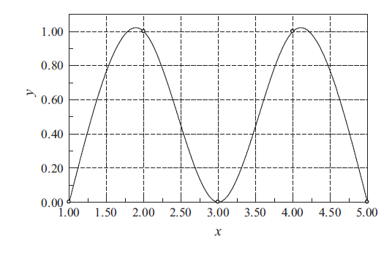
Therefore,
The plot of the interpolant, which in this case is made up of four cubic segments, is shown in the figure.

Slide 20
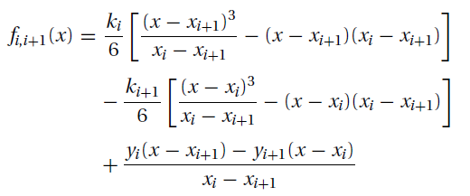
Example 4 : Sometimes it is preferable to replace one or both of the end conditions of the cubic spline with something other than the natural conditions. Use the end condition f _{0,1}(0) = 0 (zero slope), rather than f _{0,1}(0) = 0 (zero curvature), to determine the cubic spline interpolant at x = 2.6, given the data points.
Solution: We must first modify Eqs. (a) to account for the new end condition. Setting i = 0 in Eq. (b) and differentiating, we get
Eqs. (a) Eq. (b)
Thus the end condition f _{0,1}(x₀) = 0 yields
or

Slide 21
From the given data we see that y₀ = y₁ = 1, so that the last equation becomes
(c)
The other equations in Eq. (a) are unchanged. Knowing that k₃ = 0, they are
(d)
(e)
The solution of Eqs. (c)–(e) is k₀ = 0.4615, k₁ = −0.9231, k₂ = 0.2308.
The interpolant can now be evaluated from Eq. (b). Substituting i = 2 and x_{i} − x_{i+1} = −1, we obtain
Therefore,

Slide 22
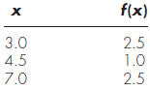
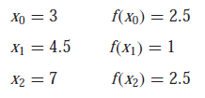
Example 5: Fit cubic splines using the data in the table. Utilize the results to estimate the value at x = 5.
Solution: The first step is to employ to generate the set of simultaneous equations that will be utilized to determine the second derivatives at the knots. For example, for the interior knot, the following data is used:
These values can be substituted into Eq. 7 to yield ( f’’ =k... )
(x₁ - x₀)f ’’(x₀) + 2 (x₂ - x₀)f ’’(x₁)+(x₂ - x₁)f ’’(x₂)=$\frac{6}{x2−x1}$(f(x₀) - f(x₁)) + $\frac{6}{x1−x0}$ (f(x₀) - f(x₁))

Slide 23
Because of the natural spline condition, f (3) = 0, and the equation reduces to
In a similar fashion, Eq. (7) can be applied to the second interior point to give
These two equations can be solved simultaneously for
These values can then be substituted into Eq. (6.a), along with values for the x’s and the f (x)’s, to yield
or

Slide 24
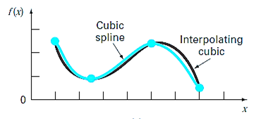
This equation is the cubic spline for the first interval. Similar substitutions can be made to develop the equations for the second and third intervals:
And
The three equations can then be employed to compute values within each interval. For example, the value at x = 5, which falls within the second interval, is calculated as
The graphic to be obtained when all values are calculated is as in the figure.

Slide 25
REFERENCES
Jaan Kiusalaas, “Numerical Methods in Engineering with Python 3”,3rd Edition, Cambridge, NY, 2013
S.C. Chapra and R.P. Canale, “Numerical Methods for Engineers”, 6th ed., McGraw-Hill,, NY, 2010

