Slide 1
YOGHURT TECHNOLGY
Res. Asst, DVM Bahar ONARAN
Ankara University, Faculty of Veterinary Medicine
Department of Food Hygiene and Technology

Slide 2
Yoghurt
A fermented dairy product whereby milk is inoculated with bacteria cultures.
Fermentation→ a slow decomposition process of organic substances induced by microorganisms or enzymes.
To produce yogurt, lactose, a compound sugar found in milk, is fermented by two different species of bacteria;
Streptococcus thermophilus
Lactobacillus delbrueckii subsp. bulgaricus

Slide 3
Streptococcus thermophilus
Lactobacillus bulgaricus
→ Thermophilic bacteria
Heat-loving
grows better at 40-45 ̊C

Slide 4
Yogurt is commercially produced by adding to milk a 2-4 % STARTER CULTURES that has been inoculated with a 2-5 % combination of S. thermophilus, L. bulgaricus (1:1 ratio).
The milk mixture is then incubated at 40-45 ̊C for 3-6 hours.
The product must be cooled immediately.

Slide 5
Milk SNF (solids-non-fat) content of yogurt varies from 9-16 %.
SNF can be increased by adding milk powder, and by other means.
Increased SNF levels are needed to increase protein content, which helps to increase product viscosity to desired levels.

Slide 6
The major flavor components of yogurt are carbonil compounds; among these, acetaldehyde is the most important and gives the yogurt its acidic flavor.
Other flavor compenents are;
diacetyl, lactic acid, acetic acid, acetoin, ethanol
Yogurt quality is based on color, apperance, body, texture and flavor.

Slide 7
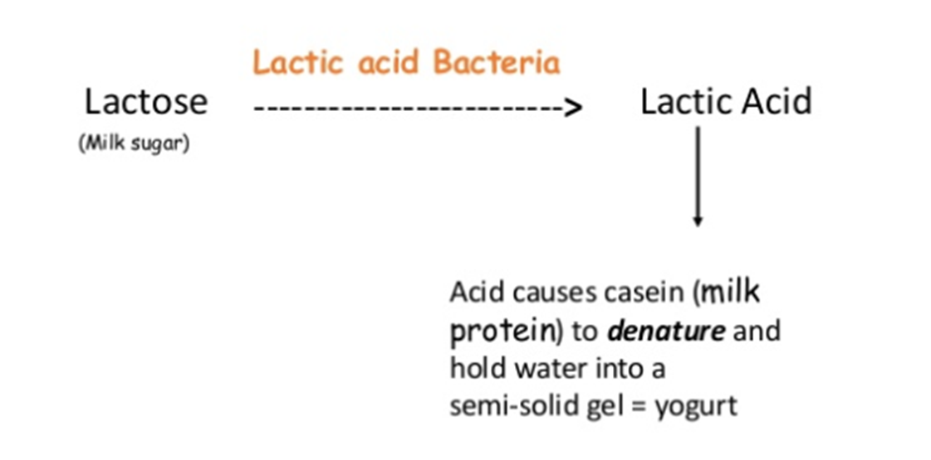
Lactic acid→ the end product of anaerobic metabolism of glucose, provides the sweet flavor of yogurt, as well as the formation of a gel structure.

Slide 8
Milk mixture: standardization of fat and solids content via seperation of fat, addition non-fat dry milk, concentrated milk
STEPS FOR THE MANUFACTURE OF YOGHURT
Homogenization: 7-17 Mpa, 50-55 ̊C
Pasteurization: 80-85 ̊C for 30 min or 90-95 ̊C for 5-10 min
and cool to 45 ̊C
Inoculation: Add 2% by weight S. thermophilus and L. bulgaricus
Incubation: Incubate for 3 hours at 45 ̊C
Cool to 4 ̊C and package

Slide 9
Why heating milk at higher temperatures?
Destroying pathogen microoorganisms
Opaque white color
Lactalbumin and lactoglobulin denaturation (they are yellow)
Consistence is higher
Condition the proteins: begins the denaturing process
A whey protein molecule binds to a casein molecule which disrupts the casein bundles allowing them to make short branched micelle chains
Appears formic acid, H2S molecules → starters grow better

Slide 10
Homogenization
Prevent creaming
More tasty due to the homogen dispertion of fatty acids
More digestable due to the little particules of fatty acids
Good effect on the consistance

Slide 11
Incubation temperature
40-45 ̊C takes 3 hours
Produces coarse protein network with thick trands give firmness but easily leak whey (a process called syneresis – the seperation of liquid from the gel)
30 ̊C takes 18 hours
Produces a finer more branched delicate network that holds the liquid whey.

Slide 12
L. bulgaricus is more acid tolerant and takes over untill acidity > 1 % (rods)
S. thermophilus is more active, then slows down when the acidity reaches 0.5 % (cocci)
These bacteria work in symbiosis.
Each bacterium stimulates the growth of to other → acidifies the milk more rapidly than either partner on its own.

Slide 13
Simbiosis
Initially S. thermophilus grows rapidly in the presence of oxygen and produce formic acid and CO2.
The anaerobic condition, formic acid and CO2 stimulate the growth of L. bulgaricus which has good exoproteinase and peptidase systems and produce amino acids and peptides from milk proteins.
L. bulgaricus produce amino acids such as glycine, valine, histidine, leucine and methionine. (sulfurous amino acids)

Slide 14
Simbiosis
These amino acids are necessary for the growth of S. thermophilus which lacks proteinase enzymes.
S. thermophilus grows rapidly until pH drops to 5.2-5.3 at the time of 2nd hour.

Slide 15
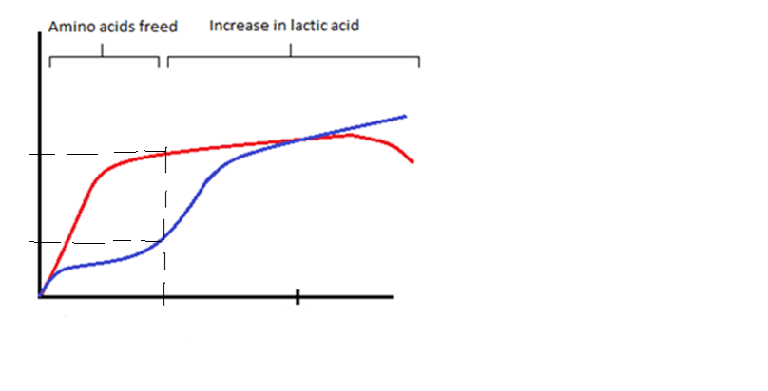
Relative concentration of bacteria
10⁹
L. bulgaricus
S. thermophilus
10³⁻⁴
Time
2 Hrs
3 Hrs

Slide 16
In pH 5.2-5.3 (at the end of the 2nd hour)
Stability of the caseinat particules break down.
Ca and phospates seperates from the casein complex
(Ca. Caseinate-Phosphate Complex) and they ionized.
Casein become precipitated.
First curd appears → it’s sweet and loose
Streptococcus thermophilus: 10⁹
Lactobacillus bulgaricus: 10³⁻⁴

Slide 17
After 2nd hour;
The growth of S. thermophilus slows down.
However, growth of L. bulgaricus continues fairly rapidly.
After 3 hours; we have to take it from the incubator.
(we have to cool it immediately)
At the time pH drops in to 4.6-4.8.
At that time both of the bacteria count: 10⁹ (and they are equal)
If we don’t take of it from the incubator, L. bulgaricus continues to grow and the taste of the yogurt become sour (acidic).
Because L. bulgaricus is proteolitic one.

Slide 18
The lactic acid coagulates the remaining milk proteins, causing the yogurt to thicken.

Slide 19
Fat contents of yogurt
The fat content of yogurt varies from 0-3.5 %,
Low fat yogurt → 1-1.5 % fat

