Slide 1
Lecture 2: One health: From Concept to Action
Video: One health:
From Concept to Action. Video link: https://www.cdc.gov/onehealth/basics/index.html
Dr. Bahar Onaran

Slide 2
…from the first lecture

Slide 3
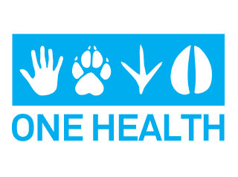
What is 'One Health'?
'One Health' is an approach to designing and implementing programmes, policies, legislation and research in which multiple sectors communicate and work together to achieve better public health outcomes.

Slide 4
The concept of One Health;
is the collaborative effort of multiple health science professions, together with their related disciplines and institutions
—working locally, nationally, and globally
—to provide optimal health for people, domestic animals, wildlife, plants, and our environment.

Slide 6
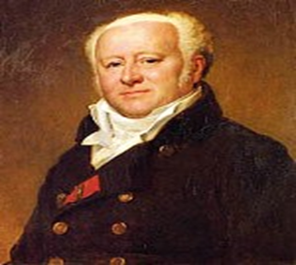
HISTORY OF ONE HEALTH
The concept of One Health is based on the historical concept of comparative medicine.
In the premodern era, there was no dividing line between human and animal medicine.
In the 19th century, rinderpest, a fatal infectious disease in cattle, was widespread in Europe.
A physician, Vicq d’Azyr, was one of the forefathers of comparative medicine, linked human and animal epidemics to climatic and geographical conditions through the study of rinderpest.

Slide 7
HISTORY OF ONE HEALTH
In the 19th century, the first modern veterinary educational institutions were established.
Still, animal medicine and human medicine were not strictly separated, and research was conducted into these 2 fields without the presence of strict disciplinary boundaries.
At the time, veterinary schools and medical schools had a system that allowed their students to attend each other and study both types of medicine without distinction.

Slide 8
HISTORY OF ONE HEALTH
“You can’t tell the story of human health separate from animal health or environmental health”.
Furthermore, most professors of early veterinary schools were physicians of human medicine.
Although the systems of medical and veterinary schools were completely separated at the end of the 19th century, physicians’ interest in animals persisted.
They used the term ‘comparative’ when studying animals, and considered animal research to be a field of medicine.
In the modern era, the epidemiologist William Foege, who played a major role in eradicating smallpox, said:

Slide 9
HISTORY OF ONE HEALTH
In 1975, the World Health Organization (WHO), the Office International des Epizooties, and the Food and Agriculture Organization of the United Nations collaboratively defined the concept of veterinary public health, which was an important facilitator of the international response to avian influenza in 2003.
One Health, which started with comparative medicine and then went through the paradigm of One Medicine before including environmental health, calls for a horizontal approach across interdisciplinary institutions and requires a contextual approach to ecosystems.

Slide 12
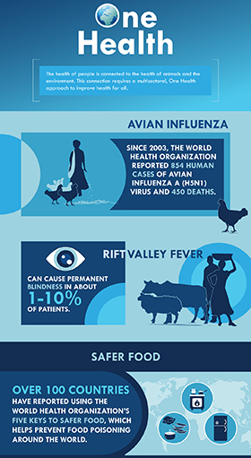
The health of people is connected to the health of animals and the environment.
This connection requires a multisectoral, One Health approach to improve health for all.
WHO: Five keys to safer food.
Video link: https://www.youtube.com/watch?v=ONkKy68HEIM

Slide 13
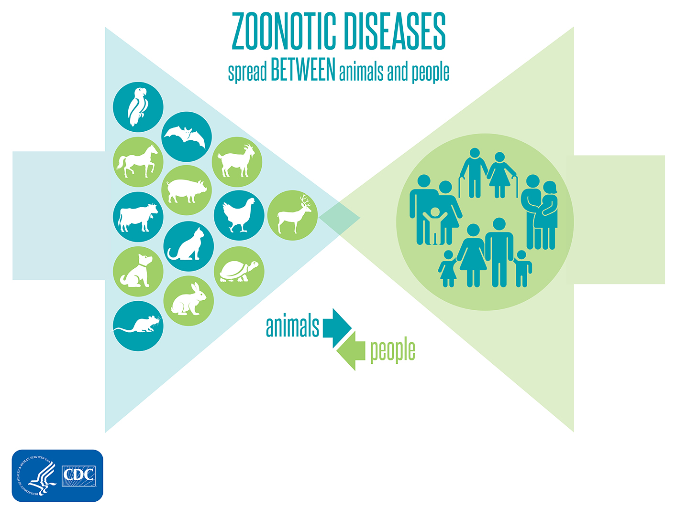
There are many examples that show how the health of people is related to the health of animals and the environment.
For instance, some diseases can be shared between animals and people.
These diseases are known as zoonotic diseases.
Examples include:
→Rabies
→Salmonella infection
→West Nile virus fever
→Q Fever (Coxiella burnetti)…

Slide 15
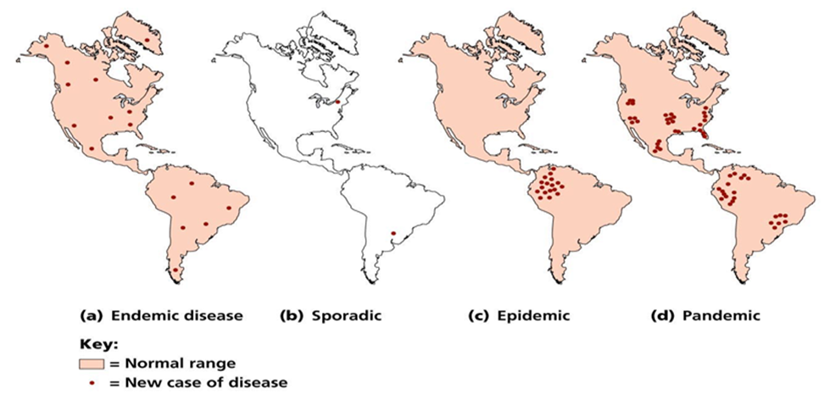

Slide 16
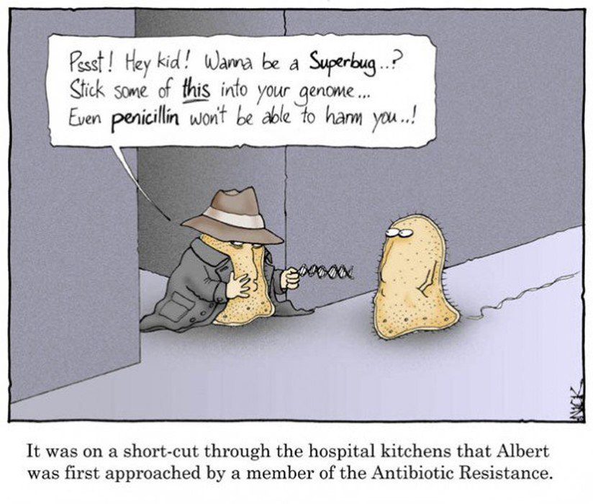
ANTIMICROBIAL RESISTANCE IN THE ONE HEALTH PERSPECTIVE
During the extended period of antibiotic exposure in animals that is used as a growth promoter, the bacteria in animals develop resistance, which can be transmitted to humans directly or indirectly.
Thus, the containment of AMR is not only an issue involving humans.

Slide 17
ANTIMICROBIAL RESISTANCE IN THE ONE HEALTH PERSPECTIVE
Each year in the United States, at least 2 million people acquire serious infections with bacteria that are resistant to one or more of the antibiotics designed to treat those infections.
At least 23,000 people die each year as a direct result of these antibiotic-resistant infections.
Many more die from other conditions that were complicated by an antibiotic resistant infection.

Slide 18
https://www.cdc.gov/drugresistance/threat-report-2013/pdf/ar-threats-2013-508.pdf#page=67

Slide 21
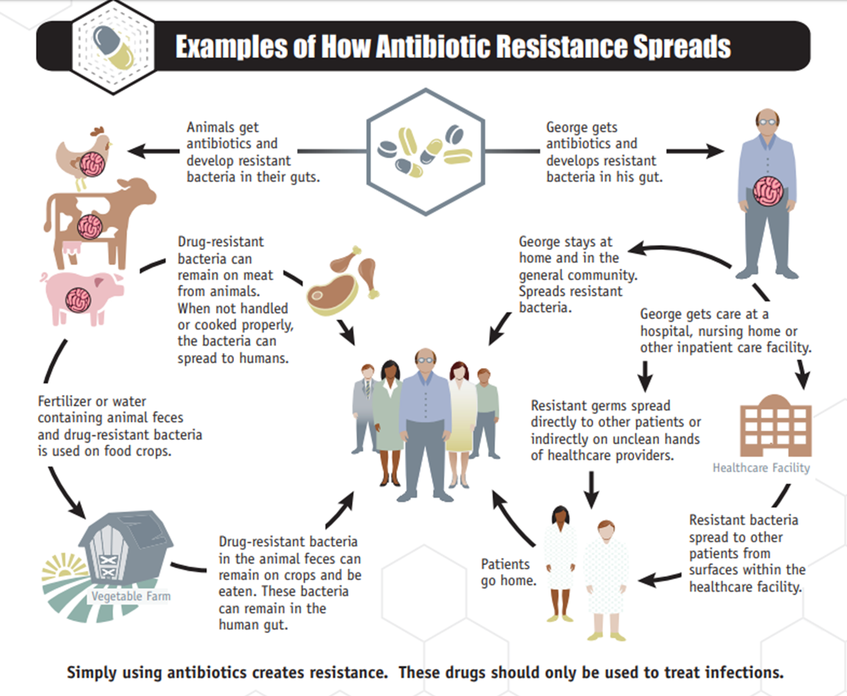

Slide 22
In general, threats assigned to the urgent and serious categories require more monitoring and prevention activities, whereas the threats in the concerning category require less.
Regardless of category, threat-specific CDC activities are tailored to meet the epidemiology of the infectious agent and to address any gaps in the ability to detect resistance and to protect against infections.

Slide 24
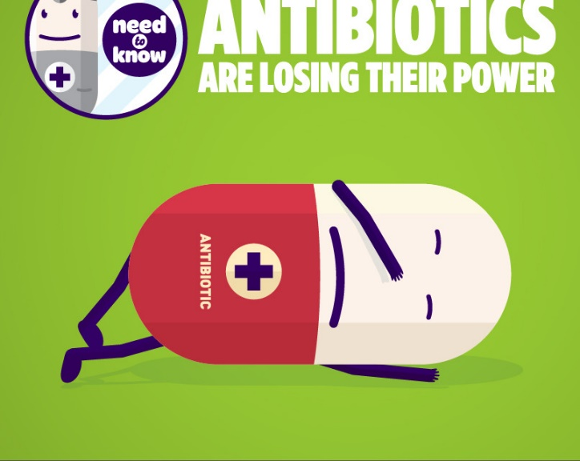
3. Lecture: Antibiotic resistance
What causes antibiotic resistance?
https://www.youtube.com/watch?v=znnp-Ivj2ek
CDC Vital Signs: Stop the Spread of Antibiotic Resistance (Extended)
https://www.youtube.com/watch?v=EPP9ReyvY2s
Superbugs: CDC's 2013 List of the Biggest Drug-Resistant Threats
https://www.youtube.com/watch?v=vb_g3lGKrso
The Threat of Antibiotic Resistance
https://www.youtube.com/watch?v=RpKZvnJwicA

Slide 26
FIGHTING BACK AGAINST ANTIBIOTIC RESISTANCE
4 Core Actions to Prevent Antibiotic Resistance
PREVENTING INFECTIONS, PREVENTING THE SPREAD OF RESISTANCE
Avoiding infections in the first place reduces the amount of antibiotics that have to be used and reduces the likelihood that resistance will develop during therapy.
There are many ways that drug-resistant infections can be prevented: immunization, safe food preparation, handwashing, and using antibiotics as directed and only when necessary.
In addition, preventing infections also prevents the spread of resistant bacteria.

Slide 27
2. TRACKING
CDC gathers data on antibiotic-resistant infections, causes of infections and whether there are particular reasons (risk factors) that caused some people to get a resistant infection.
With that information, experts can develop specific strategies to prevent those infections and prevent the resistant bacteria from spreading.

Slide 28
3. IMPROVING ANTIBIOTIC PRESCRIBING/STEWARDSHIP
Perhaps the single most important action needed to greatly slow down the development and spread of antibiotic-resistant infections is to change the way antibiotics are used.
Up to half of antibiotic use in humans and much of antibiotic use in animals is unnecessary and inappropriate and makes everyone less safe.
Stopping even some of the inappropriate and unnecessary use of antibiotics in people and animals would help greatly in slowing down the spread of resistant bacteria.
This commitment to always use antibiotics appropriately and safely—only when they are needed to treat disease, and to choose the right antibiotics and to administer them in the right way in every case—is known as antibiotic stewardship.

Slide 29
4. DEVELOPING NEW DRUGS AND DIAGNOSTIC TESTS
Because antibiotic resistance occurs as part of a natural process in which bacteria evolve, it can be slowed but not stopped.
Therefore, we will always need new antibiotics to keep up with resistant bacteria as well as new diagnostic tests to track the development of resistance.

Slide 30
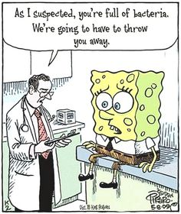
Preventing Infections: CDC’s Work to Prevent Antibiotic Resistance in Food
Each year, millions of people in the United States become sick from foodborne and other enteric (gastrointestinal) infections.
While many of these infections are mild and do not require treatment, antibiotics can be lifesaving in severe infections.
Antibiotic resistance compromises our ability to treat these infections and is a serious threat to public health.

Slide 31
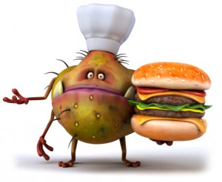
Preventing Infections: CDC’s Work to Prevent Antibiotic Resistance in Food
Preventing resistant enteric infections requires a multifaceted approach and partnerships because bacteria that cause some infections, such as salmonellosis and campylobacteriosis, have animal reservoirs, while other bacteria, such as those that cause shigellosis and typhoid fever, have human reservoirs.
To prevent antibiotic-resistant foodborne infections, CDC works closely with state and local health departments; with the U.S. Food and Drug Administration (FDA), which regulates antibiotics, many foods, animal feed, and other products; and with the U.S. Department of Agriculture (USDA), which regulates meat, poultry, and egg products.

Slide 32
1.Tracking Antibiotic Resistance
In 1996, the National Antimicrobial Resistance Monitoring System (NARMS) was established as a collaboration among CDC, FDA, USDA, and state and local public health departments.
This national public health surveillance system tracks antibiotic resistance among Salmonella, Campylobacter, and other bacteria transmitted commonly through food.
NARMS tests bacteria from humans (CDC), retail meats (FDA), and food-producing animals (USDA) in the United States.

Slide 33
1.Tracking Antibiotic Resistance
The primary objectives of the NARMS program are to:
Monitor trends in antibiotic resistance among enteric bacteria from humans, retail meats, and food-producing animals.
Disseminate information on antibiotic resistance to promote interventions that reduce antibiotic resistance among foodborne bacteria.
Conduct research to better understand the emergence, persistence, and spread of antibiotic resistance.
Provide data that assist the FDA in making decisions about approving safe and effective antibiotic drugs for animals.

Slide 34
1.Tracking Antibiotic Resistance
The CDC reference laboratory conducts antibiotic susceptibility testing on isolates from sporadic cases and outbreaks of illness.
The lab also confirms and studies bacteria that have new antibiotic resistance patterns.
NARMS provides information about patterns of emerging resistance among enteric pathogens to stakeholders, including federal regulatory agencies, policymakers, consumer advocacy groups, industry, and the public, to guide public health prevention and policy efforts that protect people from resistant infections.
For more information about NARMS: www.cdc.gov/narms.

Slide 35
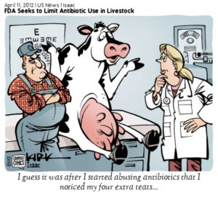
2.Improving Antibiotic Use
Antibiotics are widely used in food-producing animals.
According to data published by FDA, there are more kilograms of antibiotics sold in the United States for foodproducing animals than for people!
→This use contributes to the emergence of antibiotic-resistant bacteria in food-producing animals.
→Resistant bacteria in foodproducing animals are of particular concern because these animals serve as carriers.

Slide 36
2.Improving Antibiotic Use
Resistant bacteria can contaminate the foods that come from those animals, and people who consume these foods can develop antibiotic-resistant infections.
Antibiotics must be used judiciously in humans and animals because both uses contribute to not only the emergence, but also the persistence and spread of antibiotic-resistant bacteria.

Slide 37
2.Improving Antibiotic Use
Scientists around the world have provided strong evidence that antibiotic use in foodproducing animals can harm public health through the following sequence of events:
■ Use of antibiotics in food-producing animals allows antibiotic-resistant bacteria to thrive while susceptible bacteria are suppressed or die.
■ Resistant bacteria can be transmitted from food-producing animals to humans through the food supply.
■ Resistant bacteria can cause infections in humans.
■ Infections caused by resistant bacteria can result in adverse health consequences for humans.

Slide 38
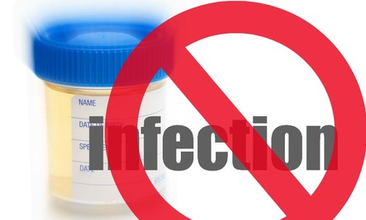
3.Preventing Infections
Efforts to prevent foodborne and other enteric infections help to reduce both antibiotic-resistant infections and antibiotic-susceptible infections →those that can be treated effectively with antibiotics.
CDC activities that help prevent these infections include:
Estimating how much foodborne illness occurs.
Monitoring trends in foodborne infections.
Investigating outbreaks and sporadic cases of foodborne illness to stop outbreaks and improve prevention.
Attributing illnesses to specific foods and settings.

Slide 39
3.Preventing Infections
Tracking and responding to changes in resistance.
Determining the sources of antibiotic-resistant enteric infections.
Educating consumers and food workers about safe food handling practices.
Identifying and educating groups at high risk for infection.
Promoting proper handwashing.
Strengthening the capacity of state and local health departments to detect, respond to, and report foodborne infections.
Developing better diagnostic tools to rapidly and accurately find sources of contamination.
Providing recommendations for travelers on safe food and clean water.

Slide 40
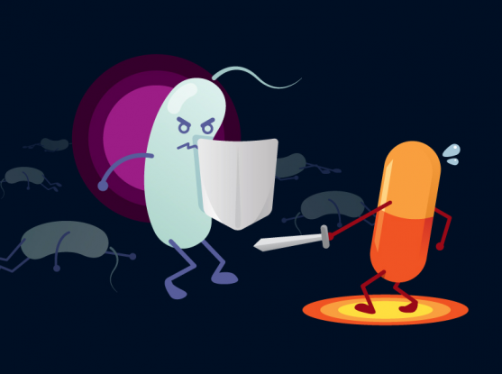
BYE !

Slide 41
