Slide 1
Trace elements

Slide 2
Naturally occuring, inorganic substance required in humans in amounts less than 100 mg/day

Slide 3
Essential trace elements are;
Iron
Zinc
Copper
Ulratrace elements:
Cobalt
Crom
Fluoride
Iodide
Mangan
Molibdenium
Selenium

Slide 4
Iron
Body content 4-6 g
in Hb %68,
ferritin 13 %,
Haemosiderin 12 %,
myoblobin 3%,
iron enzymes 0.2 %

Slide 5
Iron dependent enzymes
Cytochrome oxidase, xanthine oxidase, peroxidase
Body requirement: 0.5 -2 mg/day
3-5 mg/day (pregnancy)
Daily excretion 0.9 mg/day
1.3 md/day (during mens. period)

Slide 6
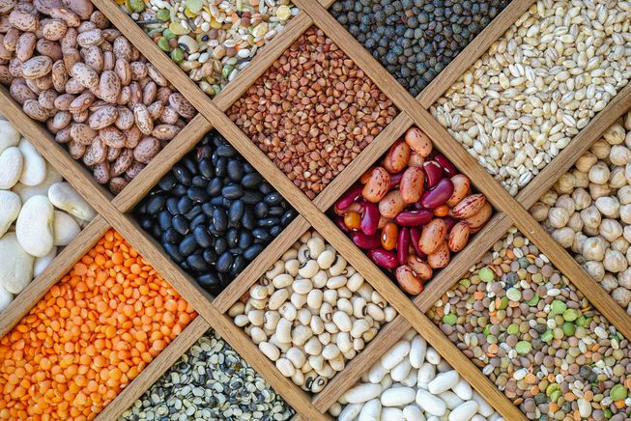
Sources
Leafy greens, broccoli, whole grains, beans, pulses, liver, spleen, egg

Slide 9
Anemia, iron deficiency
When iron deficient, hemoglobin cannot be produced.
When there is unsufficient hemoglobin, red blood cells are small, microcyctic and hypochromic and so unable to deliver suffiennt oxygen to the tissues. This stuation is known as iron deficiency anemia

Slide 10
Iron is essential for cellular metabolism (enzymatic reactions, oxygen transport, oxidation-reduction reactions etc.) but too much can be toxic
Iron overload can happen over time and accumulates in tissues as heart and liver
Most common form of iron overload is hemochromatosis

Slide 11
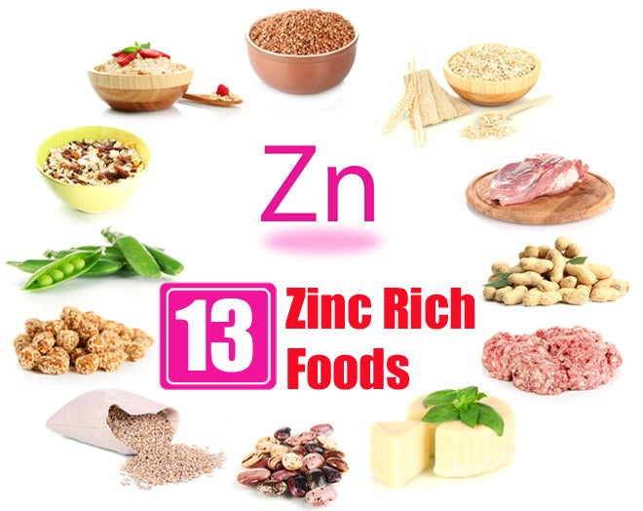
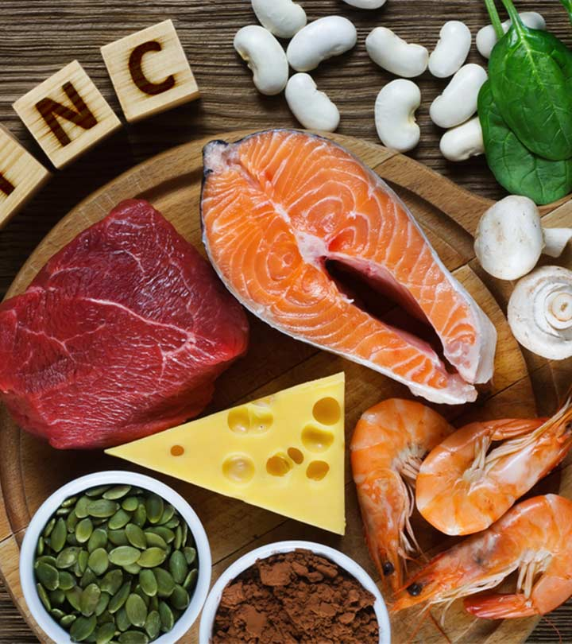
Zinc
Zinc is essential in the diet for growth and development
It is most abundant intracellular trace element
It is involved in thr functioning of over 300 different enzymes, SOD (superoxide dismutase, protecting cells from free radical damage)
Zinc can be bound phytates, affecting bioavailability
It can be toxic if taken in excess as iron

Slide 12
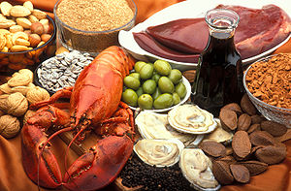
Copper
Copper is important for enzyme activity
Helping to prevent certain types of anemia
The richest dietary source of copper is organ meat, seafood, nuts, whole grain foods, chocolate
RDA 900 micrograms per day
Zinc can decrease bioavailability of copper

Slide 13
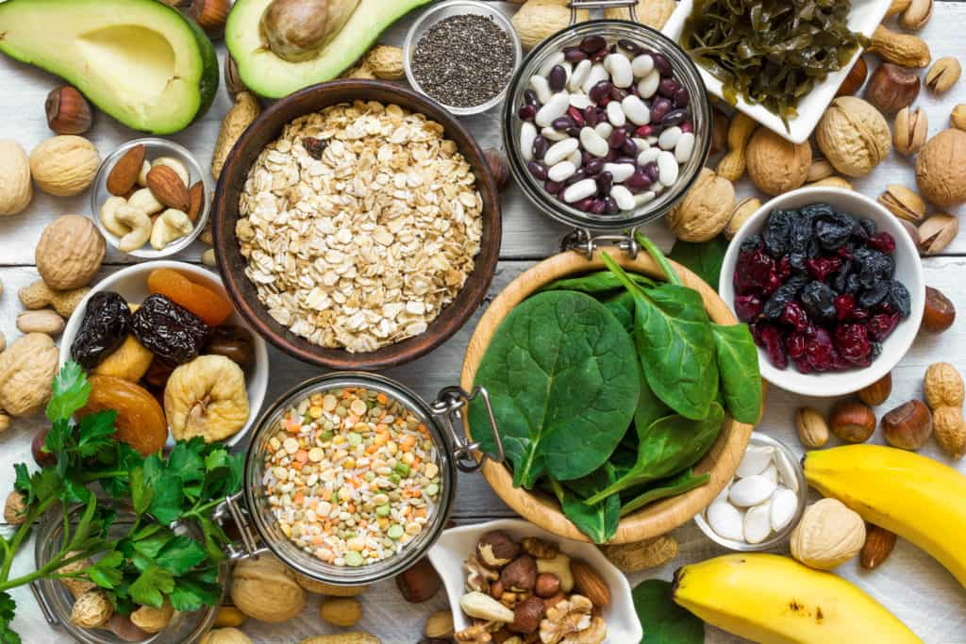
Manganese
Manganese is a constituent of some enzymes and activator of some enzymes
Manganese-requiring enzymes: carbohydrates, amino acid and cholesterol metabolism
It is needed for the activity of a form of superoxide dismutase

Slide 14
Selenium
It is content of plant foods, grains and seeds
Its deficiency can lead to Keshan disease affecting the heart muscle
In deficiency ; muscular discomfort,weakness
Low selenium----------higher incidence of cancer

Slide 15
Iodine
Iodine content of food depends on the soil
Soil near the ocean or sea is higher in iodine than soil in land
Iodized salt is salt fortified with iodine. Natural sea salt may be low in iodine
More than half the iodine in thr body is found in the thyroid gland
It is an essential component of thyroid hormones, T4

Slide 17
When supply of iodine is adequate, the body can produce the needed thyroid hormones
Consuming diets high in goitrogens such as cabbage, millet limits bioavailability of iodine
RDA; 150 micrograms
1100 mictogram toxic

Slide 18
Chromium
Dietary sources of chromium include liver, nuts, whole grains
Using stainles steel can increase foods chromium content
Chromium is involved in carbohydrate and lipid metabolism

Slide 19
Fluoride
It is important for dental health
The most common sources of fluoride are tea, marine fish’s bone (salmon, sardine), toohpaste
Calsium-rich foods reduce the bioavailability of fluoride

