Slide 1
LIFE AND WORK IN THE 19TH CENTURY UNITED STATES
AKE 118 DR. GAMZE KATI GUMUS

Slide 2
The rise of industrial America, 1876-1900
In the decades following the Civil War, old industries expanded and many new ones emerged:
petroleum refining
steel manufacturing
electrical power
The expansion of the railroads brought even remote parts of the country into the national market economy.
Notes:
The materials for this week’s course are taken from https://www.loc.gov/classroom-materials/united-states-history-primary-source-timeline/rise-of-industrial-america-1876-1900/

Slide 3
The Emergence of new classes
Wealthy industrialists
Prosperous middle class
Expanded blue-collar working class
millions of newly arrived immigrants
even more migrants from rural America

Slide 4
LABOR UNIONS
Many workers supported and joined labor unions because
Many were typically unemployed during some parts of the year
Wages were relatively low
Farmers also faced hard times because of the competition and the falling prices caused by
Technology
Increasing production
Therefore, many young people that lived in the rural parts of the US moved to the city in search of better job opportunities.

Slide 5
wHAT ELSE CHANGED SINCE MID-19TH CENTURY?
The major source of light changed from candles, to kerosene lamps, and then to electric light bulbs.
The transportation evolved from walking and horse power to steam-powered locomotives, to electric trolley cars, to gasoline-powered automobiles.
In the mid-19th century, most people were involved in agriculture, but with the industrial revolution millions of people migrated from rural America to the nation's rapidly growing cities.

Slide 6
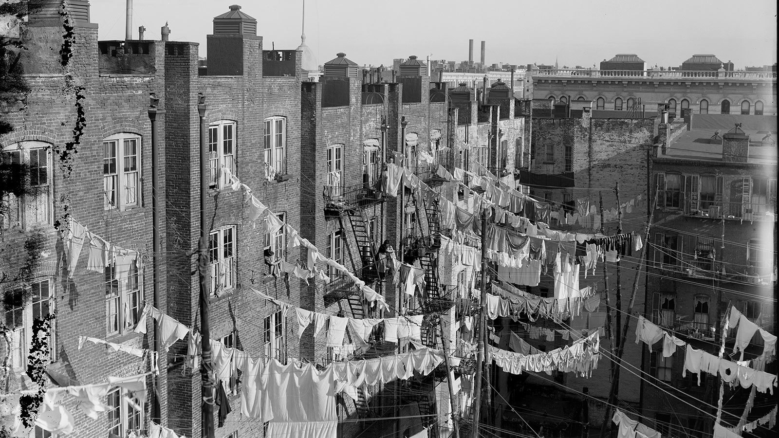
CITY LIFE IN THE 19TH CENTURY

Slide 7
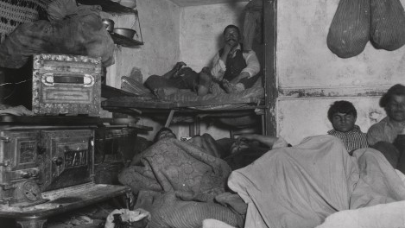
Jacob Riis – Lodgers on Bayard Street, NY

Slide 8
City life in the 19th century us
Owing most of their population growth to the expansion of industry, U.S. cities grew by about 15 million people in the two decades before 1900.
Noise, traffic jams, slums, crime, air pollution, sanitation, and health problems became commonplace.

Slide 9
City life in the 19th century us
Cholera, tuberculosis,yellow-fever epidemics swept through the slums on a regular basis.
Almost 25% of babies born in late-19th century cities died before reaching the age of one.
Notes:
From https://www.ushistory.org/us/38b.asp

Slide 10
City life in the 19th century us
People used private cesspools, which overflowed with a long, hard rain. Old sewage pipes dumped the waste directly into the rivers or bays. These rivers were often the very same used as water sources.
Trash collection had not yet been systemized. Trash was dumped in the streets or in the waterways. Better sewers, water purification, and trash removal were some of the most pressing problems for city leadership.
Notes:
https://www.ushistory.org/us/38b.asp

Slide 11
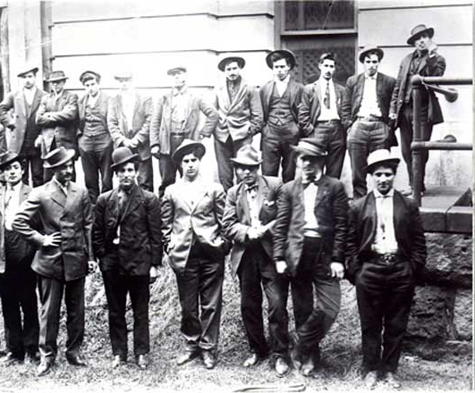
City life in the 19th century us
Youths who dreaded a life of monotonous factory work and pauperism sometimes roamed the streets in gangs.
Vices such as gambling, prostitution, and alcoholism were widespread.
Gambling rendered the hope of getting rich quick.
Prostitution provided additional income.
Alcoholism furnished a false means of escape.
City police forces were often understaffed and underpaid, so those with wealth could buy a better slice of justice.
Notes:
https://www.ushistory.org/us/38b.asp
The Five-Points Gang

Slide 12
City life in the 19th century us
Mass transit, in the form of trolleys, cable cars, and subways, was built.
Boston Subway, the nation’s first subway, was built in 1897.

Slide 13
Boston Subway (1897)

Slide 14
City life in the 19th century us
The skyscrapers began to dominate city skylines in Chicago and New York.

Slide 15
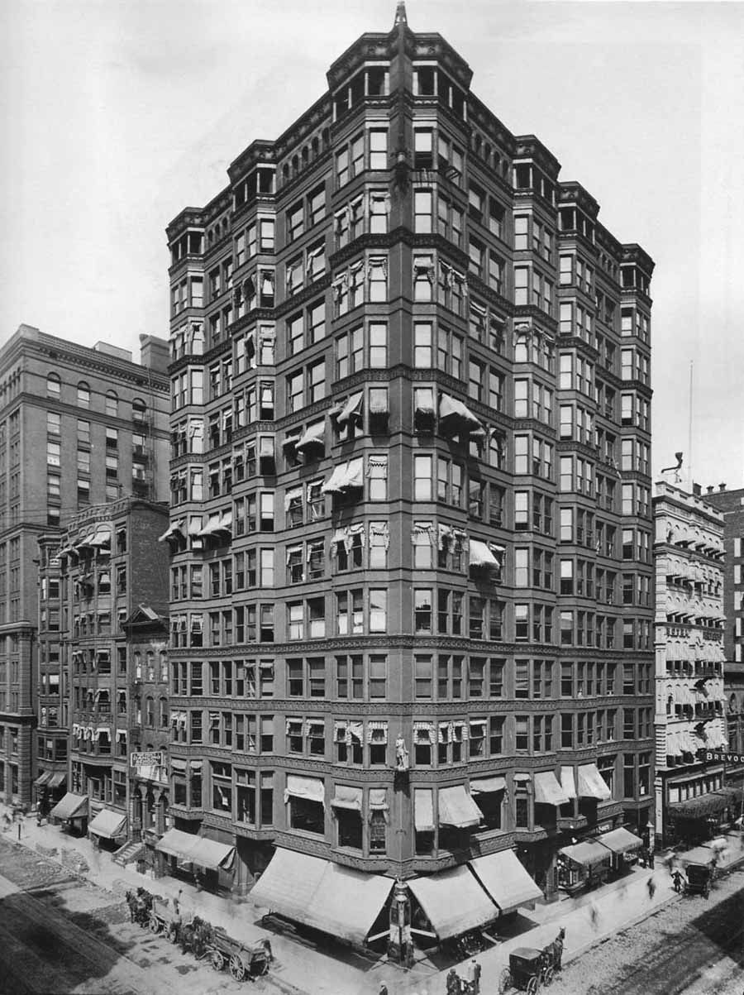
Tacoma building, 1889 Chicago

Slide 16
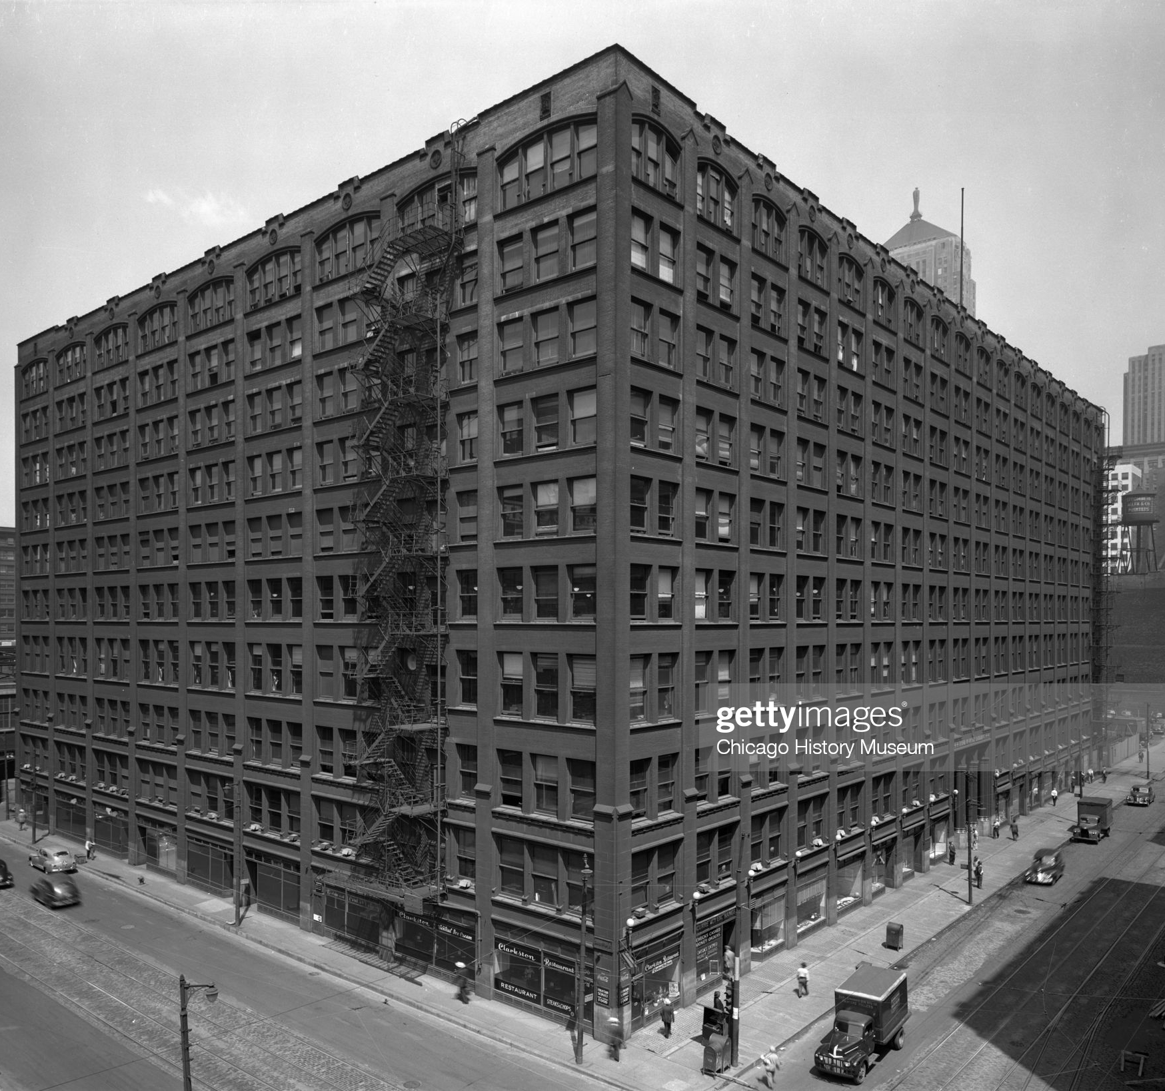
The rand- McNally building, 1889 chicago

Slide 17
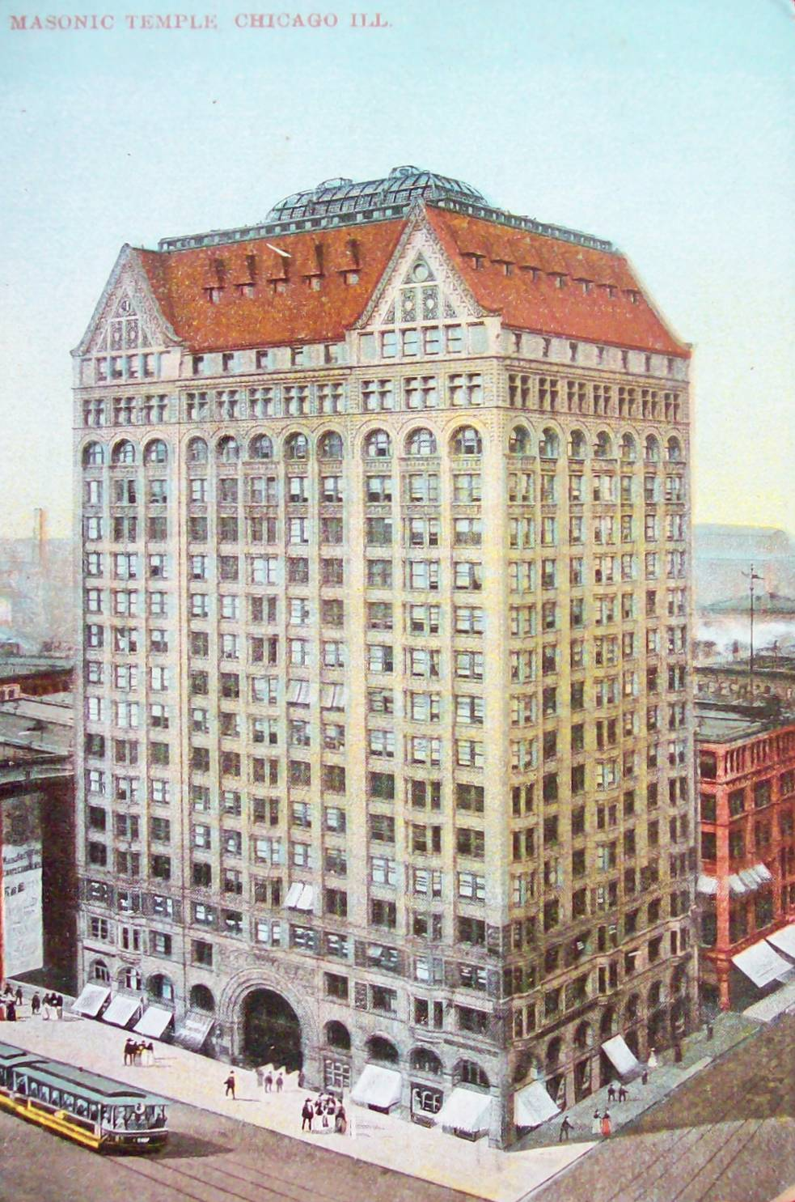
THE MASONIC TEMPLE, 1892 CHICAGO

Slide 18
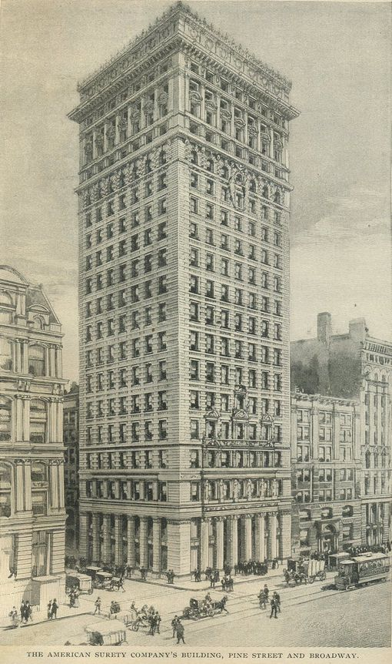
AMERICAN SURETY BUILDING, 1896 NY

Slide 19
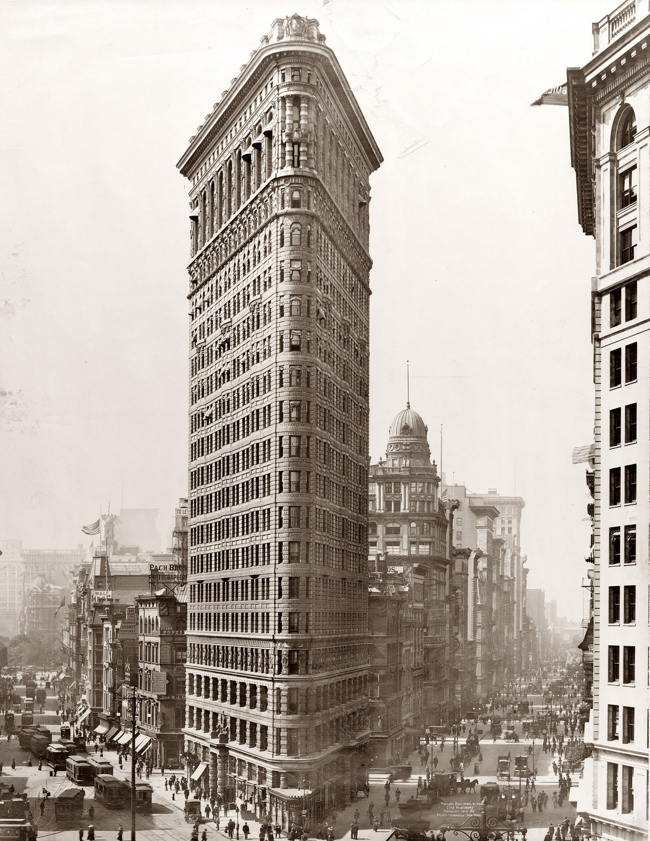
THE FLATIRON BUILDING, 1902 NY

Slide 20
City life in the 19th century us
New communities, known as suburbs, began to be built just beyond the city.
Commuters, those who lived in the suburbs and traveled in and out of the city for work, began to increase in number.

Slide 21
City life in the 19th century us
Many of those who resided in the city lived in rental apartments or tenement housing.
Neighborhoods, especially for immigrant populations, were often the center of community life.
In the enclave neighborhoods, many immigrant groups attempted to hold onto and practice precious customs and traditions. Even today, many neighborhoods or sections of some of the great cities in the United States reflect those ethnic heritages.

Slide 22
Italian immigrant rag-picker, ny
Notes:
These photographs are taken by Jacob Riis and are compiled in his 1890 book How the Other Half Lives. This and the ones about tenements that follow are from https://www.history.com/topics/immigration/tenements#&gid=ci023648dc900027a7&pid=jacob-riis-tenements-3233302

Slide 23
Single family Houses were divided to pack in as many people as possible

Slide 24
Tenement buildings often used cheap materials, had little or no indoor plumbing nor proper ventilation

Slide 25
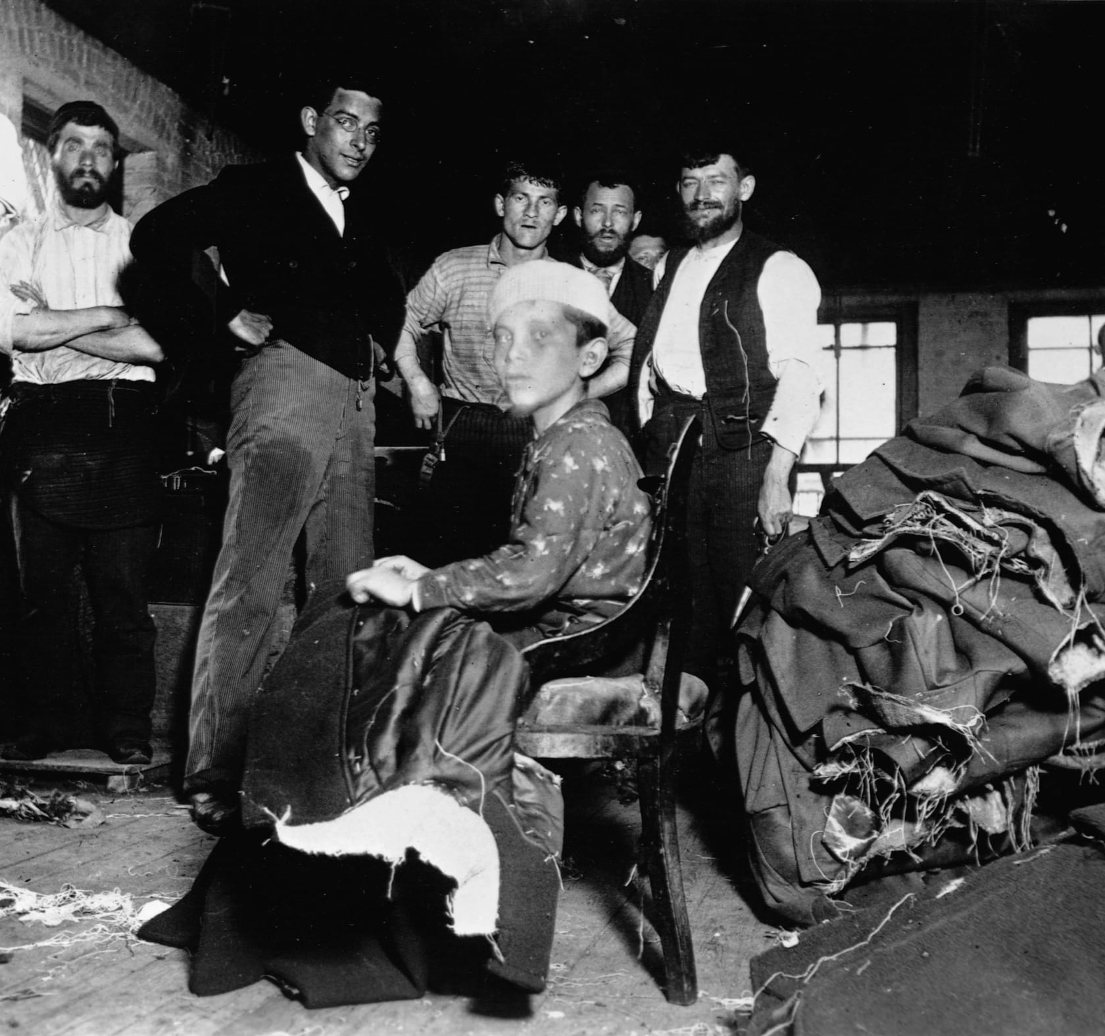
Child labor, 12-year-old thread puller

Slide 26
Street children/ragamuffin/street urchin

Slide 27
A man sorts through trash in a makeshift home under a dump in ny.

Slide 28
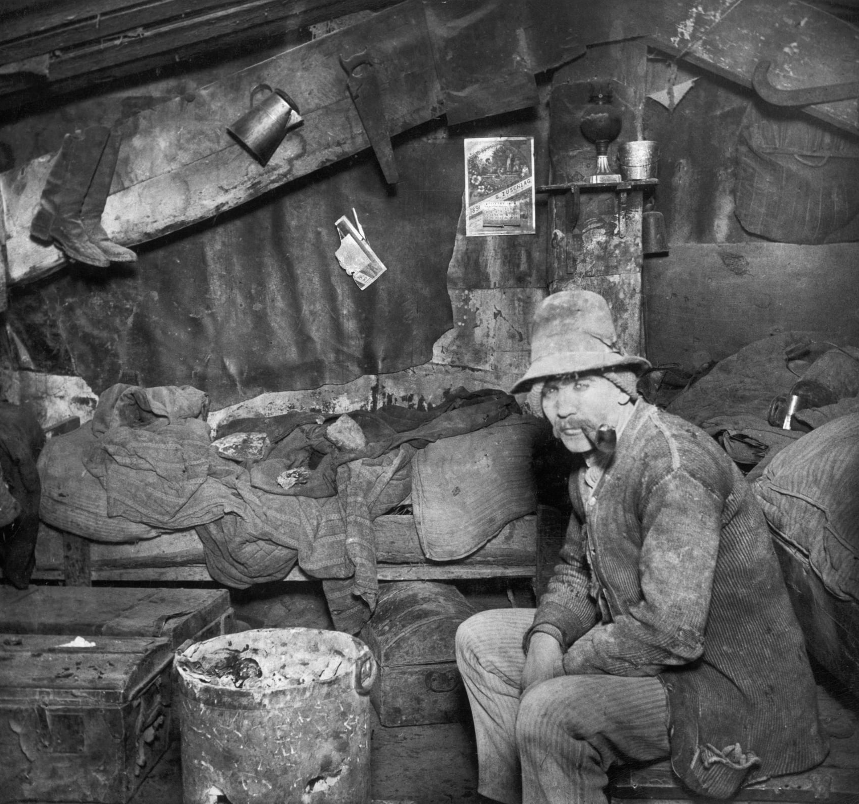
Cellar of a tenement house

Slide 29
Little italy
Notes:
https://stuffnobodycaresabout.com/2015/06/03/new-yorks-little-italy-described-in-1898/

Slide 30
Chinatown, 1896

Slide 31
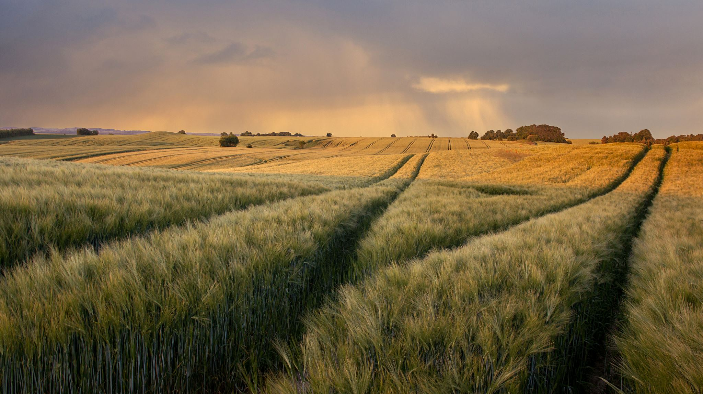
RURAL LIFE IN THE 19TH CENTURY US

Slide 32
RURAL LIFE IN THE 19TH CENTURY US
Abundant rainfall in the 1880s and the promise of free land under the Homestead Act drew easterners to the plain.
When dry weather returned, the homesteaders' crops failed, sending many of them into debt, farther west, or back to the east or south.
Notes:
https://www.loc.gov/classroom-materials/united-states-history-primary-source-timeline/rise-of-industrial-america-1876-1900/rural-life-in-late-19th-century/

Slide 33
RURAL LIFE IN THE 19TH CENTURY US
New machines for use in farming were invented in this period, but horses, oxen, and people still provided most of the power that operated the machinery.
While farmers now produced cash crops (crops grown for sale), they were still remarkably self-sufficient, often making or trading for nearly everything required by their own families.

Slide 34
RURAL LIFE IN THE 19TH CENTURY US
Under the crop-lien and sharecropping systems, poor southern farmers — white and black — endured a vicious cycle.
Their debt payments left them with little for basic necessities and farm improvements. In order to satisfy their obligations, farmers had no choice but to grow more cotton: the only crop of value.
As a result, they could not devote much of their land to food crops, which meant they had to rely on store owners and creditors to provide for their families. In this way, many farmers were trapped in a never-ending cycle of debt, unable to buy the land they farmed or to stop working for their creditors.
Notes:
https://www.sophia.org/tutorials/rural-america-in-the-late-19th-century

Slide 35
Work in the late 19th century

Slide 36
Work in the late 19th century
In the century since such mechanization had begun, machines had replaced highly skilled craftspeople in one industry after another.
By reducing labor costs, such machines not only reduced manufacturing costs but lowered prices manufacturers charged consumers.
In short, machine production created a growing abundance of products at cheaper prices.
Notes:
https://www.loc.gov/classroom-materials/united-states-history-primary-source-timeline/rise-of-industrial-america-1876-1900/work-in-late-19th-century/

Slide 37
Work in the late 19th century
Skilled craftspeople of earlier days had the satisfaction of seeing a product through from beginning to end.
Machines, on the other hand, tended to subdivide production down into many small repetitive tasks with workers often doing only a single task.
The pace of work usually became faster and faster; work was often performed in factories built to house the machines.
Finally, factory managers began to enforce an industrial discipline, forcing workers to work set hours which were often very long.

Slide 38
Average WORK HOURS in the 19th century?
14-16 hours a day
6 days a week
Notes:
https://www.striking-women.org/module/workplace-issues-past-and-present/working-hours

