Slide 1
BIO 206 PLANT MORPHOLOGY
LECTURE NOTES
3RD WEEK
DR. AYDAN ACAR ŞAHİN

Slide 2
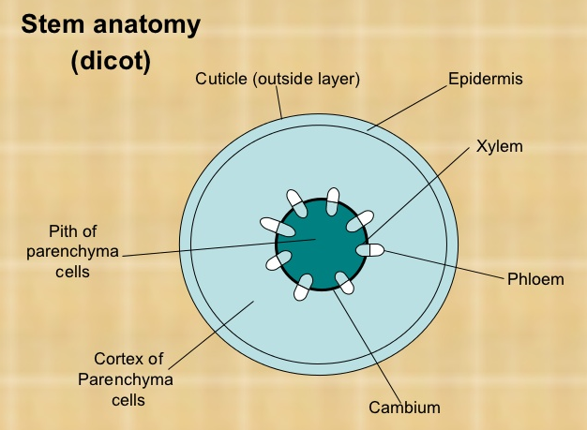
Dıcot stem anatomy
Anatomically (in cross section) the dicot stem has the following regions:
(1). Epidermis
(2). Cortex
(3). Central cylinder

Slide 3
Epidermis:
Outermost layer
Composed of single layer of cells.
Closely packed without any intercellular spaces.
Deposited with fatty substances called cutin.
Cutin occurs as separate layer called cuticle.
The epidermis of young stem also contains few stomata.
Multicellular hairs (called trichome) are usually present in the epidermis.
In herbaceous plants, where secondary growth is absent, the epidermis remains throughout the life cycle.
However, in woody plants, the epidermis is replaced with periderm after the secondary growth due to bark formation.
Notes:
outermost layer
Usually, epidermis composed of single layer of cells.
Cells are closely packed without any intercellular spaces.
This wall area is deposited with fatty substances called cutin.
The cutin over the cell wall occurs as separate layer called cuticle.
The epidermis of young stem also contains few stomata.
Multicellular hairs (called trichome) are usually present in the epidermis.
In herbaceous plants, where secondary growth is absent, the epidermis remains throughout the life cycle.
However, in woody plants, the epidermis is replaced after the secondary growth due to back formation.

Slide 4
EPIDERMIS

Slide 5
Cortex
The tissue inner to the epidermis.
In some plants, the cortex is simple and undifferentiated.
Loosely packed with plenty of intercellular spaces.
Cells of this region are chlorenchymatous (parenchyma with chloroplasts).
In xerophytes, the outer cortical cells forms palisade like tissue for photosynthesis, since these plants usually lack leaves.
Sometimes composed of loosely packed parenchymatous cells which is storage of carbohydrates.
Sclerenchymatous patches occur in the cortex
Secretory cavities occur in the cortex
Resin canals occur in the cortex
Laticifer cells occur in the cortex of latex producing plants.
Notes:
Cortex is the tissue occupied just inner to the epidermis.
In some plants, the cortex is simple and undifferentiated.
Cells of this region are chlorenchymatous (parenchyma with chloroplasts).
The cells are loosely packed with plenty of intercellular spaces.
In xerophytes, the outer cortical cells forms palisade like tissue for photosynthesis, since these plants usually lack leaves.
Sometimes Composed of loosely packed parenchymatous cells which is storage of carbohydrates.
Sclerenchymatous patches occur in the cortex
Secretory cavities occur in the cortex
Resin canals occur in the cortex
Laticifer cells occur in the cortex of latex producing plants.

Slide 6
CORTEX

Slide 7
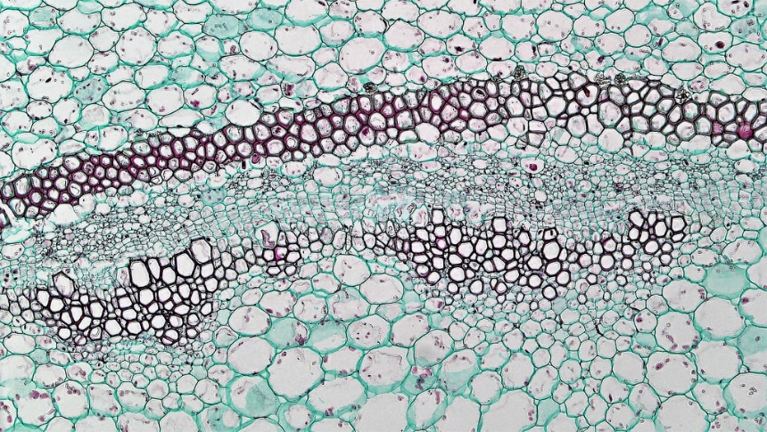
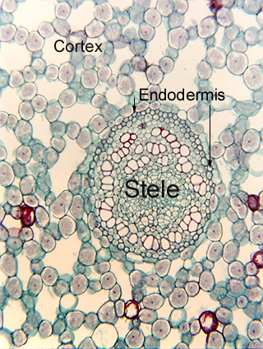
Endodermis
The innermost layer of cortex.
Very distinct in lower plants such as Pteridophytes.
NOT distinct in the stem of Gymnosperms and Angiosperms.
Cells of the endodermis accumulate plenty of starch grains. Thus, the endodermis is also called starch sheath or starch band or starch layer.
If distinct, the endodermis is uniseriate (single layer) with barrel shaped cells.
Cells paranchymatous and they compactly arranged.
Have characteristic thickness in radial and inner tangential walls.
This thickening is called casparian thickening (casparian band, casparian layer).
The casparian band is composed of suberin and lignin, both of them are impervious to water.
Due to the presence of casparian thickening, they block the passage of water and solutes through the protoplasts of endodermal cells..
Notes:
Endodermis is the innermost layer of cortex.
The endodermis is very distinct in lower plants such as Pteridophytes.
NOT distinct in the stem of Gymnosperms and Angiosperms.
Cells of the endodermis accumulate plenty of starch as grains. Thus, the endodermis is also called starch sheath or starch band or starch layer.
If distinct, the endodermis is uniseriate (single layer) with barrel shaped cells.
Cells paranchymatous and they compactly arranged.
Endodermal cells have characteristic thickness in radial and inner tangential walls.
This thickening is called casparian thickening (casparian band, casparian layer).
The casparian band is composed of suberin and lignin, both of them are impervious to water.
Due to the presence of casparian thickening, they block the passage of water and solutes through the protoplasts of endodermal cells..

Slide 8
CENTRAL CYLINDER
The central cylinder of stem composed of three components:
a) Pericycle b) Vascular tissues c) Pith
(a) Pericycle
Pericycle is the outermost layer of the central cylinder.
It is located next (just inner) to the endodermis.
The nature of pericycle in stem shows wide variation.
Pericycle is absent in some plants.
If present, it usually multilayered composed of 3 or more layers of cells.
Sclerenchymatous pericycle forms the bundle sheath of the vascular bundle in most of the dicot plants.

Slide 9
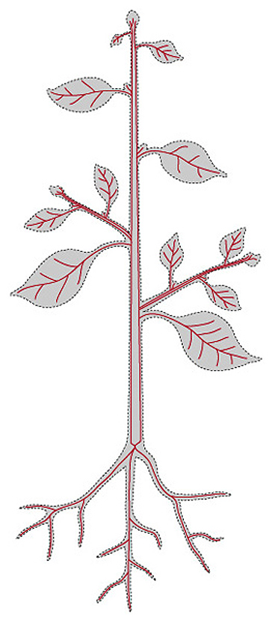
B. Vascular tıssues
Transports water and organic materials (sugars) throughout the plant
Xylem – transports water and
dissolved ions from the root
to the stem and leaves.
Phloem – carries dissolved sugars
from leaves to rest of the plant

Slide 10
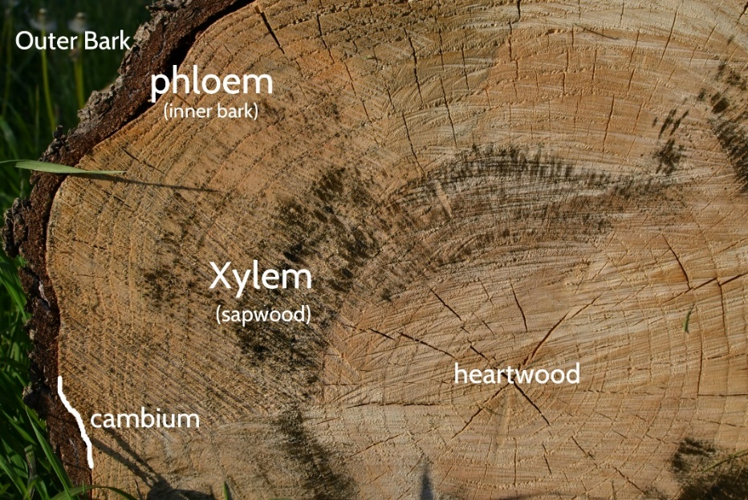
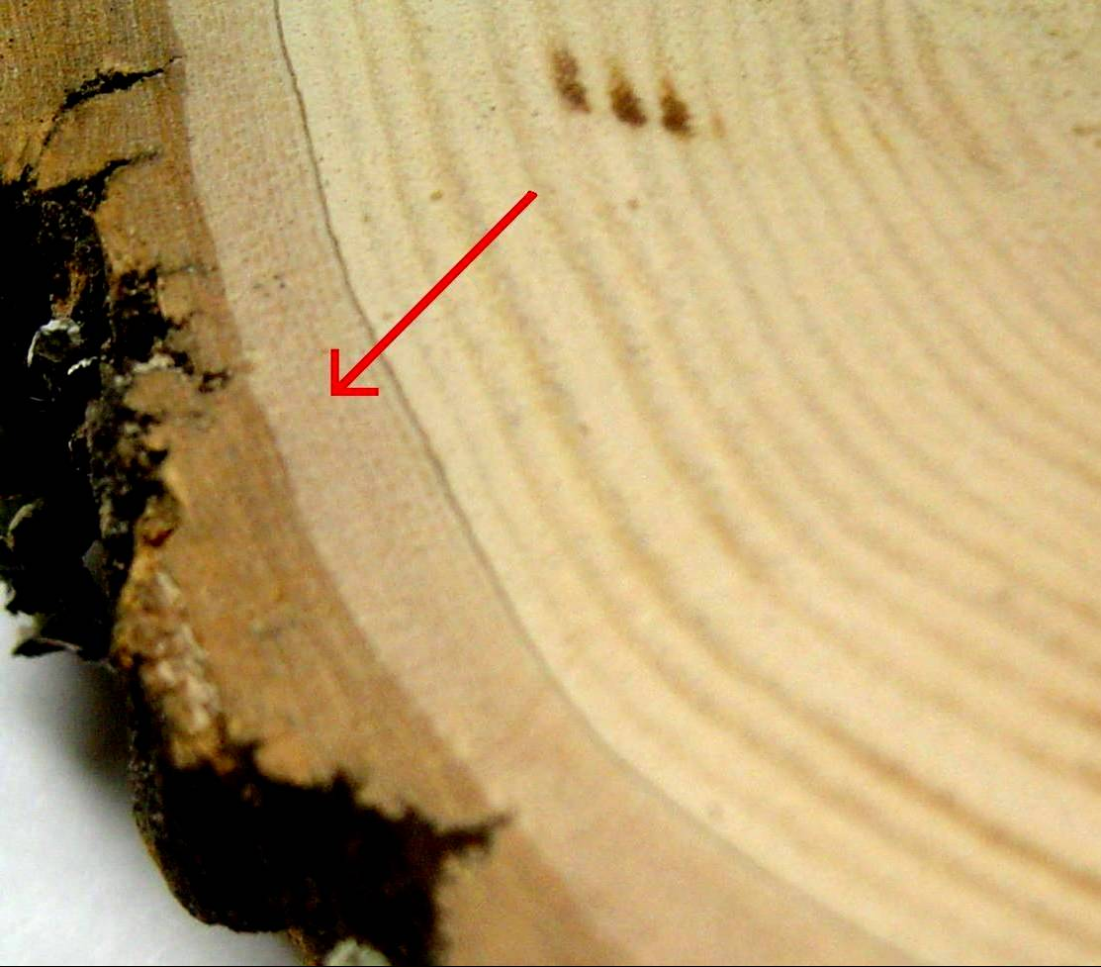
A) Xylem – conducts the water and minerals upward throughout the plant
Made of tube-like cells which grow together to conduct liquids
Tends to be found closer to the center of the stem
B) Phloem – conducts the food that is produced in the leaf downward to the rest of the plant
These cells also form tubes
Tends to be found towards the outside of the stem
C) Cambium – the tissue responsible for the production of new xylem & phloem
Also increases the girth (width) of a stem
Generally found between the xylem and phloem

Slide 11
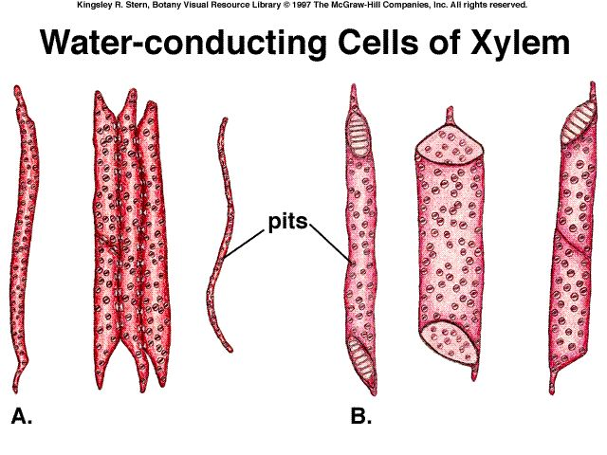
Vascular tıssues-XYLEM
Components of xylem: tracheids, vessels, xylem fibres, xylem parenchyma.
Tracheids have secondary walls hardened with lignin, allowing them to function in support.
Water is transported through pits in the secondary cell wall.
Vessel elements are wider, shorter, and have thinner walls. They align end to end to form “pipes” or xylem vessels.
Xylem cells are dead!!!

Slide 12
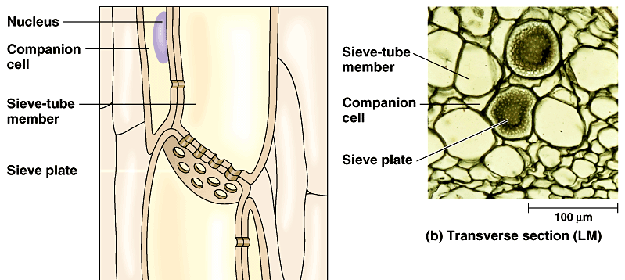
VASCULAR TISSUES-PHLOEM
Components of phloem: sieve tube cells, companion cells, phloem fibres (sclerenchyma), phloem parenchyma.
Sugars and other organic molecules and ions are transported through chains of specialized cells- the sieve tube members.
Sieve-tube members are alive, but have no nucleus or ribosomes! Each sieve-tube has a companion cell connected by plasmodesmata.
Phloem cells are alive!

Slide 13
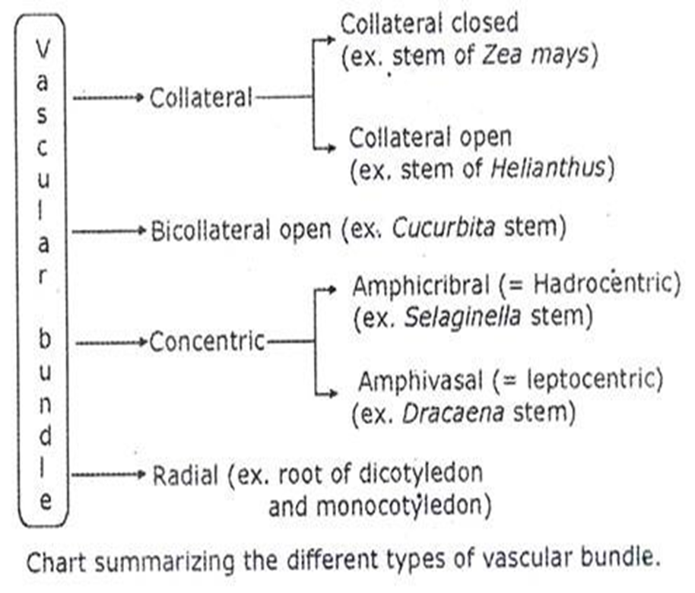
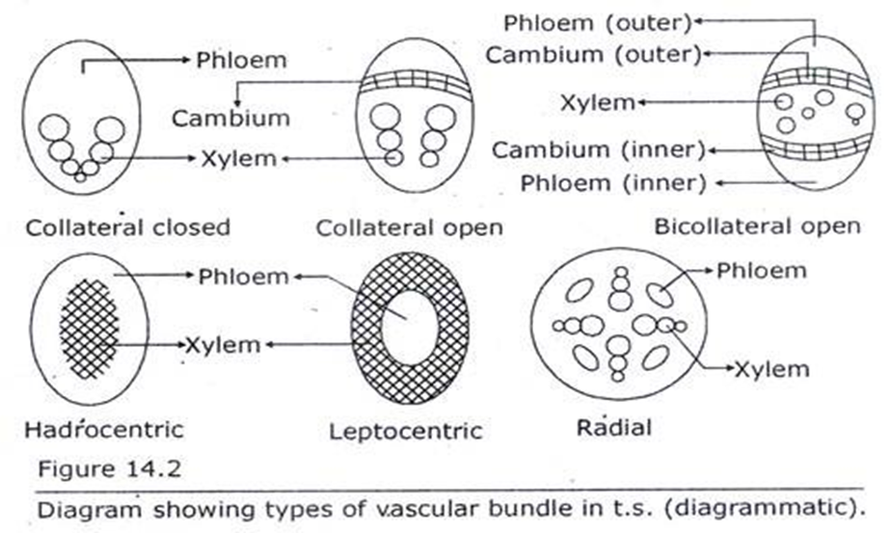
Vascular bundles
Vascular bundles (VB) are also called as fascicles.
They are located inner to the pericycle.
The vascular bundles composed of (I) Xylem placed inner to cambium; and (II) Phloem placed outer to cambium.
The three main types of vascular bundle. The types are:

Slide 14
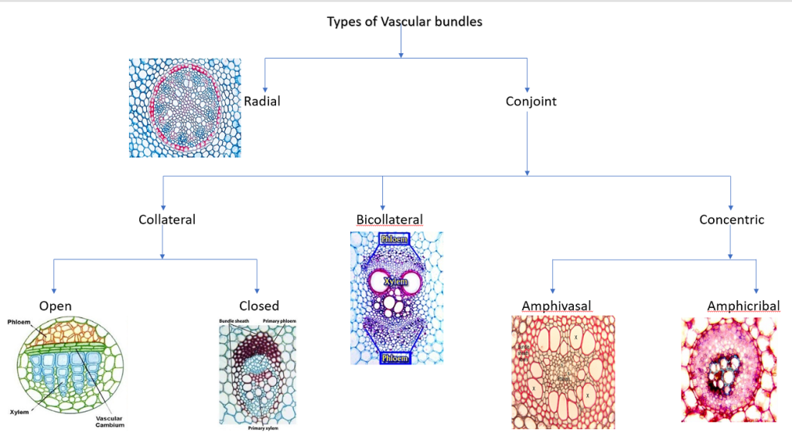

Slide 15
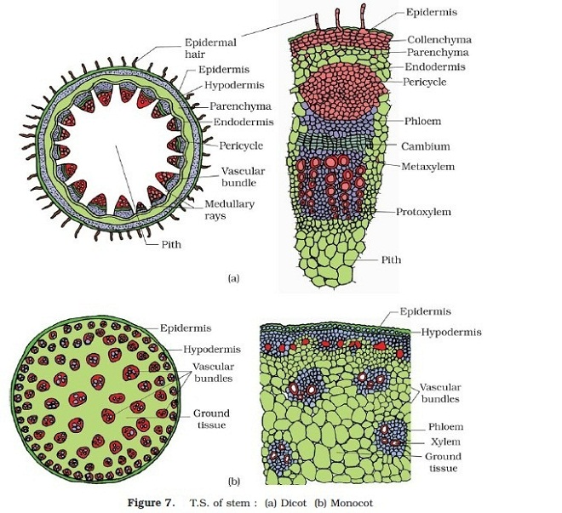
The other most important difference is their arrangement in the stem ground tissue.
In dicots, the bundles form a ring around the central pith. In monocots, the bundles are scattered randomly throughout the ground tissue (sometimes called pith).

Slide 16
Differences between Monocot and Dicot Stems:

Slide 17
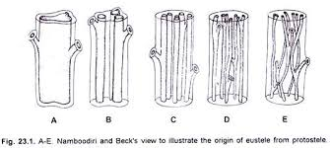
Stele
The term stele sums up the vascular system, associated tissues and the enclosed pith.
The stele consists of xylem, phloem, pericycle and medullary rays and pith if present.
The term ‘stele’ was for the first time used by Van Tieghem and Douliot in 1886 in their ‘Stelar Theory’
What is ‘stellar theory’?
Major highlights in stellar theory are:
The stele is a real entity and present universally in all axis of higher plants.
The primary components of stele are xylem and phloem.
Tissues like pericycle, medullary rays and pith are also the components of stele
‘Stelar theory’ also says that the cortex and the stele are the two fundamental parts of a shoot system.
Both these components (stele and cortex) are separated by the endodermis.
Notes:
The spatial arrangements of vascular bundles is explained by the theory of steles. Different types of steles, like the protostele, the plectostele or the siphonostele exist. Monocot steles are a highly specialized exception.

Slide 18
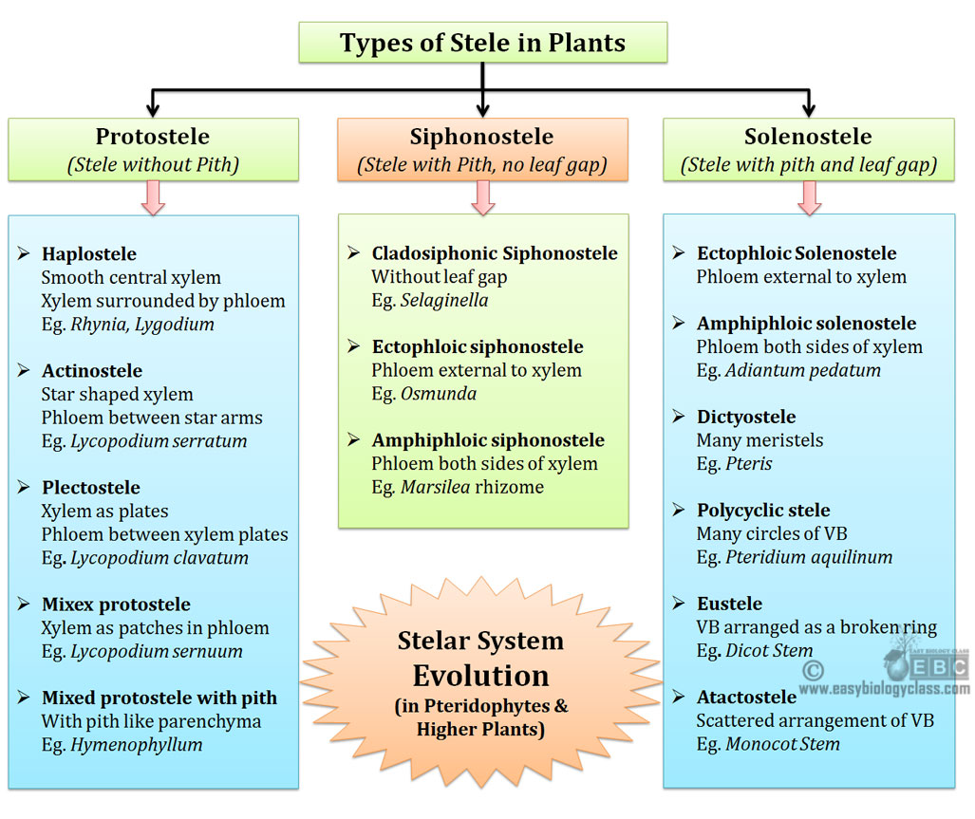
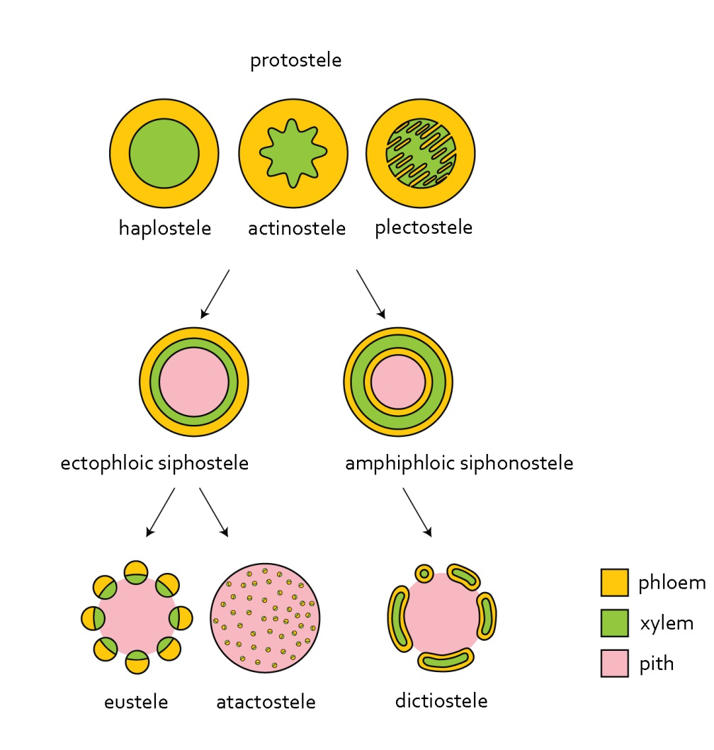
Notes:
They are:
(1). Protostele
(2). Siphonostele
(3). Solenostele
Ø Some authors recognize only two categories (Protostele and Siphonostele). They
consider Solenostele as a sub-category of Siphonostele.

