Slide 1
Sociology of Religion
4. Week
March 14th 2019

Slide 2
Insights from the Sociological Theories of Religion
Classical Theory (Marx- Durkheim- Weber)
Karl Marx - Conflict theory
Emile Durkeim – Fonctionalist theory
Max Weber – theory of social actions

Slide 3
Alienation, Labor, Surplus Value
For Marx, Religion was a significant barrier to reason, inherently masking the truth and misguiding/distort followers.
Marx viewed alienation as the heart of social inequality.
The antithesis to this alienation is freedom.
Central to Marx's theories was the oppressive economic situation in which he dwelt.
Film Önerisi: Modern Times- Charlie Chaplin

Slide 4
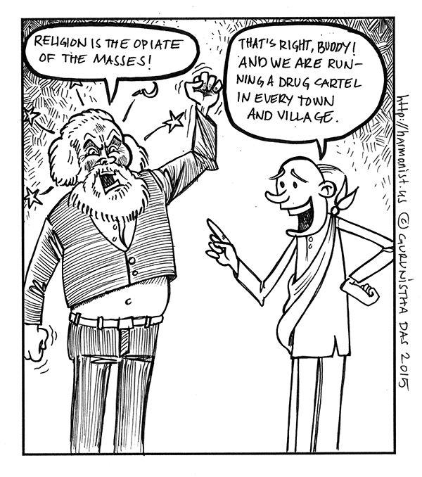

Slide 6
Emile Durkheim

Slide 7
Durkheim and religion
Émile Durkheim placed himself in the positivist tradition, meaning that he thought of his study of society as dispassionate and scientific.
Religion, for Durkheim, is not "imaginary", although he does deprive it of what many believers find essential.

Slide 10
The three aspects of social Integration
Rituals: such as baptism, communion, wedding, confession, etc..
Beliefs: more religious beliefs regulate the individual's life.
Organization: Catholicism is more hierarchical than Protestantism.

Slide 11
Elementary Forms of Religious Life
In the fieldwork that led to his famous Elementary Forms of Religious Life, Durkheim, looked at anthropological data of Indigenous Australians.
His underlying interest was to understand the basic forms of religious life for all societies.

Slide 12
Elementary Forms of Religious Life
Durkheim's definition of religion, from Elementary Forms, is as follows:
"A religion is a unified system of beliefs and practices relative to sacred things, that is to say, things set apart and forbidden – beliefs and practices which unite into one single moral community called a Church, all those who adhere to them."
This is a functional definition of religion, meaning that it explains what religion does in social life: essentially, it unites societies.

