Slide 1
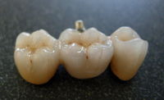
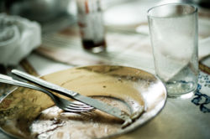
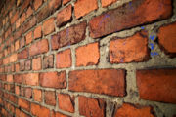
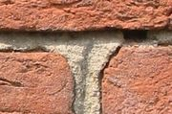
BÖLÜM 7
SERAMİK ENDÜSTRİLERİ

Slide 2
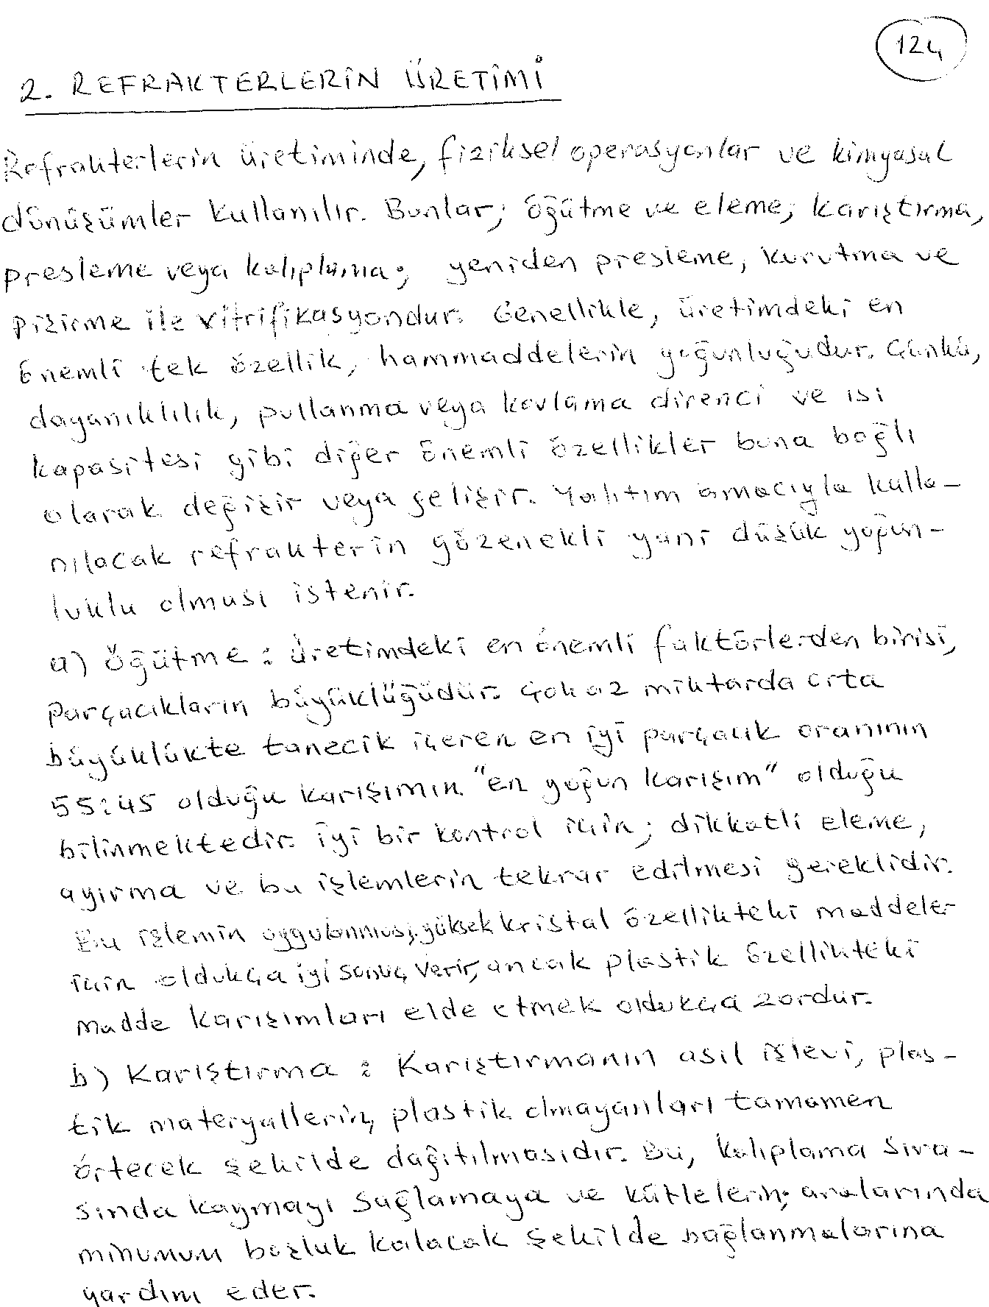

Slide 3
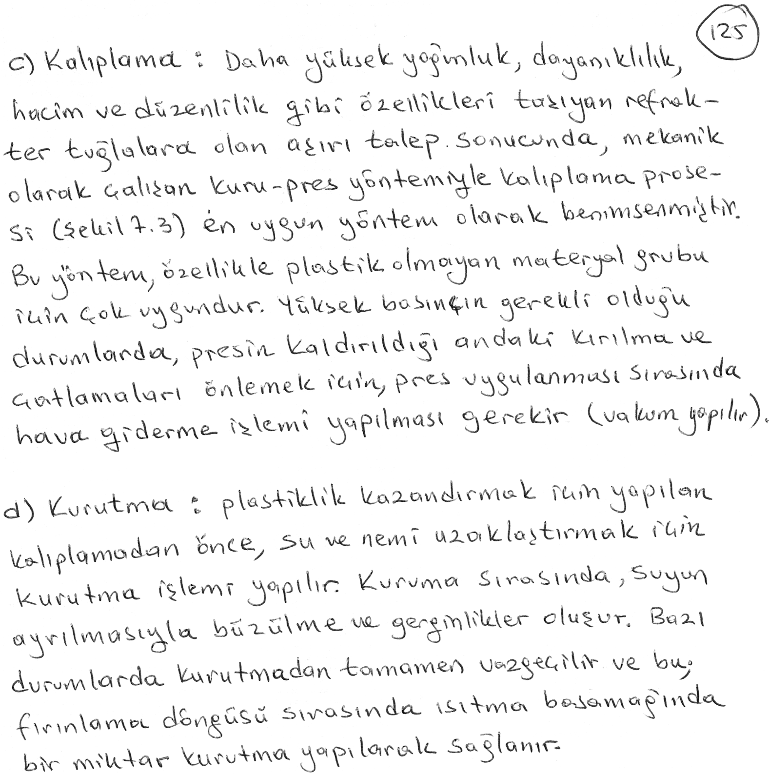

Slide 4
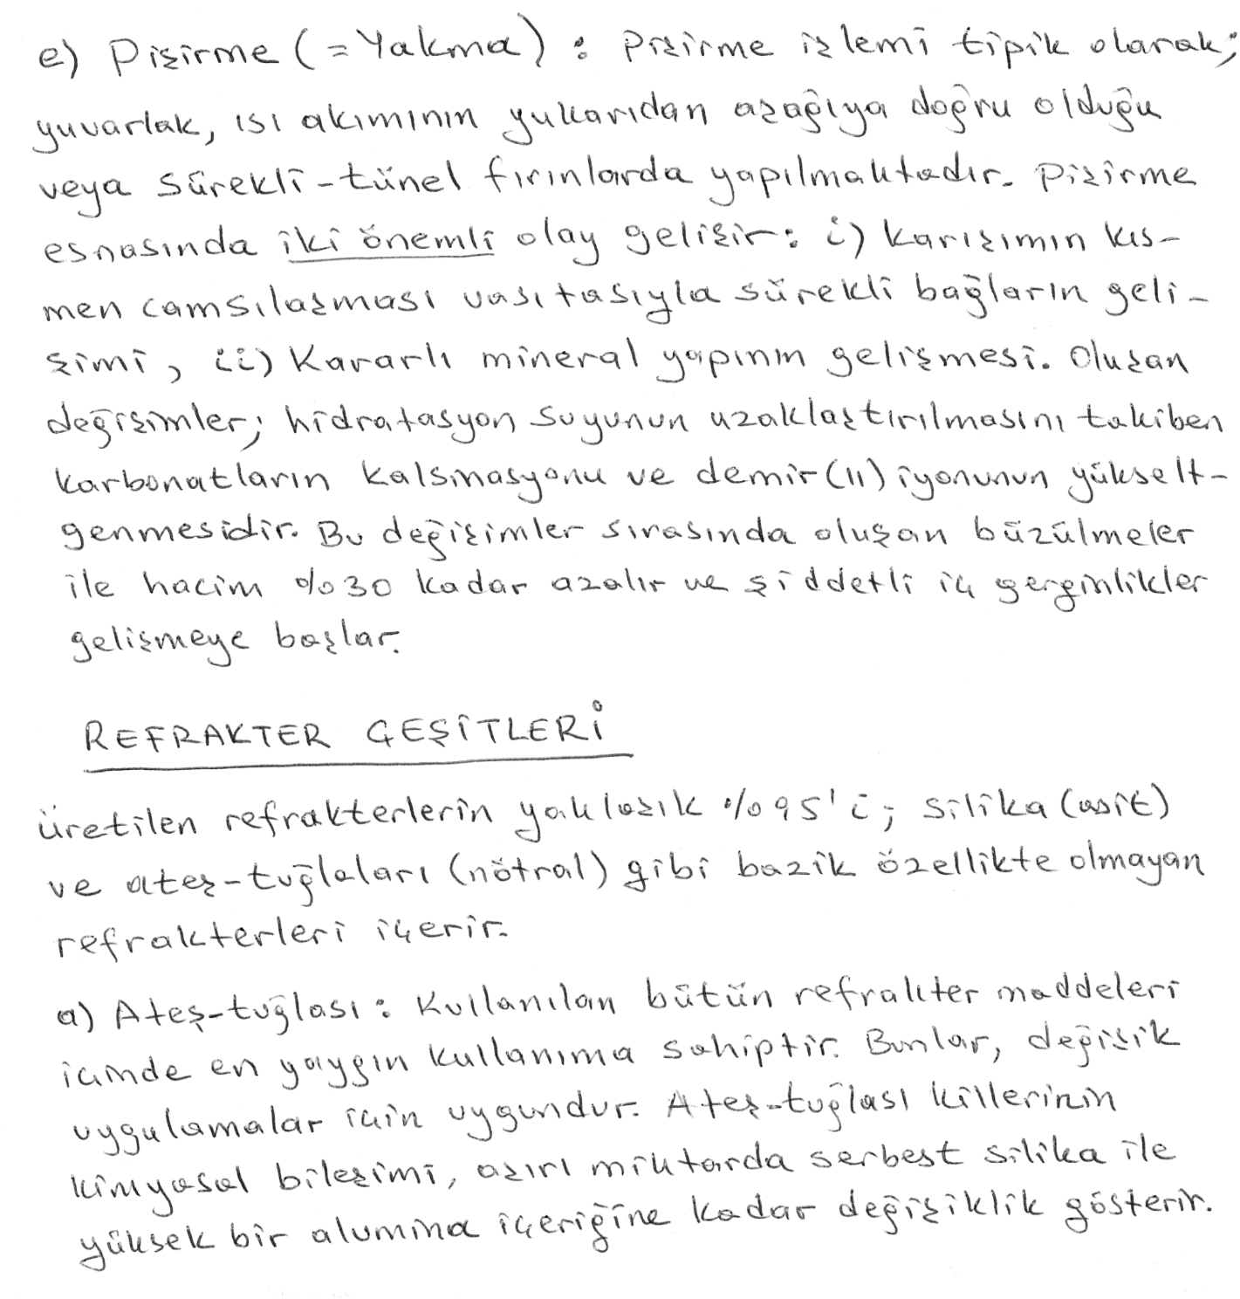

Slide 5
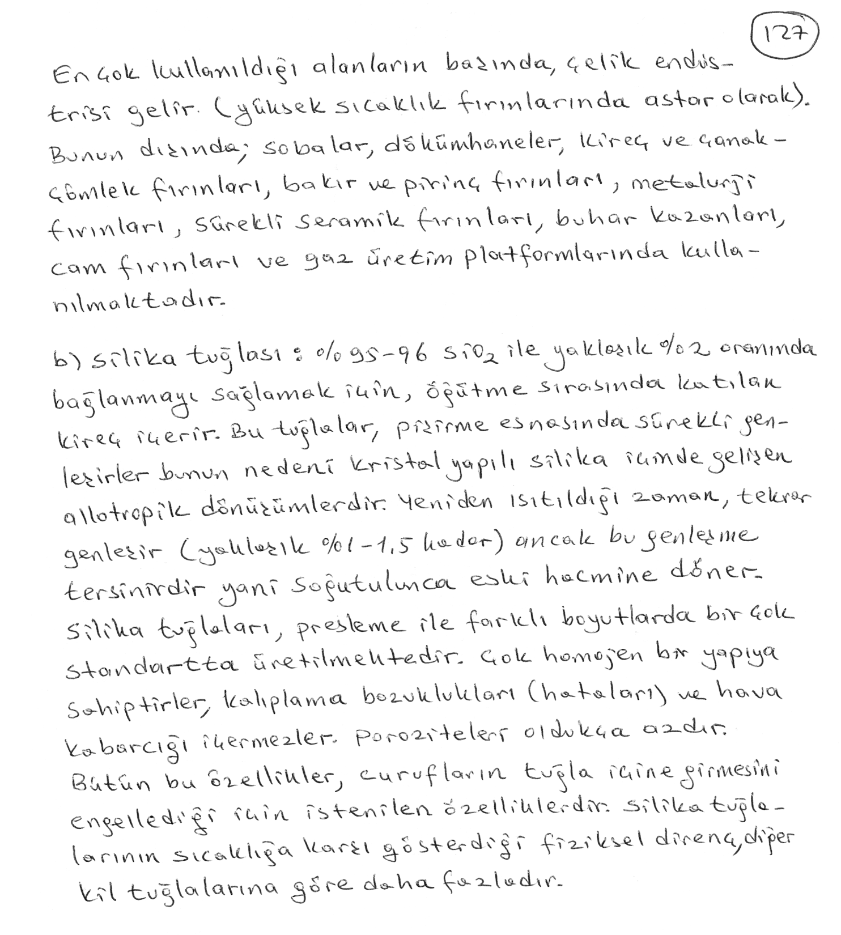

Slide 6
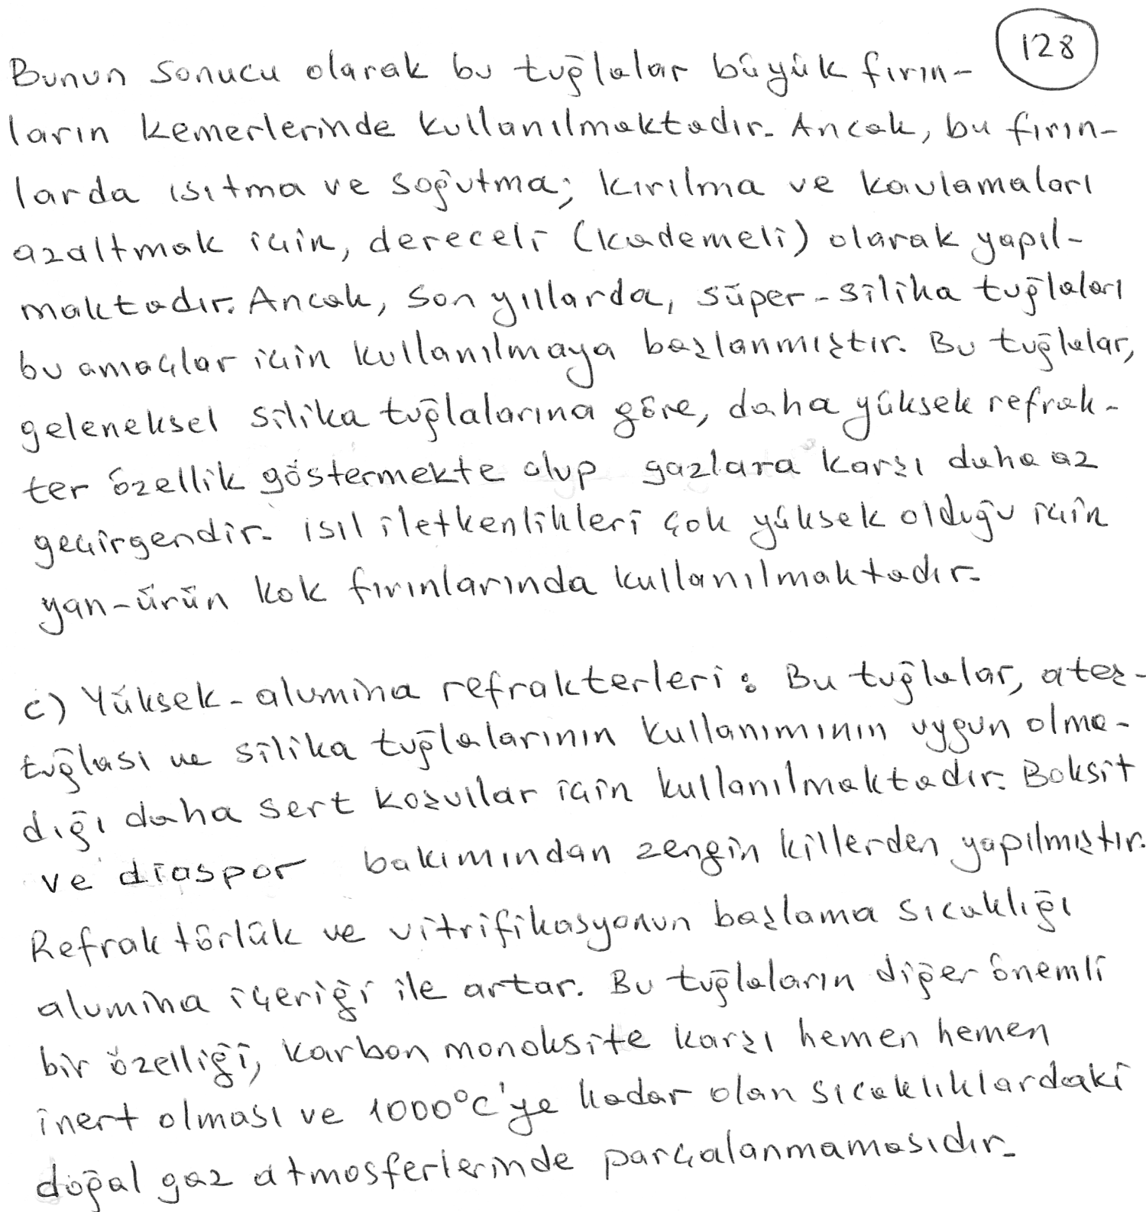

Slide 7
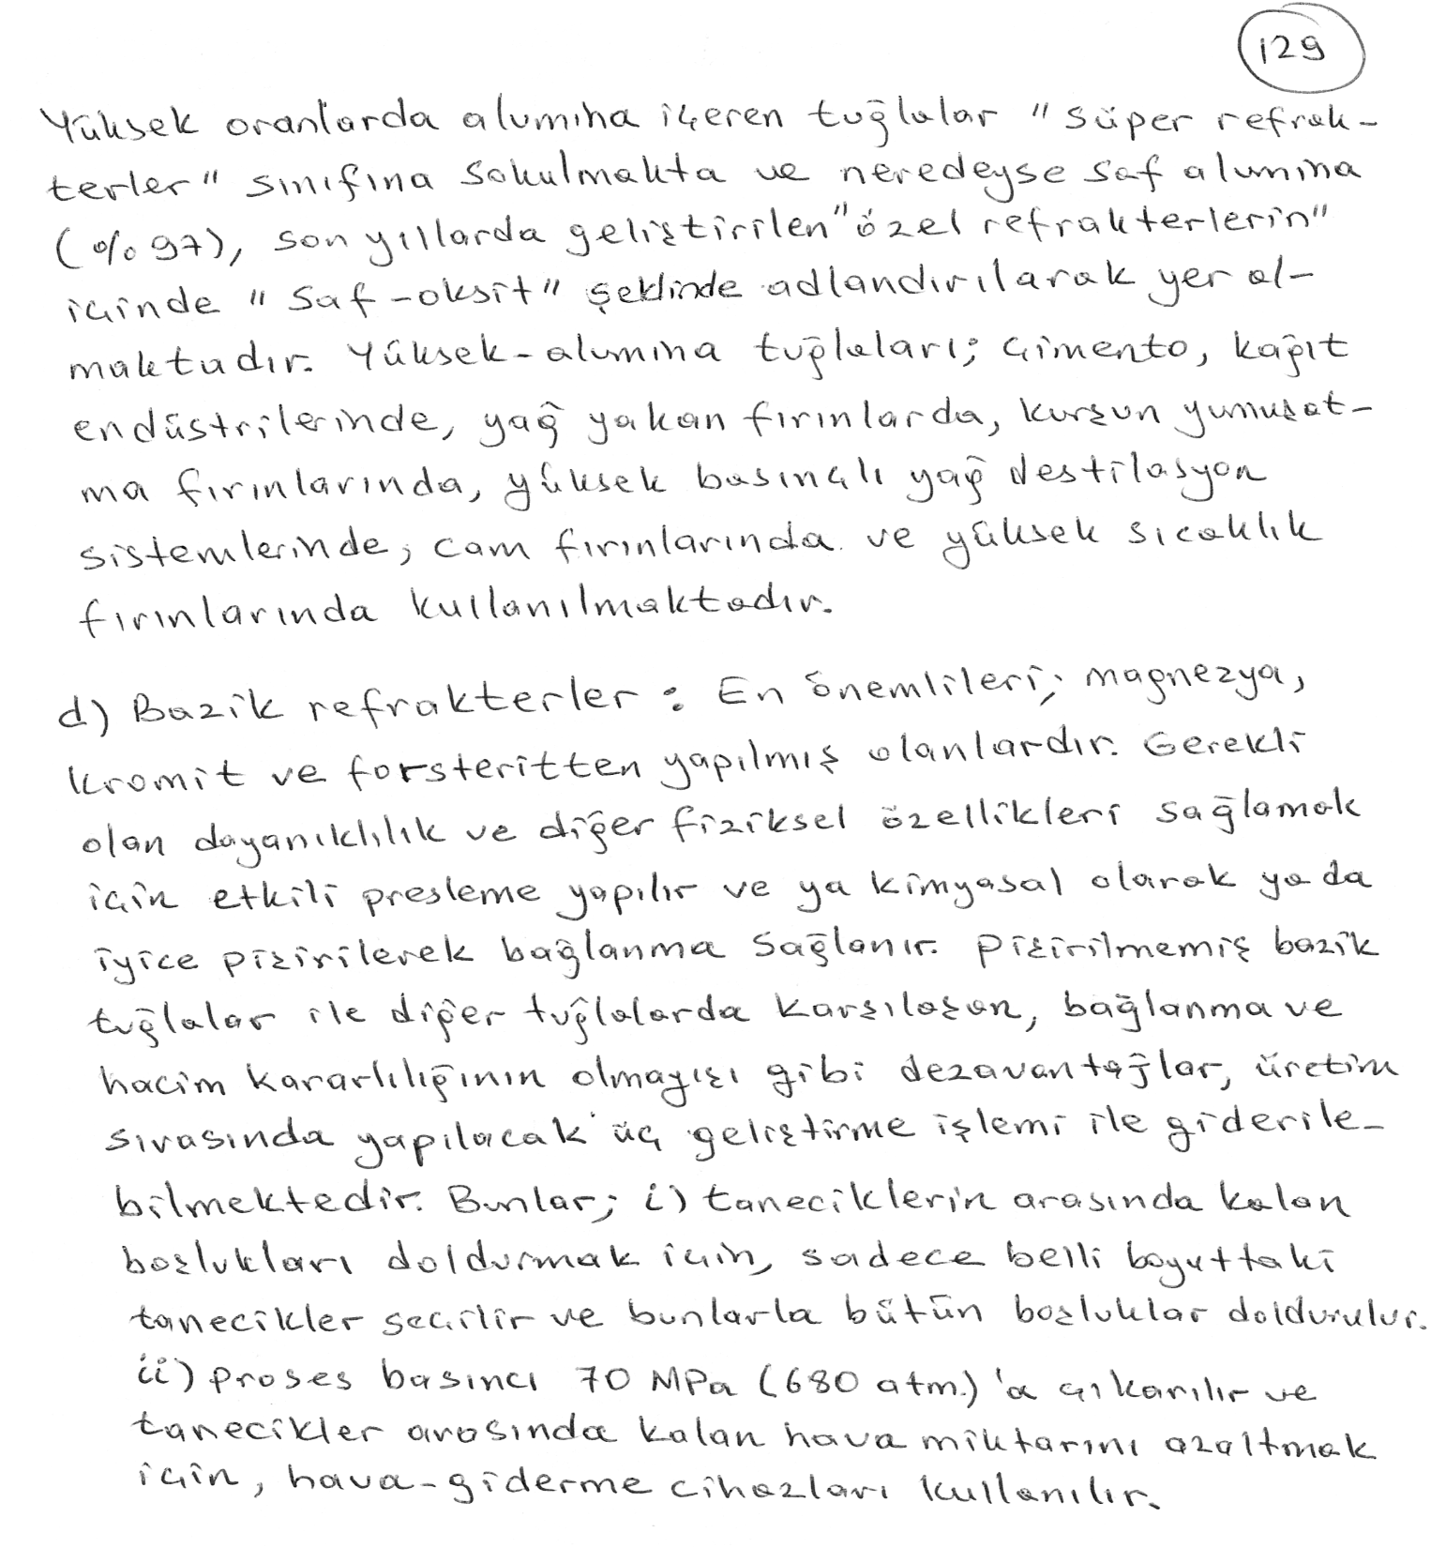

Slide 8
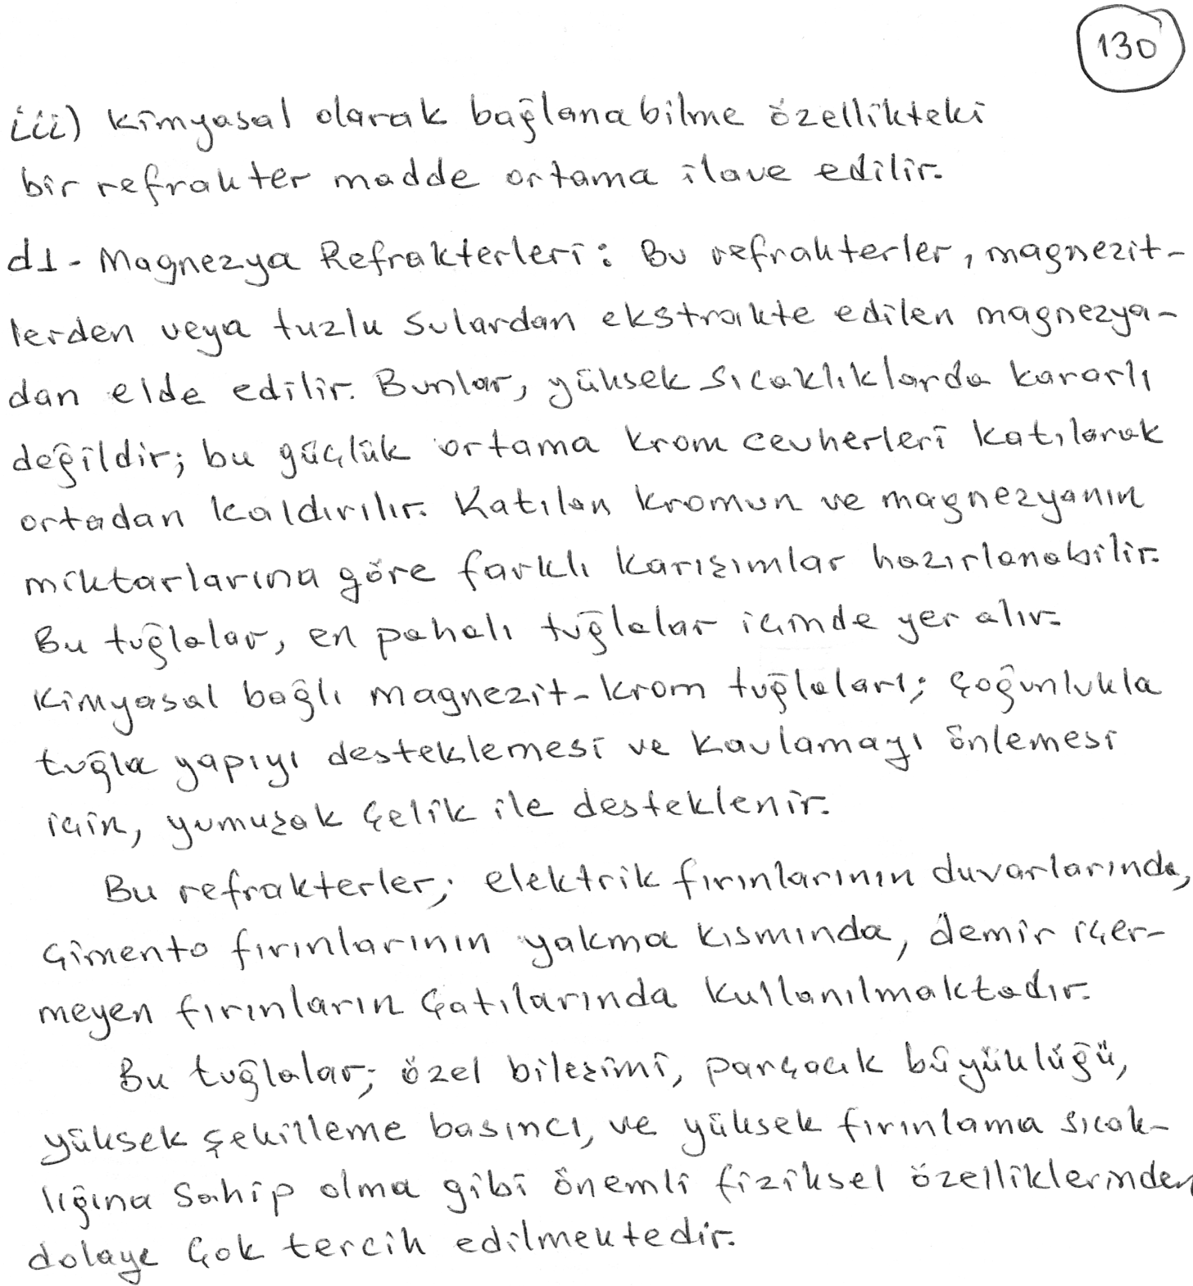

Slide 9
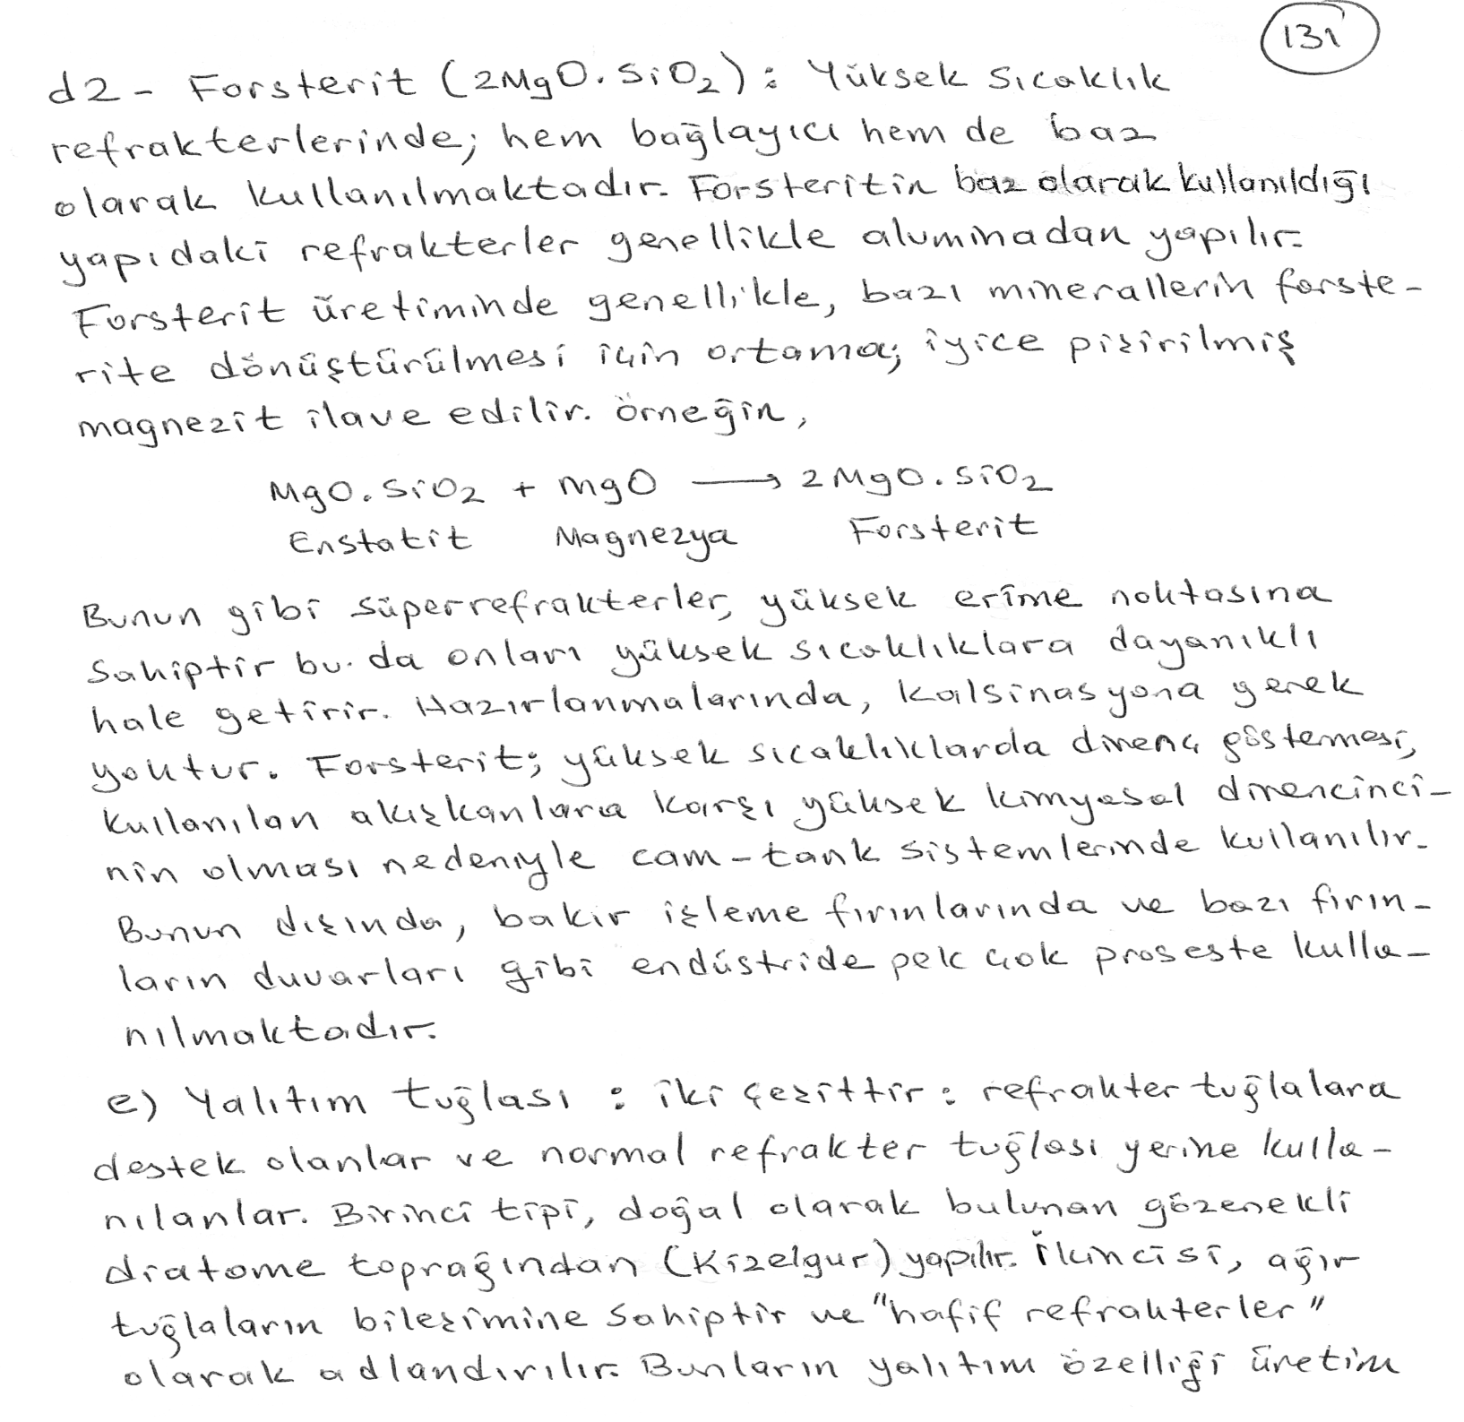

Slide 10
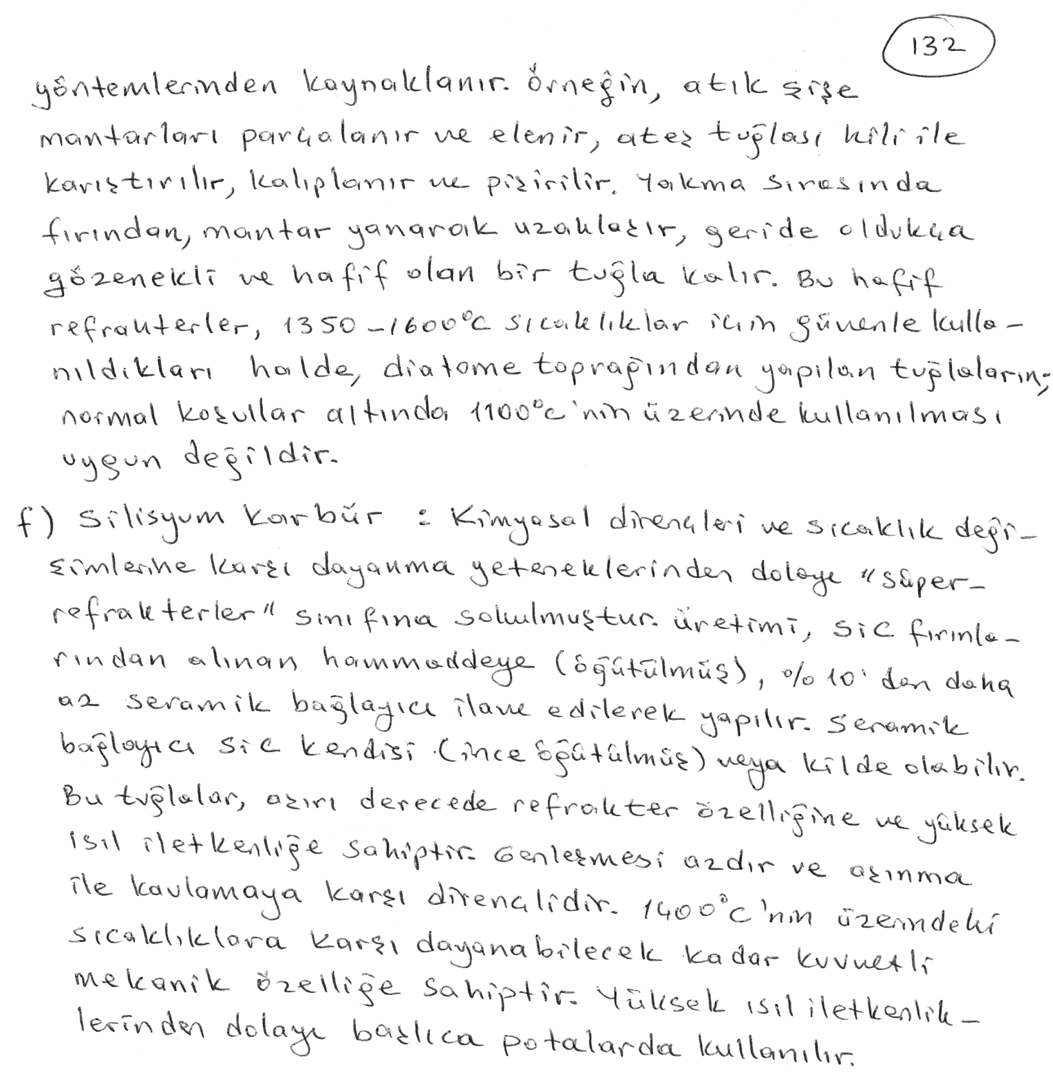

Slide 11
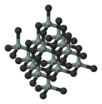
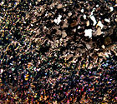
2730°C
Silicon carbide (SiC) is a ceramic compound of silicon and carbon that is manufactured on a large scale for use mainly as an abrasive but also occurs in nature as the extremely rare mineral moissanite.

Slide 12
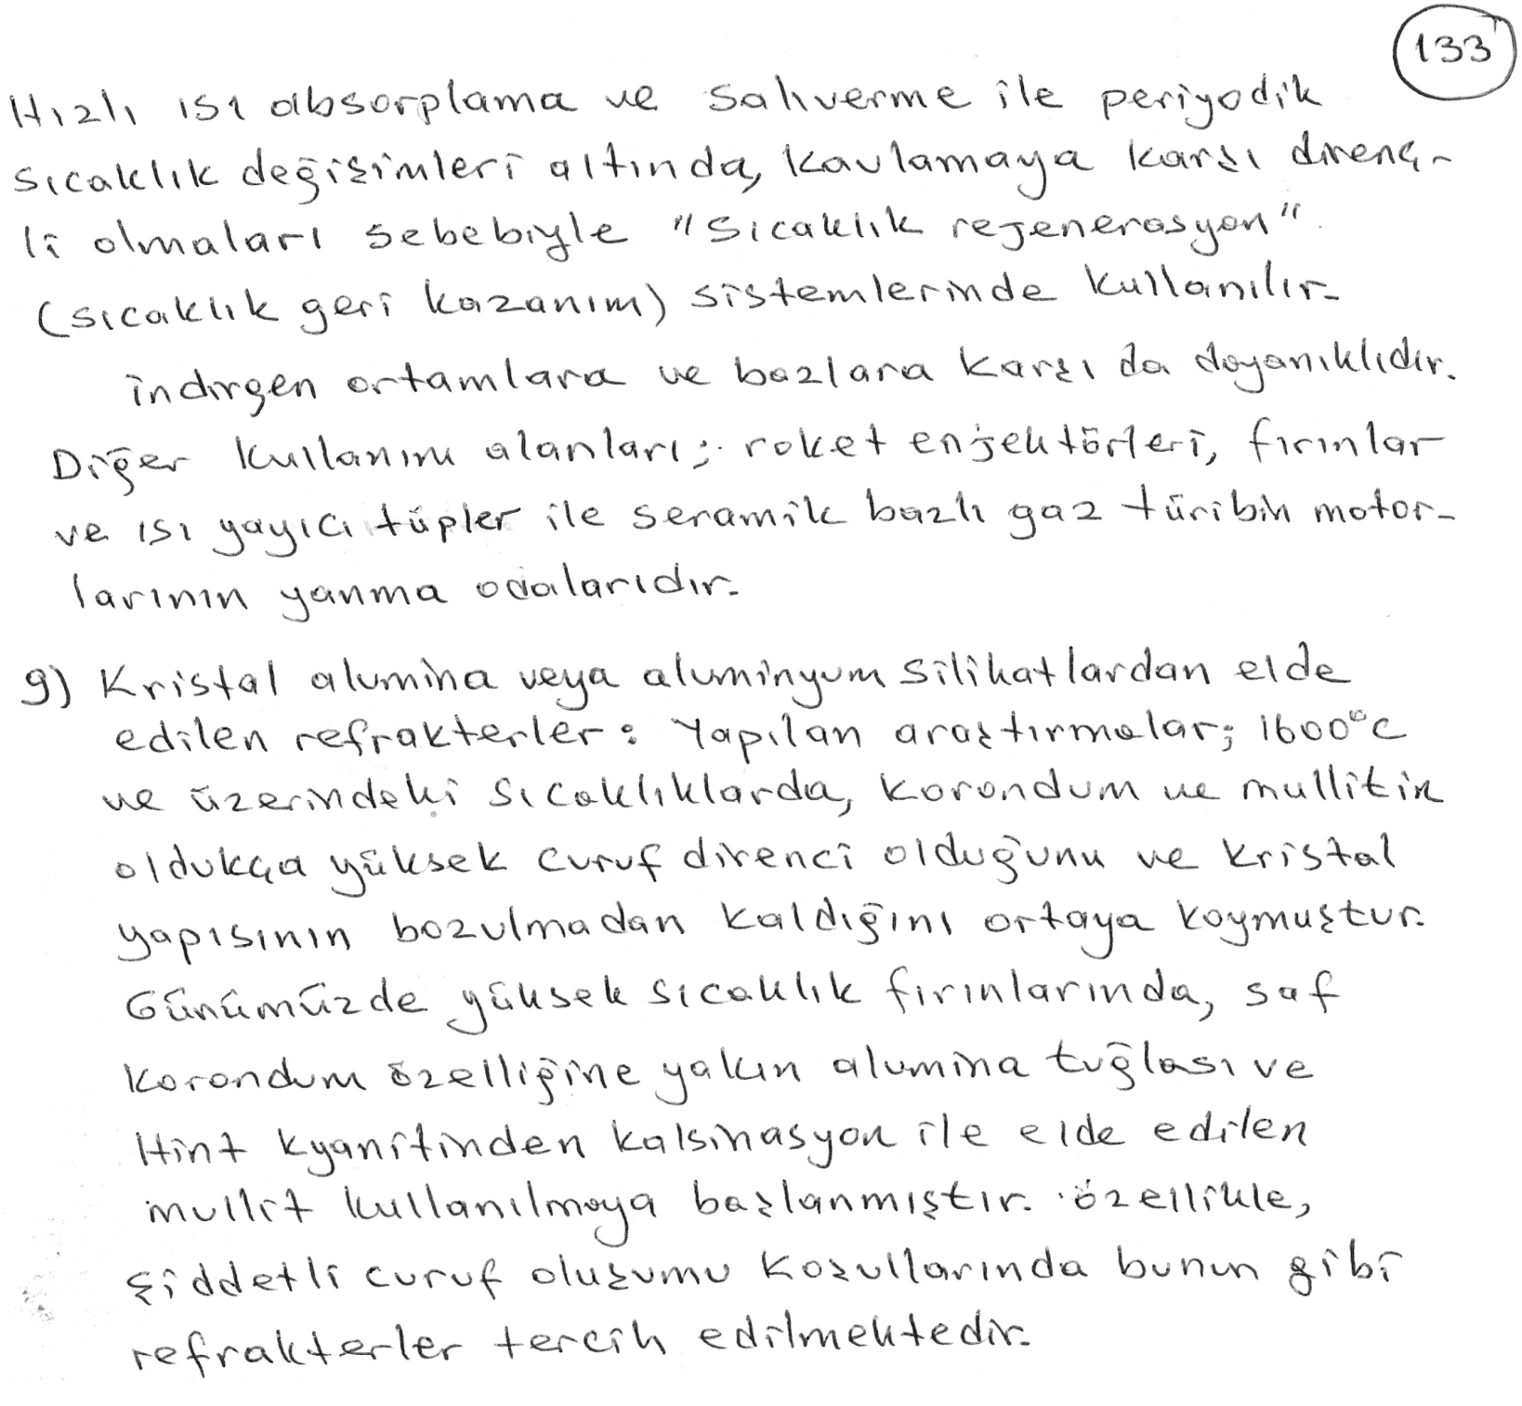

Slide 13
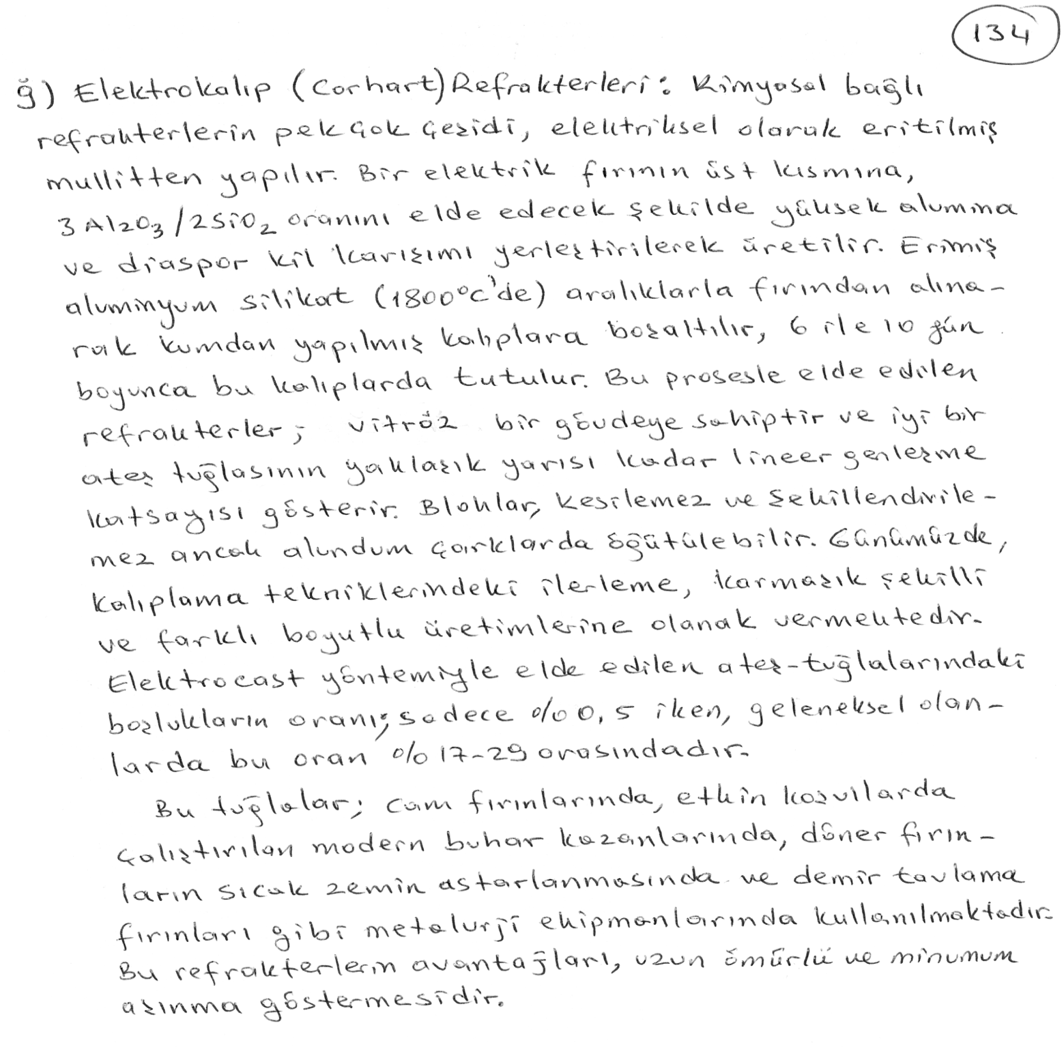

Slide 14
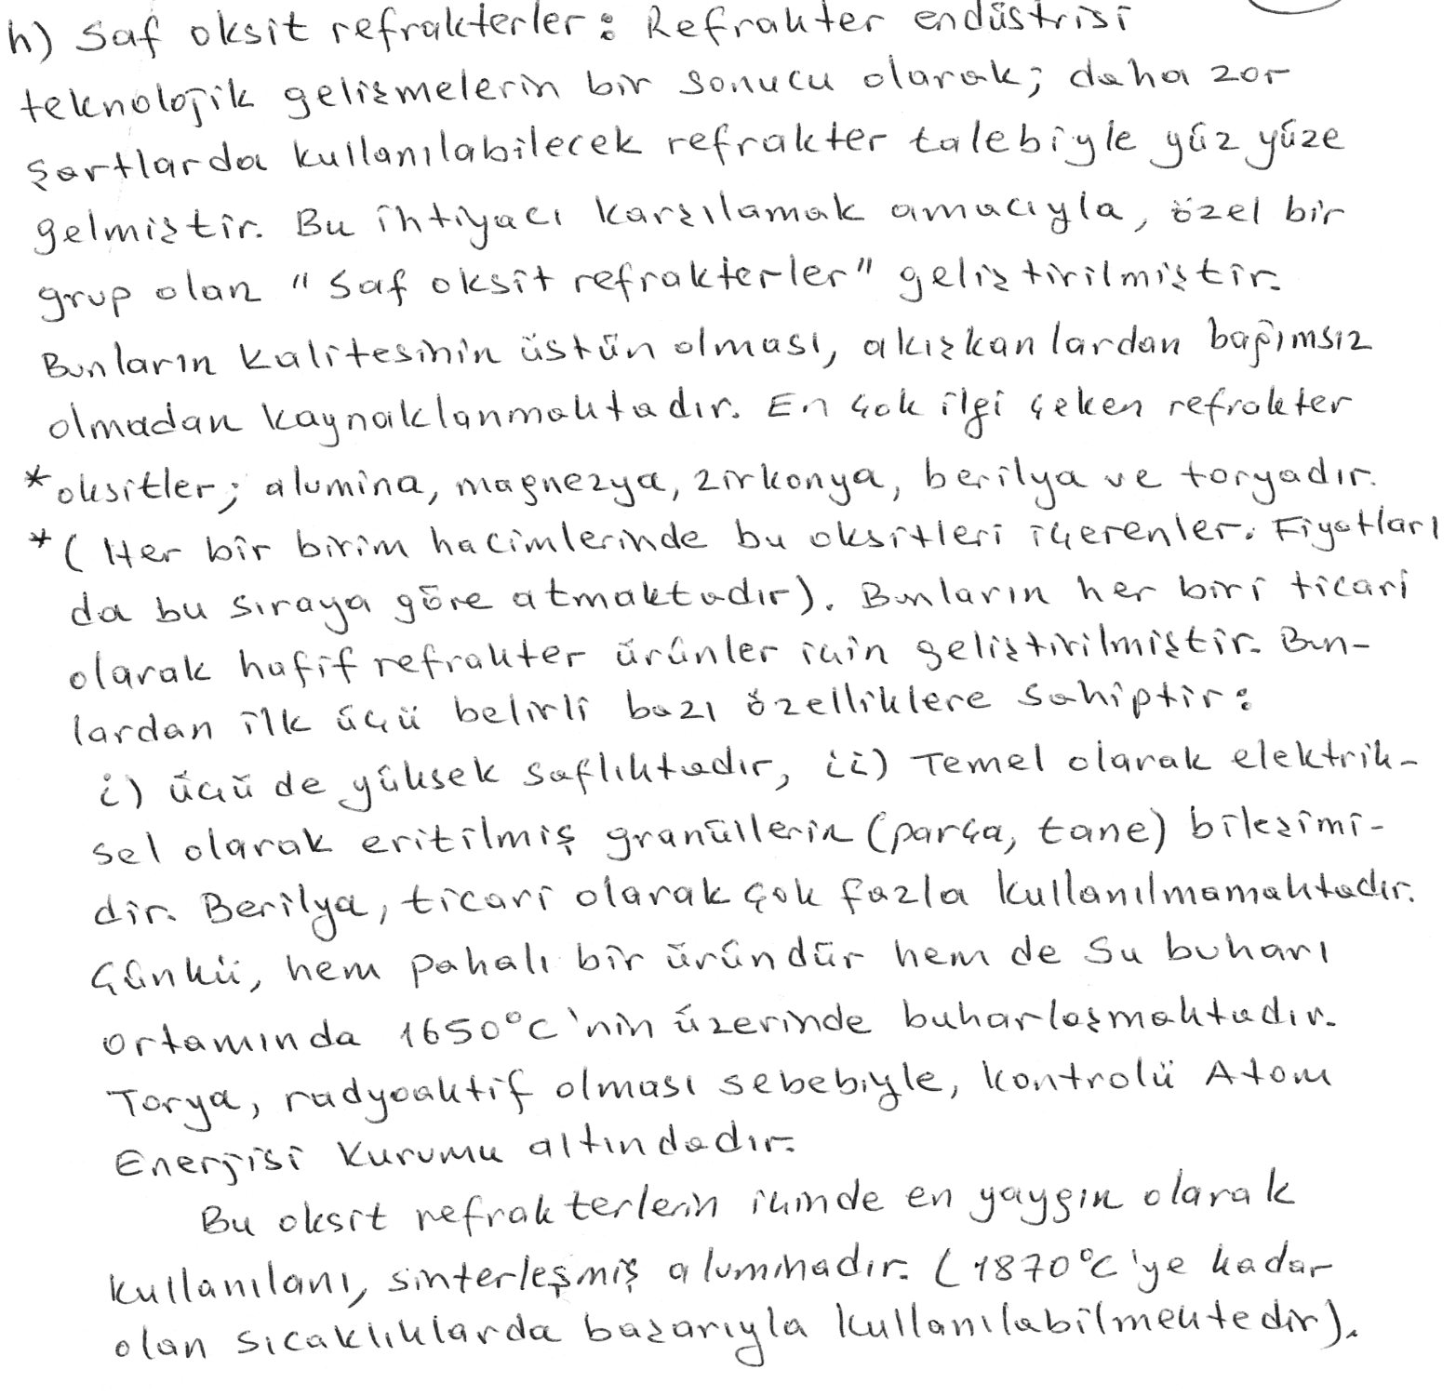

Slide 15
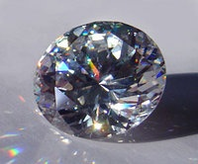
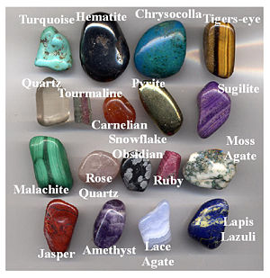
Zirconium dioxide (ZrO₂), sometimes known as zirconia, is a white crystalline oxide of zirconium. Its most naturally occurring form, with a monoclinic crystalline structure,. The high temperature cubic crystalline form, called 'cubic zirconia', is rarely, if ever, found in nature, but is synthesized in various colours for use as a gemstone. The cubic crystal structured variety cubic zirconia is the best-known diamond simulant.

Slide 16
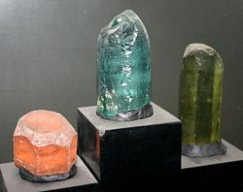
Be₃Al₂(SiO₃)₆
The mineral beryl is a beryllium aluminium cyclosilicate with the chemical formula Be₃Al₂(SiO₃)₆. The hexagonal crystals of beryl may be very small or range to several meters in size. Terminated crystals are relatively rare. Beryl exhibits conchoidal fracture, has a hardness of 7.5–8, a specific gravity of 2.63–2.80. It has a vitreous luster and can be transparent or translucent. Its cleavage is poor basal and its habit is dihexagonal bipyramidal. Pure beryl is colorless, but it is frequently tinted by impurities; possible colors are green, blue, yellow, red, and white. The name comes from the Greek beryllos which referred to a precious blue-green color of sea water stone.[3] The term was later adopted for the mineral Beryl more exclusivly.[4]

Slide 17
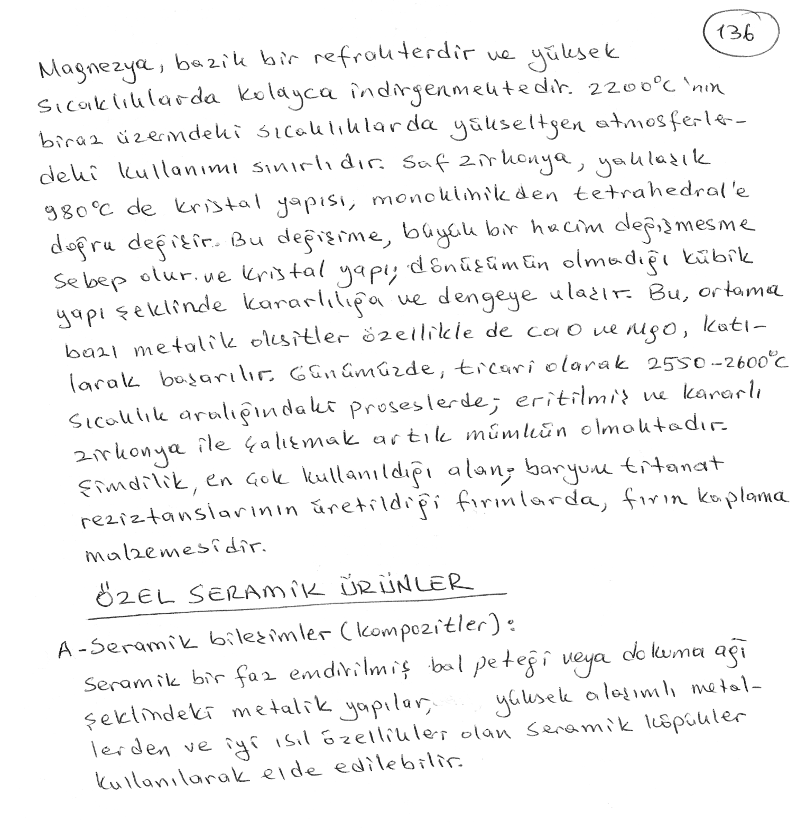

Slide 18
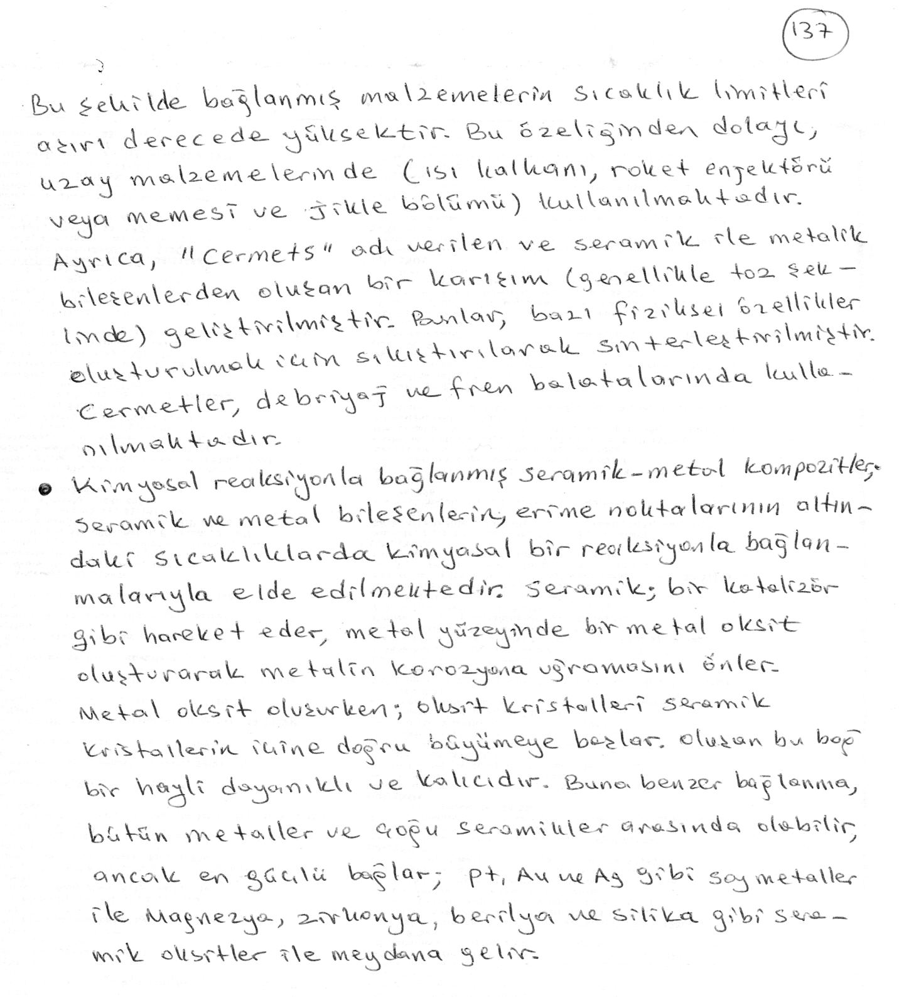

Slide 19
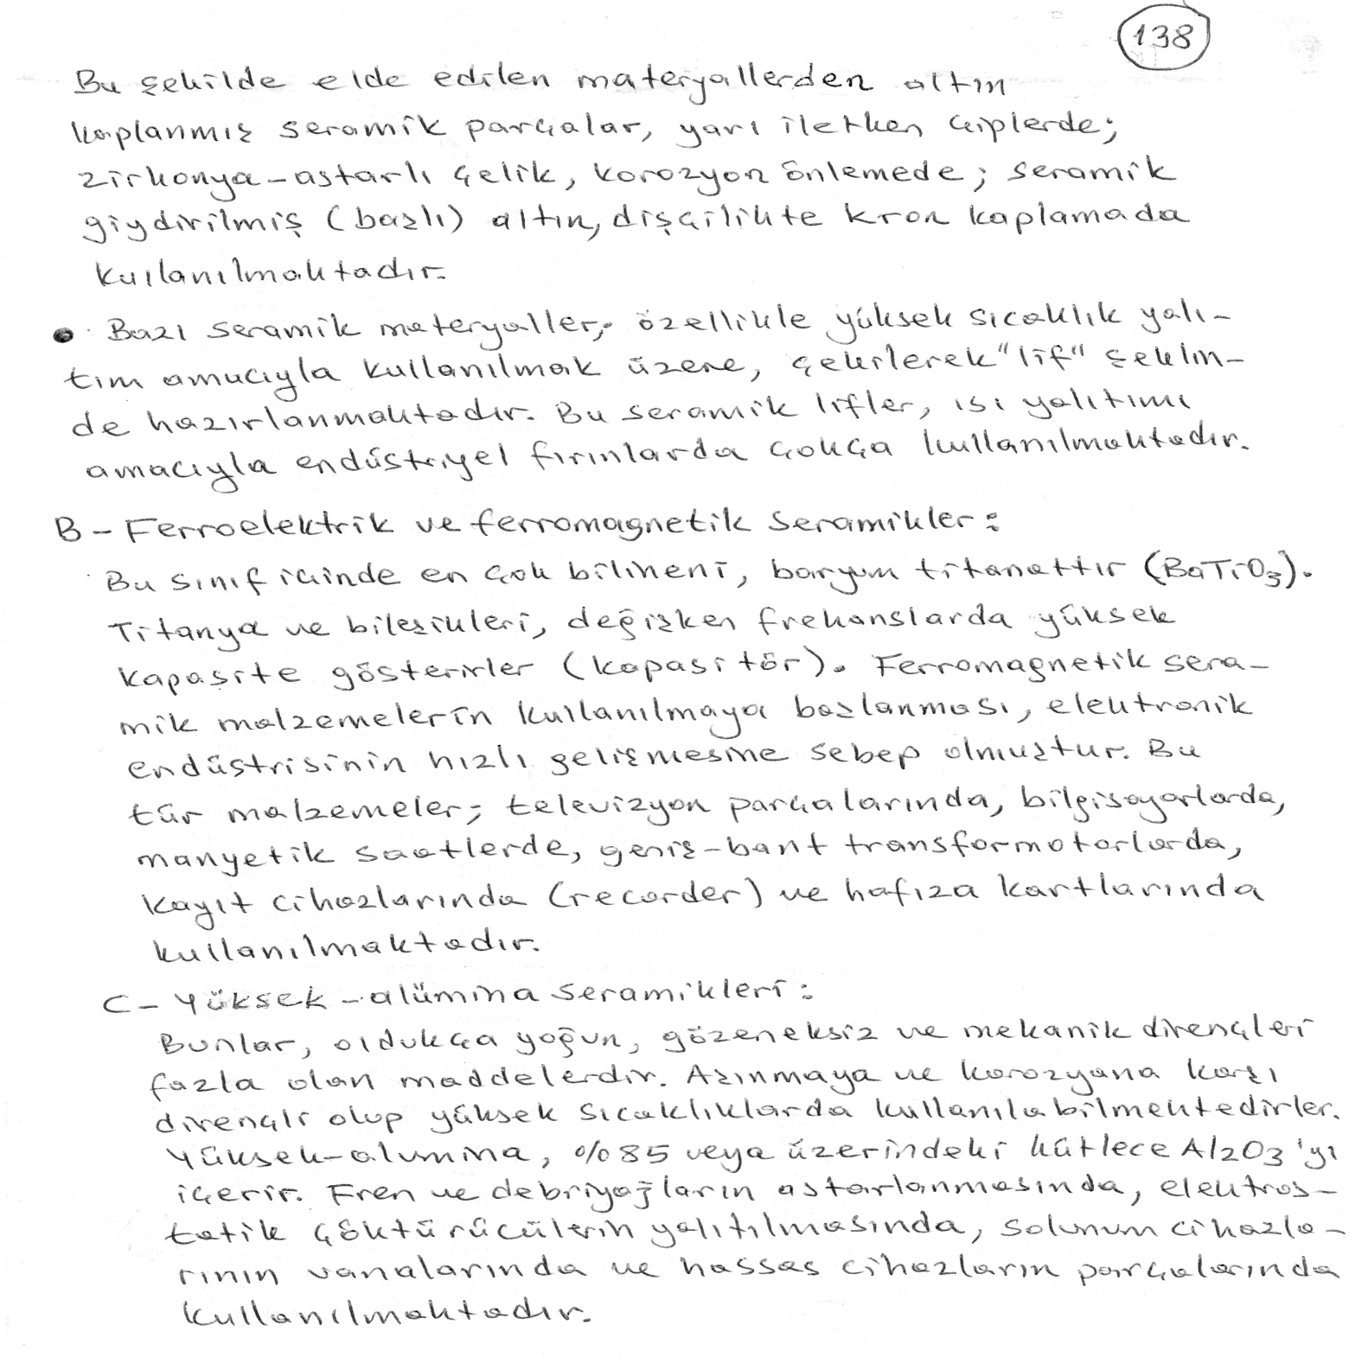

Slide 20
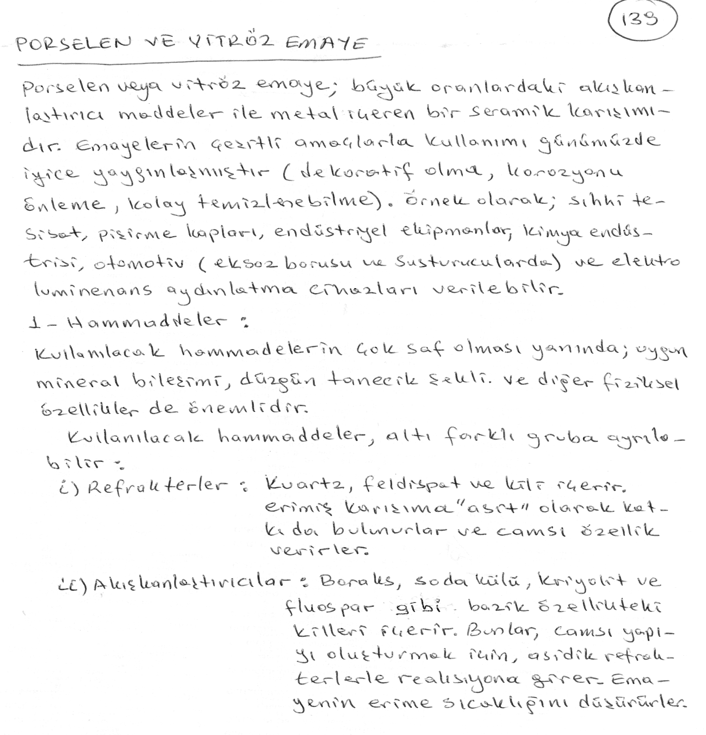

Slide 21
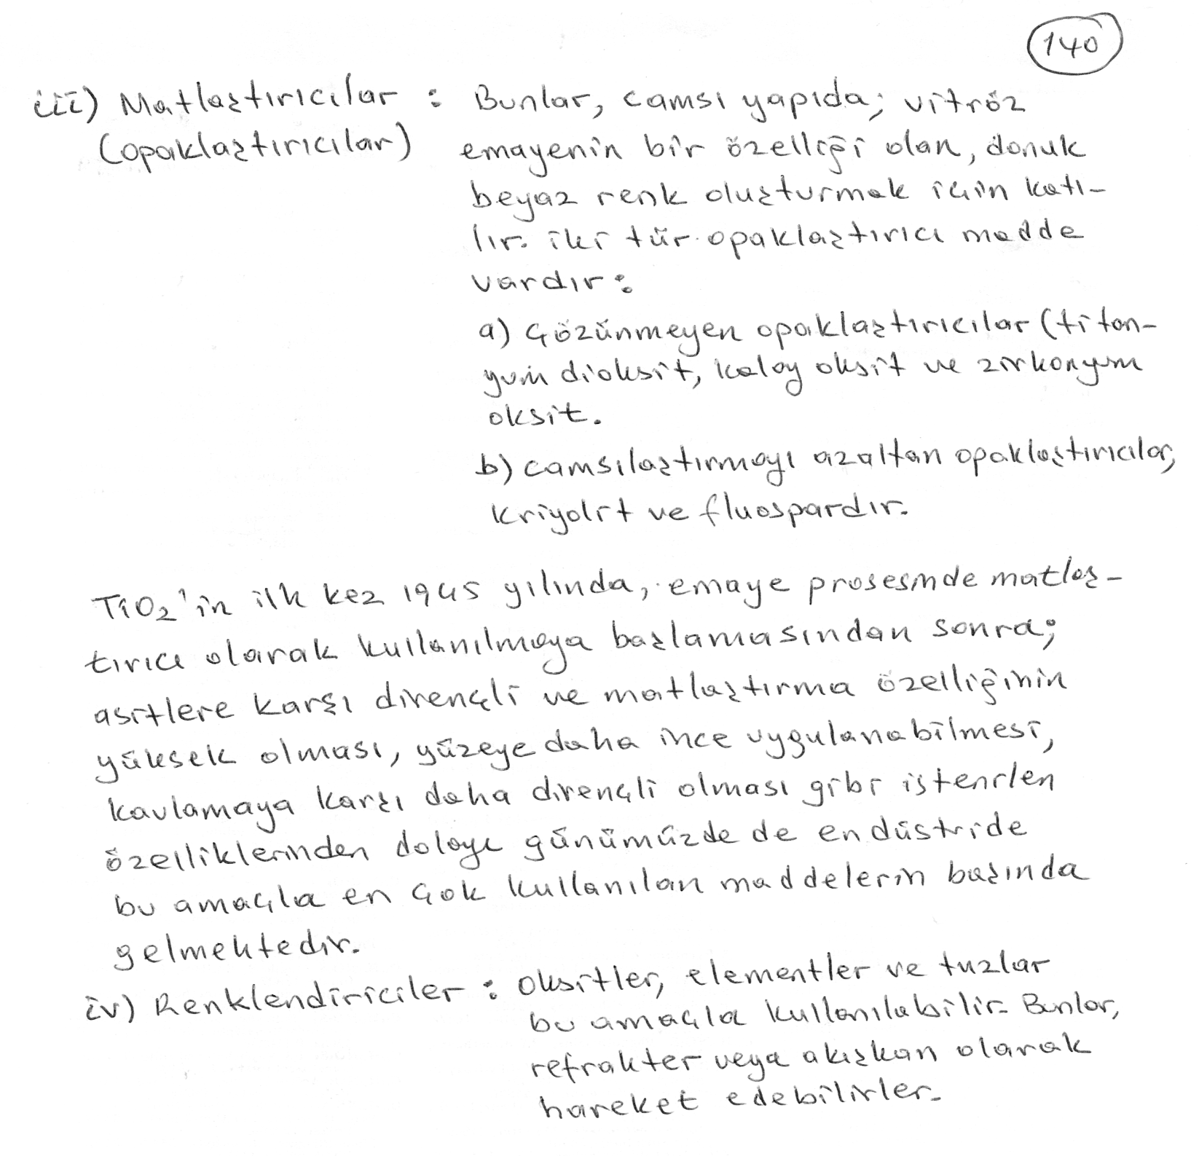

Slide 22
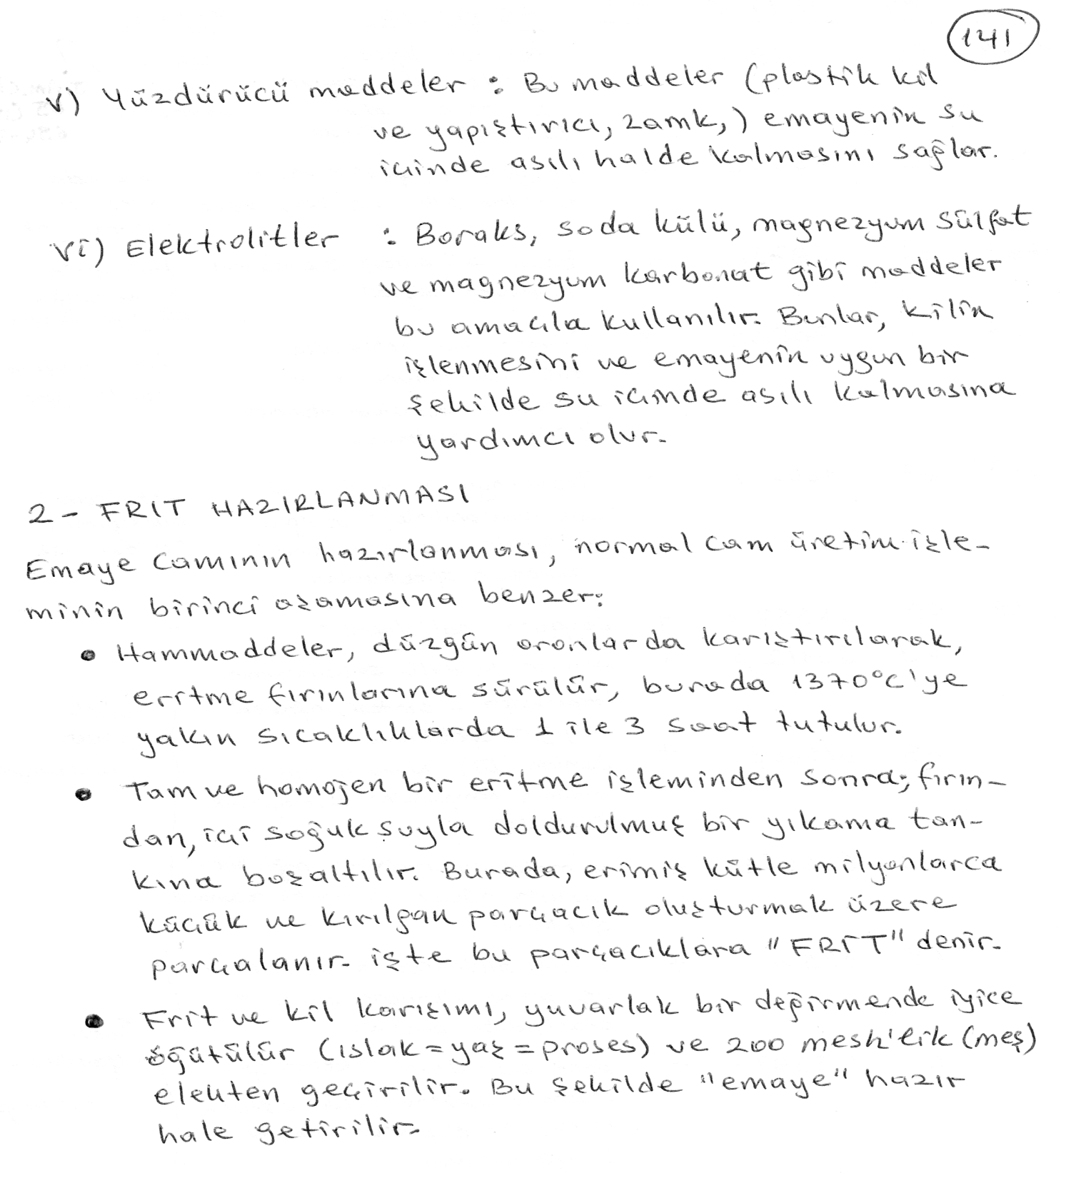

Slide 23
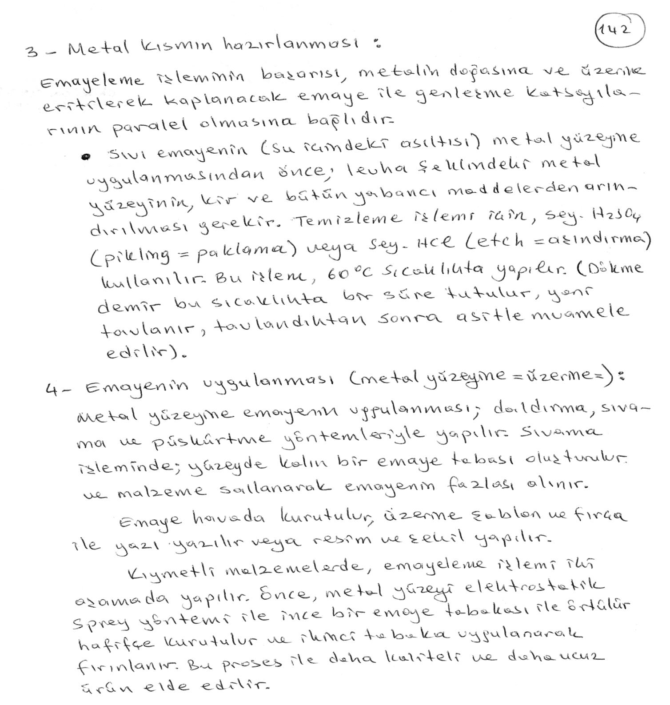

Slide 24
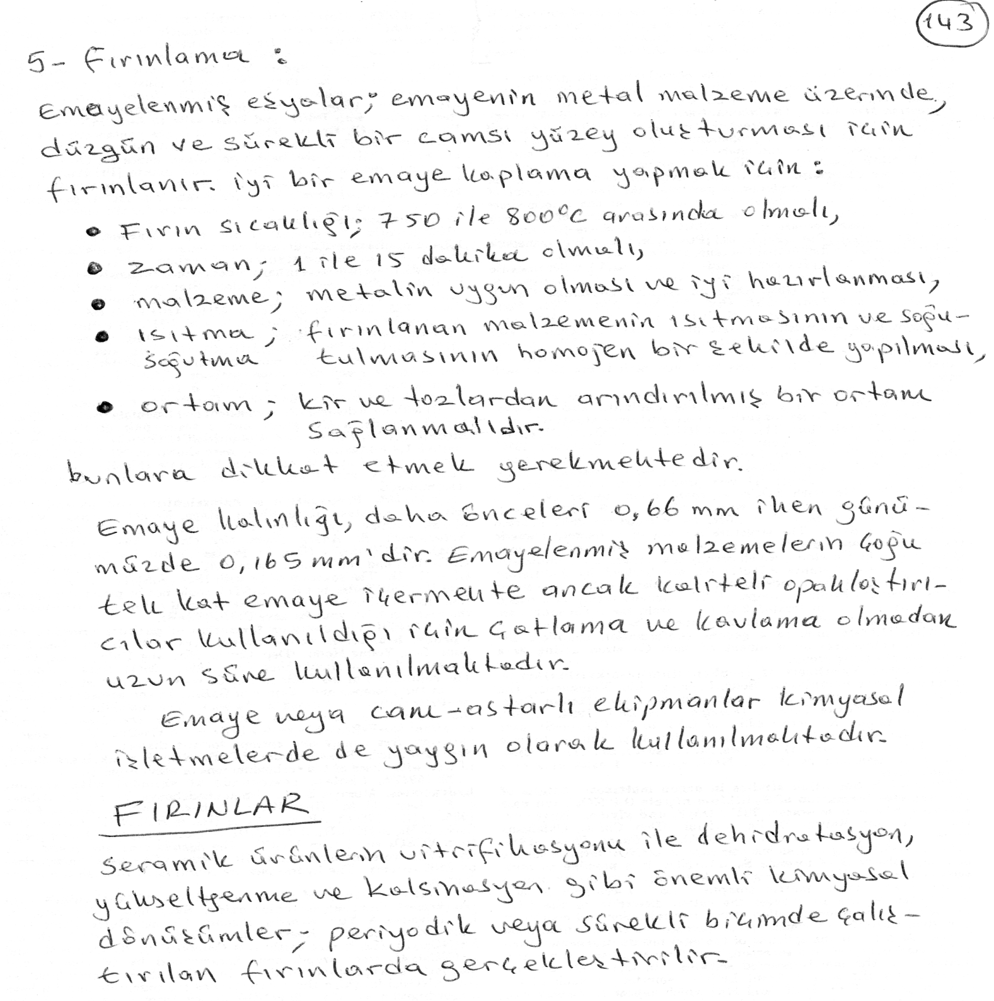

Slide 25
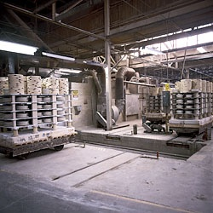
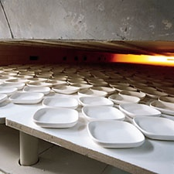

Slide 26
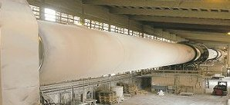
DÖNER FIRIN

Slide 27
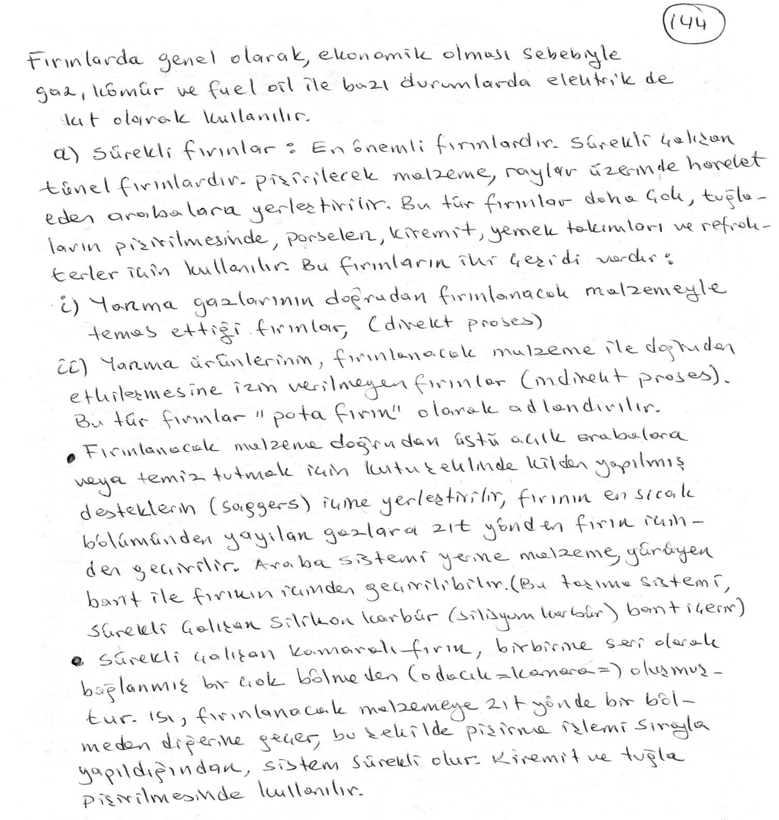

Slide 28
