Slide 1
WOMEN’S SUFFRAGE
AKE 118
Dr. Gamze kati gumus

Slide 3
WOMEN’s suffrage
During the late 1800s and early 1900s, women and women's organizations not only worked to gain the right to vote, they also worked for broad-based economic and political equality and for social reforms.
Notes:
https://www.loc.gov/classroom-materials/united-states-history-primary-source-timeline/progressive-era-to-new-era-1900-1929/womens-suffrage-in-progressive-era/

Slide 4
WOMEN’s suffrage
Between 1880 and 1910, the number of women employed in the United States increased from 2.6 million to 7.8 million.
Although women began to be employed in business and industry, the majority of better paying positions continued to go to men.
At the turn of the century, 60 percent of all working women were employed as domestic servants.

Slide 5
WOMEN’s suffrage
In the area of politics, women gained the right to
control their earnings
own property
in the case of divorce, take custody of their children

Slide 6
WOMEN’s suffrage
By 1896, women had gained the right to vote in four states (Wyoming, Colorado, Idaho, and Utah).
Women and women's organizations also worked on behalf of many social and reform issues.
By the beginning of the new century, women's clubs in towns and cities across the nation were working to promote suffrage, better schools, the regulation of child labor, women in unions, and liquor prohibition.

Slide 7
EARLY SUFFRAGE MOVEMENT
The campaign for women’s suffrage began in earnest in the decades before the Civil War.
At the same time, all sorts of reform groups were proliferating across the United States—temperance leagues, religious movements, moral-reform societies, anti-slavery organizations—and in many of these, women played a prominent role.
During the 1820s and '30s, most states had extended the franchise to all white men, regardless of how much money or property they had
Notes:
https://www.history.com/topics/womens-history/the-fight-for-womens-suffrage

Slide 8
EARLY SUFFRAGE MOVEMENT
Meanwhile, many American women were irritated by what historians have called the “Cult of True Womanhood”: that is, the idea that the only “true” woman was a pious, submissive wife and mother concerned exclusively with home and family.
Put together, all of these contributed to a new way of thinking about what it meant to be a woman and a citizen of the United States.

Slide 9
Seneca Falls Convention
In 1848, a group of abolitionist activists—mostly women, but some men—gathered in Seneca Falls, NY to discuss the problem of women’s rights. They were invited there by the reformers Elizabeth Cady Stanton and Lucretia Mott.
Most of the delegates to the Seneca Falls Convention agreed: American women were autonomous individuals who deserved their own political identities.

Slide 10
Seneca Falls Convention
“We hold these truths to be self-evident,” proclaimed the Declaration of Sentiments that the delegates produced, “that all men and women are created equal, that they are endowed by their creator with certain inalienable rights, that among these are life, liberty, and the pursuit of happiness.”
Declaration of Independence: “We hold these truths to be self-evident, that all men are created equal, that they are endowed by their Creator with certain unalienable Rights, that among these are Life, Liberty and the pursuit of Happiness.
What this meant, among other things, was that they believed women should have the right to vote.

Slide 11
SOJOURNER TRUTH AT THE SENECA FALLS CONVENTION (Frances Gage’s inaccurate version)
Well, children, where there is so much racket there must be something out of kilter. I think that 'twixt the negroes of the South and the women at the North, all talking about rights, the white men will be in a fix pretty soon. But what's all this here talking about? That man over there says that women need to be helped into carriages, and lifted over ditches, and to have the best place everywhere. Nobody ever helps me into carriages, or over mud-puddles, or gives me any best place! And ain't I a woman? Look at me! Look at my arm! I have ploughed and planted, and gathered into barns, and no man could head me! And ain't I a woman? I could work as much and eat as much as a man - when I could get it - and bear the lash as well! And ain't I a woman? I have borne thirteen children, and seen most all sold off to slavery, and when I cried out with my mother's grief, none but Jesus heard me! And ain't I a woman? Then they talk about this thing in the head; what's this they call it? [member of audience whispers, "intellect"] That's it, honey. What's that got to do with women's rights or negroes' rights? If my cup won't hold but a pint, and yours holds a quart, wouldn't you be mean not to let me have my little half measure full? Then that little man in black there, he says women can't have as much rights as men, 'cause Christ wasn't a woman! Where did your Christ come from? Where did your Christ come from? From God and a woman! Man had nothing to do with Him. If the first woman God ever made was strong enough to turn the world upside down all alone, these women together ought to be able to turn it back , and get it right side up again! And now they is asking to do it, the men better let them. Obliged to you for hearing me, and now old Sojourner ain't got nothing more to say.
Notes:
https://www.nps.gov/articles/sojourner-truth.htm

Slide 12
SOJOURNER TRUTH AT THE SENECA FALLS CONVENTION (Marius Robinson’s transcription)
I want to say a few words about this matter. I am a woman’s rights. I have as much muscle as any man, and can do as much work as any man. I have plowed and reaped and husked and chopped and mowed, and can any man do more than that? I have heard much about the sexes being equal. I can carry as much as any man, and can eat as much too, if I can get it. I am as strong as any man that is now.
As for intellect, all I can say is, if a woman have a pint, and a man a quart — why can’t she have her little pint full? You need not be afraid to give us our rights for fear we will take too much, — for we can’t take more than our pint’ll hold. The poor men seems to be all in confusion, and don’t know what to do. Why children, if you have woman’s rights, give it to her and you will feel better. You will have your own rights, and they won’t be so much trouble.
I can’t read, but I can hear. I have heard the bible and have learned that Eve caused man to sin. Well, if woman upset the world, do give her a chance to set it right side up again. The Lady has spoken about Jesus, how he never spurned woman from him, and she was right. When Lazarus died, Mary and Martha came to him with faith and love and besought him to raise their brother. And Jesus wept and Lazarus came forth. And how came Jesus into the world? Through God who created him and the woman who bore him. Man, where was your part? But the women are coming up blessed be God and a few of the men are coming up with them. But man is in a tight place, the poor slave is on him, woman is coming on him, he is surely between a hawk and a buzzard.
Notes:
https://sojournertruthmemorial.org/sojourner-truth/her-words/
https://www.thesojournertruthproject.com/compare-the-speeches/

Slide 13
Civil War and Civil Rights
During the 1850s, the women’s rights movement gathered steam, but lost momentum when the Civil War began. Almost immediately after the war ended, the 14th Amendment and the 15th Amendment to the Constitution raised familiar questions of suffrage and citizenship.
The 14th Amendment, ratified in 1868, extends the Constitution’s protection to all citizens—and defines “citizens” as “male”; the 15th, ratified in 1870, guarantees Black men the right to vote.

Slide 14
Civil War and Civil Rights
Some women’s suffrage advocates believed that this was their chance to push lawmakers for truly universal suffrage. As a result, they refused to support the 15th Amendment and even allied with racist Southerners who argued that white women’s votes could be used to neutralize those cast by African Americans.

Slide 15
WOMEN’S SUFFRAGE
Susan B. Anthony registers and votes for Ulysses S. Grant in the presidential election in New York. She is arrested, tried, and convicted in 1873. Her defense, that the Equal Protection Clause of the 14th Amendment entitled her to vote, was not successful.
“No State shall make or enforce any law which shall abridge the privileges or immunities of citizens of the United States; nor shall any State deprive any person of life, liberty, or property, without due process of law; nor deny to any person within its jurisdiction the equal protection of the laws.”**
Notes:
https://www.americanbar.org/groups/public_education/programs/19th-amendment-centennial/toolkit/suffrage-timeline/
https://constitutioncenter.org/interactive-constitution/interpretation/amendment-xiv/clauses/702

Slide 16
WOMEN’S SUFFRAGE
In 1869, a new group called the National Woman Suffrage Association was founded by Elizabeth Cady Stanton and Susan B. Anthony. They began to fight for a universal-suffrage amendment to the U.S. Constitution.
Others argued that it was unfair to endanger Black enfranchisement by tying it to the markedly less popular campaign for female suffrage. This pro-15th-Amendment faction formed a group called the American Woman Suffrage Association and fought for the franchise on a state-by-state basis.
This animosity eventually faded, and in 1890 the two groups merged to form the National American Woman Suffrage Association. Elizabeth Cady Stanton was the organization’s first president.

Slide 17
WOMEN’S SUFFRAGE
By then, the suffragists’ approach had changed. Instead of arguing that women deserved the same rights and responsibilities as men because women and men were “created equal,” the new generation of activists argued that women deserved the vote because they were different from men.
They could make their domesticity into a political virtue, using the franchise to create a purer, more moral “maternal commonwealth.”

Slide 18
WOMEN’S SUFFRAGE
This argument served many political agendas: Temperance advocates, for instance, wanted women to have the vote because they thought it would mobilize an enormous voting bloc on behalf of their cause, and many middle-class white people were swayed once again by the argument that the enfranchisement of white women would “ensure immediate and durable white supremacy, honestly attained.”

Slide 19
Opposition to the suffrage movement
Not all women believed in equality for the sexes, though. Women who upheld traditional gender roles argued that politics were improper for women. Some even insisted that voting might cause some women to "grow beards."
The challenge to traditional roles represented by the struggle for political, economic, and social equality was as threatening to some women as it was to most men.
Notes:
https://www.loc.gov/classroom-materials/united-states-history-primary-source-timeline/progressive-era-to-new-era-1900-1929/womens-suffrage-in-progressive-era/

Slide 20
Opposition to the suffrage movement
The Anti-Suffrage Party is founded in 1871.
Many people, including prominent women, such as Ellen Sherman, wife of General William Tecumseh Sherman, challenged the notion of suffrage as a “natural right,” and opposed its extension to women.
In their view, women’s political participation threatened their important roles as wives, mothers, educators, and philanthropists.
Notes:
https://www.americanbar.org/groups/public_education/programs/19th-amendment-centennial/toolkit/suffrage-timeline/

Slide 21
1912
Theodore Roosevelt's Bull Moose Party becomes the first national major political party to support women’s suffrage.
Notes:
https://www.americanbar.org/groups/public_education/programs/19th-amendment-centennial/toolkit/suffrage-timeline/

Slide 22
WOMEN’S SUFFRAGE
World War I slowed the suffragists’ campaign but helped them advance their argument nonetheless: Women’s work on behalf of the war effort, activists pointed out, proved that they were just as patriotic and deserving of citizenship as men.

Slide 23
WOMEN’S SUFFRAGE
18 Aug. 1920
Finally, on August 18, 1920, the 19th Amendment to the Constitution was ratified.
2 Nov. 1920
On November 2, 1920, more than 8 million women across the United States voted in elections for the first time.

Slide 24
Full Voting Rights before 19th Amendment and before statehood
1869
Territory of Wyoming
1870
Territory of Utah
1883
Territory of Washington
1887
Territory of Montana
1913
Territory of Alaska

Slide 25
States granting women the right to vote prior to the 19th Amendment
1890: Wyoming
1893: Colorado
1896: Utah
1896: Idaho
1910: Washington
1911: California
1912: Arizona
1912: Kansas
1912: Oregon
1914: Montana
1914: Nevada
1917: New York
1918: Michigan
1918: Oklahoma
1918: South Dakota
Notes:
https://constitutioncenter.org/timeline/html/cw08_12159.html

Slide 26
could vote for President prior to the 19th Amendment
1913: Illinois
1917: Nebraska
1917: Ohio
1917: Indiana
1917: North Dakota
1917: Rhode Island
1919: Iowa
1919: Maine
1919: Minnesota
1919: Missouri
1919: Tennessee
1919: Wisconsin

Slide 27
Gained Voting Rights after the passage
Vermont New Hampshire Massachusetts Connecticut Pennsylvania New Jersey Delaware Maryland West Virginia Virginia North Carolina South Carolina Georgia Alabama Florida Mississippi Louisiana Arkansas Texas New Mexico Kentucky

Slide 28
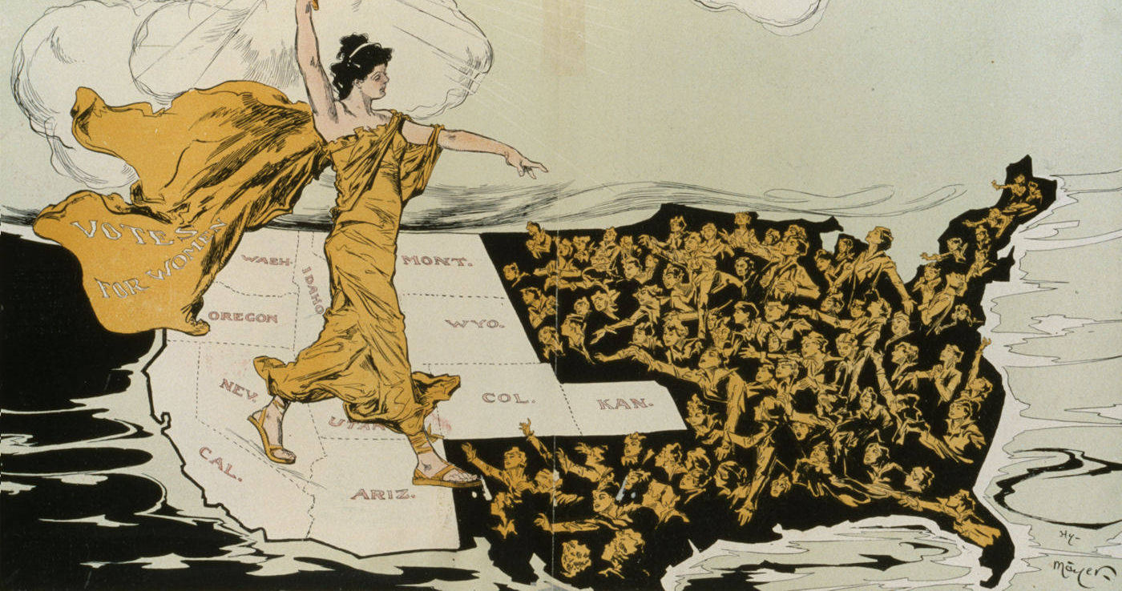
Notes:
This and the following cartoons are from https://twincitiesarts.com/2016/11/08/feature-anti-womens-suffrage-cartoons/

Slide 29
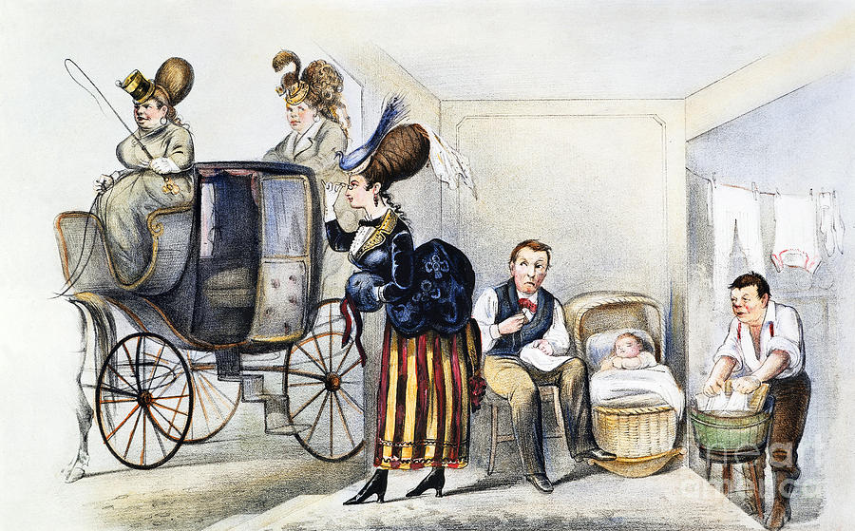

Slide 30
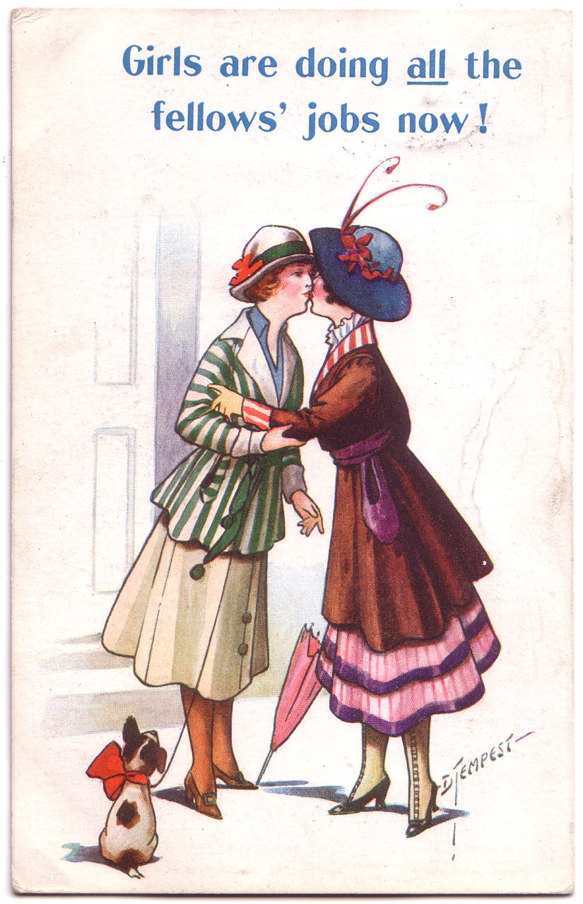

Slide 31
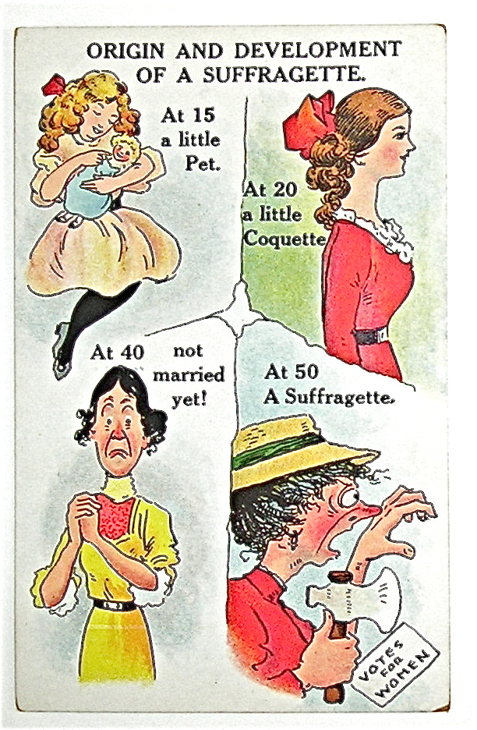
Notes:
This and the following cartoons are from https://www.mentalfloss.com/article/52207/12-cruel-anti-suffragette-cartoons

Slide 32
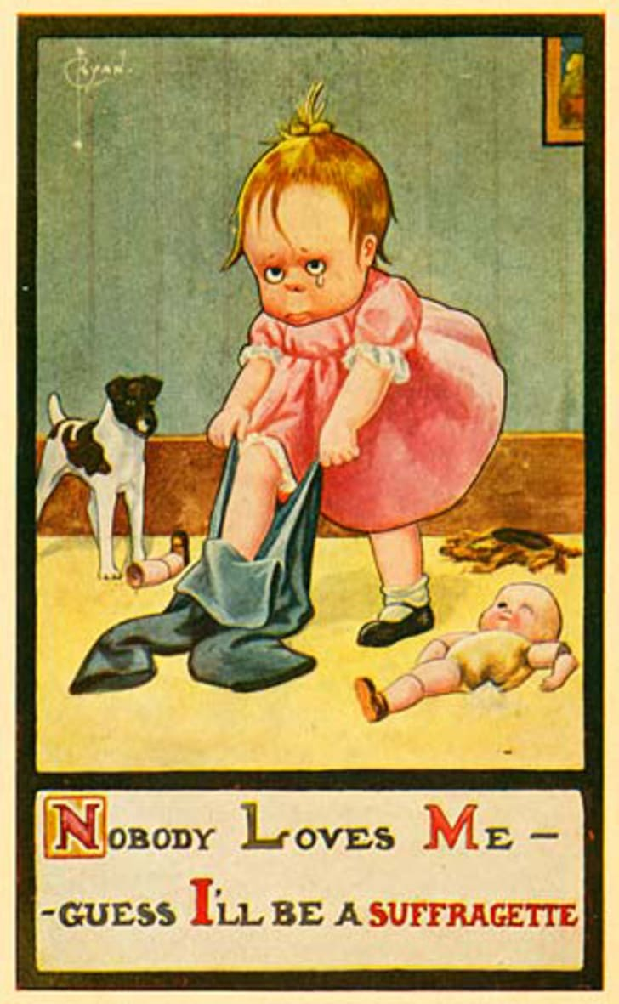

Slide 33
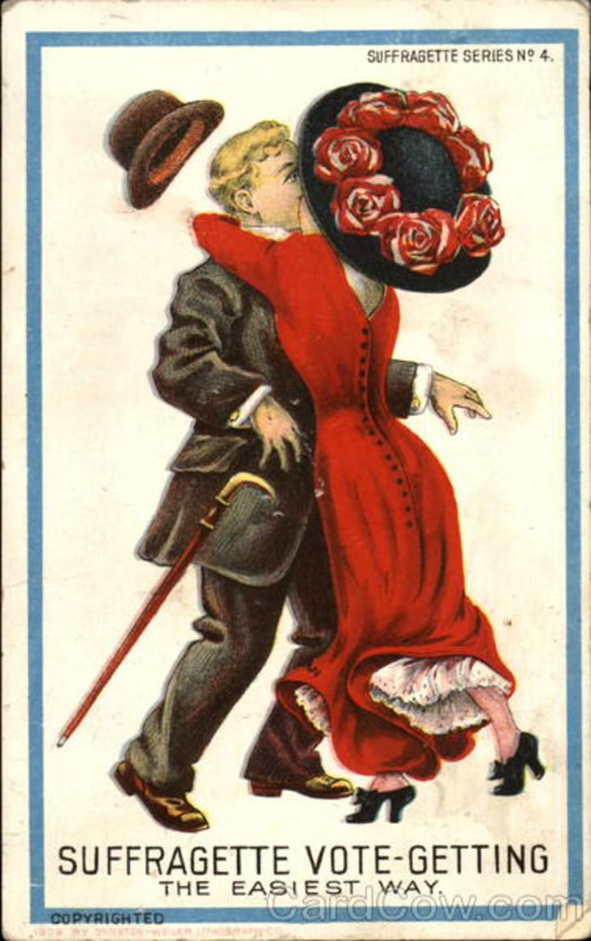

Slide 34
