Slide 1
Water and Aqueous Solutions
Lecture 2
© 2009 W. H. Freeman and Company

Slide 2
Physics of Non-covalent Interactions
Non-covalent interactions do not involve sharing a pair of electrons. Based on their physical origin, one can distinguish between
Ionic (Coulombic) Interactions
Electrostatic interactions between permanently charged species,
or between the ion and a permanent dipole
Dipole Interactions
Electrostatic interactions between uncharged, but polar molecules
Van der Waals Interactions
Weak interactions between all atoms, regardless of polarity
Attractive (dispersion) and repulsive (steric) component
Hydrophobic Effect
Complex phenomenon associated with the ordering of water molecules around non-polar substances

Slide 3
Examples of Noncovalent Interactions

Slide 4
Hydrogen Bonds
Strong dipole-dipole or charge-dipole interaction that arises between an acid (proton donor) and a base (proton acceptor)
Typically 4-6 kJ/mol for bonds with neutral atoms,
and 6-10 kJ/mol for bonds with one charged atom
Typically involves two electronegative atoms (frequently nitrogen and oxygen)
Hydrogen bonds are strongest when
the bonded molecules are oriented to
maximize electrostatic interaction.
Ideally the three atoms involved are in a line

Slide 5
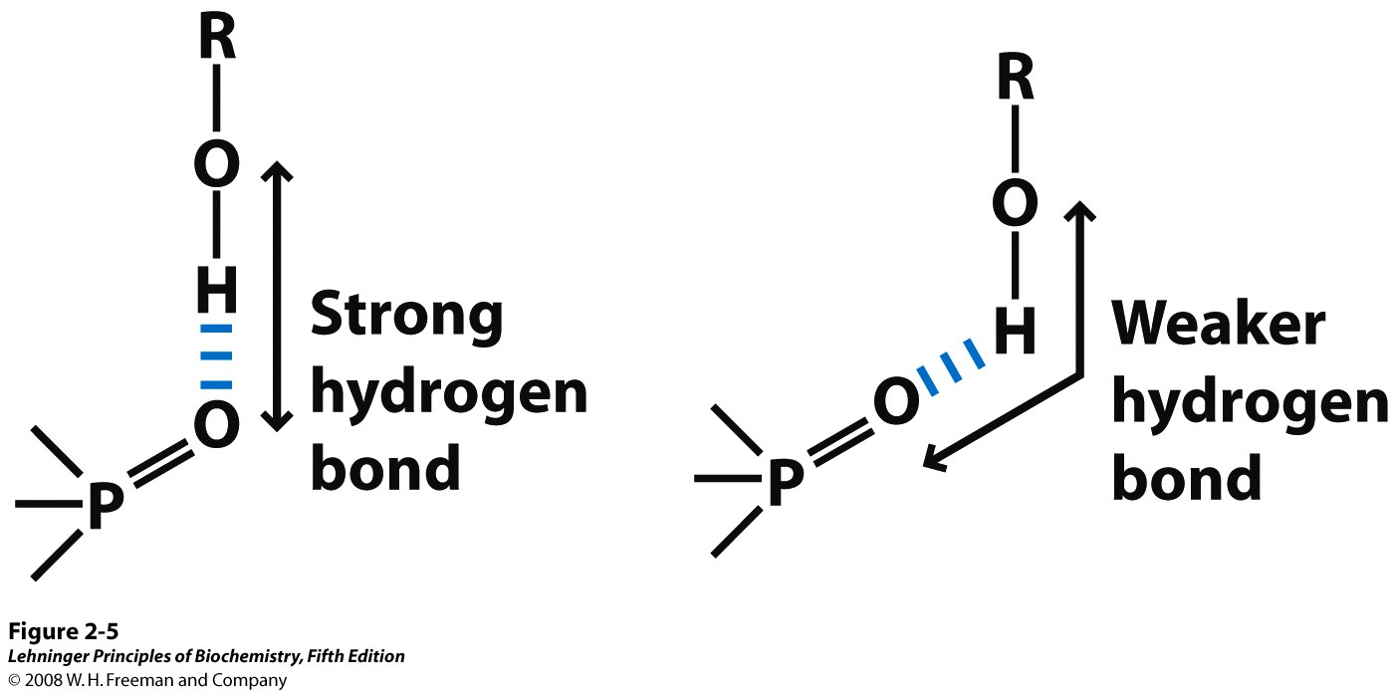
Directionality of the hydrogen bond. The attraction between the partial electric charges (see Figure 2-1) is greatest when the three atoms involved in the bond (in this case O, H, and O) lie in a straight line. When the hydrogen-bonded moieties are structurally constrained (when they are parts of a single protein molecule, for example), this ideal geometry may not be possible and the resulting hydrogen bond is weaker.
Notes:
FIGURE 2-5 Directionality of the hydrogen bond. The attraction between the partial electric charges (see Figure 2-1) is greatest when the three atoms involved in the bond (in this case O, H, and O) lie in a straight line. When the hydrogen-bonded moieties are structurally constrained (when they are parts of a single protein molecule, for example), this ideal geometry may not be possible and the resulting hydrogen bond is weaker.

Slide 6
Hydrogen Bonds: Examples

Slide 7
Importance of Hydrogen Bonds
Source of unique properties of water
Structure and function of proteins
Structure and function of DNA
Structure and function of polysaccharides
Binding of a substrates to enzymes
Binding of hormones to receptors
Matching of mRNA and tRNA

Slide 8
Biological Relevance of Hydrogen Bonds

Slide 9
Van der Waals Interactions
Van der Waals interactions have two components:
Attractive force (London dispersion) Depends on the polarizability
Repulsive force (Steric repulsion) Depends on the size of atoms
Attraction dominates at longer distances (typically 0.4-0.7 nm)
Repulsion dominates at very short distances
There is a minimum energy distance (van der Waals contact distance)

Slide 10
Biochemical Significance of Van der Waals Interactions
Weak individually
Easily broken, reversible
Universal:
Occur between any two atoms that are near each other
Importance
determines steric complementarity
stabilizes biological macromolecules (stacking in DNA)
facilitates binding of polarizable ligands

Slide 11
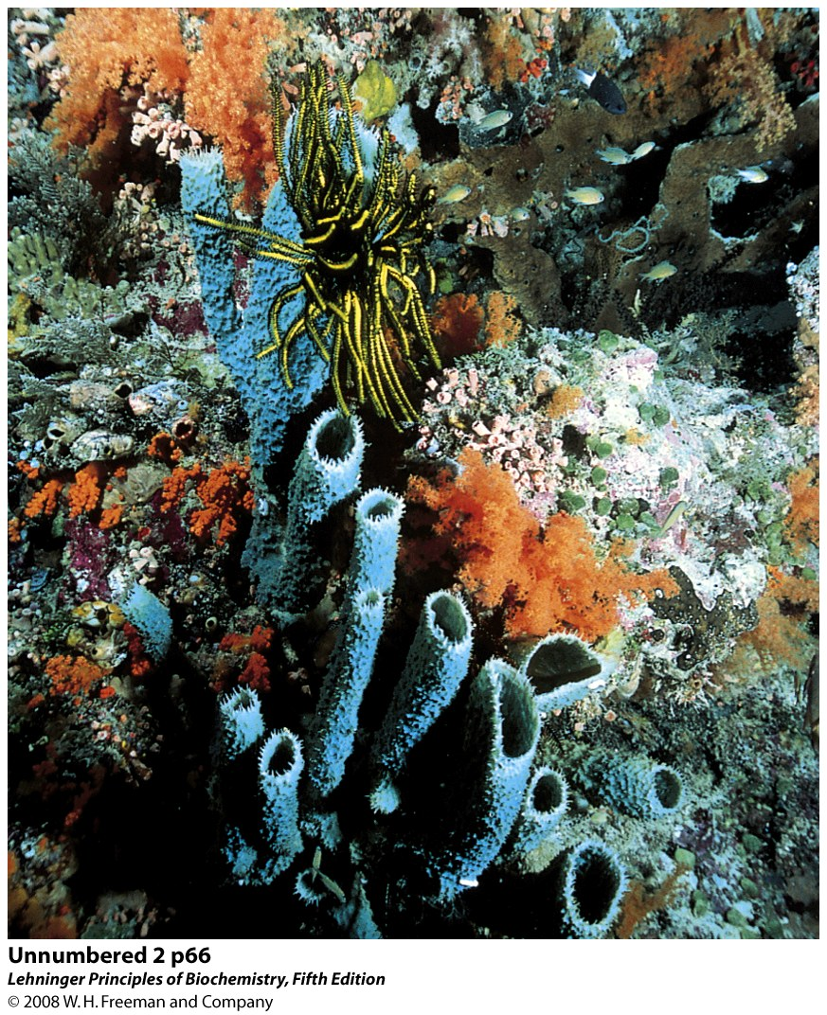
Water is the Medium for Life
Life evolved in water (UV protection)
Organisms typically contain 70-90% water
Chemical reactions occur in aqueous milieu
Water is a critical determinant of the structure and function of proteins, nucleic acids, and membranes

Slide 12
Structure of the Water Molecule
Octet rule dictates that there are four electron pairs around an oxygen atom in water. These electrons are on four sp³ orbitals
Two of these pairs covalently link two hydrogen atoms to a central oxygen atom.
The two remaining pairs remain nonbonding (lone pairs)
Water geometry is a distorted tetrahedron
The electronegativity of the oxygen atom induces a net dipole moment
Because of the dipole moment, water can serve as both a hydrogen bond donor and acceptor.

Slide 13
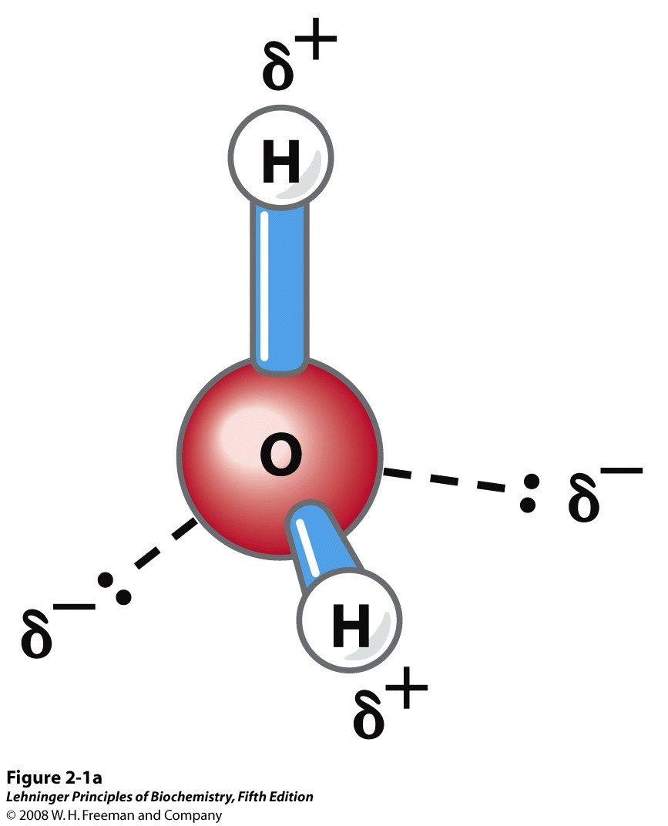
The dipolar nature of the H₂O molecule
Notes:
FIGURE 2-1a Structure of the water molecule. (a) The dipolar nature of the H₂O molecule is shown in a ball-and-stick model; the dashed lines represent the nonbonding orbitals. There is a nearly tetrahedral arrangement of the outer-shell electron pairs around the oxygen atom; the two hydrogen atoms have localized partial positive charges (δ⁺) and the oxygen atom has a partial negative charge (δ–).

Slide 14
Hydrogen Bonding in Water
Water can serve as both
an H donor and
an H acceptor
Up to four H-bonds per water molecule gives water the
anomalously high boiling point
anomalously high melting point
unusually large surface tension
Hydrogen bonding in water is cooperative.
Hydrogen bonds between neighboring molecules are weak (20 kJ/mole) relative to the H–O covalent bonds (420 kJ/mol)

Slide 15
Water as a Solvent
Water is a good solvent for charged and polar substances
amino acids and peptides
small alcohols
carbohydrates
Water is a poor solvent for nonpolar substances
nonpolar gases
aromatic moieties
aliphatic chains

Slide 16
Water Dissolves Many Salts
High dielectric constant reduces attraction between oppositely charged ions in salt crystal, almost no attraction at large (> 40 nm) distance
Strong electrostatic interactions between the solvated ions and water molecules lowers the energy of the system
Entropy increases as ordered crystal lattice is dissolved

Slide 17
The Hydrophobic Effect
Refers to the association or folding of non-polar molecules in the aqueous solution
Is one of the main factors behind:
Protein folding
Protein-protein association
Formation of lipid micelles
Binding of steroid hormones to their receptors
Does not arise because of some attractive direct force between two non-polar molecules

Slide 18
Solubility of Polar and Non-polar Solutes
Why are non-polar molecules poorly soluble in water?

Slide 19
Low Solubility of Hydrophobic Solutes can be Explained by Entropy
Bulk water has little order:
- high entropy
Water near a hydrophobic solute is highly ordered:
- low entropy
Low entropy is thermodynamically unfavorable, thus hydrophobic solutes have low solubility

Slide 20
Origin of the Hydrophobic Effect (1)
Consider amphipathic lipids in water
Lipid molecules disperse in the solution; nonpolar tail of each lipid molecule is surrounded by ordered water molecules
Entropy of the system decreases
System is now in an unfavorable state

Slide 21
Origin of the Hydrophobic effect (2)
Non-polar portions of the amphipathic molecule
aggregate so that fewer water molecules
are ordered. The released water molecules
will be more random and the entropy increases.
All non-polar groups are sequestered
from water, and the released water
molecules increase the entropy further.
Only polar “head groups” are exposed
and make energetically favorable H-bonds.

Slide 22
Hydrophobic Effect Favors Ligand Binding
Binding sites in enzymes and receptors are often hydrophobic
Such sites can bind hydrophobic substrates and ligands such as steroid hormones
Many drugs are designed to take advantage of the hydrophobic effect

Slide 23
Colligative Properties
Some properties of solution — boiling point, melting point, and osmolarity — do not depend strongly on the nature of the dissolved substance. These are called colligative properties
Other properties — viscosity, surface tension, taste, and color, among other — depend strongly on the chemical nature of the solute. These are non-colligative properties.
Cytoplasm of cells are highly concentrated solutions and have high osmotic pressure

Slide 24
Effect of Extracellular Osmolarity

Slide 25
Ionization of Water
→
←
H₂O H⁺ + OH⁻
O-H bonds are polar and can dissociate heterolytically
Products are a proton (H⁺) and a hydroxide ion (OH⁻)
Dissociation of water is a rapid reversible process
Most water molecules remain un-ionized, thus pure water
has very low electrical conductivity (resistance: 18 MΩ•cm)
The equilibrium H₂O H⁺ + OH⁻ is strongly to the left
Extent of dissociation depends on the temperature
→
←

Slide 26
Proton Hydration
Protons do not exist free in solution.
They are immediately hydrated to form hydronium (oxonium) ions
A hydronium ion is a water molecule with a proton associated with one of the non-bonding electron pairs
Hydronium ions are solvated by nearby water molecules
The covalent and hydrogen bonds are interchangeable. This allows for an extremely fast mobility of protons in water via “proton hopping”

Slide 27
Ionization of Water: Quantitative Treatment
Concentrations of participating species in an equilibrium process
are not independent but are related via the equilibrium constant
→
[H⁺]•[OH⁻]
←
H₂O H⁺ + OH⁻
K_{eq} = ————
[H₂O]
K_{eq} can be determined experimentally, it is 1.8•10⁻¹⁶ M at 25 °C
[H₂O] can be determined from water density, it is 55.5 M
Ionic product of water:
In pure water [H⁺] = [OH⁻] = 10⁻⁷ M

