Slide 1
THE CIVIL RIGHTS MOVEMENT IN AMERICA
AKE 118
Dr. Gamze Kati Gumus
Notes:
https://www.history.com/topics/black-history/civil-rights-movement
https://www.history.com/topics/civil-rights-movement

Slide 2
The Civil Rights Movement
The fight for equal rights of Black Americans under the law took place in 1950s and 60s.

Slide 3
Jim Crow Laws
1868
In 1868, the 14th Amendment to the Constitution gave Black people equal protection under the law.
1870
In 1870, the 15th Amendment granted Black American men the right to vote.

Slide 4
Jim Crow Laws
During Reconstruction (1865-77), Jim Crow laws were established in the South beginning in the late 19th century to marginalize Black people, keep them separate from white people and erase the progress they’d made during this era.

Slide 5
Jim Crow Laws
Black people could not use the same public facilities as white people
Black people could not live in many of the same towns or go to the same schools
Interracial marriage was illegal
Most Black people could not vote because they were unable to pass voter literacy tests

Slide 6
Jim Crow Laws
Jim Crow laws were not adopted in northern states; however, Black people still experienced discrimination at their jobs or when they tried to buy a house or get an education.
Laws were passed in some states to limit voting rights for Black Americans.

Slide 7
The NAACP (The National Association for the Advancement of Colored People)
The NAACP was established in 1909 and is America’s oldest and largest civil rights organization.
It was formed in New York City by white and Black activists, partially in response to the ongoing violence against African Americans around the country.
In the NAACP’s early decades, its anti-lynching campaign was central to its agenda.
During the civil rights era in the 1950s and 1960s, the group won major legal victories.
Notes:
https://www.history.com/topics/civil-rights-movement/naacp

Slide 8
World War II
Prior to WWII, most Black people worked as low-wage farmers, factory workers, domestics or servants.
By the early 1940s, war-related work was booming, but most Black Americans weren’t given the better paying jobs.
They were also discouraged from joining the military.

Slide 9
World War II
After thousands of Black people threatened to march on Washington to demand equal employment rights, President Franklin D. Roosevelt issued Executive Order 8802 on June 25, 1941.
It opened national defense jobs and other government jobs to all Americans regardless of race, creed, color or national origin.

Slide 10
World War II
Black men and women fought in the American Army, and the Tuskegee Airmen became the first Black military aviators in the U.S. Army Air Corps.
However, when these soldiers came back, they continued to face discrimination and scorn.

Slide 11
The Cold War
As the Cold War began, President Harry Truman initiated a civil rights agenda.
In1948, Truman issued Executive Order 9981 to end discrimination in the military.
These events helped set the stage for grass-roots initiatives to enact racial equality legislation and incite the civil rights movement.

Slide 12
Rosa Parks and the Montgomery Bus Boycott

Slide 13
Rosa Parks and The Montgomery Bus Boycott
Rosa Parks worked for a civil rights organization named NAACP as a sexual assault investigator.
On December 1, 1955, a 42-year-old Parks found a seat on a Montgomery, Alabama bus after work. Segregation laws at the time stated Black passengers must sit in designated seats at the back of the bus, and Parks had complied.
When a white man got on the bus and couldn’t find a seat in the white section at the front of the bus, the bus driver instructed Parks and three other Black passengers to give up their seats. The other three complied, Parks refused and was arrested.

Slide 14
From Rosa Park’s A/B
“People always say that I didn’t give up my seat because I was tired,” wrote Parks in her autobiography, “but that isn’t true. I was not tired physically… No, the only tired I was, was tired of giving in.”
Notes:
https://www.history.com/topics/black-history/rosa-parks

Slide 15
Little Rock Nine

Slide 16
Little Rock Nine
In 1954, the civil rights movement gained momentum when the United States Supreme Court made segregation illegal in public schools in the case of Brown v. Board of Education.
Oliver Brown filed a suit against the Board of Education of Topeka, Kansas, when his daughter Linda was denied entrance to Topeka’s all-white elementary schools.
In his lawsuit, Brown claimed that schools for Black children were not equal to the white schools, and that segregation violated the so-called “equal protection clause” of the 14th Amendment, which holds that no state can “deny to any person within its jurisdiction the equal protection of the laws.”
In 1957, Central High School in Little Rock, Arkansas asked for volunteers from all-Black high schools to attend the formerly segregated school.

Slide 17
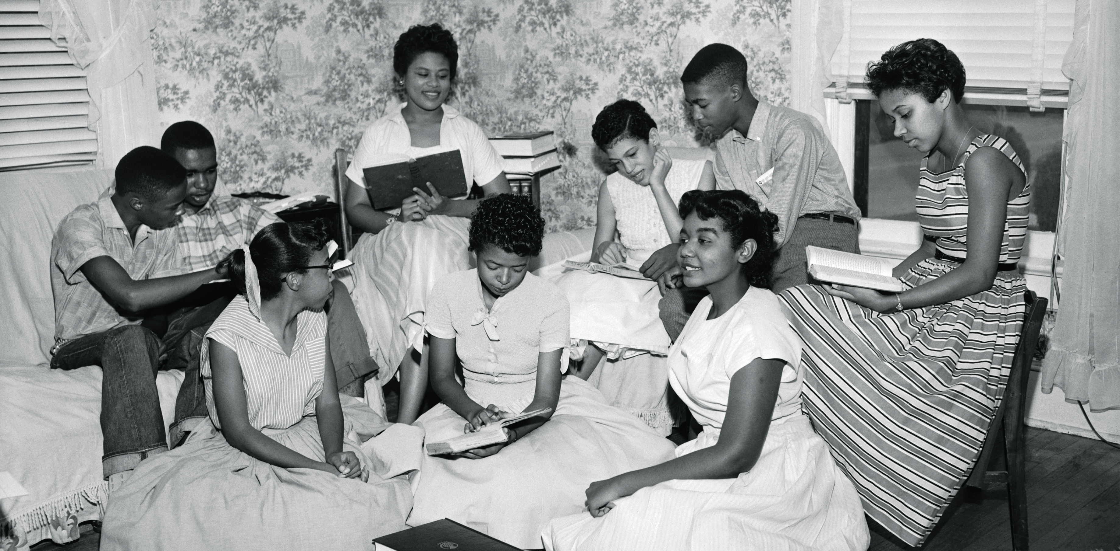
Little Rock Nine
On September 3, 1957, nine Black students, known as the Little Rock Nine, arrived at Central High School to begin classes but were instead met by the Arkansas National Guard (on order of Governor Orval Faubus) and a screaming, threatening mob.
The Little Rock Nine tried again a couple of weeks later and made it inside but had to be removed for their safety when violence ensued.
Finally, President Dwight D. Eisenhower intervened and ordered federal troops to escort the Little Rock Nine to and from classes at Central High. Still, the students faced continual harassment and prejudice.

Slide 18
Civil Rights Act of 1957
On September 9, 1957, President Eisenhower signed the Civil Rights Act of 1957 into law, the first major civil rights legislation since Reconstruction.
It allowed federal prosecution of anyone who tried to prevent someone from voting.
It also created a commission to investigate voter fraud.

Slide 19
Greensboro Sit-ins

Slide 20
Greensboro Sit-ins
On February 1, 1960, four college students took a stand against segregation in Greensboro, North Carolina when they refused to leave a Woolworth’s lunch counter without being served.
Over the next several days, hundreds of people joined their cause in what became known as the Greensboro sit-ins.
After some were arrested and charged with trespassing, protesters launched a boycott of all segregated lunch counters until the owners caved and the original four students were finally served at the Woolworth’s lunch counter where they’d first stood their ground.

Slide 21
Greensboro Sit-ins
Their efforts spearheaded peaceful sit-ins and demonstrations in dozens of cities and helped launch the Student Nonviolent Coordinating Committee to encourage all students to get involved in the civil rights movement.

Slide 22
The Freedom Riders

Slide 23
The Freedom Riders
On May 4, 1961, 13 “Freedom Riders”—seven Black and six white activists–mounted a Greyhound bus in Washington, D.C., embarking on a bus tour of the American south to protest segregated bus terminals.
They were testing the 1960 decision by the Supreme Court in Boynton v. Virginia that declared the segregation of interstate transportation facilities unconstitutional.

Slide 24
The Freedom Riders
On Mother’s Day 1961, the bus reached Anniston, Alabama, where a mob mounted the bus and threw a bomb into it.
The Freedom Riders escaped the burning bus, but were badly beaten.
Photos of the bus engulfed in flames were widely circulated, and the group could not find a bus driver to take them further.

Slide 25
The Freedom Riders
U.S. Attorney General Robert F. Kennedy (brother to President John F. Kennedy) negotiated with Alabama Governor John Patterson to find a suitable driver, and the Freedom Riders resumed their journey under police escort on May 20.
But the officers left the group once they reached Montgomery, where a white mob brutally attacked the bus.
Attorney General Kennedy responded to the riders—and a call from Martin Luther King, Jr.—by sending federal marshals to Montgomery.
Hundreds of new Freedom Riders were drawn to the cause, and the rides continued.

Slide 26
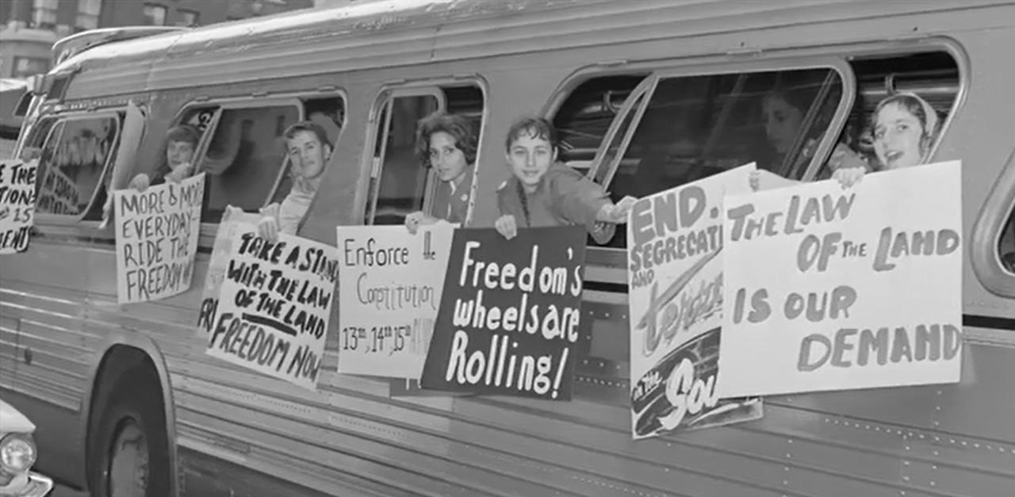
The Freedom Riders
In the fall of 1961, under pressure from the Kennedy administration, the Interstate Commerce Commission issued regulations prohibiting segregation in interstate transit terminals.

Slide 27
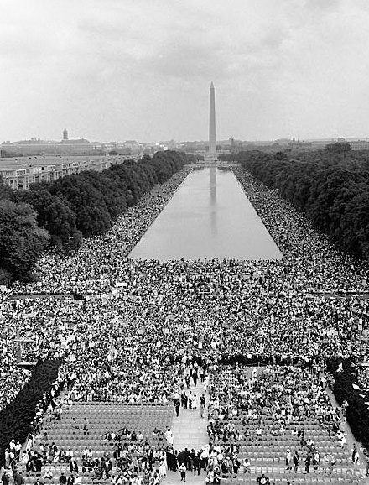
March on Washington
One of the most famous events of the civil rights movement took place on August 28, 1963: the March on Washington. It was organized and attended by civil rights leaders such as A. Philip Randolph, Bayard Rustin, and Martin Luther King, Jr.
More than 200,000 people of all races congregated in Washington, D. C. for the peaceful march with the main purpose of forcing civil rights legislation and establishing job equality for everyone.
The highlight of the march was King’s speech, which became a slogan for equality and freedom.

Slide 28
Civil Rights Act of 1964
President Lyndon B. Johnson signed the Civil Rights Act of 1964.
The law guaranteed equal employment for all, limited the use of voter literacy tests and allowed federal authorities to ensure public facilities were integrated.

Slide 29
Voting Rights Act of 1965
President Johnson signed the Voting Rights Act into law on August 6, 1965.
The new law banned all voter literacy tests and provided federal examiners in certain voting jurisdictions.

Slide 30
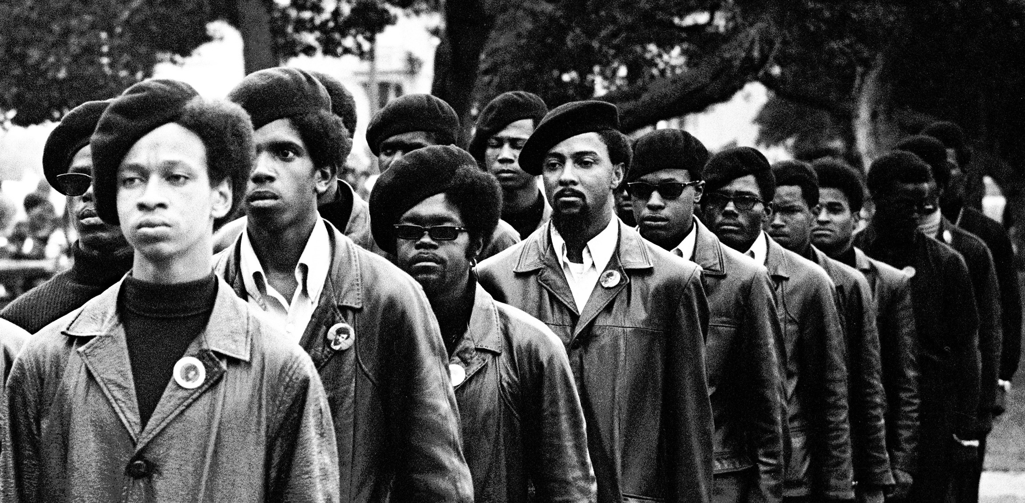
The Black Panthers
The Black Panthers, also known as the Black Panther Party, was a political organization founded in 1966 by Huey Newton and Bobby Seale to challenge police brutality against the African American community.
Dressed in black berets and black leather jackets, the Black Panthers organized armed citizen patrols of Oakland and other U.S. cities.
At its peak in 1968, the Black Panther Party had roughly 2,000 members.
The organization later declined as a result of internal tensions, deadly shootouts and FBI counterintelligence activities aimed at weakening the organization.
Notes:
https://www.history.com/topics/civil-rights-movement/naacp

Slide 31
Assassination of Civil Rights Leaders
21 Feb. 1965
On February 21, 1965, former Nation of Islam leader and Organization of Afro-American Unity founder Malcolm X was assassinated at a rally.
4 Apr. 1968
On April 4, 1968, civil rights leader and Nobel Peace Prize recipient Martin Luther King, Jr. was assassinated on his hotel room’s balcony.

Slide 32
The Fair Housing Act
The Fair Housing Act was signed into law by President Johnson on April 11, 1968, just days after King’s assassination.
It prevented housing discrimination based on race, sex, national origin and religion.
It was also the last legislation enacted during the civil rights era.

Slide 33
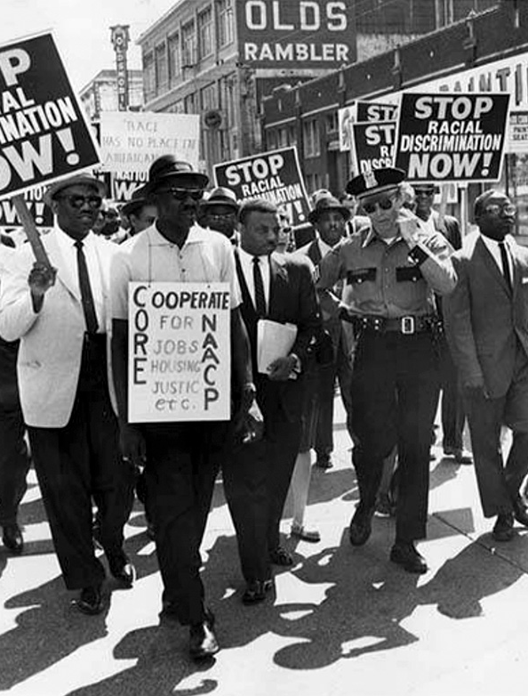
The civil rights movement was an empowering yet precarious time for Black Americans.
The efforts of civil rights activists and countless protesters of all races brought about legislation to end segregation, Black voter suppression and discriminatory employment and housing practices.

