Slide 1
EMERGENCY CONTRACEPTION
OTC: Levonorgestrel

Slide 2
Postcoital
“morning after”, “the day after”,
ertes☺
Very high dose of progesterone
(levonorgestrel, 1,5 mg)
Up to 72 hrs (!) after coitus

Slide 3
Drug | Dosing
Ulipristal (SPRM), 30 mg (Ella®) | 1 tablet within 120 hrs (5 days)
Levonorgestrel, 0.75 mg Norlevo® | 2 tablets within 12-72 hrs
Levonorgestrel, 1.5 mg (Postpill One®, Ertes72☺) | 1 tablet within 12-72 hrs
Norjestrel, 0.5 mg + Etinyløstradiol, 0.01 mg | bid (12 hrs apart)

Slide 4
Together with antiemetics
(vomiting 5-20%)
Headache, dizziness, abdominal
discomfort
Levonorgestrel

Slide 5
Effectiveness
A meta-analysis of two studies showed that women who used ECPs with UPA had a pregnancy rate of 1.2%
Studies have shown that ECPs with LNG had a pregnancy rate of 1.2% to 2.1% (1) (2).
Ideally, ECPs with UPA, ECPs with LNG or COCs should be taken as early as possible after unprotected intercourse, within 120 hours.
ECPs with UPA are more effective between 72–120 hours after unprotected intercourse than other ECPs.
http://www.who.int/news-room/fact-sheets/detail/emergency-contraception

Slide 6
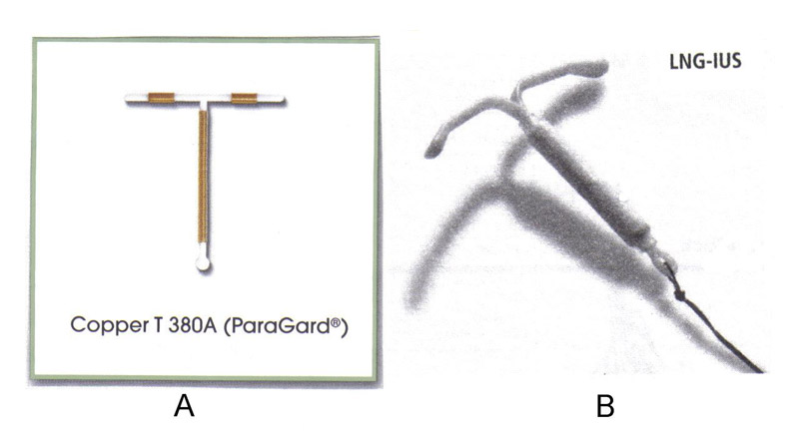
Copper-bearing intrauterine devices
WHO recommends that a copper-bearing IUD, when used as an emergency contraceptive method, be inserted within 5 days of unprotected intercourse.
Effectiveness
When inserted within 120 hours of unprotected intercourse, a copper-bearing IUD is more than 99% effective in preventing pregnancy. This is the most effective form of emergency contraception available. Once inserted, women can continue to use the IUD as an ongoing method of contraception, or may choose to change to another contraceptive method.

Slide 7
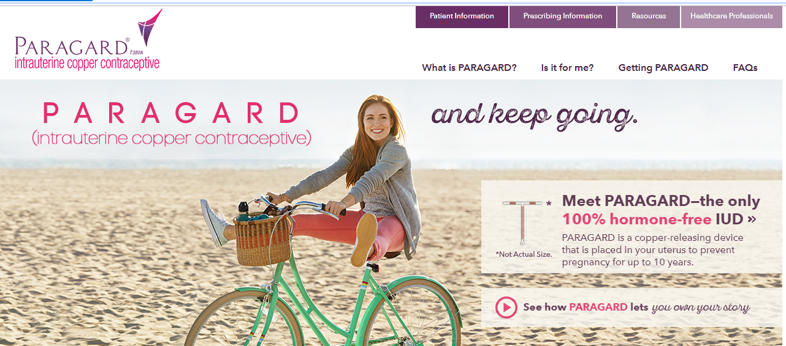
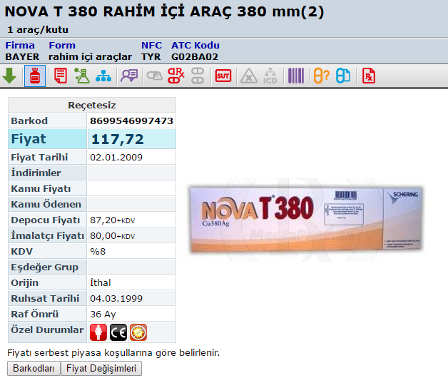

Slide 8
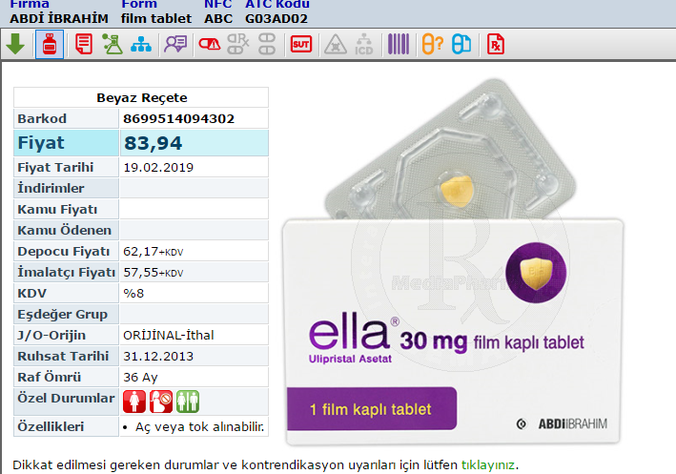
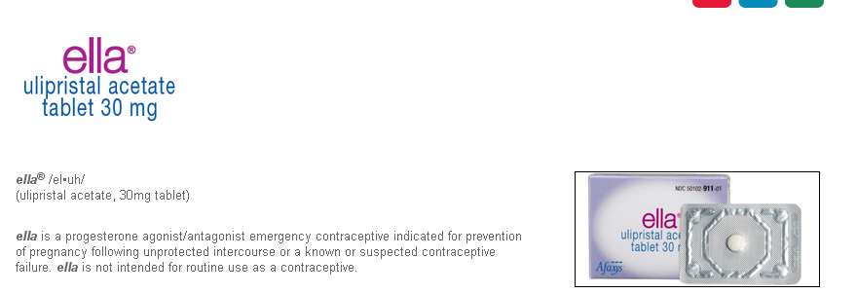

Slide 9
Labeling | Levonorgestrel | Ulipristal
Approved indication | Emergency contraception, as long as 72 h after intercourse | Emergency contraception, as long as 120 h after intercourse
Women 17 y and older | Available without a prescription | Prescription required
Women younger than 17 y | Prescription required

Slide 10
SPRM
selective progesterone-receptor modulator that has predominantly antiprogestin activity
The drug blocks or delays ovulation and suppresses endometrial growth
Interestingly, ulipristal can block ovulation for as long as 5 days, even if administered after the onset of the luteinizing hormone (LH) surge

Slide 11
Normal menstrual cyclus 21-40 days
Luteal phase 14 ± 2 days
Ovulation predictors for LH peak in urine
(Peak: 8-40 pre-ovulation)
drop in progesterone
Vasoconstriction
Contraction of uterus

Slide 12
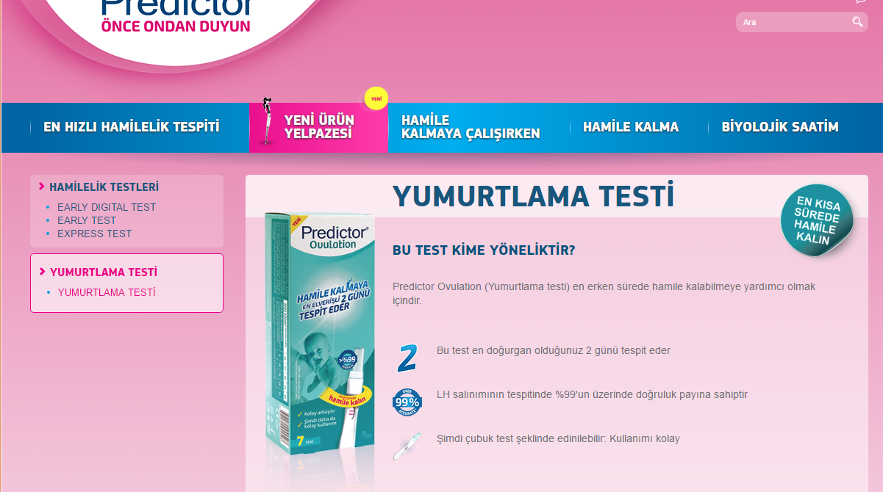
To be or not to be?

Slide 13
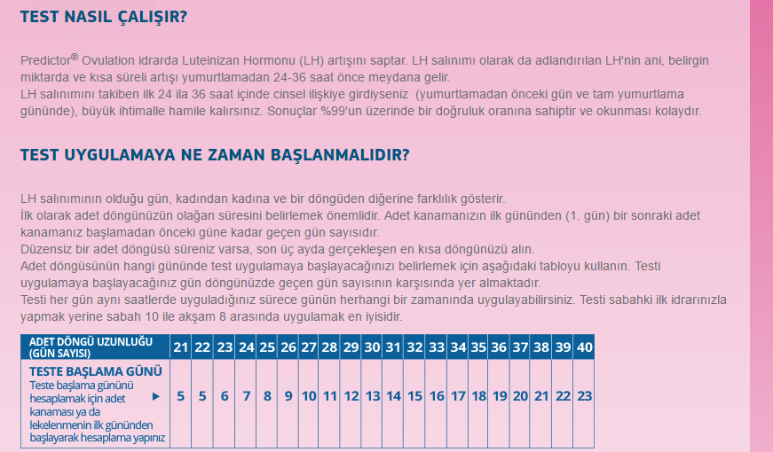

Slide 14
Disorders related to
menstruation

Slide 15
dysmenorrhea
prostaglandins
Leucotrienes and vasopressin also play a role
Cyclic pain in primary dysmenorrhea
Nausea, vomiting, headache, dizziness, diarrhea, fatigue due to
PGs in circulation

Slide 16
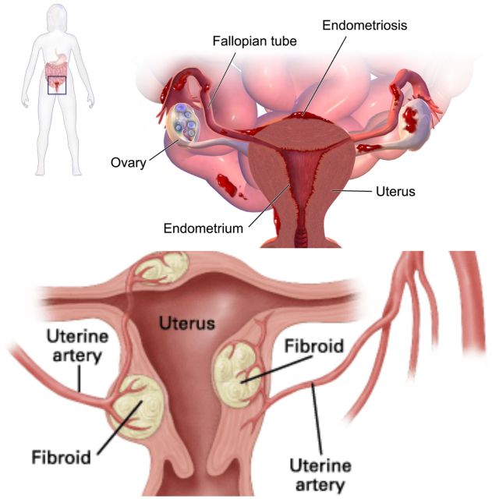
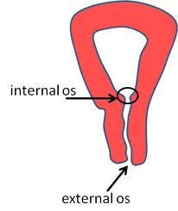
Secondary dysmenorrhea
pain is caused by a disorder in the woman's reproductive organs:
endometriosis
adenomyosis
uterine fibroids,
or infection

Slide 17
Treatment
Non-pharmacologic: heating pad,
increase ω-3 consumption
Ibuprofen ve naproxene are effective; aspirin
and paracetamol may be used
Patients have different preferences as for NSAIDs
on a schedule rather than as-needed (ibuprofen
every 4-6 hrs; naproxen every 8-12 hrs)
No relief with nonsalicylate NSAIDs ⇒ COC,
medroxyprogesterone acetate or levonorgestrel IUD

Slide 18
Warnings
Women attempting to become pregnant
should avoid use of NSAIDs as they may impair blastocyte implantation
Paracetamol and ibuprofen are safe for
breast-feeding
Contemporary
Magnezyum, B1 ve E vitamini

Slide 19
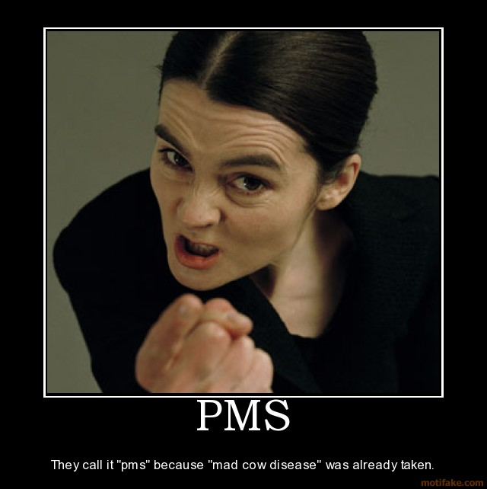

Slide 20
Premenstrual Syndrome (PMS)
Premenstrual Dysphoric Disorder (PMDD)
Physical, emotional/mood, behavioral symptoms during
luteal phase:
Food cravings
Physical symptoms
Emotional lability
Irritability
Lowered mood

Slide 21
Pathophysiology
Changes in 5-HT and 5-HT-effect
Alterations in allopregnanolon sensitivity or GABA receptors
In fact, SSRI increase allopregnanolon
Abdominal bloating often occurs without weight gain

Slide 22
Treatment
Calcium 600mg, bid to 466 moderate-to-severe PMS
Symptoms were reduced by the 2nd month of therapy
Ca reduced overall symptoms 48% by the 3rd month
Thys-Jacobs, et al. 1998
Hurray Calcium!

Slide 23
Treatment
Magnesium
PMS patients have lower Mg in their erythrocytes
beneficial effects/no benefit with Mg

Slide 24
Treatment
Diuretics:
Caffeine, pamabrom (theophylline derivative)
Do we really?
Problem is fluid redistribution, not retention
Abdominal distention secondary to relaxion of gut
muscle caused by progesterone

Slide 25
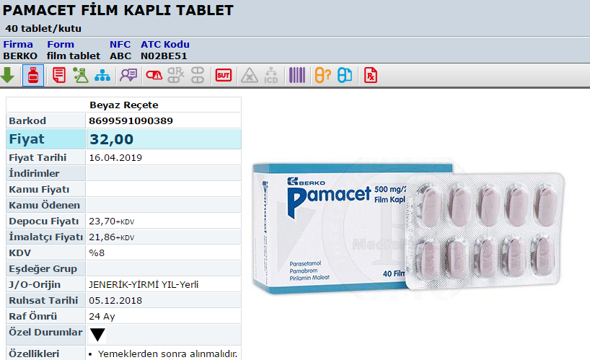
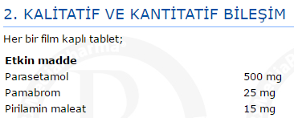

Slide 26
Toxic Shock Syndrome
multi-system disease first identified in 1978:
fever, dangerously low blood pressure, diarrhea, mental confusion, renal failure, erythroderma
It's caused by the release of toxins from an
overgrowth of Staphylococcus aureus,
which is found in many women's bodies
TSS affects menstruating women, especially those who use super-absorbent tampons
(super-absorbent tampons banned after 1979-1980 epidemic)
CMC or synthetic materials no longer used

Slide 27
intravaginal diaphragm is also associated
inflammatory immun rxn to Staphylococcus aureus
or Streptococcus pyogenes enterotoxins
TSST-1 antibodies in adults but not in younger

Slide 28
TSS
Menstrual blood is a good media for bacteria
Trapping of menstral blood in vagina is
even better (!) for bacteria
Factors that induce toxin production:
high protein content
neutral pH
high CO₂ and low O₂

Slide 29
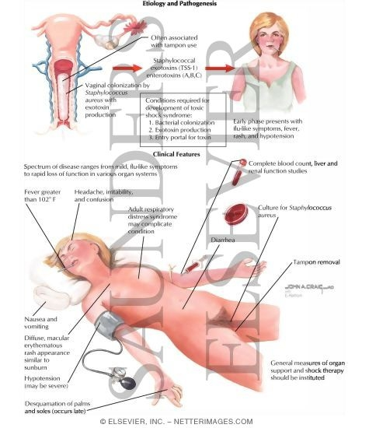
TSS
GI problems first: nausea, pain
Very fast worsening of symptoms
A characteristic “sunburn-like” skin rash

Slide 30
NONCURABLE
but vaccine-preventable STIs
Disease: Genital Warts (HPV)*
Incubation period: 2-4 months
warts on external genitalia,
rectum, anus, mouth, larynx, cervix
Complications: cervical dysplasia/neoplasia
* self-clearance of HPV may occur

Slide 31
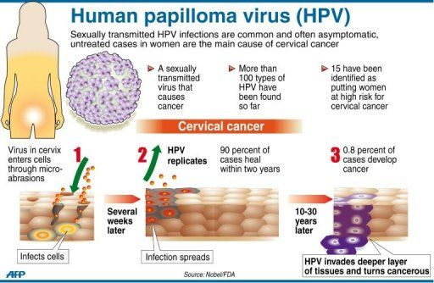
NONCURABLE
but vaccine-preventable STIs

Slide 33
