Slide 1
Social Responsibility

Slide 2
Reading: Social Responbility
«Adidas is turning plastic ocean waste into sneakers and sportswear»
Source: hhttps://www.businessinsider.com/adidas-sneakers-plastic-bottles-ocean-waste-recycle-pollution-2019-8
Pre-reading Discussion:
What is social responsibility?
Think about social responsibility campaign and describe it.

Slide 3
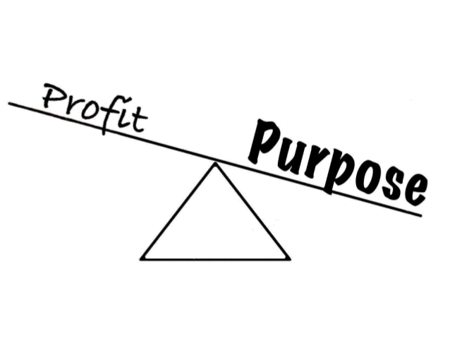
Social Responsibility
Why businesses exist ?
Customers
Shareholders
Workers
Environment

Slide 4
Social Responsibility
Conventional View:
- To earn profit a company is forced to care about society.
High quality products
Treat their workers well
Can’t pollute the enivornment

Slide 5
Social Responsibility
‘Corporate Social Responsibility is the continuing commitment by business to behave ethically and contribute to economic development while improving the quality of life of the workforce and their families as well as of the local community and society at large’.
– World Business Council For Sustainable Development

Slide 6
Social Responsibility – A Critical Definition
Corporate Social Responsibility aims to create a positive perception of the company in order to neutralize the responses to the negative consequences of its investment and commercial activities.

Slide 7
Vocabulary for Reading:
- Pollution:
The action of polluting especially by environmental contamination with man-made waste.
- Polyester:
Any of a group of polymers that consist basically of repeated units of an ester and are used especially in making fibers or plastics
- Manufacture:
Something made from raw materials by hand or by machinery.
- Seabird:
A bird (such as a gull or an albatross) frequenting the open ocean.

Slide 8
Vocabulary for Reading:
- Waste:
Gradual loss or decrease by use, wear, or decay.
- Recycle:
To process (something, such as liquid body waste, glass, or cans) in order to regain material for human use.
- Trash:
Something worth little or nothing.
- Coastal:
The land near a shore.

Slide 9
Vocabulary for Reading:
- Dehydrate:
To remove bound water or hydrogen and oxygen from (a chemical compound) in the proportion in which they form water.
- Flake:
A thin flattened piece or layer.
- Filament:
A single thread or a thin flexible threadlike object, process, or appendage.
- Spin:
To draw out and twist fiber into yarn or thread.

Slide 10
Vocabulary for Reading:
- Intercepted:
To stop, seize, or interrupt in progress or course or before arrival.
- Apparel:
Personal attire, clothing of a particular kind.
- Eliminate:
To put an end to or get rid of.
- Microfiber:
A fine usually soft polyester fiber.

Slide 11
Listening: Social Responsibility
Source: «The Business Benefits of Doing Good”
https://www.ted.com/talks/wendy_woods_the_business_benefits_of_doing_good#t-657454
Discussion about the listening:
What is the main point of the speech?
Do you agree or disagree with the speaker? Why?

