Slide 1
Timing ?
Koray tekin
Ankara Üniversitesi, Veteriner Fakültesi
Reprodüksiyon ve Suni Tohumlama Anabilim Dalı
Notes:
değerli dinleyiciler, sizlere köpeklerde suni tohumlama ile ilgili bir seminer sunacağım.
Sunum sırasın

Slide 2
The Success of AI?
Timing,
Right amount of semen concentration,
Sperm selection and examination,
Deposition of sperm into right place,
Notes:
Bundan sonraki slaytlarda spermanın doğru zamanlama, canlılık, aktarım noktası hakkında ki konular üzerine olacaktır.

Slide 3
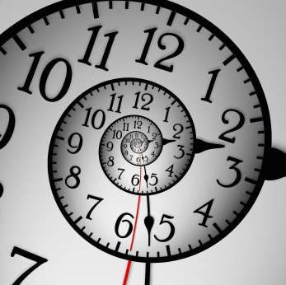
Timing
Mono-estrus.
Ovulation 24 to 72 hours after the LH peak
Ova may be released over 24 to 96 hours
Dog ovulates primary oocytes
The oviductal transit takes 5-10 days.
MII stage, 48-60 hours post ovulation
Fertilization
Mature canine ova may remain fertilizable for 2 to 4.5 days
Ovulate as early as day 3 to 4, late as day 26 or 27
Notes:
yılda bir ya da 2 kez kızgınlık geçirirler,
Hormonal, davranışsal ve fizyolojik olaylar siklus üzerine etki ederler,

Slide 4
Vaginal Cytology, PG₄, Vaginal endoscopy, USG
Vaginal cytology & PG₄
Must be repeated 2-3 days interval
Must be combined
Notes:
On the vaginal cytology, epithelial cells of the vagina change their form in response to estrogen impregnation, and passes from small round cells with a clearly visible cytoplasm in non-estrogenic stages, to larger, cornified, angular shaped-cells with small pyknotic nucleus, almost to the point of disappearing, under the influence of estrogens (Figure 1). At beginning of estrus, vaginal cytology presents its maximum cornification index (>70%). By that time, serial blood sampling for progesterone determination should start to detect the initial progesterone rise (2-3 ng/mL) which correlates with LH surge, which in turn triggers ovulation within 2 days. On the day of ovulation (day “0” of the cycle) progesterone concentrations may vary between 4 and 10 ng/mL. The sudden increase in the number of round-shaped cells and of neutrophils reflects the onset of diestrus (Fontbonne & Malandain, 2006).

Slide 5
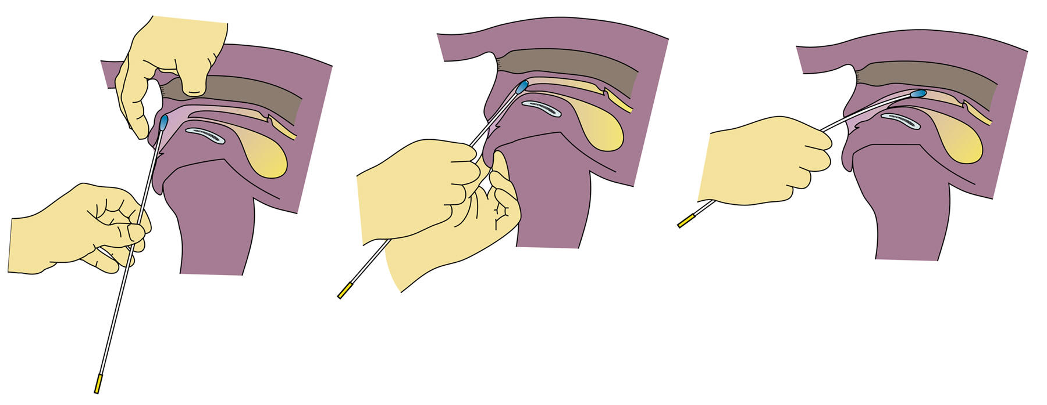
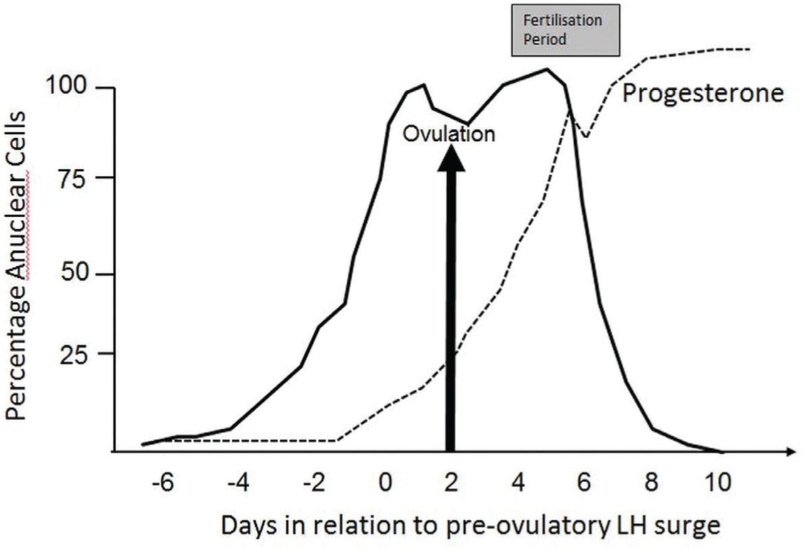
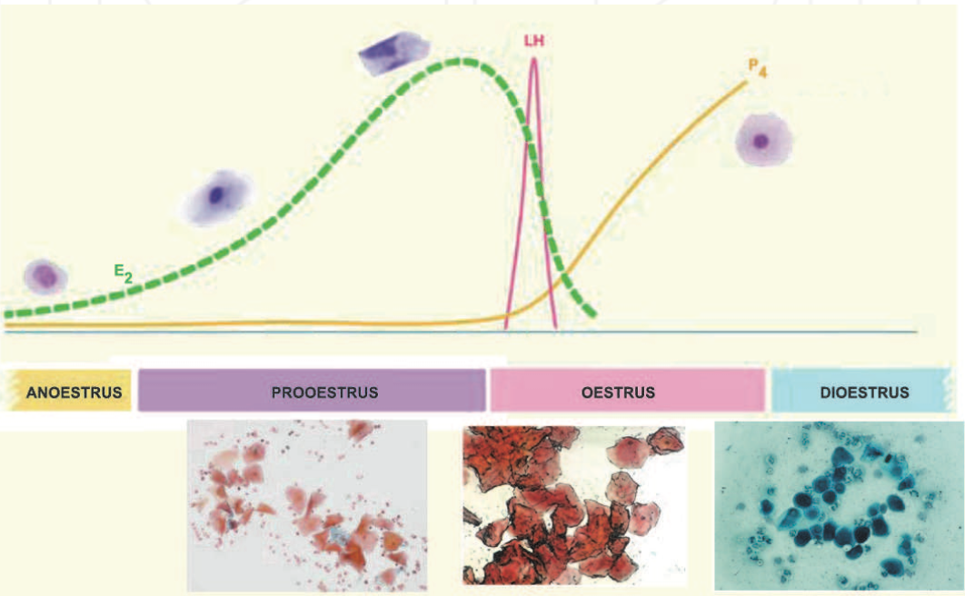
Vaginal cytology
Notes:
Progesterone semi-quantitative immunoenzymatic assays are available for clinical routines, but although rapids, these test lack accuracy. They give progesterone concentration according to a colorimetric scale for values corresponding to basal progesterone levels (0-1 ng/mL), intermediate levels corresponding to the LH surge (around 1-2.5ng/mL) and the ovulation periods (2.5 – 8ng/mL), and high progesterone levels (more than 8 or 10, depending on the kit). A recent study showed that, in dogs, semi-quantitative methods for progesterone determination are less accurate than the quantitative methods, in particular at intermediate plasma progesterone concentrations (Moxon et al., 2010). According to this study, the tested semi-quantitative assay estimated higher progesterone concentration than RIA (radioimmunoassay), which could suggest that the fertilization period had commenced earlier than it was actually the case. In addition to those assays, quantitative radio or chemiluminescent assays can also be used, even if not always available in the house lab, since cross-reactivity exist t

Slide 6
P₄ & USG
ovarian bursa
Notes:
Although ovarian ultrasound examination is a reliable and accurate method to determine ovulation in most domestic females, in the bitch fat accumulation in ovarian bursa that encloses the ovaries may difficult the value of the technique. In addition, several studies demonstrated that ultrasound images of the ovaries around ovulation are more difficult to analyze, due to the fact that ovarian follicles do not differ much in the immediate pre- and post-ovulatory period (England & Concannon, 2002), as not all dog follicles collapse at ovulation (Yeager & Concannon, 1996) and also because non-ovulated follicles frequently remain in the ovary (Wallace et al. 1992).
Consequently, follicular dynamics evaluation through ultrasonography (US) in dogs is still experimental and must follow a very precise protocol, which accuracy increase with the use of frequent examinations. In a recent study, Fontbonne (2008) reported that US was accurate enough to detect the occurrence of ovulation and obtain comparable numbers of ovarian structures between US examinations and macroscopic visual count on the surface of the ovaries after surgical removal, even if only one daily examination was performed. However, that author accepts that features of ovulation may be difficult to visualize in large breeds and in overweight animals. Pre-ovulatory follicles may present different aspects at US. Usually they appear as round to slightly triangular anechoic structures, sometimes slightly flattened, giving a honeycomb aspect to the ovary (Figure 2). At ovulation, different degrees of follicular collapse can be found in the US images, and usually a clear change of the ovarian echogenicity has been detected in a large number of bitches, giving the ovary a more homogeneous aspect (Fontbonne, 2008; Fontbonne & Malandain, 2006). Persistence of non-ovulatory follicular structures was perceived in US images after ovulation. Also, in the immediate post-ovulation period, until 24 hours after US changes of the ovaries at ovulation, hypoechoic structures were observed in most cases (Figure 2). These structures were very similar to the pre-ovulatory follicles, although slightly smaller, and tending to increase in echogenicity (from the border to the interior of the structure) with time (Fontbonne, 2008; Fontbonne & Malandain, 2006).

Slide 7
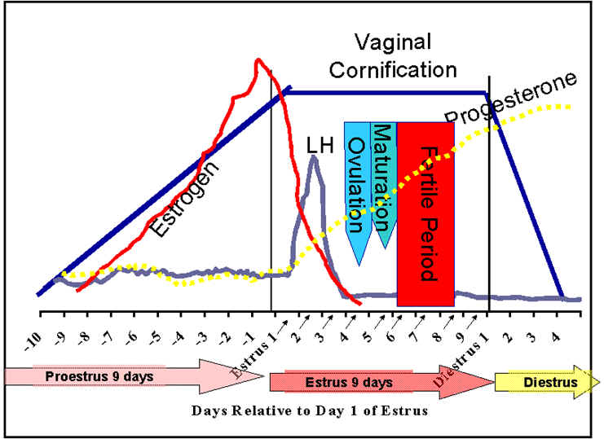
Relative progesterone concentrations during the proestrual/estrual period. P4 (ng/ml) Relative time points 1.1-1.9 Before LH surge 2.1-2.9 Day of LH surge 3.1-3.9 Days 1-2 after the LH surge 4.0-8.0 Day of ovulation 10-80 2-3 weeks post-ovulation

Slide 8
Vaginal endoscopy
Erken Pro-östrus
Pro-östrus
Östrus
Di-östrus
Notes:
It is possible to use vaginal endoscopy to determine the fertile period although it does not allow accurate timing of ovulation. However, this method requires expensive equipment. Nevertheless, it may give a huge contribution to the vaginal evaluation and detection of anatomical abnormalities that may impair proper reproductive performance.
The fluctuation of estrogen and progesterone concentrations in the blood at consecutive stages of estrous cycle in the bitch results in specific morphologic changes of the vaginal mucosa. Analysis of these changes allows for exact assessment of the stage of the estrous cycle and for determination of the optimal insemination time (Goodman, 2001; Jeffcoate & Lindsay, 1989; Lindsay 1983). The observation of the cranial part of the vagina is performed for this purpose. The deep introduction of the tip of endoscope into the narrow part of the vagina close to the cervix (dorsal median postcervical fold) or paracervix, is of less diagnostic value (Pineda et al., 1973).
Vaginoscopic examination is performed using a rigid endoscope 3-4 mm in diameter, with diagnostic sheath and a length of 30-33 cm or longer. The examination should be done on the standing animal. Usually there is no need of administration of sedatives. The tip of the endosope is introduced at the beginning at angle of 45-60o cranially and dorsally. When the tip of the optics reaches the vagina it should be repositioned at horizontal axis. During proestrus the increase of the estrogen concentration results in the oedema of the vaginal mucosa. Vaginoscopy reveals rounded folds in the vagina. The mucosa of the folds is turgid, pink in colour and with a smooth surface. Normally the bloody discharge is also visible in the vagina. Sometimes, periodic blood outflow from the cervix, through the paracervix may be observed. The lumen of the vagina is narrow, which can be appreciated when the endoscope is advanced cranially. At the last days of proestrus and at beginning of estrus, the decrease of estrogen concentration and increase of progesterone (P4) level is noted. It results in the collapse of vaginal folds. Formerly turgid and smooth, the mucosa, becomes wrinkled and shrunked. Vaginal folds become smaller. Maximal intensity of shrinkage of vaginal mucosa is observed between 3 and 7-8 days of estrous cycle. This time the loss of fluid from the tissue of vaginal mucosa and submucosa is great and the shape of vaginal folds become angulated with sharp angles at the top of folds. As the result, the lumen of the vagina is wider in comparison to proestrus. During diestrus vaginal folds become flat and round. The mucosa is red and small petechia may be visible at places touched by the tip of the endoscope. This is due to the fact that epithelium of the vagina is thin and consists of only 2-3 cell layers in diestrus and anestrus. An opaque, thick mucus is sometimes visible on the surface of epithelium (Figure 3).
Other methods has been proposed to monitor the bitch oestrous cycle, such as serial reading of the electrical resistance of the vaginal mucus around the time of ovulation, using probes inserted into the vagina during the heat period (Fontbonne, 2008), or the crystallization patterns in anterior vaginal fluids (England & Allen, 1989) or in saliva (Pardo-Carmona et al., 2010), which have been found up not to present an acceptable reliabily in the identification of the canine ovulation.

