Slide 1
SEPARATION PROCESSES

Slide 2
Separation process
This operation is designed for the separation or physical removal of food components
Centrifugation
Filtration
Extraction using solvents
Expression (pressing)
Membrane separation
Main separation processes

Slide 3
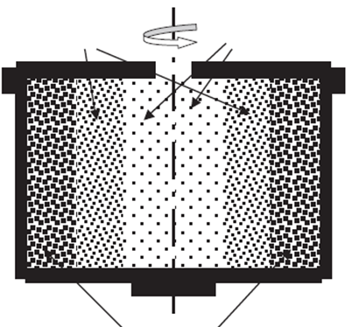
Working principles of centrifugation
Medium phase
Light phase
Centrifugal force acts outwards from the centre
Acceleration force acts towards the centre of the cycle
Heavy phase
When a material (milk) is exposed to centrifugation, the heavier phase (water in milk) moves to the wall of the centrifuge and the lighter phase (fat in milk) is displaced to an inner annulus of the centrifuge as a result of the effect of these forces

Slide 4
Calculation for the rate of seperation
The rate of separation as expressed by velocity is calculated by formula given below
This formula is used to calculate the separation rate between two phases (solid in liquid) with different densities

Slide 5
Problems
Beef is clarified from the unwanted compounds by using centrifugate operation at 2600 rpm, with a radius of 15 cm. Calculate the centrifugal force for this operation.

Slide 6
Problems
The solid particles in a liquid-solid suspension are to be separated by centrifugal force. The particles are 100 microns in diameter with a density of 800 kg/m³. The liquid is water with a density of 993 kg/m³, and the effective radius separation is 7.5 cm. If the required velocity for separation is 0.03 m/s, determine the rotation speed for the centrifuge.

Slide 7
Problems
Cream is separated from the whole milk by using centrifugation. The density for the skim milk is 1025 kg/m³ and it has a 5 cm outlet radius. Radius of cream outlet is 2.5 cm and the density for cream is 865 kg/m³. Design the separation cylinder and suggest a required radius for the feeding (inlet).

Slide 8
FILTRATION

Slide 9
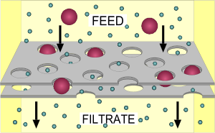
Filtration
Filtration is the removal of insoluble solids from a liquids by passing it through a porous material
Filtration is used to clarify wine, beer, juices, oils and syrups in the food industry
Filter medium

Slide 10
Calculation of filtration rate
The rate of filtration can be described as the ratio of driving force (the pressure required to move the fluid through the filter medium) to resistance
The mathematical equation to calculate rate of filtration is given below
Volumetric flow rate (m³/s)

Slide 11
Problem
An air filter is used to remove small particles from an air supply to a quality control laboratory. The air (0°C) is supplied at a rate of 0.5 m³/s through an air filter with a 0.5 m² cross-sectional area. If the pressure drop across the filter is 0.25 cm water after one hour of use, determine the life of the filter if a filter change is required when the pressure drop is 2.5 cm of water.
Assumption: Due to the nature of air filtration, constant-rate filtration can be assumed and the filter medium thickness is negligible.
Use the table (A.4.4) given at next slide to find the viscosity of the air.

Slide 13
Problem
The liquid is filtered at a pressure of 200 kPa through a 0.2 m² filter. Initial results indicate that 5 min is required to filter 0.3 m³ of liquid. Determine the time that will elapse until the rate of filtration drops to 5x10⁻⁵ m³/s.
Assumption: Due to information given in the question, filtration is assumed to be constant-pressure condition and the filter medium thickness (L) is negligible.

Slide 14
Design of a filtration system
The usage of equations given for constant-rate and constant-pressure filtration systems requires knowlegde of several parameters. However, in most cases, viscosity and spesific resistance values may not be known. Additionally, filter medium thickness (L) is not assumed to be negligible.
A small or pilot-scale operation in the food industry results in determination of filtration rate after given periods of time at a constant-pressure on the small scale filter.

Slide 15
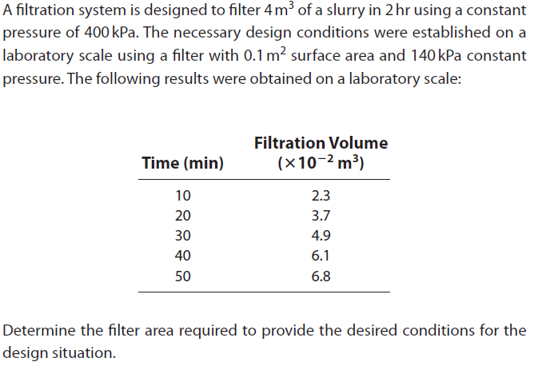
Problem

Slide 16
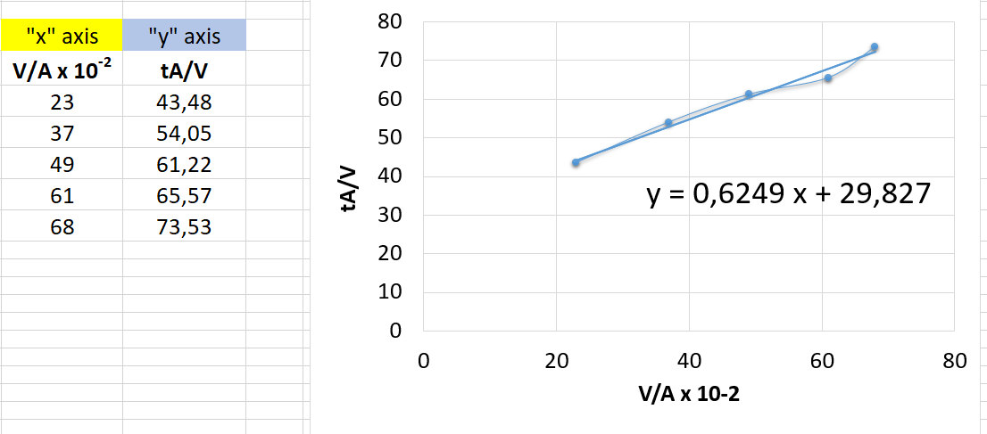
Problem (cont.)
slope
intercept

Slide 17
Problem (cont.)
Desired conditions
Designed conditions
Volume (V): 4 m³
Time (t): 2 hour
Pressure (∆P): 400 kPa
Ouestion:
Filter area ???
Area (A): 0.1 m²
Pressure (∆P): 140 kPa
Slope 0.6249
Intercept 29.827

Slide 18
EXTRACTION USING SOLVENTS
(Solid-liquid extraction)

Slide 19
Extraction using solvents
Solid-liquid extraction is defined as removal of a desired compound, which is called solute, from a food by using a liquid, which is called solvent
Extraction process has many application areas in the food industry such as
Extraction of oil from oilseeds and nuts
Extraction of essential oil and flavor compounds from herbs, spices, fruits and vegetables
Coffee, tea, and decaffeinated coffee and tea

Slide 20
References
Singh, R.P. and Heldman D.R. (2009) Introduction to food engineering. Chapter 13: Supplemental processes. Pages 689-720. (4th ed.) Academic Press, California, USA (In the library of our department)
Fellows, P.J. (2017). Food processing technology principles and practice. Part II Ambient Temperature Processing. Pages 201-386. (4th ed.) Woodhead Publishing, Duxford, United Kingdom
Campbell-Platt, G. (2009). Food Science and Technology. Chapter 9: Food processing, Unit operations. Pages 219-234. Blackwell Publishing (In the library of our department)

