Slide 1
PACKAGING of fresh fruits and vegetables
Instructor
Assist. Prof. Dr. Eda Demirok Soncu
E-mail: edemirok@eng.ankara.edu.tr
Phone: +90312 203 3300 (3639 ext.)
Office: 2nd floor #212
Fde 216 food packagıng

Slide 2
WHAT ARE QUALITY CHANGES ?

Slide 3
Quality changes in fresh fruits and vegetables

Slide 4
1) Sensory attributes
Texture, flavor, odor, color, and visual development of fresh fruits and vegatables change in time.
For example (changes regarding texture);
Softening of fresh produce is due to the solubilization and depolymerization of pectins by the action of pectinolytic enzymes
Dehydration of produce can lead to a soft texture and wilt surface

Slide 5
1) Sensory attributes
For example (changes regarding flavor);
Starch degradation and decarboxylation of organic acids induce modification of flavor, where the ratio between sweetness and acidity is important
For example (changes regarding color);
Change in color is attributed to the degradation of color compounds or enzymatic browning
Decarboxylation means removal or elimination of carboxyl group (-COOH) from a molecule

Slide 6
2) Safety concerns (Microbial spoilage)
Spoilage microorganisms are involved in product degradation but generally do not directly affect human health
Fungi mycotoxin is an exception. Mycotoxin is toxic compound that produce by fungi
Although fruits have generally been considered safe from pathogens, some might be found sporadically in vegetables (for example Clostridium botulinum in vegetables. It is a pathogenic microorganism and responsible from food poisoning)

Slide 7
FACTORS AFFECTING QUALITY FACTORS

Slide 8
What are the factors that affect quality changes?
Factors that affect previously mentioned quality changes in fresh fruits and vegetables are listed below
Respiration and ripening
Dehydration
Temperature effect
Gas composition effect

Slide 9
1) Respiration and ripening
Once fruits and vegetables are harvested, they have to draw on their own reserves to achieve aerobic respiration and maintain their cellular integrity
During respiration, stored carbohydrates are broken down into glucose, which is oxidized into CO₂, water, and energy via several enzymatic steps.
As soon as these substrates become unavailable, other carbonated resources (protein or lipids) are used, leading to the death of the harvested product

Slide 10
1) Respiration and ripening
Thus, the potential shelf life of fruits and vegetables is closely related to their respiration rate
The lower the respiration rate, the longer the potential shelf life
For climacteric fruits (peaches, apples, kiwis, etc…), an increase in respiration is associated with an increase in ethylene. During the biosynthesis of ethylene, the produce ripens and several biochemical and structural changes occur, such as softening due to the degradation of pectins or internal browning caused by the enzymatic oxidation of phenolic compounds

Slide 11
2) Dehydration
In association with aerobic respiration, moisture vapor is produced and natural dehydration occurs, caused by diffusion of moisture vapor from the high-concentration compartments in fresh product to the low concentration in the surrounding environment
Fruits and vegetables contain over 90% water. Loss of 5% or more water is visually noticeable, lowering the grade of the product and resulting in a decrease in its commercial value

Slide 12
2) Dehydration
Major effects of water loss are
reduction in weight
wilted appearance
reduction in nutritional value as the amount of water-soluble components decreases when water is released
loss in aroma and flavor
enhanced sensitivity to chilling injuries

Slide 13
3) Temperature effect
Temperature is one of the major factors affecting shelf life of fresh produce. Chill temperatures slow down the rate of deteriorative reactions
Respiration of raw fruits and vegetables increases 2- to 3-fold for every 10°C rise in temperature
The rate of enzymatic reactions and respiration is reduced by decreasing temperature
Therefore it needs to be positively controlled during handling and marketing

Slide 14
4) Gas composition effect
Gas composition is an important factor to control respiration
Usually, lowering the O₂ level is really effective in reducing respiration, but anoxia (a switch to anaerobic catabolism and growth of anaerobic flora that produce undesirable off-flavors and off-odors) should be avoided

Slide 15
4) Gas composition effect
High CO₂ levels (more than 10%) might also reduce the respiration in onions, strawberries, or cucumbers and can limit the production of ethylene as observed in kiwifruit
High CO₂ levels induce a bacteriostatic effect on aerobic bacteria but might lead to the development of anaerobic flora
On the other side, each fruit or vegetables has its own tolerance limit for CO_{2.} High CO₂ can lead to formation of some visual degradations (such as brown spots in lettuce or yellow color formation in mushrooms)

Slide 16
4) Gas composition effect
In brief, critical concentrations of O₂ and CO₂ exist for each fruit or vegetable
Therefore, optimal combination of O₂ and CO₂ should be applied to each fruit or vegetable

Slide 17
WHICH TYPE OF PACKAGING SYSTEM SHOULD BE USED FOR FRESH FRUITS AND VEGETABLES?

Slide 18
Packaging systems for fresh fruits and vegetables
The two packaging system given below can be used for fresh fruits and vegetables to extend their shelf life and preserve their quality
Modified atmosphere packaging (MAP): Only gas or vapor permeation properties of the material is important
Active modified atmosphere packaging (MAP)
Edible packaging, which is a coating of products with waxes to increase the natural barrier properties of fruit and vegetables

Slide 19
Active MAP
Plastic packaging material used | Plastic films for lidding Plastic trays or foams
Barrier properties of packaging material | It is essential to carefully select a film with suitable gas and vapor permeabilities. Most synthetic polymer films exhibit too low permeability to gases and vapors; therefore, films should be perforated (micro-holes) to allow sufficient gas exchange ---Packaging material should have O₂ and CO₂ permeability for respiration ---Packaging material should have water vapor permeability. Excess moisture, occured as a result of transpiration, should be removed to prevent condensation. On the other side, moisture intake is desirable to prevent drying ---Packaging material should have ethylene permeability for maturation

Slide 20
Active MAP
What should be done to extend the shelf life under this packaging condition? | ---Controlled release of antimicrobial agents, which are incorporated into packaging film, can be used to control microbial growth ---Ethylene scavengers can be used to delay ripening of climacteric fruits ---Undesirable gas or vapors should be absorbed by active agents (such as oxygen scavengers, CO₂ absorbers, moisture absorbers….)

Slide 21
Schematic demonstration of active MAP

Slide 22
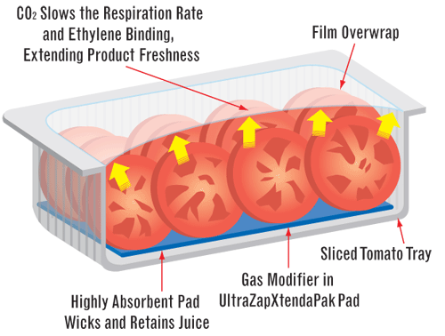
Example for active MAP

Slide 23
PACKAGING of pasteurized milk
Instructor
Assist. Prof. Dr. Eda Demirok Soncu
E-mail: edemirok@eng.ankara.edu.tr
Phone: +90312 203 3300 (3639 ext.)
Office: 2nd floor #212
Fde 216 food packagıng

Slide 24
Attributes of pasteurized milk
Pasteurization is a heat treatment which applies for a definite time and to a specific temperature
Pasteurization is applied to milk to destroy all vegetative and pathogenic microorganisms and nearly all other bacteria without significantly altering the flavor or composition of the product
It also kills all the yeasts and molds that might be present in the product

Slide 25
QUALITY CHANGES IN PASTEURIZED MILK

Slide 26
Deteriorative reactions in pasteurized milk
Quality changes in pasteurized milk can be listed in one of four titles
Light-induced oxidation
Oxidation of milk fat (Lipid peroxidation)
Microbial activity
Pick-up of odor compounds at any stage of production and processing or interaction with the packaging material resulting in product flavor deterioration

Slide 27
1) Light-induced oxidation
This reaction results in off-flavor formation. For example;
Degradation of sulfur-containing amino acids (methionine), which develops during the first 2–3 days of storage
Light-induced oxidation of lipids is responsible from metallic off-flavor
Destruction of light-sensitive vitamins (mainly riboflavin and vitamin A) in the case of light exposure, especially at wavelengths below 500 nm

Slide 28
2) Oxidation of milk fat
Lipid peroxidation in considered to be the main chemical defect in pasteurized milk
Unsaturated fatty acids are attacked by free radicals, which is followed by the addition of O₂ to form peroxides or hydroperoxides
Lipid peroxidation results in off-flavor development

Slide 29
3) Microbial activity
Microbiological changes involve growth of psychrotrophic bacteria as a result of either inadequate pasteurization or postpasteurization contamination
It leads to the formation of microbial flavor described as acidic, bitter, fruity, malty, putrid, or unclean
Additionally, some pathogenic microorganisms, which are contaminated to milk after pasteurization, can grow in pasteurized milk

Slide 30
WHICH TYPE OF PACKAGING SYSTEM SHOULD BE USED FOR PASTEURIZED MILK?

Slide 31
General requirements of packaging material?
Packaging material should have the common attributes given below to protect the quality of pasteurized milk
It is able to protect the milk from light, O₂, and microbial cross-contamination
It also protects the product from loss of desirable flavor compounds or pick-up of undesirable odors
Other requirements including recyclability or reuse, tamper evidence, nontoxicity, aesthetics, machinability, and functionality in terms of shape, size, and disposability

Slide 32
Packaging materials used for pasteurized milk
Packaging materials used for pasteurized milk are listed as follow
Glass
Plastic containers
High Density Polyethylene Bottles (HDPE)
Poly(ethylene Terephthalate) Bottles (PET)
Polycarbonate Bottles (PC)
Linear Low Density Polyethylene/Low Density Polyethylene Pouches (LLDPE / LDPE)
Paperboard Laminate Cartons

Slide 33
Packaging materials used for pasteurized milk
GLASS | ---It is inert material --- It provides ultimate protection from O₂, moisture, and microorganisms ---When it is colored appropriately (blue, amber, green, and, to a lesser degree, white), glass can protect milk from harmful UV light ---Sealing of glass bottles for milk packaging is usually achieved with aluminum foil caps ---Most glass bottles are returnable ---Major disadvantages of glass are its fragility and weight

Slide 34
Packaging materials used for pasteurized milk
HDPE bottles | ---HDPE bottles transmit 58–79% of the incident light ---To improve this property, HDPE bottles are pigmented with TiO₂ , producing an opaque bottle
PET bottles | ---They are superior to HDPE bottles in terms of their mechanical and optical properties, their lower flavor scalping potential, and substantially lower gas permeability ---Due to the almost complete transparency of PET to light, milk bottles are either labeled or, even better, sleeved using thermoshrinkable polypropylene (PP) labels ---Today most PET bottles are sealed with rigid PP screw caps

Slide 35
Packaging materials used for pasteurized milk
PC bottles | ---PC bottles have a high temperature resistance and high impact strength and clarity ---They are currently used for multiuse baby bottles ---PC bottles are lightweight, clear, and are recyclable
LLDPE/LDPE bottles | ---Pillow-shaped pouches (also referred to as sachets) for milk are produced by feeding a linear LDPE ---A disadvantage of the pouch is that it cannot be reclosed, thus exposing the milk to odor absorption in the refrigerator ---The pouch material should be pigmented to reduce light transmission

Slide 36
Packaging materials used for pasteurized milk
Paperboard laminate cartons | ---Paperboard laminate cartons are multilayer containers ---The paperboard is coated with LDPE on both sides ---The external LDPE coating is used to provide protection from moisture and indirectly for mechanical integrity ---The internal LDPE coating is used to prevent interaction of milk with the paperboard and to provide effective heat sealing

Slide 37
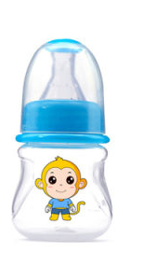
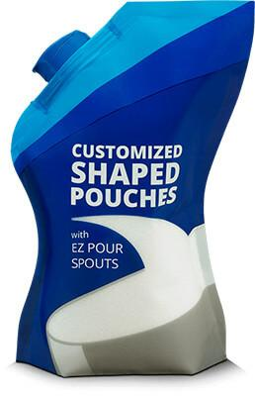
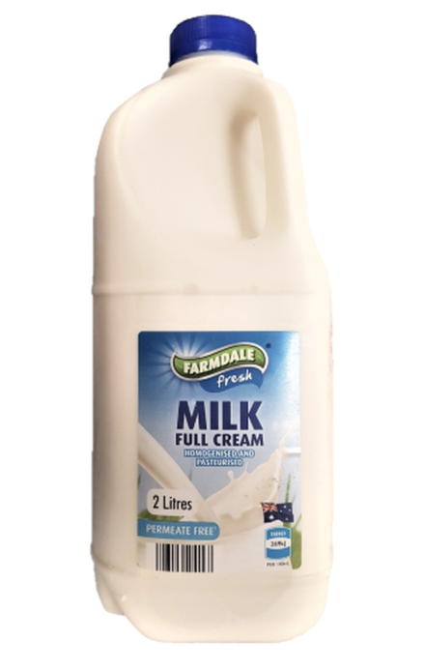
Packaging materials used for pasteurized milk
PC bottles
LLDPE/LDPE pouches
PET bottles
HDPE bottles
Paperboard laminated carton bottles

Slide 38
References
Robertson, G.L. (2010). Packaging and the shelf life of fruits and vegetables (Chapter 16 pages 297-310) In Food Packaging and Shelf Life: A Practical Guide. CRC Press Taylor&Francis Group
Robertson, G.L. (2010). Packaging and the shelf life of milk (Chapter 5 pages 82-99) In Food Packaging and Shelf Life: A Practical Guide. CRC Press Taylor&Francis Group

