Slide 1
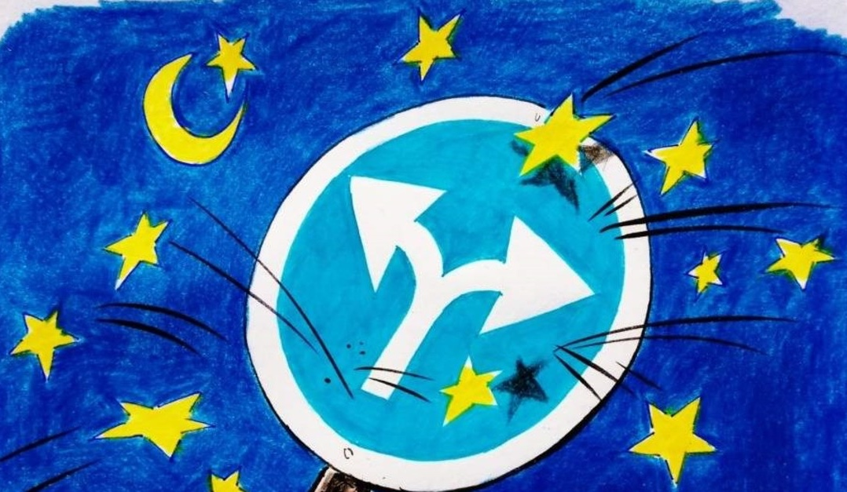
TR - EU Negotiation Process
CHAPTER 8
Res. Assist. PhD. Arzu Gökdai

Slide 2
Negotiations
The European Union enlargement process took a major step forward on 3 October, 2005 when accession negotiations were opened with Turkey and Croatia. After years of preparation the two candidates formally opened the next stage of the accession process.
The negotiations relate to the adoption and implementation of the EU body of law, know as the acquis. The acquis is approximately 130,000 pages of legal documents grouped into 35 chapters and forms the rules by which Member States of the EU should adhere.

Slide 3
Negotiations
As a candidate country, Turkey needs to adapt a considerable part of its national legislation in line with EU law. This means fundamental changes for society that will affect almost all sectors of the country, from the environment to the judiciary, from transport to agriculture, and across all sections of the population.
The negotiation aspect is on the conditions for harmonisation and implementation of the acquis, that is, how the rules are going to be applied and when.

Slide 4
Negotiations
In order to become a Member State, the candidate country must bring its institutions, management capacity and administrative and judicial systems up to EU standards, both at national and regional level.
This allows them to implement the acquis effectively upon accession and, where necessary, to be able to implement it effectively in good time before accession!

Slide 5
How does it work?
Negotiations are conducted according to a Negotiating Framework that sets out the method and the guiding principles of the negotiations in line with the December 2004 European Council conclusions!

Slide 6
Screening
The first part of the process is the "screening" of each of the 35 chapters of the negotiations. Screening is a preliminary assessment of the degree of preparedness of the Candidate Country on each of the negotiating chapters. Each chapter contains a specific part of EU policy (known as the "acquis", which in French means something which is agreed), for example "science and research" or "energy" or the "environment".

Slide 7
Screening
Two formal meetings are held for each acquis chapter in the screening phase. An initial explanatory meeting is held with the candidate country during which the Commission sets out the main objectives and requirements of EU policy in that field.
In the second meeting the candidate country explains its degree of preparedness vis a vis EU policy and outlines its plans for alignment.

Slide 8
Following these meetings, the Commission prepares a screening report for the chapter, which may recommend either that the candidate country, is sufficiently prepared to open negotiations on the chapter or that the candidate country cannot be considered sufficiently prepared.
https://www.ab.gov.tr/files/tarama/tarama_files/11/sorular_cevaplar_files/cevaplar/Yumurta%20ve%20Kanatli%20Eti.pdf

Slide 9
Opening and Closing Chapters
If the Council decides to open the chapter for negotiation, it will invite the candidate country to present its Negotiating Position (NP). Once this has been received, the Commission prepares a Draft Common Position (DCP).
The Council assesses and examines the DCP and on the basis of unanimity may adopt the definitive European Union Common Position (EUCP). With the NP and the EUCP completed, the Council and the Candidate Country at the Accession Conference can formally open the chapter for negotiation.

Slide 10
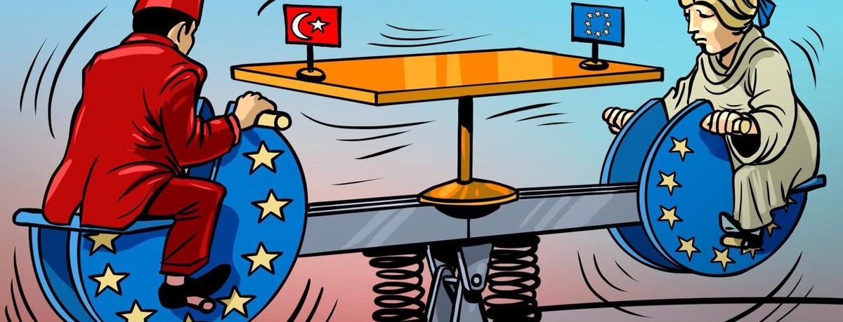
Opening and Closing Chapters
The chapters are provisionally closed as agreement is reached on each – but nothing is agreed until everything is agreed. As the acquis is constantly evolving chapters can be reopened later should it be necessary.
Throughout this process, the Commission monitors progress of the candidate country's preparations for membership. The results of the monitoring exercise are published in a yearly 'Regular Report'. The speed of the accession negotiations is determined by the progress on implementation of the reforms in the candidate country, in line with the Copenhagen Criteria for membership.

Slide 11
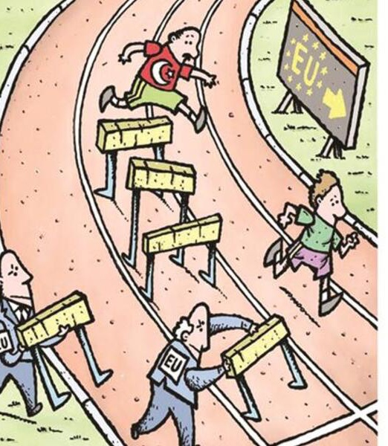
Becoming an EU member
Once agreement has been reached on all chapters of the acquis, a process that takes some years, the results are incorporated into an "Accession Treaty".
Prior to signing the Accession Treaty, the Commission delivers its final opinion on the Candidate Country's membership application. Additionally, the European Parliament needs to give its consent and, finally, the European Council must reach a unanimous decision on acceptance of the application.

Slide 12
Who is involved ?
Negotiations take place in bilateral Intergovernmental Conferences between the Member States and Turkey, called accession conferences.
27 Member States of the EU…
In order to agree common positions among themselves before presenting them to Turkey, the EU Member States meet in the framework of the EU Council of Ministers. All decisions are taken by unanimity.
The Council of Ministers (one representative from each Member States) is the chief actor and decision-maker on the EU side. The rotating Presidency of the Council chairs the meetings and ensures communication with Turkey.
…and Turkey

Slide 13
Negotiation chapters
The 130,000 pages, which make up the European Union Acquis is grouped in 35 chapters, and it is constantly evolving as new rules and regulations are incorporated.
In terms of content the acquis includes:
the content, principles and political objectives of the Treaties on which the Union is founded
other acts, legally binding or not, adopted within the Union framework, such as inter-institutional agreements, resolutions, statements, recommendations, guidelines;
joint actions, common positions, declarations, conclusions and other acts within the framework of the common foreign and security policy
joint actions, joint positions, conventions signed, resolutions, statements and other acts agreed within the framework of justice and home affairs;
international agreements concluded by the Communities, the Communities jointly with their Member States, the Union, and those concluded by the Member States among themselves with regard to Union activities.

Slide 14
Chapters opened for Turkey

Slide 15
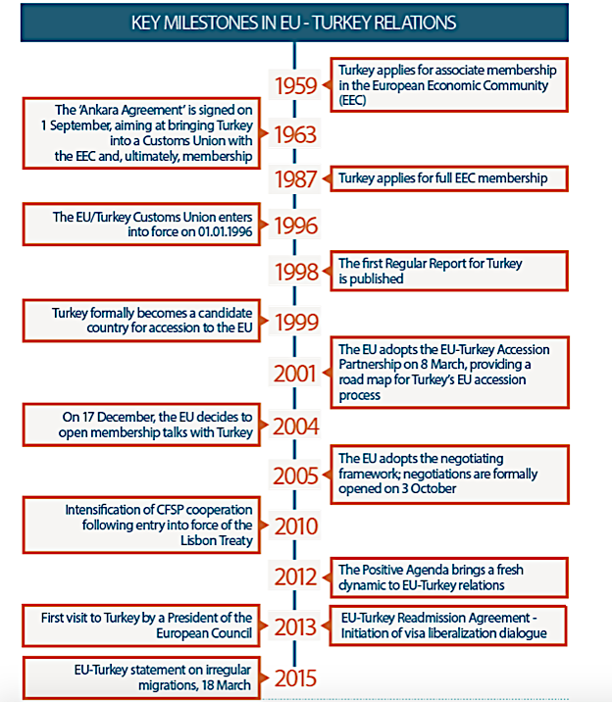

Slide 19
Any Questions?!?

