Slide 1
The Yellow Wallpaper Charlotte Perkins Gilman
AKE 107/ING 109/DING 109 TEXTUAL ANALYSIS: PROSE AND SHORT STORY
Dr. Gamze Katı Gümüş

Slide 2
Charlotte Perkins Gilman (1860-1935)
Produced feminist fiction
Refused the role the society designated for women
Became a leading feminist theoretician and writer of her period

Slide 3
A Personal Note…
When she became depressed following the birth of her daughter, her husband suggested that Gilman should be treated by Dr. S. Weir Mitchell.

Slide 4
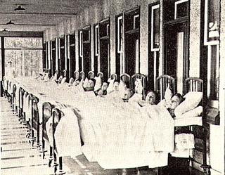
“Mitchell developed the Rest Cure, a treatment for …neurasthenia (physical and mental exhaustion) and hysteria. Women most often received the Rest Cure, which typically involved six-to-eight weeks of isolation, bed rest, a high-calorie diet, massage and electrotheraphy.
…
[…] Mitchell developed the West Cure. Men-including Walt Whitman and Theodore Roosevelt-were sent to West to “engage in vigorous physical activity … and to write about the experience.”
From “Beyond the Yellow Wallpaper: Silas Weir Mitchell, Doctor and Poet” by Joanna Goldberg*
Notes:
https://nyamcenterforhistory.org/tag/west-cure/

Slide 5
The Yellow Wallpaper was first published in the New England Magazine in January 1892.

Slide 6
What does the term “gender roles” mean?
The role or behavior learned by a person as appropriate to their gender, determined by the culture norms.

Slide 7
According to traditional gender roles
Women
Men
Irrational
Powerless
Unassertive
Passionate
Logical
Powerful
Defensive
Strong-minded

Slide 8
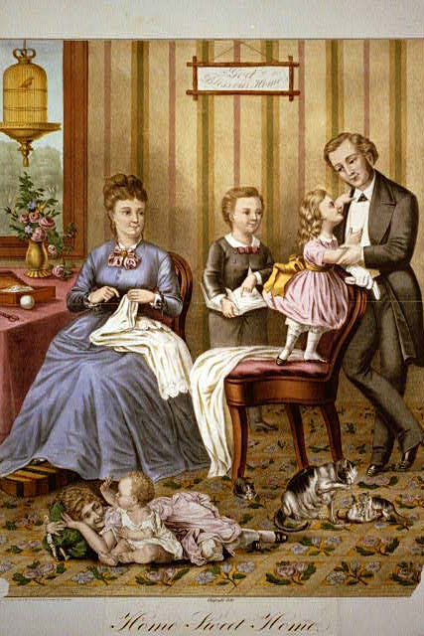
The True Womanhood
Coined in the 19th century US and UK.
A woman was expected to have
Piety
Purity
Submissiveness
domesticity

Slide 9
From “The Cult of True Womanhood: 1820-1860” by Barbara Welter
Devote themselves to religion
Never talk harshly with their husbands even when they are abusive
Accept submission
Do not give their opinions until their husbands ask for it
Be child-like
Turn the domestic space into a happy home
Act as a comforter and a nurse
Avoid sensational literature a.k.a. novels
Do housework

Slide 10
“Why I wrote the Yellow Wallpaper?” by Gilman
What was the main idea behind “The Yellow Wallpaper?”
What are the biographical facts in TYW?
What was the endresult/effect of TYW?
Is everything in the story autobiographical? What are the things that are fictionalized?
What does it tell us about gender roles?

Slide 11
The Panopticon

Slide 12
From Discipline and Punish, Michel Foucault
“All that is needed, then, is to place a supervisor in a central tower and to shut up in each cell a madman, a patient, a condemned man, a worker or a schoolboy.By the effect of backligthing, one can observe from the tower, standing out precisely against the light, the small captive shadows in the cells of the periphery. They are like so many cages, so many small theatres, in which each actor is alone, perfectly individualized and constantly visible. [...] In short, it reverses the principle of the dungeon; or rather of its three functions—to enclose, to deprive of light and to hide—it preserves only the first and eliminates the other two. […] Visibility is a trap.”

