Slide 1
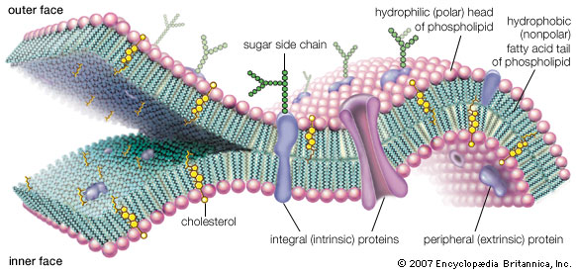
Membranes, CHANNELS AND TRANSFER WEEK 2
Dr. Etkin ŞAFAK
Department of Physiology

Slide 2
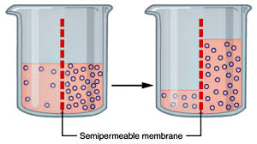
OSMOSIS
Artificial phospholipid bilayer is somewhat permeable to water to some extent, through the membrane lipid layer.
Most plasma membranes have a permeability to water that is 10 times greater than that of an artificial lipid membrane.
The reason is that a group of membrane proteins known as aquaporins.
They form channels through which water can diffuse.
The net diffusion of water across a membrane is called osmosis.

Slide 3
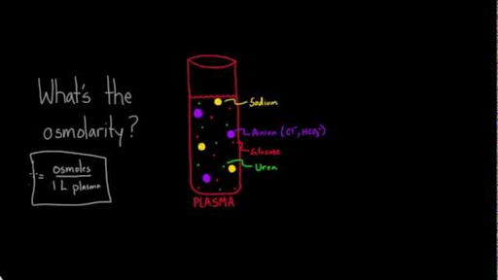
OSMOSIS
As with any diffusion process, there must be a concentration difference in order to produce a net flux.
How can a difference in water concentration be established across a membrane?
The water concentration in a solution depends upon the number of solute particles.
The total solute concentration of a solution is known as its osmolarity.
One osmol is equal to 1 mol of solute particles. Thus, a 1 M solution of glucose has a concentration of 1 Osm (1 osmol per liter), whereas a 1 M solution of sodium chloride contains 2 osmol of solute per liter of solution

Slide 4
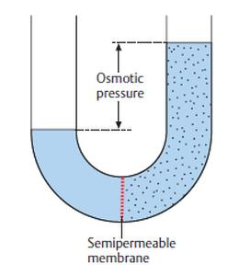
OSMOSIS
Osmolarity refers to the concentration of solute particles,
It also determines the water concentration in the solution - the higher the osmolarity, the lower the water concentration.
The pressure that must be applied to the solution to prevent the net flow of water into the solution - osmotic pressure
The greater the osmolarity of a solution, the greater its osmotic pressure.

Slide 5
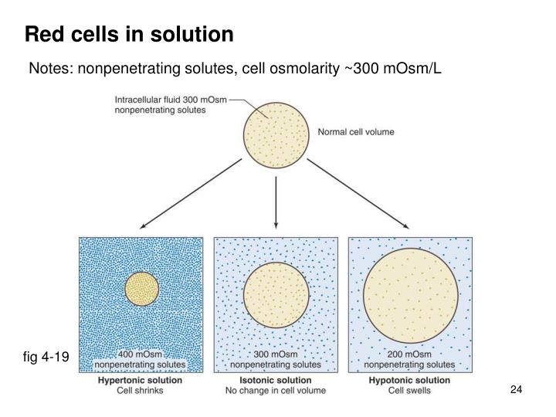
TONICITY
The ability of an extracellular solution to make water move into or out of a cell by osmosis is know as its tonicity.
A solution's tonicity is related to its osmolarity
A solution with low osmolarity has fewer solute particles per liter of solution, while a solution with high osmolarity has more solute particles per liter of solution.
When solutions of different osmolarities are separated by a membrane permeable to water, but not to solute, water will move from the side with lower osmolarity to the side with higher osmolarity.

Slide 6
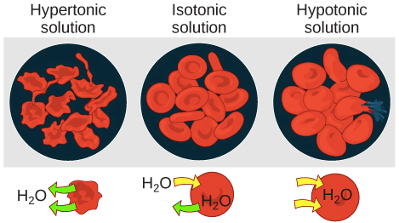
TONICITY
Three terms—hypotonic, isotonic, and hypertonic—are used to compare the osmolarity of a cell to the osmolarity of the extracellular fluid around it.
If the extracellular fluid has lower osmolarity than the fluid inside the cell, it’s said to be hypotonic — the net flow of water will be into the cell.
If the extracellular fluid has a higher osmolarity than the cell’s cytoplasm, it’s said to be hypertonic — water will move out of the cell to the region of higher solute concentration.
In an isotonic solution — there will be no net movement of water into or out of the cell.

Slide 7
Osmosıs vs. TONICITY

Slide 8
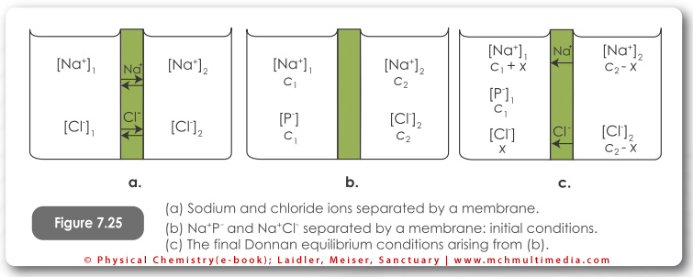
Donnan Equılıbrıum
The Gibbs-Donnan Equilibrium or Donnan Equilibrium is the basis for electrical charges that are found across the membranes of many cells (e.g. nerve and muscle cells).
It refers to the uneven distribution of charged particles on one side of a semipermeable membrane.
When two solutions of differing concentrations are separated by a semipermeable membrane their concentrations will equalize as a result of diffusion.
If there is an impermeable solute in one of the solutions, the concentration of the solution does not equalize.
The concentration of the solution with impermeable solutes remains high even at equilibrium. This effect is called the Donnan equilibrium.

Slide 9
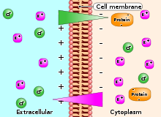
THE DONNAN EQUILIBRIUM IN LIVING CELLS
The flow of molecules and ions between a cell and its environment is regulated by the Donnan effect.
Living cells contain impermeable anionic colloids, which are mostly made up of proteins and organic phosphates.
As a result of this, there is a high concentration of non-diffusible anions across the cell membrane, thus creating the Donnan Equilibrium.
This means that there are more ions inside the cell than outside.

Slide 10
THE DONNAN EFFECTS IN THE BODY
Because of proteins (Prot-) in cells, there are more osmotically active particles in cells than in interstitial fluid,
Because at equilibrium there is an asymmetric distribution of permeant ions across the membrane, there will be an electrical difference across the membrane
Since there are more proteins in plasma than in interstitial fluid, there is a Donnan effect on ion movement across the capillary wall
Notes:
and since animal cells have flexible walls, osmosis would make them swell and eventually rupture if it were not for Na+-K+ ATPase pumping ions back out of cells.

Slide 11
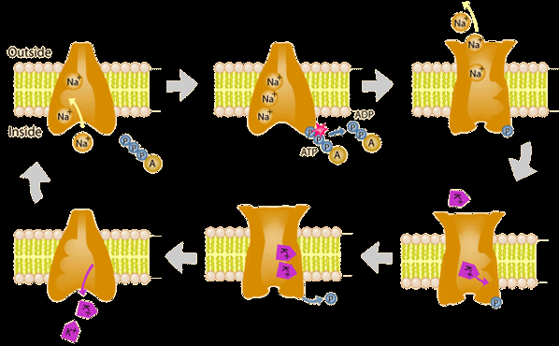
WHAT IS THE MECHANISM THAT PREVENTS CELLS FROM SWELLING AND RUPTURING?
The answer is the sodium pump (Na⁺- K⁺ ATPase) in the cell membrane.
The presence of the ATP-driven Na⁺ and K⁺ pump is nature’s way of preventing cells from rupturing by continuously pushing out excess ions.
The pump together with the membrane’s low permeability to sodium effectively prevents sodium from entering the cell.
The sodium pump renders the membrane impermeable to sodium, setting up a second Donnan Equilibrium.

Slide 12
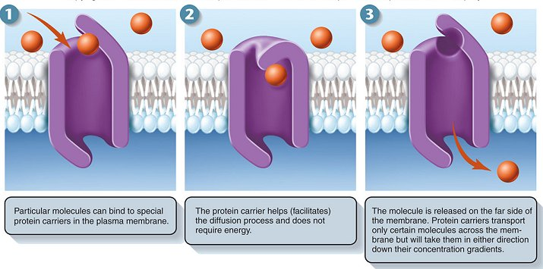
FACILITATED DIFFUSION
The term arose because the end results of both diffusion and facilitated diffusion are the same.
In both processes, the net flux of molecules across a membrane proceeds from higher to lower concentration
It continues until the concentrations on the two sides of the membrane become equal.
Neither diffusion nor facilitated diffusion is coupled to energy derived from metabolism,
They are incapable of moving solute from a lower to a higher concentration across a membrane.

Slide 13
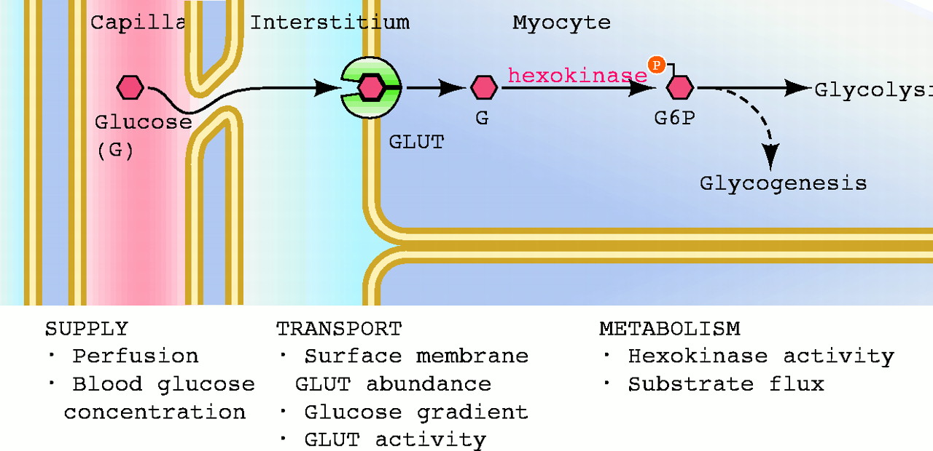
FACILITATED DIFFUSION
Among the most important facilitated-diffusion systems in the body are those that move glucose across plasma membranes.
One might expect that as a result of facilitated diffusion the glucose concentration inside cells would become equal to the extracellular concentration.
This does not occur - because glucose is metabolized to glucose 6-phosphate almost as quickly as it enters.

Slide 14
FACILITATED DIFFUSION

Slide 15
ANY QUESTIONS?

