Slide 1
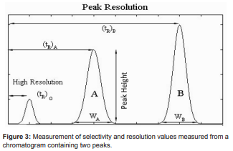

Slide 2
If we approximate peaks by symmetric triangles, then, if R is equal to or more than 1 then components are completely separated. If R is less than 1, then components are overlapped. By using the expressions for capacity factor and column efficiency the equation for R could be transferred to the form:

Slide 4
where the dependence of resolution on the column efficiency is represented by the square root of N, which means that increasing the efficiency is not so favourable for resolution improvement. Resolution can also be expressed in form:

Slide 5
Theoretical Plate Count
Plate count is a (theoretical) measure of the efficiency of the HPLC column. In HPLC chromatography there’s equilibrium between the stationary phase and the mobile phase. During the time of elution there’s a transfer of molecules from the mobile phase to the stationary phase and back to the mobile phase, and so on back and forth down the length of the column that’s how the separation occurs. The distance along the column that it takes to make one of these transfers between phases and re-equilibrate is called the theoretical plate Height (H). If it takes less distance, that means the plates are narrow and you have more of them in the column, which means more transfers between phases can take place, and the column is more efficient. That of course means better resolution and better peak separation.

Slide 6
If it takes a comparatively greater distance for one phase transfer event, the plates are wider and there are fewer of them, so your efficiency (and therefore your resolution) is not as good. The relationship between theoretical plate height, plate count, and column length is theoretical plate Height (H) x plate count (N) = column Length (L) or plate count = column length/ theoretical plate height Remember, this is only theoretical, so round off any calculations you do for plate count. N, the number of theoretical plates, is one index used to determine the performance and effectiveness of columns, and is calculated using equation.

Slide 7
N, the number of theoretical plates, is one index used to determine the performance and effectiveness of columns, and is calculated using equation.

Slide 8
Where
tr : retention time, and W: peak width This peak width, W, is based on the baseline intercepts of tangent lines to a Gaussian peak, which is equivalent to the peak width at 13.4 % of the peak height. However, to simplify the calculation and accommodate non-Gaussian peaks, the following calculation methods are used in actual practice.

