Slide 1
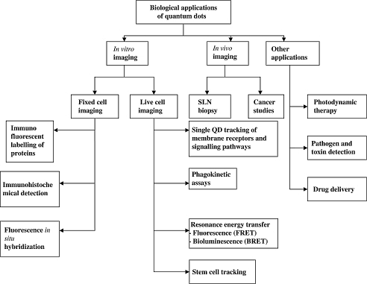

Slide 2
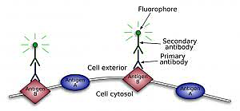
IN VITRO IMAGING - FIXED CELLS
Immunohistochemistry (IHC) is an important application of monoclonal as well as polyclonal antibodies to determine the tissue distribution of an antigen of interest in health and disease. IHC is widely used for diagnosis of cancers; specific tumor antigens are expressed de novo or up-regulated in certain cancers.

Slide 3
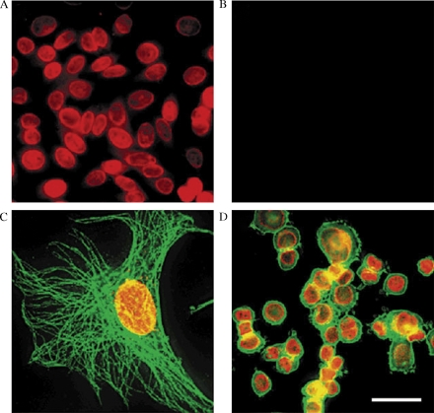
Fixed cell imaging and simultaneous detection of multiple cellular targets using QD conjugates.
(A) Nuclear antigens in the nuclei of human epithelial cells labelled with ANA, anti-human IgG-biotin and QD 630-streptavidin.
(B) When normal human IgGs were used, no detectable stain was observed.
(C) Simultaneous labelling of nuclear antigens (red) and microtubules (green) using different QD conjugates in a 3T3 cell.
(D) Her2 on the surface of SK-BR-3 cells was stained green with mouse anti-Her2 antibody and QD 535-IgG (green). Nuclear antigens were labelled with ANA, anti-human IgG-biotin and QD 630-streptavidin (red).

Slide 4
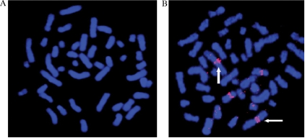
Fluorescence in situ hybridisation (FISH) technology to detect nucleic acid sequences in fixed biological structures has been well established. It uses fluorescently labelled DNA probes for gene mapping and identification of subtle chromosomal abnormalities and can provide diagnostic and prognostic results for particular chromosomal disorders. A QD-FISH probe is used to analyse human metaphase chromosomes and found that compared to organic dyes, QDs were more photostable and significantly brighter, making them a more stable and quantitative mode of FISH for research and clinical applications.
Detection of chromosome region 1q12 in human metaphase chromosomes by FISH using a QD-labelled probe.
(A) Control (no QD conjugate);
(B) streptavidin-Qdot 605 detection of chromosome 1q12 region in homologous chromosomes (vertical and horizontal arrows); bar in panel C is 10 µm.

Slide 5
IN VITRO IMAGING – LIVE CELLS:
QDs introduced to live cells can be
used for various applications like cell
tracking, which are crucial to stem cell
research and determining the
metastatic potential of cancer
cells.

Slide 6
Intracellular labelling:
Could be achieved by incubating cells with QDs via non-specific endocytosis.
They can be introduced into the cell via microinjection
Extracellular labelling:
Via membrane receptors and membrane-associated proteins are good targets for QD imaging. Various biological processes and pathways, rely on the transmembrane receptors and signalling pathways.

Slide 7
SINGLE- PARTICLE TRACKING :
This is a technique of following single molecules in real time to visualise the actual molecular dynamics in their habitat environment.
This can be used to track various biological molecules like lipids, membrane-associated proteins and cytosolic motor proteins
QD labelling enabled imaging for 20 min as compared to the organic dye Cy3, which allowed imaging for only 5 sec.
Tracking individual dots allowed characterisation of multiple diffusion domains showing that QDs are ideal probes for single-molecule studies in live cells.

Slide 8
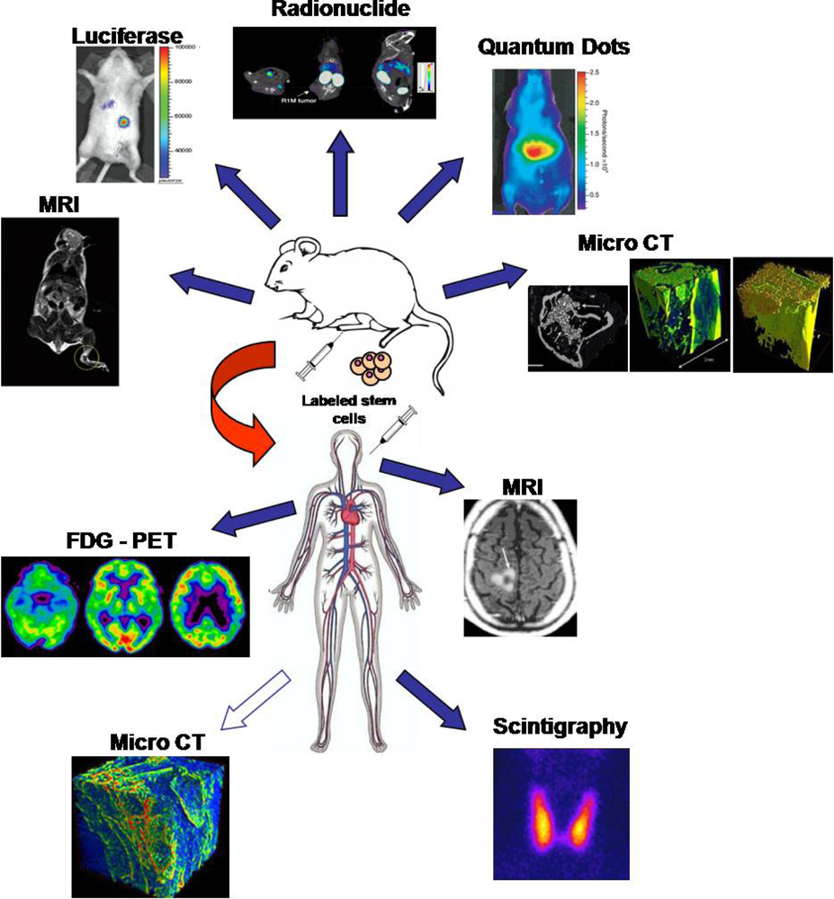
STEM CELL TRACKING:
To monitor stem cell survival, distribution, differentiation and regenerative impact
Recently, non invasive imaging based monitoring methods have been developed to track stem cell transplantation by labeling injected cells using nanotechnologies
i) magnetic nanoparticles for stem cell labeling and successive visualization by in vivo MRI
ii) quantum dots or radionuclides for in vivo visualization of stem cells by PET or SPECT
Recent advances in nanotechnology for stem cell tracking.

Slide 9
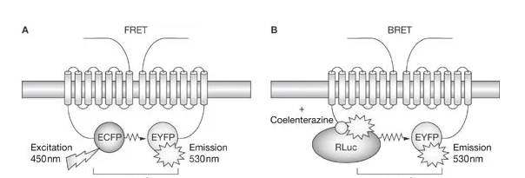
BIOSENSING APPLICATIONS:
In the case of FRET (A), excitation of the donor by an external light source results in energy transfer to the acceptor with release of light in the acceptor emission spectrum—but only if the distance btw donor and acceptor is smaller than Förster radius. The principle of BRET (B) is similar, except that light emitting protein that acts as a donor (Renillaluciferase) transfers energy to a fluorescent protein as an acceptor and is activated by addition of an appropriate substrate.

Slide 10
IN VIVO IMAGING:
Fluorescence imaging is a way to image live animals but there are limitations caused by both source and tissues. The QDs advantages take imaging method a step further by using NIR (near infrared).
(A) Molecular targeting and in vivo imaging of prostate tumor using QD–antibody conjugate.
(B) In vivo near-infrared fluorescence imaging of tumor-bearing mice injected with QD705-RGD peptide or QD705.
(E) Simultaneous tracking of different populations of QD-labeled metastatic tumor cells in mice lung tissue.

Slide 11
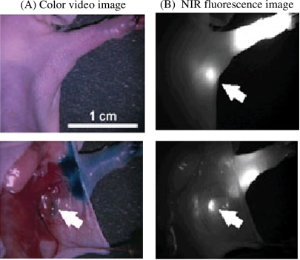
Sentinel lymph node biopsy (SLNB) :
In ultra-staging cancer metastasis and standardization of care in breast cancer surgeries, the sentinel lymph node is become the first target. The determination of the first draining lymph node lead to understand the stage of cancer and the need for the surgery.
Detection of sentinel lymph node using NIR QDs in a mouse model. NIR QDs injected intradermally into the foot pad of a mouse migrate to the sentinel lymph node 5 min post injection.
(A) Colour video image;
(B) NIR fluorescence image; isosulphan blue dye colocalised to the same node (indicated by the arrows).

Slide 12
The schematic diagram of an NIR imaging system for SLNB in breast cancer surgery. The NIR light penetrates deep tissues with minimal scatter and excites the QDs that emit in the NIR range. The fluorescence from these dots is detected by an NIR camera. These images can be superimposed with images from the colour camera on a PC to anatomically locate the exact position of the QDs.

Slide 13
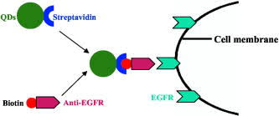
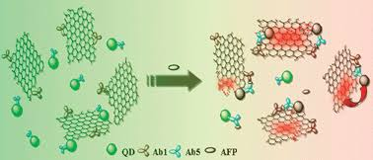
Cancer localisation and therapy
Molecular imaging studies have demonstrated in vivo localization of cancer antigens using tumor-specific antibodies-bound QDs.

Slide 14
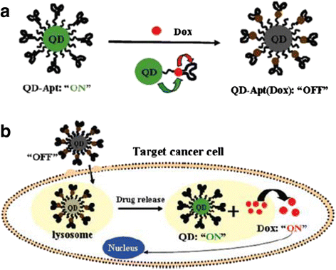
OTHER APPLICATIONS Drug Delivery
Targeted QD imaging may find application as an ultrasensitive tool for early cancer diagnosis as well as image-guided drug delivery of chemotherapeutic agents to overcome systemic side effects. Drugs can be targeted to tumours by an enhanced permeability and retention (EPR) effect and this concept has been applied to anticancer agents.

Slide 15
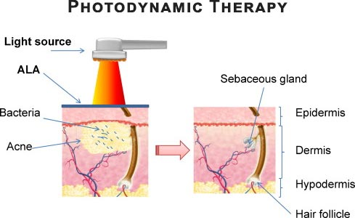
Photodynamic Therapy (PDT)
One of the major advances in minimally invasive therapies for cancer is photodynamic therapy (PDT). First discovered in the early 1900s, it is now an approved cancer treatment for various superficial malignancies, including basal cell carcinoma, oral, oesophageal and lung cancers. It is based on the targeted localised destruction of diseased tissues via the generation of cytotoxic singlet oxygen

Slide 16
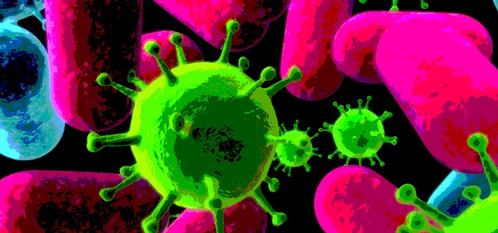
Micro-organism and Toxin Detection
Using the concept of multiplexed imaging, different food- borne pathogenic bacteria have been simultaneously detected at low concentrations of 10􏰚3 cfu/ml within 2 h by using antibody-conjugated QDs and magnetic microparticles .

Slide 17
Limitations !!
Characterisation of in vitro and in vivo toxicity of QDs has been a daunting task due to the complex nature of these nanomaterials. Over the years, a number of studies have emerged with conflicting results, which makes it difficult to evaluate, generalise and predict the important aspects of toxicity. Most research is based on in vitro cytotoxicity, which involves exposure to very high doses.
Other limitations to the QD application are based on photophysical properties like blinking and photobrigh- tening. Blinking occurs when the QD rapidly alternates between an emitting and non-emitting state. This may cause problems in single-molecule imaging or tracking. Photobrightening on the other hand, is the increase in the intensity of fluorescence of the QD on excitation.

Slide 18
Future Perspective
QD’s have found vast application in biological and biomedical research as the next generation fluorescent probes. They are a powerful tool for illuminating many of the mysteries that encompass signal transduction pathways and biomolecular interaction within cells. Through extrapolating their properties for in vivo molecular and cellular imagining. QD’s have a potential to lead to major advances in nanomedicine. They can revolutuinise cancer diagnosis and threapy through early pre-symptomatic diagnosis and image-guided drug delivery of chemotherapeutic agents.

Slide 19
THANKS
FOR LISTENING ☺

