Slide 1
Faith and Education,

Slide 2
We shall be God’s Helpers…(61.Saf.14)

Slide 3
“Always remember ! Every difficulty is a test and opportunity”

Slide 4
My mother used to say “YA FETTAH”
Fettah: The Opener, The Reliever, The Judge
Fettah; by whose guidance everything that is obscure is made manifest

Slide 5
The Most Beautiful Names (Asma Al Husna)
the Merciful (al-Rahman)
the Compassionate (al-Rahim)
the Ruler (al-Malik)
the Holy (al-Qaddus)
the Peace (al-Salam)
the Protector (al-Mu' min)
the Protector (al-Muhaimin)
the Mighty (al-Aziz)
the Repairer (al-Jabbar)
the Great (al-Mutakabbir)
the Creator (al-Khaliq)
the Creator (al-Bari)
the Fashioner (al-Musawwir)
the Forgiver (al-Ghaffar)
the Dominant (al-Qahhar)
the Bestower (al-Wahhab)
the Provider (al-Razzaq)
the Opener (al-Fattah)
the Knowledge (al-'Alim)
the Restrainer (al-Qabid)
the Spreader (al-Bas it)
the Guardian (al-Hafiz)
the Exalter (al-Raft)
the Honourer (al-Mu' izz)
the Destroyer (al-Muzil)
the Hearer (al-Sarni')
the Seer (al-Basir)
the Judge (al-Hakim)
Justice (al-'Adl)
the Subtle (al-Lath
the Avere (al-Khabir)
the Clement (al-Halim)
the Grand (al-'Azim)
the Forgiving (al-Ghafur)
the Grateful (al-Shakur)
the Exalted (al-'Ali)
the Great (al-Kabir)
the Guardian (al-Hafiz)
the Strengthener (al-Muqit)
the Reckoner (al-Hasib)
the Majestic (al-Jalil)
the Generous (al-Karim)
the Watcher (al-Raqib)
the Answerer of Prayer (al-Mujib)
the Comprehensive (al-Was i)
the Wise (al-Hakim)
the Loving (al-Wadud)
the Glorious (al-Majid)
the Raiser (al-Ba' ith)
the Witness (al-Shahid)
the Kind (al-Ra'uj)
the Truth (al-Haqq)
the Guardian (al-Wakil)
the Strong ((al-Qawiyy)
the Firm (al-Matin)
the Patron (al-Waliyy)
the Laudable (al-Hamid)
the Counter (a1=Muhsi)
the Beginner (al-Mubck)
the Restorer (al-Mu' id)
the Quickener (al-Muhyi)
the Killer (al-Mum it)
the Living (al-Hayy)
the Self-Subsisting (al-Qayyum)
the Existing (al-Wajid)
the Glorious (al-Majid)
the One (al-Wahid)
the Eternal (al-Samad)
the Powerful (al-Qadir)
the Prevailing (al-Muqtadir)
the Deferrer (al-Mu' akhkhir)
the Bringer-forward (al-Muqaddin2)
the First (al-Awwal)
the Last (al-Akhir)
the Apparent (al-Zahir)
the Innermost (al-Batin)
the Governor (al-Wall)
the Exalted (al-Muta' al)
the Righteous (al-Barr)
the Relenting (al-Tawwab)
the Avenger (al-Muntagim)
the Pardoner (al-'Afuww)
the Ruler of the Kingdom
(al-Malik al-Mulk)
the Equitable (al-Muqsit)
the Collector (al-Jami)
the Independent (al-Ghani)
the Enricher (al-Mughni)
the Giver (al-Mu' ti)
the Withholder (al-Mani')
the Distresser (al-Darr)
the Profiter (al-Nafi')
the Light (al-Nur)
the Guide (al-Hadi)
the Incomparable (al-Badi' )
the Enduring (al-Baqi)
the Inheritor (al-Warith)
the Rightly-directing (al-Rashid)
the Patient (al-Sabur)
the Lord of Majesty and Glory
(Dhu' 1 Jalal wa' 1 Ikram)

Slide 6
“And, behold, with every hardship comes ease: verily, with every hardship comes ease!” (Ash-Sharh, 94:5,6)

Slide 7
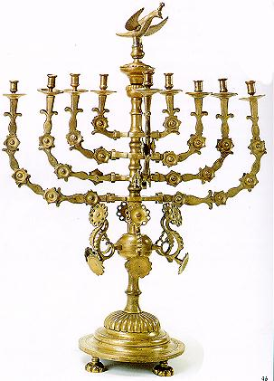
Worldview
Monotheistic
Judaism, Christianity, Islam
Spiritualities
Buddhism, Hinduism, Confucianism, Native Spirituality
eco-feminism, earth-based spiritualities, creation spirituality, wiccan, pantheism, polytheism

Slide 8
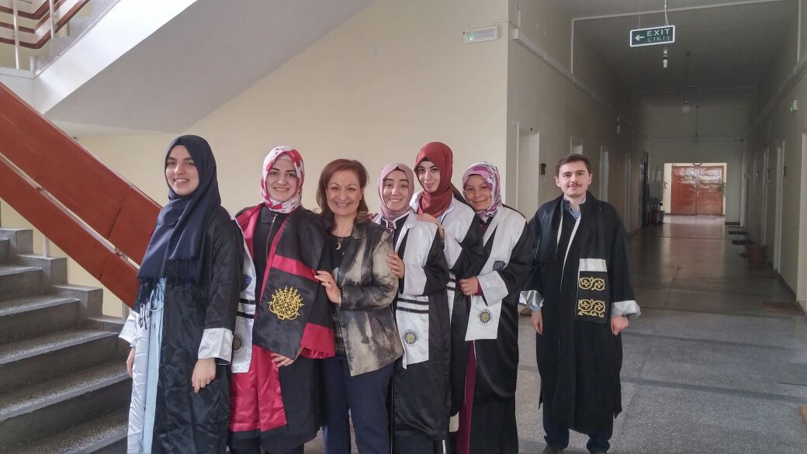

Slide 9
Reflection in Action Teaching about and from the The Most Beautiful Names (Asma Al Husna) Metaphor’dan yazılacak

Slide 10
…Activities Reflection in Action
Point to ponder
Teachings to remember
Questions to deepen the subject

