Slide 1
Makroiktisat
Acemoğlu vd. ( 2. Basım)
Bölüm 13
Karşı yönlü devrevi Makroiktisadi politikalar
Notes:
If this PowerPoint presentation contains mathematical equations, you may need to check that your computer has the following installed:
1) MathType Plugin
2) Math Player (free versions available)
3) NVDA Reader (free versions available)

Slide 2
Temel hususlar
Karşı yönlü devrevi politikalar, ekonomik dalgalanmaların yoğunluğunu azaltmaya ve istihdam, GSYİH ve fiyatlarda istikrar sağlanmasını amaçlar.
Karşı yönlü devrevi para politikası, banka rezervlerini ve faiz oranlarını manipüle ederek ekonomik dalgalanmaları azaltır.
Notes:
Instructor: Remind students that the Fed, the central bank of the United States, controls monetary policy.

Slide 3
Temel hususlar
Genişletici para politikası banka rezervlerinin artmasına ve faiz haddinin düşmesine neden olur. Daraltıcı para politikası banka rezervlerini azaltır ve faiz haddinin artmasına neden olur.
Karşı yönlü maliye politikası hükümet alımları ve vergilerde değişimlerle dalgalanmaları azaltır
Notes:
Instructor: Remind students that expansionary policy seeks to raise economic activity to reduce unemployment. Contractionary policy, on the other hand, seeks to lower economic activity to reduce the rate of inflation.
Instructor: Remind the students that federal, state, and local governments control fiscal policy.

Slide 4
Temel hususlar
Genişletici mali politika hükümet alımlarının artışı veya vergilerin düşürülmesi yoluyla gerçekleştirilebilir. Daraltıcı mali politika hükümet alımlarının azaltılması veya vergilerin arttırılması yoluyla gerçekleştirilebilir.
Notes:
Instructor: Remind students that expansionary policy seeks to raise economic activity to reduce unemployment. Contractionary policy, on the other hand, seeks to lower economic activity to reduce the rate of inflation.

Slide 5
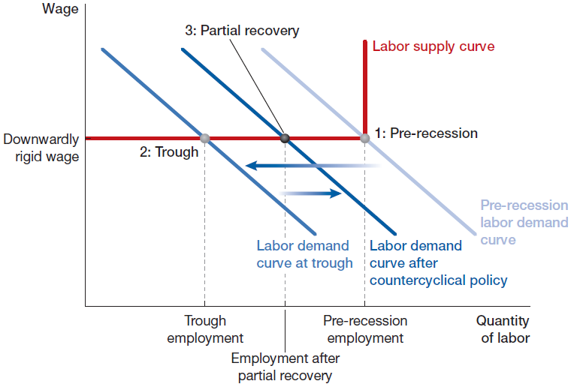
Karşı yönlü deverevi politikaların işleyişi
İşgücü piyasasında etkileri
Notes:
Instructor: This is the downward rigid wage case.
A recession occurs when the labor demand curve shifts to the left. With wages being downward rigid, the real wage stays the same and the economy moves to point 2: Trough, which is larger than the flexible wage case.
With wages being downward rigid, countercyclical policy is more effective. As before, expansionary policy shifts the labor demand curve to the right. However, with wages rigid, the real wage does not fall and the economy moves to point 3: Partial recovery, where the distance between 2 and 3 is larger. Why is countercyclical policy more effective? Because there is no wage response, the full force of expansionary policy impacts employment.

Slide 6
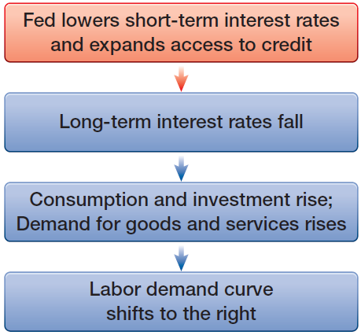
Para politikası
Genişletici para politikası
Notes:
Instructor: A decrease in short-term interest rates will usually lead to a decrease in long-term interest rates. A fall in long-term interest rates encourages households to buy more durable goods, like cars, because a lower interest rate implies a lower cost of a car loan. Likewise, a fall in long-term interest rates causes firms to engage in more investment in plants and equipment because a lower interest rate implies a lower opportunity cost of investment.

Slide 7
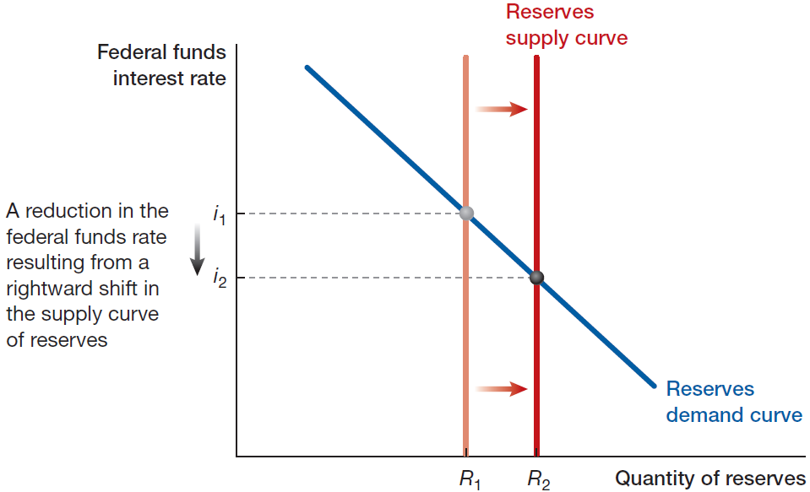
Para politikası
Açık piyasa işlemleriyle faizin control edilmesi
Notes:
Instructor: In monetary policy design, open market operations is the policy instrument of the Fed, and influencing (or targeting) the federal funds rate is the intermediate target of the Fed. In addition, the dual mandate of full employment and low, stable inflation are the final goals of the Fed.

Slide 8
Countercyclical Monetary Policy (6 of 22)
Exhibit 13.3 The Federal Funds Market
Notes:
Instructor: When the Fed conduct an open market purchase, the quantity of bank reserves increases, and the reserves supply curve shifts to the right. The federal funds rate decreases as a result. When the Fed conducts an open market sale, the quantity of bank reserves decreases, and the reserve supply curve shifts to the left. The federal funds rate increases.

Slide 9
Açık Piyasa İşlemlerinin İşleyişi
Citibank Mali Bilançosu (Öncesi ve Sonrası)
Blank
Varlıklar
Yükümlülükler ve Özkaynaklar
Önce
Reserves: | $100 billion | Deposits and other liabilities | $800 billion
Bonds and other investments: | $900 billion | Shareholders’ equity: | $200 billion
Total assets: | $1,000 billion | Liabilities + shareholders’ equity: | $1,000 billion
Blank
Varlıklar
Yükümlülükler ve Özkaynaklar
Sonra
Reserves: | $101 billion | Deposits and other liabilities: | $800 billion
Bonds and other investments: | $899 billion | Shareholders’ equity: | $200 billion
Total assets: | $1,000 billion | Liabilities + shareholders’ equity: | $1,000 billion
Notes:
Instructor: In an open market purchase, the Fed buys government bonds from banks and sells bank reserves to them in exchange.
In this example, the Fed buys $1 billion in bonds from Citibank in exchange for $1 billion in reserves. This operation changes nothing on the liabilities and shareholders’ equity side of Citibank’s balance sheet. On the assets side, total assets stay the same, but the composition changes. After the trade, Citibank has an additional $1 billion in reserves on deposit at the Fed and $1 billion less in bonds.
Note that the exact opposite happens when the Fed conducts an open market sale of, say, 41 billion. Citibank’s bond holdings increase by $1 billion. To purchase the bonds, Citibank uses its bank reserves held at the Fed. Therefore Citibank’s reserves decrease by $1 billion. No change to total assets and total liabilities and shareholders’ equity.

Slide 10
APİ İşleyişi
Merkez Bankasının Citibank’tan Hazine Bonosu Satın Alması
Blank
Assets
Liabilities and Shareholders’ Equity
Önce:
Treasury bonds: | $1,000 billion | Reserves: | $1,000 billion
Other bonds: | $1,000 billion | Currency: | $1,000 billion
Total assets: | $2,000 billion | Total liabilities: | $2,000 billion
Blank
Assets
Liabilities and Shareholders’ Equity
Sonra
Treasury bonds: | $1,001 billion | Reserves: | $1,001 billion
Other bonds: | $1,000 billion | Currency: | $1,000 billion
Total assets: | $2,001 billion | Total liabilities: | $2,001 billion
Notes:
Instructor: when the Fed purchases $1 billion in government bonds from Citibank, its assets and liabilities change. The Fed’s holdings of bonds increase by $1 billion, so its assets increase by $1 billion. Since Citibank added $1 billion in liquidity after it sold bonds to its reserves, bank reserves on the liability side of the Fed’s balance sheet will increase by $1 billion. Therefore, the Fed’s liabilities increase by $1 billion.
The exact opposite happens if the Fed conducts an open market sale of, say, $1 billion. The Fed’s bond holdings decrease by $1 billion (assets decrease by $1 billion), and bank reserves decrease by $1 billion (liabilities decrease by $1 billion). Citibank will use $1 billion of its own reserves held at the Fed to buy government bonds, so bank reserves decrease by the same amount.

Slide 11
Para Politikası
Taylor Kuralı:
r= 3% + 1.5(1.5% – 2.0%) + 0.5(– 4%) = 0.25%
Notes:
Instructor: The first term is the long-run federal funds rate. The second term is the response of current inflation at 1.5% relative to a 2.0% target. The third term is the response of the U.S. economy being 4% below its trend GDP level.

Slide 12
Maliye Politikası Basit Harcama Çarpanı
Ulusal Gelir
Y = C + I + G + X – M
$1 artış G ‘de :
[Y + 1] = C + I + [G + 1] + X – M
Notes:
Instructor: Y is GDP, C is consumption, I is investment, G is government expenditure, X is exports, M is imports, and thus X − M is net exports.
The first scenario is where changing government expenditure does not change any of the other terms on the right-hand side of the equation.

Slide 13
Maliye Politikası Basit Harcama Çarpanı
Yanıt: $1/$1 = 1.
İkinci durumda:
[Y + 2] = [C + 1] + I + [G + 1] + X – M
Notes:
Instructor: Y is GDP, C is consumption, I is investment, G is government expenditure, X is exports, M is imports, and thus X − M is net exports.
The second scenario is where changing government expenditure raises household income and, thus, consumption on the right-hand side of the equation.

Slide 14
Maliye Politikası Basit Harcama Çarpanı
İkinci durumda ise $2/$1 = 2.
$1 artış G’de üçüncü durum:
[Y + 3] = [C + 1] + [I + 1] + [G + 1] + X – M
Notes:
Instructor: Y is GDP, C is consumption, I is investment, G is government expenditure, X is exports, M is imports, and thus X − M is net exports.
The third scenario is where increased government expenditure raises household income and, thus, consumption and also firm investment on the right-hand side of the equation.

Slide 15
Maliye Politikası Basit Harcama Çarpanı
Yanıt: $3/$1 = 3.
Farklı çarpan büyüklüklerini açıklayalım.

Slide 16
Maliye Politikası Basit Harcama Çarpanı
$1 artış G’de dışlama durumunda:
Y = C + [I – 1] + [G + 1] + X – M
Notes:
Instructor: Y is GDP, C is consumption, I is investment, G is government expenditure, X is exports, M is imports, and thus X − M is net exports.
The crowding out scenario is where an increase in government expenditure is met by an equal decrease in investment spending. As a result, there is no effect on real GDP.

Slide 17
Maliye Politikası Basit Harcama Çarpanı
Yanır: tam dışlama durumunda $0/$1 = 0.
Soru: Peki hangisi en doğru yaklaşım?
Farklı bulgular veriye dayalı analizler
Aynı egzersizleri vergi çarpanı ve transfer ödemeleri çarpanı için de yapalım

