Slide 1
2nd WEEK: The Essential Elements of Biomimicry
Dr . Arzu GÜRSOY ERGEN

Slide 2
What is biomimicry?
(From the Greek bios, life, and mimesis, imitation)
Bio= Life, living things
Mimicry= Copying, emulating
Biomimicry is a design tool based on emulating the strategies used by living things.
The interdisciplinary field where technology, science, art, design and architecture influence each other and use biology for innovative solutions and products is called biomimicry.

Slide 3
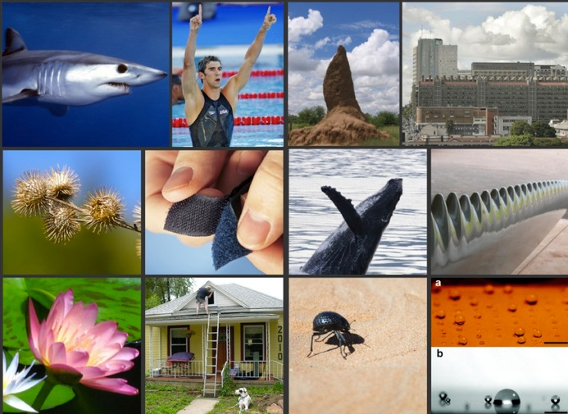
BIOMIMICRY EXAMPLES??

Slide 4
EMULATE (RE)CONNECT ETHOS
The Essential Elements of Biomimicry:

Slide 5
The Essential Elements of Biomimicry:
The practice of biomimicry embodies three interconnected, but unique ingredients;
the three Essential Elements of Biomimicry represent the foundation of the biomimicry meme.

Slide 6
What we have learned?
Living species in nature avoid competition as much as possible.
Nature tends to cooperate.
Cooperation requires minimal energy and creates benefits for all parties

