Slide 1
HYPERLIPIDEMIA

Slide 2
DEFINITION
Dyslipidemia is defined as elevated total cholesterol, LDL cholesterol, or triglycerides; a low HDL cholesterol; or a combination of these abnormalities.
Abnormalities of plasma lipids can result in a predisposition to coronary, cerebrovascular, and peripheral vascular arterial disease.

Slide 3
Pathophysiology:
Lipids are transported in the bloodstream as complexes of lipid and proteins known as lipoproteins.
Atherosclerosis can result from injury to endothelium accompanied with or mediated by oxidation; infection or immunity; or a combination of those.
Oxidized LDL provokes an inflammatory response mediated by a number of chemoattractants and cytokines.

Slide 4
Types:
Dyslipidemia can be primary (Genetic or familial) or secondary to a medication.
The primary defect in familial hypercholesterolemia is the inability to bind LDL to the LDL receptor (LDL-R) or, rarely, a defect of internalizing the LDL-R complex into the cell after normal binding.
This leads to lack of LDL degradation by cells and unregulated biosynthesis of cholesterol,

Slide 5
Secondary:
Medications like:
progestins, thiazide diuretics, glucocorticoids, β-blockers, isotretinoin, protease inhibitors, cyclosporine, mirtazapine, sirolimus.

Slide 6
CLINICAL PRESENTATION

Slide 7
Presentation:
Most patients are asymptomatic for many years.
Symptomatic patients may complain of chest pain, palpitations, sweating, anxiety, shortness of breath, abdominal pain, loss of consciousness or difficulty with speech or movement.
Signs on physical examination may include cutaneous xanthomas, perpheral polyneuropathy, high blood pressure and increased body mass index or waist size.

Slide 8
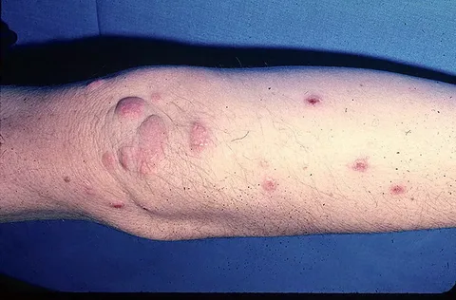

Slide 9
DIAGNOSIS

Slide 10
Tests:
A fasting lipoprotein profile including total cholesterol, LDL, HDL, and triglycerides should be measured in all adults 20 years of age or older at least once every 5 years.
Measurement of plasma cholesterol , triglyceride, and HDL levels after a 12-hour or longer fast is important, because triglycerides may be elevated in nonfasted individuals;

Slide 11
Assessment:
A complete history and physical examination should be assessed:
(1) Presence or absence of cardiovascular risk factors or definite cardiovascular disease in the individual;
(2) Family history of premature cardiovascular disease or lipid disorders;

Slide 12
Assessment:
(3) Presence or absence of secondary causes of hyperlipidemia, including concurrent medications; and
(4) Presence or absence of xanthomas, abdominal pain, or history of pancreatitis, renal or liver disease, peripheral vascular disease, abdominal aortic aneurysm, or cerebral vascular disease (carotid bruits, stroke, or transient ischemic attack).

Slide 13
Risk Factors:
Diabetes mellitus is regarded as a CHD risk equivalent.

Slide 14
Further Invistigations:
If the triglyceride levels are <400 mg/dL one can calculate VLDL and LDL concentrations:
VLDL = triglycerides ÷ 5;
LDL = total cholesterol – (VLDL + HDL).

Slide 15
HDL:
Total cholesterol is composed of cholesterol derived from LDL, VLDL, and HDL,
Determination of HDL is useful when total plasma cholesterol is elevated.
HDL may be elevated by moderate alcohol ingestion (fewer than two drinks per day), physical exercise, smoking cessation, weight loss, oral contraceptives, phenytoin, and terbutaline.
HDL may be lowered by smoking, obesity, a sedentary lifestyle, and drugs such as β-blockers.

Slide 16
DESIRED OUTCOME
The goals of treatment are to lower total and LDL cholesterol in order to reduce the risk of first or recurrent events such as myocardial infarction, angina, heart failure, ischemic stroke, or other forms of peripheral arterial disease such as carotid stenosis or abdominal aortic aneurysm.

Slide 17
TREATMENT

Slide 18
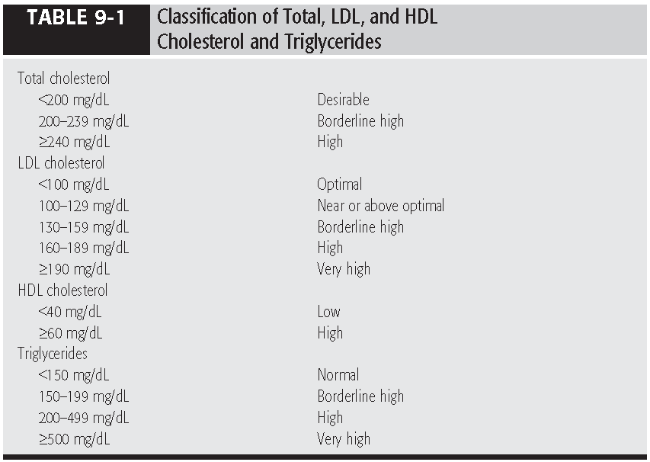

Slide 19
Nonpharmacologic Therapy

Slide 20
Life Style Modifications:
Therapeutic lifestyle changes include dietary therapy, weight reduction, and increased physical activity.
a weight loss of 10% should be discussed with patients who are overweight.
In general, physical activity of moderate intensity 30 minutes a day for most days of the week should be encouraged.

Slide 21
Life Style Modifications:
to stop smoking
to control hypertension.
The objectives of dietary therapy are to progressively decrease the intake of total fat, saturated fat, and cholesterol and to achieve a desirable body weight.

Slide 22
Dietary Alternatives:
Increased intake of soluble fiber in the form of oat bran, and whole grain can result in useful adjunctive reductions in total and LDL cholesterol (5% to 20%).
They have little or no effect on HDL-C or triglyceride concentrations. These products may also be useful in managing constipation associated with the bile acid resins (BARs).

Slide 23
Dietary Alternatives:
In epidemiologic studies, ingestion of large amounts of cold-water oily fish was associated with a reduction in CHD risk.
Fish oil supplementation has a fairly large effect in reducing triglycerides and VLDL cholesterol, but it either has no effect on total and LDL cholesterol or may cause elevations in these fractions.
Other actions of fish oil may account for any cardioprotective effects.

Slide 24
Efficacy:
If all recommended dietary changes were instituted, the estimated average reduction in LDL would range from 20% to 30%.

Slide 25
PHARMACOLOGIC THERAPY

Slide 26
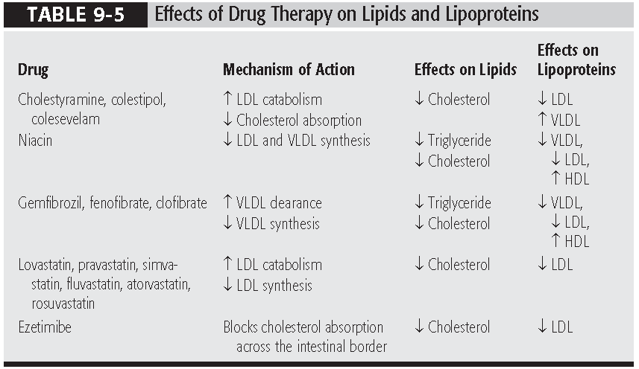

Slide 27
Bile Acid Resins (BARs):
Agents: (Cholestyramine, Colestipol, Colesevelam)
The primary action of BARs is to bind bile acids in the intestinal lumen, with a concurrent interruption of enterohepatic circulation of bile acids, which decreases the bile acid pool size and stimulates hepatic synthesis of bile acids from cholesterol.

Slide 28
MOA:
Depletion of the hepatic pool of cholesterol results in an increase in cholesterol biosynthesis and an increase in the number of LDL-Rs on the hepatocyte membrane, which stimulates an enhanced rate of catabolism from plasma and lowers LDL levels.

Slide 29
Indications & SE:
BARs are useful in treating primary hypercholesterolemia
GI complaints of constipation, bloating, epigastric fullness, nausea, and flatulence are most commonly reported.
These adverse effects can be managed by increasing fluid intake, modifying the diet to increase bulk, and using stool softeners.

Slide 30
Adverse effects:
Impaired absorption of fat-soluble vitamins A, D, E, and K;
hypernatremia and hyperchloremia;
GI obstruction;
reduced bioavailability of acidic drugs such as warfarin, nicotinic acid, thyroxine, acetaminophen, hydrocortisone, hydrochlorothiazide, loperamide, and possibly iron.
Drug interactions may be avoided by alternating administration times with an interval of 6 hours or greater between the BAR and other drugs.

Slide 31
Administration:
Powder form can be used by mixing with orange drink or juice.
Colestipol may have better palatability than cholestyramine because it is odorless and tasteless.
Tablet forms should help improve adherence with this form of therapy.

Slide 32
Niacin
Niacin (nicotinic acid) reduces the hepatic synthesis of VLDL, which in turn leads to a reduction in the synthesis of LDL.
Niacin also increases HDL by reducing its catabolism.
The principal use of niacin is as a second-line agent in combination therapy for hypercholesterolemia.
It is a first-line agent or alternative for the treatment of hypertriglyceridemia and diabetic dyslipidemia.

Slide 33
Adverse Reactions:
Cutaneous flushing and itching appear to be prostaglandin mediated and can be reduced by taking aspirin 325 mg shortly before niacin ingestion.
Taking the niacin dose with meals and slowly titrating the dose upward may minimize these effects.
Concomitant alcohol and hot drinks may magnify the flushing and pruritus from niacin. they should be avoided at the time of ingestion.

Slide 34
Adverse Reactions:
GI intolerance is also a common problem.
elevated liver function tests,
hyperuricemia,
hyperglycemia.

Slide 35
Adverse Reactions:
Niacin-associated hepatitis is more common with sustained-release preparations, and their use should be restricted to patients intolerant of regular-release products.
Niacin is contraindicated in patients with active liver disease,
it may exacerbate preexisting gout and diabetes.

Slide 36
HMG-CoA Reductase Inhibitors
Agents: (Atorvastatin, Fluvastatin, Lovastatin, Pravastatin, Rosuvastatin, Simvastatin)
Statins inhibit 3-hydroxy-3-methylglutaryl coenzyme A (HMG-CoA) reductase, interrupting the conversion of HMG-CoA to mevalonate, the rate-limiting step in de novo cholesterol biosynthesis.
Reduced synthesis of LDL and enhanced catabolism of LDL mediated through LDL-Rs appear to be the principal mechanisms for lipid-lowering effects.

Slide 37
Efficacy:
When used as monotherapy, statins are the most potent total and LDL cholesterol-lowering agents
Total and LDL cholesterol are reduced in a dose-related fashion by 30% or more when added to dietary therapy.

Slide 38
Combinations:
A statin can be used in combination with a BAR or ezetimibe

Slide 39
Adverse Reactions:
Constipation occurs in fewer than 10% of patients taking statins.
elevated serum aminotransferase levels (primarily alanine aminotransferase),
elevated creatine kinase levels,
myopathy, and rarely rhabdomyolysis.

Slide 40
Fibric Acids
Agents: (Gemfibrozil, Fenofibrate, Clofibrate)
Fibrate monotherapy is effective in reducing VLDL, but a reciprocal rise in LDL may occur
Plasma HDL concentrations may rise 10% to 15% or more with fibrates.

Slide 41
Efficacy:
Clofibrate is less effective than gemfibrozil or niacin in reducing VLDL production.

Slide 42
Adverse Reactions:
GI complaints ,
rash,
dizziness,
transient elevations in transaminase levels and alkaline phosphatase
Clofibrate and, less commonly, gemfibrozil may enhance the formation of gallstones.

Slide 43
Adverse Reactions:
A myositis syndrome of myalgia, weakness, stiffness, malaise, and elevations in CK and AST may occur and seems to be more common in patients with renal insufficiency.
Fibrates may potentiate the effects of oral anticoagulants, and the INR should be monitored very closely with this combination.

Slide 44
Ezetimibe
Ezetimibe interferes with the absorption of cholesterol from the intestine,
It is approved as both monotherapy and for use with a statin.
It is given with or without food.
Ezetimibe is well tolerated; approximately 4% of patients experience GI upset.

Slide 45
Fish Oil Supplementation
Diets high in omega-3 polyunsaturated fatty acids (from fish oil), reduce cholesterol, triglycerides, LDL, and VLDL and may elevate HDL cholesterol.
Fish oil supplementation may be most useful in patients with hypertriglyceridemia, but its role in treatment is not well defined.

Slide 46
Uses & SE:
The daily dose is 4 g/day, which can be taken as four 1-g capsules once daily or two 1-g capsules twice daily. This product lowers triglycerides by 14% to 30% and raises HDL by about 10%.
Complications of fish oil supplementation such as thrombocytopenia and bleeding disorders have been noted, especially with high doses (EPA, 15 to 30 g/day).

