Slide 1
Road to Obesity
Assoc. Prof. Dr. Özgür Demir
Department of Endocrinology and Metabolic Diseases

Slide 2
Overweight/Obesity
Overweight and obesity are defined as abnormal or excessive fat accumulation that presents a risk to health.
Measure of obesity is
Body Mass Index (BMI), a person’s weight (in kilograms) divided by the square of his or her height (in metres)

Slide 3
Overweight and Obesity
Underweight BMI < 18.5 kg/m2
Normal BMI 18.5-24.9 kg/m2
Overweight: BMI 25–29.9 kg/m2
Class 1 obesity: BMI 30–34.9 kg/m2
Class 2 obesity: BMI 35–39.9 kg/m2
Class 3 obesity: BMI ≥ 40.0 kg/m2
BMI correlates with total adiposity, morbidity & mortality

Slide 4
BMI value may be misleading in terms of health risk?
East and South Asians
Increased diabetes risk at BMI=23 kg/m2
Asia-Oceania criteria different than U.S.
Overweight 23.0–24.9 kg/m2; obese ≥25.0 kg/m2
African Americans
Disease risk may be lower than whites at same BMI
Women
≈12% higher body fat than men
Older persons
Lost muscle mass ups risk for obesity-associated conditions
Elite athletes
Elevated weight may be due to increased lean mass

Slide 5
Waist circumference instead of BMI
When: measure waist circumference in patients who are
Overweight or have class 1 obesity
Waist measurement doesn’t add additional risk information if BMI <25 kg/m2 or ≥35 kg/m2
How: measure over iliac crests in a horizontal plane after patient exhales following a normal breath
Elevated waist circumference:
Central adiposity correlates well with visceral adiposity
Risk: diabetes, hypertension, nonalcoholic fatty liver disease

Slide 6
Waist Circumference for Obesity
WHO
Female ≥88 cm
Male ≥102 cm
IDF
Female ≥ 80 cm
Male ≥ 94 cm
TEMD
Female ≥90 cm
Male ≥100 cm

Slide 7
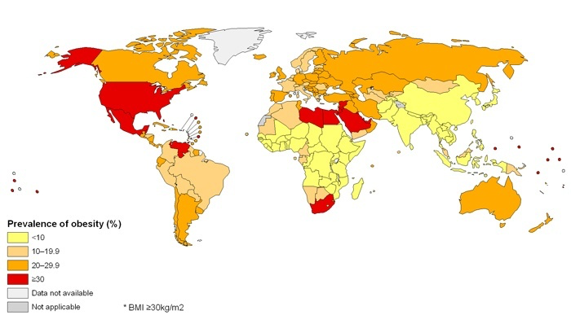

Slide 8
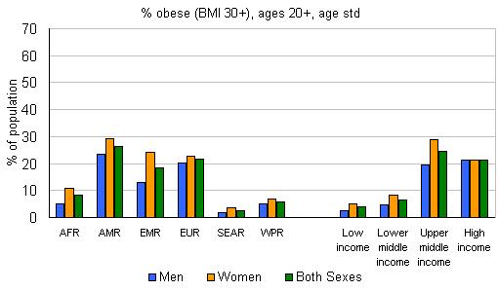

Slide 9
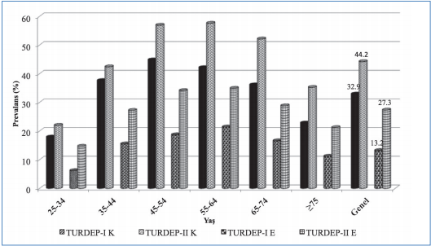
Change of obesity prevalence from TURDEP-I to TURDEP-II by age group and gender in Turkey
TURDEP-I TURDEP-II ARTIŞ ORANI
Male % 13,2 27,3 107
Female% 32,9 44,2 32

Slide 10
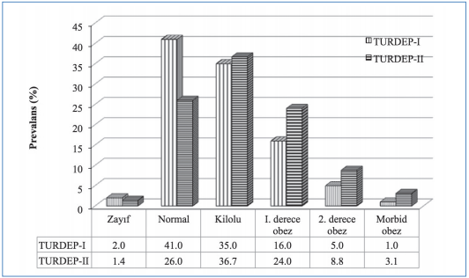
BMI Distribution in Adult Turkish Population with respect toTURDEP-I ve TURDEP-II

Slide 11
TURDEP-I (1998) TURDEP-II (2010)
In the 12-year period, the average age of our adult population increased by 4 years.
 | Height | KG | Waist Circumference | Hip Circumference
Female | 1 CM | 6 KG | 6 CM | 7 CM
Male | 1 CM | 8 KG | 7 CM | 2 CM

Slide 12
TURDEP-II (2010)
Obesity prevalence in Turkey is 32%
Being overweight in men and obesity in women are more common.
Urban and rural obesity rates are close to each other
In general, 2/3 of the Turkish population is overweight or obese

Slide 13
Obesity Has Multiple Pathophysiologic Origins
Epigenetic
Environmental
Genetic
Obesity
Sociocultural
Physiologic
Behavioral

Slide 14
Dietary Behaviors
Increased consumption of sugar
sweetened beverages
Continued low consumption of fruits and vegetables
Notes:
Sugar-sweetened beverages (SSBs) are the largest source of added sugar and an important contributor of calories in the U.S. diet (8). High consumption of SSBs has been associated with obesity. Many longitudinal studies, but not all, have shown an association between SSBs and various measures of increased body fat (9-16). SSBs also tend to have few, if any, nutrients. SSBs include: soft drinks (soda or pop), fruit drinks, sports drinks, tea and coffee drinks, energy drinks, sweetened milk or milk alternatives, and any other beverages to which sugar, typically high fructose corn syrup or sucrose (table sugar), has been added.
Fruits and vegetables, as part of a healthy diet, are important for optimal child growth, weight management, and chronic disease prevention. Fewer than 1 in 10 American adolescents and adults consume recommended amounts of fruits & vegetables (17)
Additional Presenter Information: For state specific information on fruit and vegetable consumption patterns and policy & environmental supports, please see CDC’s 2009 State Indicator Report on Fruits and Vegetables, available at: http://www.fruitsandveggiesmatter.gov/health_professionals/statereport.html

Slide 15
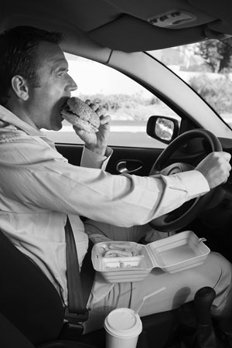
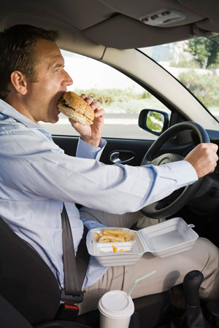
Dietary Behaviors
Increased frequency of meals eaten away from home
Notes:
The percentage of the food budget spent on away-from home food has increased steadily since the 1970’s and this trend is projected to continue. Approximately 1/3 of daily caloric intake in the United States comes from foods consumed away from home. Studies suggest that consuming quick service food is associated with increased caloric intake and weight status (7).
It is estimated that children eat almost twice as many calories in restaurant meals compared to meals at home, 770 vs. 420 calories (35)

Slide 16
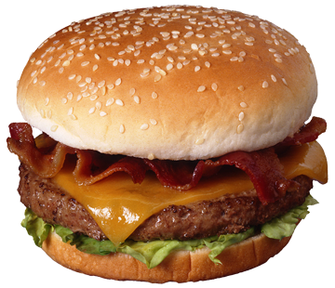
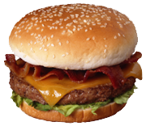
The Food Environment
Increased number of fast food establishments.
Lack of access to full service grocery stores selling affordable healthful foods
Less healthy food & beverage advertising aimed at children
Notes:
In addition to dietary behaviors of individuals, the food environment has grown to encourage higher caloric intake. Convenience has become a way of life for many individuals and families. There has been a dramatic rise in consumption of foods eaten away from home which may contribute to the rise in obesity through the following:(7):
-Increased number of fast food establishments in the U.S.
-Availability of large portion sizes when dining out
-Tendency to select more calorie dense, nutrient poor, foods when dining out
People with better access to supermarkets and other retail stores that provide healthful foods, tend to have healthier diets, including higher intake of fruits and vegetables. Research suggests that residents of rural, minority, and lower income neighborhoods are more likely to have poor access to supermarkets (18). Access to more healthful foods can be improved by building and attracting new supermarkets; improving transportation to stores that provide fruits and vegetables; and increasing the availability of affordable fruits and vegetables at existing stores, or corner stores.
Food marketing to children and adolescents is a big business. The Federal Trade Commission (FTC) estimates that in 2006, food, beverage, and quick-serve restaurant companies spent more than $1.6 billion to promote their products to young people (19). Children and adolescents are an important demographic for marketers for several reasons: (a) they are customers themselves; (b) they influence purchases made by parents and caregivers; and (c) they are the future adult market (20).

Slide 17
Physical Activity
35.5% of adults do not engage in recommended levels of physical activity for health benefits and 25.4% of adults report no leisure-time activity
81.6% of high school students did not participate in 60 or more minutes of physical activity on any day of the previous 7 days.
Only 30.3% of high school students, grades 9-12, have daily physical education
Notes:
17
Extensive research shows that regular physical activity is important for preventing and treating obesity and other chronic diseases (e.g., cardiovascular disease, diabetes mellitus, breast cancer, colon cancer), disabling conditions (e.g., osteoporosis, arthritis) and risk factors for chronic disease (e.g., hypertension, high cholesterol) (24). Health benefits from regular physical activity occur for children and adolescents, young and middle aged adults, older adults, and those in every studied racial and ethnic group(25).
The 2008 Physical Activity Guidelines for Americans recommends that children and adolescents participate in 60 minutes or more of physical activity daily. To obtain substantial health benefits, adults are recommended to accumulate at least 150 minutes of moderate-intensity or 75 minutes of vigorous-intensity aerobic physical activity per week, or an equivalent combination of the two(25).
Additional Presenter Information:
CDC’s State Indicator Report on Physical Activity, 2010, provides additional information on physical activity behavior and policy and environmental supports with in each state. The report can be found: http://www.cdc.gov/physicalactivity/downloads/PA_State_Indicator_Report_2010.pdf
Physical Activity statistics for selected metropolitan cities across the U.S. can be found: http://www.cdc.gov/nccdphp/dnpa/physical/stats/metropolitan.htm

Slide 18
Community Design & the Built Environment
Standardized Share of Mode for Trips to School: National Personal Transportation Survey
Car
Bus
Walk/bike
Public Transit
McDonald NC. Am J Prev Med 2007;32:509
Notes:
Here is an example of how transportation patterns have changed in the U.S. over time; it illustrates our increased automobile dependence.
Policies supporting physical activity through urban design, land use, or developing non-motorized travel options are environmental strategies to increase physical activity(26).

Slide 19
Community Design & the Built Environment
Environmental factors beyond the control of individuals contribute to increased obesity rates by reducing the likelihood of healthy eating and active living behaviors.
Environmental factors that influence physical activity behavior:
Lack of infrastructure supporting active modes of transportation, i.e. sidewalks & bike facilities
Access to safe places to play and be active
Access to public transit
Notes:
“Place Matters”: The physical environment affects the daily choices we make, which in turn, affect our health and weight. For example, children who live in unsafe neighborhoods may be restricted to watching television indoors instead of playing outside after school. Families living in neighborhoods that are zoned exclusively for residential use must drive to work and school because it is too far to walk. Communities that lack full-service grocery stores and neighborhood food markets have less access to fresh fruits and vegetables. Therefore, it is important to develop community environments that foster and support healthier lifestyle choices.

Slide 24
History and Physical Examination are important
Rule out secondary causes of obesity (uncommon)
TBI + hypothalamic injury: can cause weight gain
Rare genetic syndromes: can cause obesity in adults
Review patient’s medication list
Include weight history at 5-y to 10-y intervals
Life events associated with significant weight gain
Previous weight loss attempts
Successful efforts and reasons for recidivism
Medical history and review of systems: focus on major comorbid conditions

Slide 25
Medications Associated With Weight Gain
Glucocorticoids
Insulin, sulfonylureas, thiazolidinediones, meglitinides
1st-generation antipsychotics (thioridazine)
2nd-generation antipsychotics (risperidone, olanzapine, clozapine, quetiapine)
Neurologic and mood stabilizing agents (carbamazepine, gabapentin, lithium, valproate)
Antihistamines (especially cyproheptadine)
Antidepressants (paroxetine, citalopram, amitriptyline, nortriptyline, imipramine, mirtazapine)
Hormonal agents (especially progestins)
Beta-blockers (especially propranolol)
Alpha-blockers (especially terazosin)

Slide 26
Is a family history of obesity important?
Family history of obesity suggests genetic component
Particularly severe obesity
Genetic polymorphisms more common than genetic abnormalities responsible for rare syndromes
Genetics accounts for ≈40–70% of variability in BMI
Genetic factors alone doesn’t explain rise in obesity
Obesity and related diseases respond to lifestyle changes
Even if genetic predisposition suspected

Slide 27
What health problems are associated with overweight and obesity?
Metabolic effects
Prediabetes and type 2 diabetes, dyslipidemia
Hypertension, CAD, stroke, CHD, AF, venous stasis, DVT, PE
Cancer (colorectal, postmenopausal breast, endometrial)
GERD, erosive gastritis, cholelithiasis, nonalcoholic FLD
Nephrolithiasis, proteinuria, CKD
Genitourinary
PCOS, infertility, pregnancy complications (women)
Benign prostatic hypertrophy, ED (men)
Neurologic: Migraine, pseudotumor cerebri
Greater severity of influenza; skin and soft tissue infections

Slide 28
What health problems are associated with overweight and obesity?
Mechanical effects
Obstructive sleep apnea
Restrictive lung disease
Osteoarthritis
Low back pain
Psychosocial effects
Depression and anxiety
Social stigmatization

Slide 29
What laboratory tests or other evaluations should be done in patients with obesity?
Routine laboratory studies
Fasting glucose and/or hemoglobin A1c
TSH, liver-associated enzymes, and fasting lipids
Optional tests depend H&P exam and initial blood test
EKG, ECHO
Overnight sleep study
Right upper quadrant ultrasound (fatty liver)
Transvaginal ultrasound (ovarian cysts)
Tests to assess HPA axis for suspected hypothalamic obesity (uncommon)

Slide 30
What laboratory tests or other evaluations should be done in patients with obesity?
Use BMI + waist circumference to assess adiposity and body composition
Bioelectrical impedance analysis: not more accurate
CT or MRI: quantify central and visceral adiposity, but both expensive + CT exposes patient to radiation
DEXA: accurate estimate of body composition
Estimate energy requirements
Resting metabolic rate + level of physical activity
Harris-Benedict equation: weight, height, demographic factors, and level of physical activity

Slide 31
Framework for Preventing Obesity
Home and Family
School
Community
Work Site
Healthcare
Social Norms and Values
Food and Beverage Industry
Agriculture
Education
Media
Government
Public Health Systems
Healthcare Industry
Business and Workers
Land Use and Transportation
Leisure and Recreation
Sectors of Influence
Behavioral Settings
Genetics
Psychosocial
Other Personal Factors
Individual Factors
Food and Beverage Intake
Physical Activity
Energy Intake
Energy Expenditure
Energy Balance
Prevention of Overweight and Obesity Among Children, Adolescents, and Adults
Notes:
The Social-Ecological Model stresses that society is composed of interconnected elements that invariably affect one another. The model is based on the premise that changes in individual behavior will come about through a combination of societal, community, organizational, interpersonal, and individual efforts.
Effective obesity prevention initiatives should address multiple levels of the environment and engage multiple sectors of society in order to affect social change and achieve health impact. For these reasons, CDC supports population based approaches to prevent and control obesity, such as policy, systems, and environmental change, in various settings and at all levels of government (i.e. local, state, and federal).

Slide 32
Target Behaviors for Change
Focus on six target behaviors for the
prevention of obesity and other chronic diseases
Increase physical activity
Increase consumption of fruits and vegetables
Increase breastfeeding initiation, duration, and exclusivity
Decrease consumption of sugar sweetened beverages
Decrease consumption of high energy dense, nutrient poor, foods
Decrease television viewing
Notes:
CDC sees these six target behaviors as key to preventing and reducing the prevalence of obesity and other chronic disease.

Slide 33
Recommended Strategies to Prevent Obesity
Strategies to Promote the Availability of Affordable Healthy Food & Beverages
Increase availability of healthier food and beverage choices in public service venues
Improve availability of affordable healthier food and beverage choices in public service venues
Improve geographic availability of supermarkets in underserved areas
Provide incentives to food retailers to locate in and/or offer healthier food and beverage choices in underserved areas
Improve availability of mechanisms for purchasing foods from farms
Provide incentives for the production, distribution, and procurement of foods from local farms

Slide 34
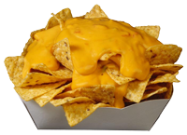
Recommended Strategies to Prevent Obesity
Strategies to Support Healthy Food and Beverage Choices
Restrict availability of less healthy foods and beverages in public service venues
Institute smaller portion size options in public service venues
Limit advertisements of less healthy foods and beverages
Discourage consumption of sugar-sweetened beverages

Slide 35
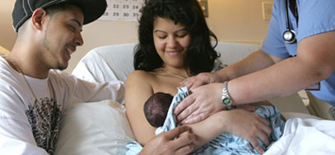
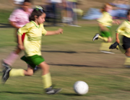
Recommended Strategies to Prevent Obesity
Strategy to Encourage Breastfeeding
Increase support for breastfeeding
Strategies to Encourage Physical Activity or Limit Sedentary Activity Among Children and Youth
Require Physical Education in schools
Increase the amount of physical activity in
PE programs in schools
Increase opportunities for extracurricular
physical activity
Reduce screen time in public service venues

Slide 36
Recommended Strategies to Prevent Obesity
Strategies to Create Safe Communities That Support Physical Activity
Improve access to outdoor recreational facilities
Enhance infrastructure supporting bicycling
Enhance infrastructure supporting walking
Support locating schools in residential neighborhoods
Improve access to transportation
Zone for mixed-use development
Enhance personal safety where people are or could be physically active
Enhance traffic safety in areas where persons are or could be physically active
Strategy to Encourage Communities to Organize for Change
Participate in community coalitions or partnerships to address obesity

Slide 37
How can people prevent obesity?
Reduce job stress
Limit time spent commuting by car
Get adequate sleep (6–9 h/night)
Review concurrent medications
Smoking cessation is a priority — even though it may lead to weight gain in 1st year
Read food labels and eat smaller portions
Eat 5 servings fruits & vegetables daily + fiber (25 g/d)
Exercise 45–60 minutes per day

Slide 38
How should clinicians counsel patients about their weight?
Weight is a sensitive subject for many patients
Say “weight” or “weight problem”, not “obesity”
Ask “Could we talk about your weight today?”
Let patients discuss their concerns
5-10% weight loss improves comorbid conditions
Patients often think must be ≥25% to be successful

Slide 39
How should clinicians counsel patients about their weight?
Try the 5A approach
Assess (assess weight and risk factors)
Advise (advise weight loss, personalize the recommendation to the patient)
Agree (agree on a target for behavior change)
Assist (assist with a referral)
Arrange (arrange follow-up)

Slide 40
How can clinicians assess readiness for weight loss?
Practical approach
Patient monitors food intake + physical activity for ≥1 week
Consensus: patients should be
Committed to monitoring food intake
Committed to physical activity
Be free of untreated major depression
Not in the middle of a major life event
Little evidence exists to guide clinicians

Slide 42
What dietary strategies are used in lifestyle modification?
Calorie restriction
Easier to reduce food intake by 500-1000 kcal/d than increase energy expenditure by equivalent amount
More weight loss via diet changes than physical activity
Main diet types: low-fat, low-carb, meal-replacement diets
Very-low-calorie diets not recommended
Physical activity
Important component of weight management
Particularly important in maintaining weight loss in adults

Slide 43
Which diet is best for long-term weight loss?
Any calorie reduction diet leads to weight loss
No matter the macronutrient content of given diet
Higher protein diets vs lower fat diets: similar weight loss
Having good support aids sustained weight loss
Calorie-deficit diet following federal dietary guidelines
Initial choice for most patients
50–60% of calories from complex carbohydrate
Emphasis on “healthy” foods (vegetables, nuts, fish)

Slide 44
What is the role of exercise in weight loss and maintenance?
Regular exercise is critical for overall health
More important to maintain weight loss than to reduce
Adds 1-3 kg weight loss if combined with diet program
Aerobic exercise + resistance training may have additional health benefits beyond either type alone

Slide 45
What makes maintaining weight loss so difficult? What improves long-term results?
Physiologic basis for regain
After substantial loss: hunger-stimulating hormones remain elevated, satiety-mediating hormones remain depressed
Obese persons who lose weight may burn fewer calories than never-obese persons with same lean body mass
Behaviors associated with weight loss maintenance
Participation in structured weight management program
Physical activity ≥60 mins/d most days of the week
Monitoring body weight frequently
Eating a reduced-calorie diet
Recording food intake periodically

Slide 46
What is the evidence that intentional weight loss improves health outcomes?
Look AHEAD trial (n = 5145)
Weight loss: 8.6% of starting weight at 1y, 6.15% at 4y
Better mood, health-related QOL, physical & sexual function
Less sleep apnea, less need for meds for CVD risk factors
Improved reduced urinary incontinence

Slide 48
Reversing the obesity epidemic is a shared responsibility. Social and environmental changes are influenced by the efforts of many…
Notes:
There is a role for everyone in discovering ways to create supportive environments to help individuals and families to easily make healthy food choices, enjoy a physically active lifestyle, and move toward a healthy weight.

