Slide 1
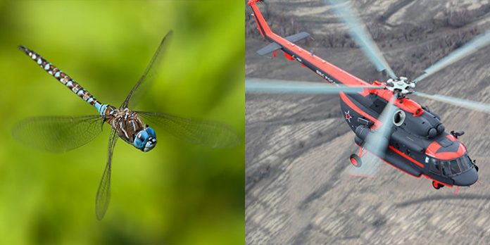
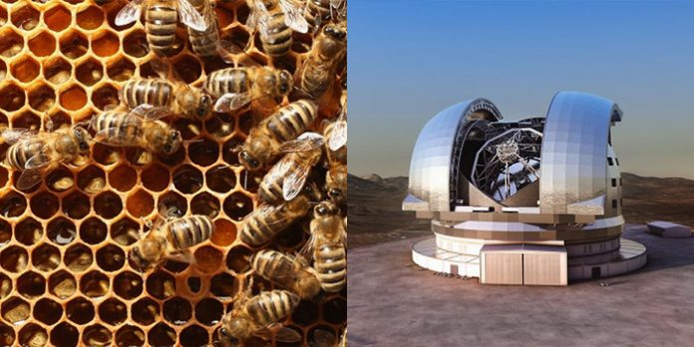
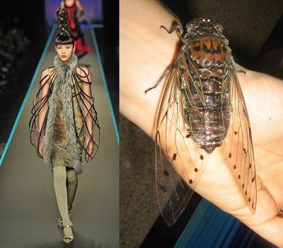
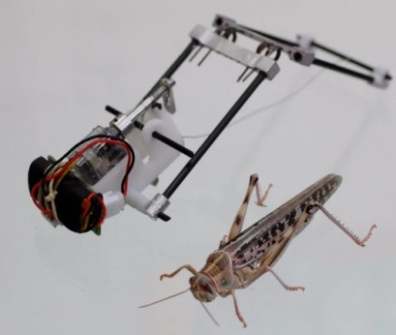
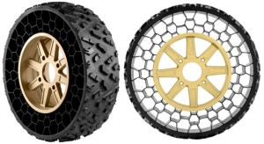
INSPIRATION FROM INSECTS
Dr. Arzu GÜRSOY ERGEN
Science Faculty
Biology Department

Slide 2
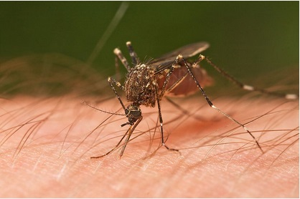
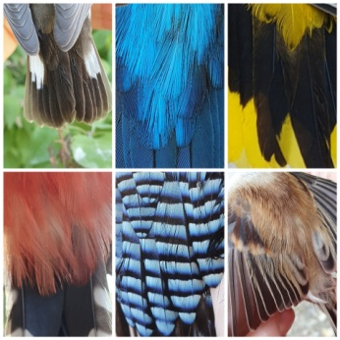
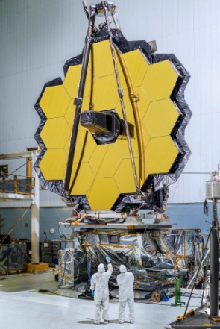
RoboBee
The Inspiration for the Helicopter: The Dragonfly
The Munich Olympic Stadium = Dragonfly
Beetle inspires Dew Bank Bottle
Clothing colored without dyes like a butterfly or a peacock
Fashion = Insecta Mirabilis
Eastgate Centre’s heating and cooling systems – Termite mound
Mosquito bite inspires less painful injection
Mimicking the beehive to develop solar shading
Honeycomb Inspired Tire
Bionic Camera Inspired by Insects
Packaging minimises - Bee hives
Toyota Working on Night Vision System Inspired by Dung Beetles
Robo Grasshopper
The James Webb telescope and honeycomp

Slide 3
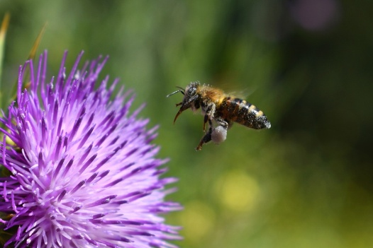
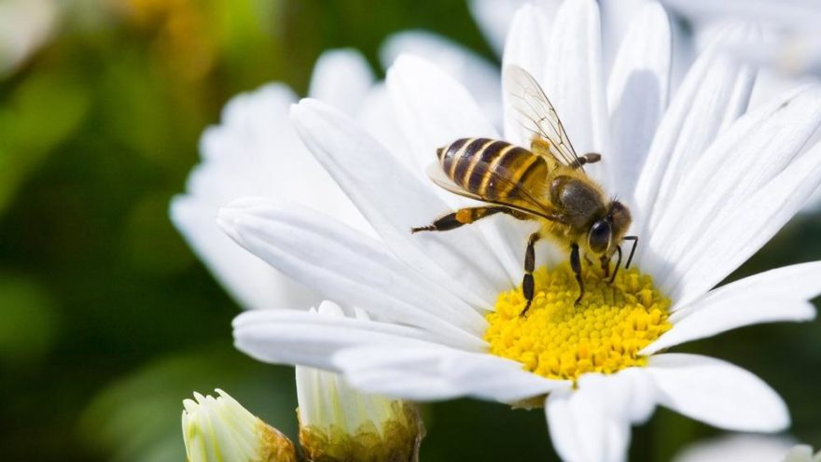
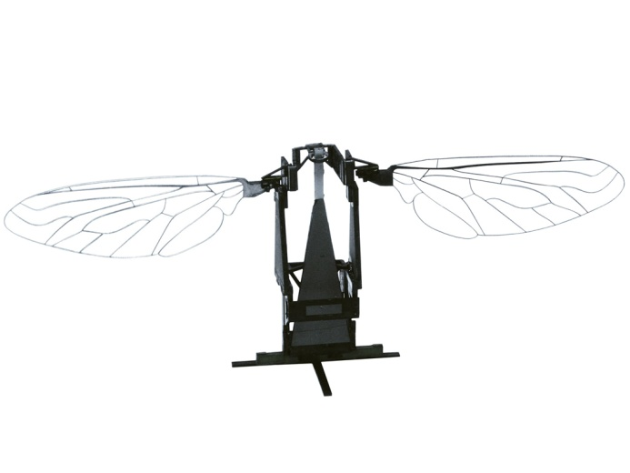
1) RoboBee
A RoboBee may be the world’s tiniest robot. It measures about half the size of a paper clip, weighs less that one-tenth of a gram.
The masterminding of the RoboBee was motivated by the idea to develop autonomous micro-aerial vehicles capable of self-contained, self-directed flight and of achieving coordinated behavior in large groups.
The RoboBee development is divided into three main components: the Body, Brain, and Colony.
Body: consists of constructing robotic insects able to fly on their own with the help of a compact and seamlessly integrated power source.
Brain is concerned with “smart” sensors and control electronics that mimic the eyes and antennae of a bee, and can sense and respond dynamically to the environment.
The Colony’s focus is about coordinating the behavior of many independent robots so they act as an effective unit.
Insect-inspired robots with potential uses in crop pollination, search and rescue missions, surveillance, as well as high-resolution weather, climate, and environmental monitoring

Slide 4
2) The Inspiration for the Helicopter: The Dragonfly
One of their most impressive adaptations is their aerial skill.
Dragonflies can fly almost impossibly fast and can even hover and fly backwards!
That skill is due to their wing design.
Rather than having one set of wings like a bird or a bat, dragonflies have two sets.
They don’t simply flap up and down. Dragonflies twist their wings at various angles and flap them independently, which is what allows them to move in almost any direction while in flight and capture prey as tiny as gnats while on the wing.
This extreme maneuverability hasn’t gone unnoticed by scientists, who’ve applied what they’ve learned from dragonfly anatomy to everything from helicopters to wind turbines.

Slide 5
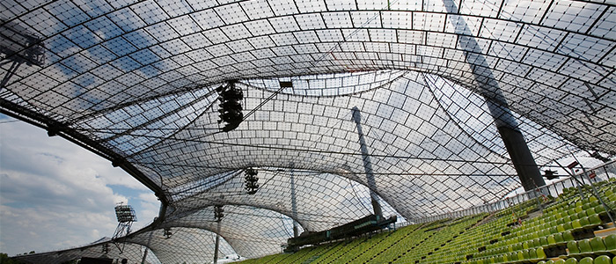
3) The Munich Olympic Stadium = Dragonfly
Despite its thinness, the dragonfly’s wing is very strong because it is made up of approximately 1,000 compartments.
Owing to this divided structure, the wings of the animal are not torn and they resist air pressure.
The roof of the Munich Olympic Stadium is constructed according to the same principle.

Slide 6
Biomimicry
Designer:
What is the product made from?
How has the product been ‘inspired by nature’?
Level 1
Level 2
Level 3
How is the product designed for the whole cycle (product in a system)?
Image/s

