Slide 1
BASIC GENETIC TERMS-V

Slide 2
Inheritance Genetics
Johann Gregor Mendel?
Mendel Genetics?
Theories about inheritance
Mendel’ laws
Crossing
Pedigrie

Slide 3
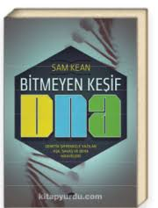
Who is Mendel?
Bitmeyen keşif DNA

Slide 4
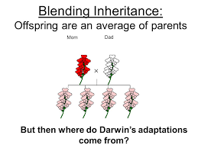
Before Mendel
blending inheritance– the idea of gene
Genetic material in oosits and sperma blends in upon fertilisation.
Trouble: you never get an «avarage» individual

Slide 5
Medel proposed particulate inheritance theory
Characters are defined by units and the units are carried over for generations
This theory explained most of the phenotypes

Slide 6
Why Pea?
The pea plant has a large number of characters with different varieties.
- Each pea flower has both male and female organs (hermaphrodite).
- At the same time, crossing plant can be controlled, can be reproduced by pollen of different plants. (n = 7)

Slide 7
Methodology
Research material and sampling suitability
Planning of the research
Collection and registration of data
Statistical analysis…
Repeatability.

Slide 8
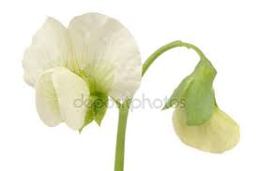
What is character?
Purebred production: for two years peas have produced for the chosen characters.
Flower color PURPLE and WHITE

Slide 9
Homozygous
- Homozygous dominant - BB
- Homozygous recessive - bb
Heterozygous - (Bb)

Slide 10
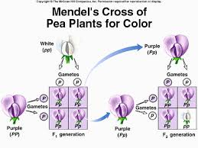

Slide 12
Dominance: Allel is called the dominance of one of the genes over the other. The character that the predominant allele genes bring to the genus is observed in the phenotype.
Recessive: a gene-recessive (recessive) gene that can not show its effect in the phenotype when allel genes are heterozygous; the characteristic that it reveals is called recession (a retracted feature).

Slide 13
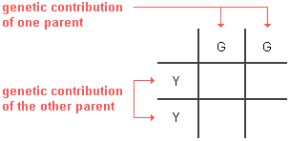
Punnett Square
Punnett square is a diagram that is used to predict an outcome of a particular cross or breeding experiment. It is named after Reginald C. Punnett.

Slide 14
Punnett Square

Slide 15
1- factors are presented in pairs ...
Genetic characters are controlled by unit factors in pairs in each organism.
Chromosomes-genes…

Slide 16
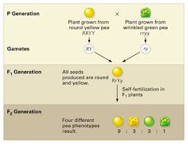
Dihybrid crossing
Crossing individuals for two characters.
Mendel crossed the homozygous individuals for two characters and obtained the phenotype / genotype ratios and ...

Slide 17
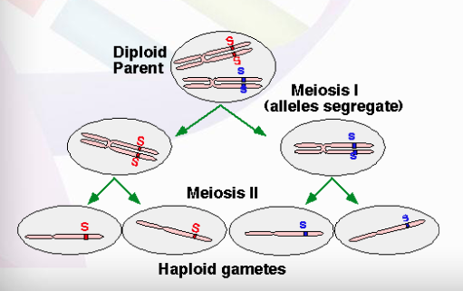
Second law: Independent Assortment
Independently distributed unit factors have suggested that different gene pairs are distributed independently during the formation of gametes.

Slide 18
polyhibrid crossing
Crossing individuals for more than 2 traits.

Slide 19
How to determine the genotype of an individual with a dominant genotype?
Test crossing: crossing an individual whose genotype is unknown with a homozygous recessive individual.
The constructed practice is called test hybrid, the individual used in the test hybrid is called the tester.

Slide 21
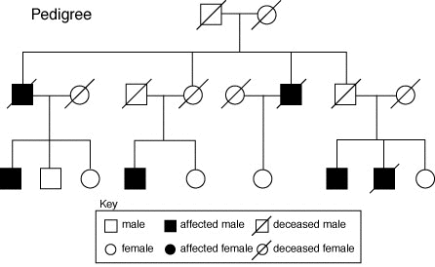
A pedigree chart is a diagram that shows the appearance or phenotypes inheritance pattern.

Slide 22
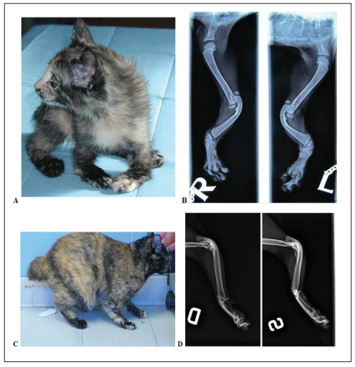
I.
II.
III.

Slide 24
NON-MENDELIAN GENETICS
Inheritance patterns are non-distributed in accordance with Mendel's rules.
The expected phenotype ratio in these cases where Mendel's proposals are not applicable differ:
Multiple alleles
Lethal genotypes
Incomplete dominance
Codominance
Penetrance
Expressivity
Pleiotropy
Epistasis

Slide 25
Homework
Multiple alleles
Lethal genotypes
Incomplete dominance
Codominance
Penetrance
Expressivity
Pleiotropy
Epistasis

