Slide 1
COM337 Computer Graphics
Lighting and Shading

Slide 2
Why do we need lights and shading?
Suppose we build a model of a sphere using many triangles and color it. (With default settings) we get something like
But we want

Slide 3
Lighting and Shading
Why does the image of a real sphere look like
and not like
Light-material interactions cause each point to have a different color or shade
Need to consider
Light sources
Material properties
Location of viewer
Surface orientation

Slide 4
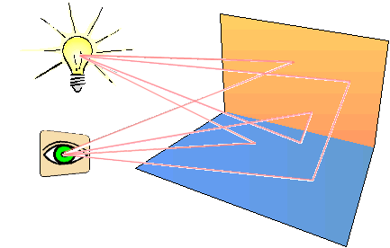
Illumination Models
Illumination: transport of energy from light sources to points on surfaces via direct & indirect paths.
Lighting: computing intensity reflected from 3D points in scene.
Shading: assigning pixel colours
Illumination Models:
Empirical: simple approximations to observed phenomena.
Physically-based: model actual physics of light interactions.

Slide 5
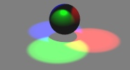
Two Components of Illumination
Light sources
Surface properties
Light sources (or emitters)
Spectrum of emittance (i.e., color of the light)
Geometric attributes
Position
Direction
Shape
Directional attenuation
Polarization

Slide 6
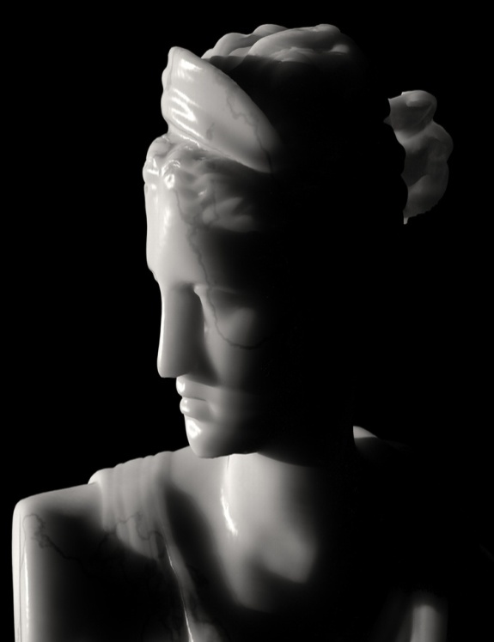
Surface properties
Reflectance spectrum (i.e., color of the surface)
Subsurface reflectance
Geometric attributes
Position
Orientation
Micro-structure

Slide 7
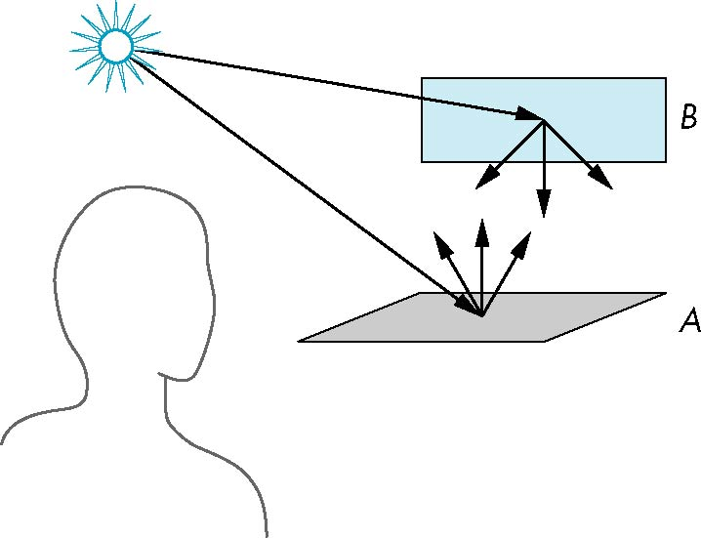
Scattering
Light strikes A
Some scattered
Some absorbed
Some of scattered light strikes B
Some scattered
Some absorbed
Some of this scattered
light strikes A and so on

Slide 8
Rendering Equation
The infinite scattering and absorption of light can be described by the rendering equation
Cannot be solved in general
Ray tracing is a special case for perfectly reflecting surfaces
Rendering equation is global and includes
Shadows
Multiple scattering from object to object

Slide 9
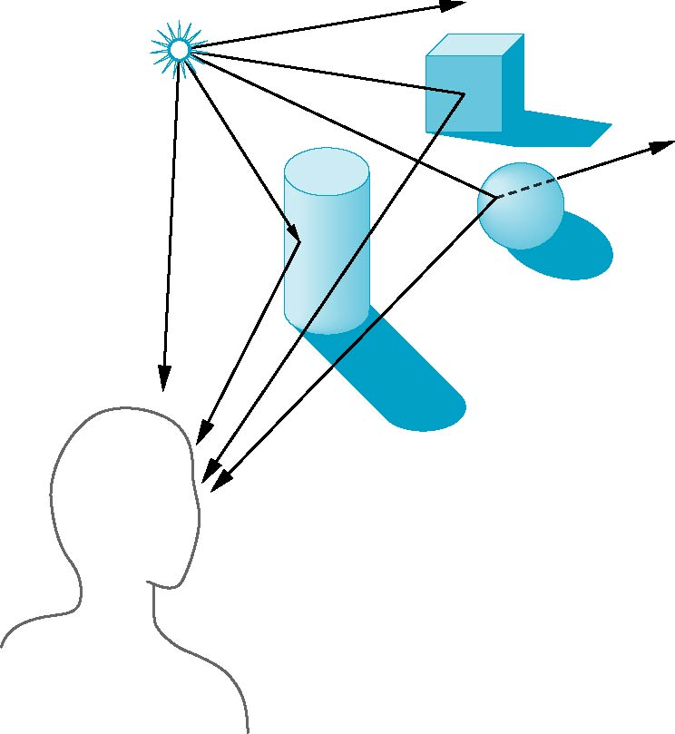
Global Effects
shadow
multiple reflection
translucent surface

Slide 10
Local vs Global Rendering
Correct shading requires a global calculation involving all objects and light sources
Incompatible with pipeline model which shades each polygon independently (local rendering)
However, in computer graphics, especially real time graphics, we are happy if things simply “look right”
Many techniques approximate global effects

Slide 11
Light-Material Interaction
Light that strikes an object is partially absorbed and partially scattered (reflected)
The amount reflected determines the color and brightness of the object
A red surface appears red under white light because the red component of the light is reflected and the rest is absorbed
The reflected light is scattered in a manner that depends on the smoothness and orientation of the surface

Slide 12
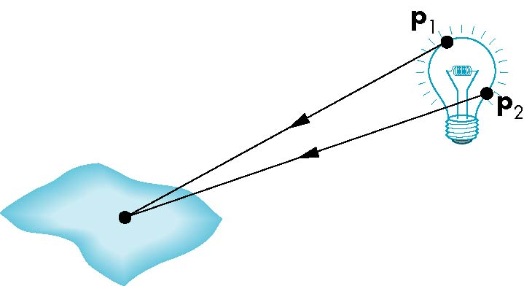
Light Sources
General light sources are difficult to work with because we must integrate light coming from all points on the source

Slide 13
Simple Light Sources
Point source
Model with position and color
Distant source = infinite distance away (parallel)
Spotlight
Restrict light from ideal point source
Ambient light
Same amount of light everywhere in scene
Can model contribution of many sources and reflecting surfaces

Slide 14
Point Light Sources

Slide 15
Infinitely Distant Light Sources
Example: sunlight

Slide 20
attenuation for rays at angle φ from the cone axis

Slide 21
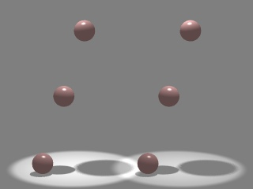
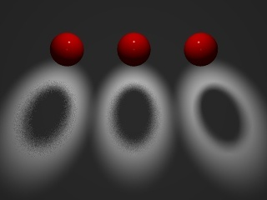
Other Light Sources
Area Light Sources
Light source occupies a 2-D area (usually a polygon or disk)
Generates soft shadows
Extended Light Sources
Spherical Light Source
Generates soft shadows

Slide 24
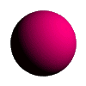
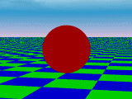
Basic (Phong) Illumination Model
Three terms linearly combined:
Diffuse component for the amount of incoming light reflected equally in all directions
Specular component for the amount of light reflected in a mirror-like fashion
Ambient term to approximate light arriving via other surfaces

Slide 28
Ideal diffuse reflection
An ideal diffuse reflector, at the microscopic level is a very rough surface
Because of these microscopic variations, an incoming ray of light is equally likely to be reflected in any direction over the hemisphere:
What does the reflected intensity depend on?
angle of incident light

Slide 29
Ideal diffuse reflector : Lambertian reflector
For a Lambertian surface we can set a parameter kd that determines the fraction of the incident light that is scattered as diffuse reflection
kd is the diffuse-reflection coefficient or diffuse reflectivity
To simulate a highly reflective surface set the value near 1
To simulate a light absorbing surface set the value near 0

Slide 31
Ambient & diffuse reflection for single point-source illumination
unit direction vector
to light source

Slide 35
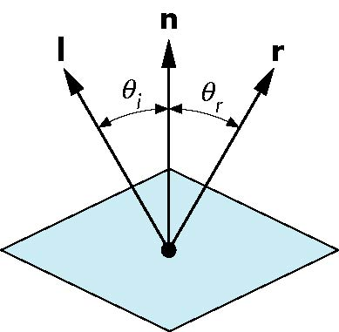
Ideal Reflector
Normal is determined by local orientation
Angle of incidence θi = angle of reflection θr
The three vectors must be coplanar
r = 2 (l · n ) n - l

Slide 36
2(N.L)N
L
N
L
R
θ
θ_{i}
θ
θ_{r}
θ_{i}=θ_{r}
R = 2(L.N)N - L

Slide 37
The specular reflection range is specified by an exponent.
Shiny surface - large specular-reflection exponent, ns, means a narrow specular reflection range -- more like a mirror, with reflections seen close to the reflection angle.
ns is infinite for a perfect mirror; for a rough surface it is assigned a value near 1
For a perfect mirror the reflection would only be seen where viewing angle φ is zero, measured relative to the specular reflection direction R

Slide 38
Intensity of Specular Reflection depends on surface material properties and angle of incidence θ (and other factors, e.g. colour): These can be expressed as coefficients W(θ), whose values can be found experimentally
Using these coefficients and Fresnel's Laws of Reflection we can write the Phong specular reflection model as
cos φ can be found as the dot product V.R
And assuming the specular reflection coefficient is constant for any surface, ks, we obtain the following expression

Slide 39
This gives us the popular Phong model for calculating specular reflection intensities

Slide 40
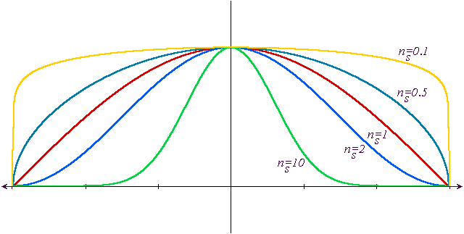
The Shininess Coefficient n_{s}
Values between 100 and 200 correspond to metals
Values between 5 and 10 give surface that look like plastic
n=0.1
n=0.5
n=1
n=2
n=10

Slide 41
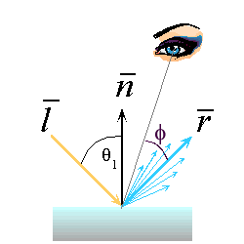
Phong Lighting
The most common lighting model in computer graphics:
v
The n_{shiny} term is a purely empirical constant that varies the rate of falloff
Though this model has no physical basis, it works (sort of) in practice

Slide 42
Where is the light?

Slide 43
Specular Reflection (Phong Model)
L
V
R
Incoming light is reflected primarily in the mirror direction, R
Perceived intensity depends on the relationship between the viewing direction, V, and the mirror direction
Bright spot is called a specularity
Intensity controlled by:
The specular reflectance coefficient, k_{s}
The parameter, n, controls the apparent size of the specularity
Higher n, smaller highlight

Slide 44
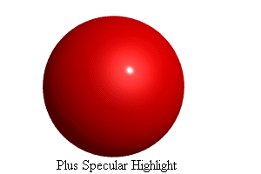
Specular Example

Slide 45
Modified Phong Model
The specular term in the Phong model is problematic because it requires the calculation of a new reflection vector and view vector for each vertex
Blinn suggested that an approximation using the halfway vector is more efficient

Slide 46
Specular Reflection Speedup
L
H
N
V
R is not shown, R≠V
Compute based on normal vector and “halfway” vector, H
Easier to compute than mirror direction
Similar result

Slide 47
Using the halfway angle
Replace (v · r )^{α} by (n · h )^{β}
β is chosen to match shinyness
Note that halfway angle is half of angle between r and v if vectors are coplanar
Resulting model is known as the modified Phong or Blinn lighting model
Specified in OpenGL standard

Slide 48
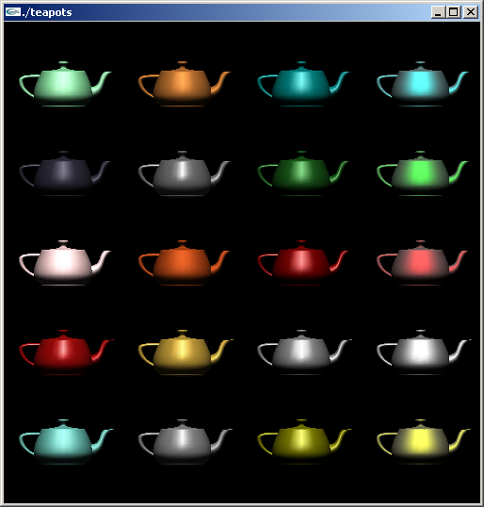
Example
Only differences in
these teapots are
the parameters
in the modified
Phong model

Slide 49
Putting It Together
Global ambient intensity, I_{a}:
Gross approximation to light bouncing around of all other surfaces
Modulated by ambient reflectance k_{a}
Just sum all the terms
If there are multiple lights, sum contributions from each light
Several variations, and approximations …

Slide 51
Colour
Do everything for three colors, r, g and b
Note that some terms (the expensive ones) are constant
This is an approximation, but few graphics practitioners realize it

Slide 52
Multiple light sources
For each light source
Do everything for three colors, r, g and b
Sum to get resultant diffuse and spectral reflection values

Slide 53
Approximations for Speed
The viewer direction, V, and the light direction, L, depend on the surface position being considered, x
Distant light approximation:
Assume L is constant for all x
Good approximation if light is distant, such as sun
Distant viewer approximation
Assume V is constant for all x
Rarely good, but only affects specularities

Slide 54
Ambient lighting only
Examples from "Learning Rendering" by Watt, online tutorial at http://www.agocg.ac.uk/graphics.htm

Slide 55
Distant light source (parallel rays) eye light source (always positioned coincidentally with the camera)

Slide 56
Point light source positioned quite close to vase object - direction from point to centre of vase is same as "distant" light source direction. Note that the shadows are different to those created with distant light source - the incoming light rays are no longer parallel.

Slide 57
A point light source coincident with the eye; thus no shadows are produced

Slide 58
Spot light in same position as point light - cone angle is 30 degrees. Note that there are apparently two shadows. The vase shadow is created normally. The spotlight shadow is not explicitly a shadow - just an area outside the cone of influence.

Slide 59
: Lighting

Slide 62
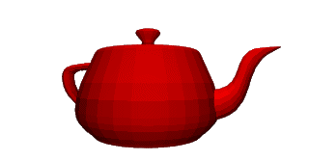
Flat Shading
The simplest shading method applies only one illumination calculation for each primitive. This technique is called constant or flat shading. It is often used on polygonal primitives.
Drawbacks:
the direction to the light source varies over the facet
the direction to the eye varies over the facet
Nonetheless, often illumination is computed for only a single point on the facet. Point use is usually the centroid
OpenGL uses one of the vertices.

Slide 63
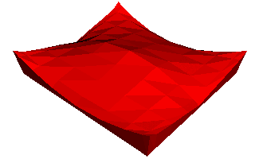
Flat shading
Compute shading at a representative point and apply to whole polygon
Advantages:
Fast - one shading value per polygon
Disadvantages:
Inaccurate
Discontinuities at polygon boundaries

Slide 64
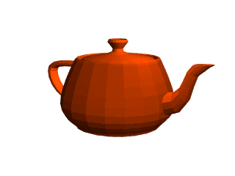
Shading Polyhedra
Flat (facet) shading:
Works well for objects
really made of flat faces.
Appearance depends on
number of polygons for
curved surface objects.
If polyhedral model is an approximation then need to smooth.

Slide 65
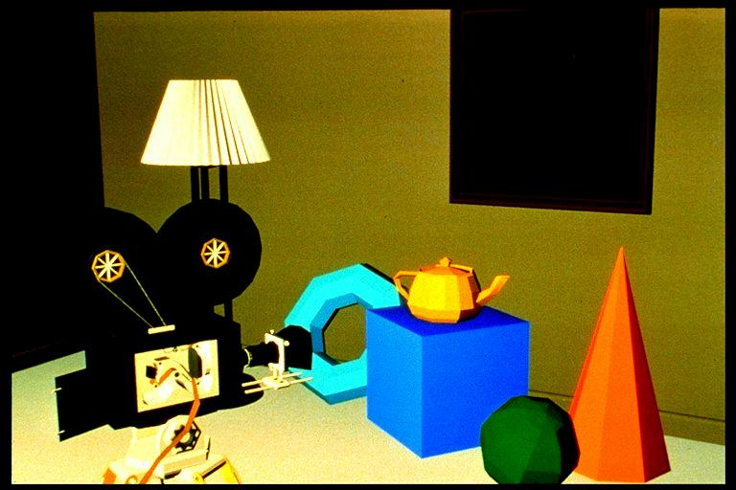
Mach banding.
Physiological effect exaggerates difference between closely coloured polygons.
Mach banding.
Exaggerates intensity change at an edge with a discontinuity in magnitude.
Our eyes are well adapted to seeing edges !
Using a finer mesh is surprisingly ineffective.

Slide 66
Facet Shading
Even when the illumination equation is applied at each point of the facets, the polygonal nature is still apparent.
To overcome this limitation normals are introduced at each vertex.
different than the polygon normal
for shading only (not backface culling or other computations)
better approximates smooth surfaces

Slide 67
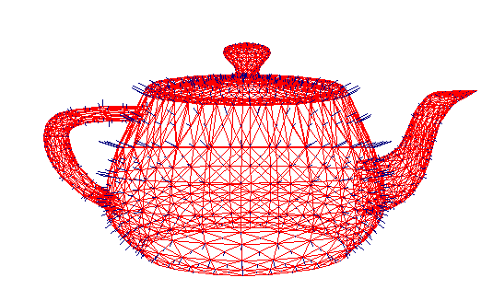
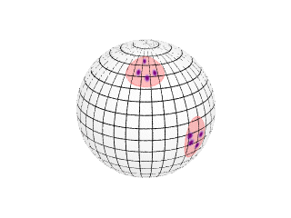
Vertex Normals
If vertex normals are not provided they can often be approximated by averaging the normals of the facets which share the vertex.
This only works if the polygons reasonably approximate the underlying surface.
A better approximation can be found using a clustering analysis of the normals on the unit sphere.

Slide 68
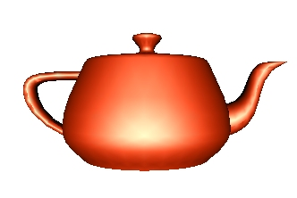
Gouraud Shading
The Gouraud shading method applies the illumination model on a subset of surface points and interpolates the intensity of the remaining points on the surface. In the case of a polygonal mesh the illumination model is usually applied at each vertex and the colors in the triangles interior are linearly interpolated from these vertex values.
The linear interpolation can be accomplished using the plane equation method discussed in the lecture on rasterizing polygons. Notice that facet artifacts are still visible.

Slide 69
Gouraud Shading
Shade each vertex with its own location and normal
Linearly interpolate across the face
Advantages:
Fast - incremental calculations when rasterizing
Much smoother - use one normal per shared vertex to get continuity between faces
Disadvantages:
Specularities get lost

Slide 72
Phong Shading
In Phong shading (not to be confused with the Phong illumination model), the surface normal is linearly interpolated across polygonal facets, and the Illumination model is applied at every point.
A Phong shader assumes the same input as a Gouraud shader, which means that it expects a normal for every vertex. The illumination model is applied at every point on the surface being rendered, where the normal at each point is the result of linearly interpolating the vertex normals defined at each vertex of the triangle.
Phong shading will usually result in a very smooth appearance, however, evidence of the polygonal model can usually be seen along silhouettes.

Slide 73
Phong Interpolation
Interpolate normals across faces
Shade each pixel
Advantages:
High quality, narrow specularities
Disadvantages:
Expensive
Still an approximation for most surfaces

Slide 74
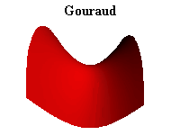
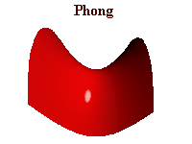
SHADING / RENDERING

Slide 76
Lighting in WebGL
For many years, Blinn-Phong model was the standard
It was implemented in the hardware
It was part of OpenGL fixed function pipeline
With shaders, we have more freedom on what to use
Again, we can choose where to apply lighting
Application,
Vertex shader, or
Fragment shader
Define necessary parameters for lighting
Use them in application code, or
Send them to shaders

Slide 77
Lighting in WebGL
For every light source, specify
Its color
var lightAmbient = vec4(0.2, 0.2, 0.2, 1.0);
var lightDiffuse = vec4(1.0, 1.0, 1.0, 1.0);
var lightSpecular = vec4(1.0, 1.0, 1.0, 1.0);
Its location/direction
var lightPosition = vec4(1.0, 2.0, 3.0,1.0);
By convention, for a directional source, you may make the last component 0.0 to indicate that it is a vector instead of a homogeneous coordinate

Slide 78
Lighting in WebGL
Specify details of materials
Ambient, diffuse, specular coefficients $\left(k_{a},k_{d},k_{s}\right)$
var materialAmbient = vec4(1.0, 0.0, 1.0, 1.0);
var materialDiffuse = vec4(1.0, 0.8, 0.0, 1.0);
var materialSpecular = vec4(1.0, 0.8, 0.0, 1.0);
Specular exponent $\left(n_{s}\right)$
var materialShininess = 100.0;

Slide 79
Lighting in WebGL
For a static scene, lighting computation needs to be done only once
So we can send values to GPU once
But, for a dynamic scene (e.g., rotating cube), we need to recompute many things
Doing these recomputations in the CPU and sending values to GPU each time is inefficient
Thus, we want to do lighting calculations in the shaders

